Slide 1

Advanced Placement
Human Geography
Unit One
Geography: Its Nature
and Perspectives
Session 1

Slide 2

Advanced placement human geography review sessions: Unit one
By Geri Flanary
To accompany AP Human Geography: A Study Guide
3rd edition
By Ethel Wood

Slide 3
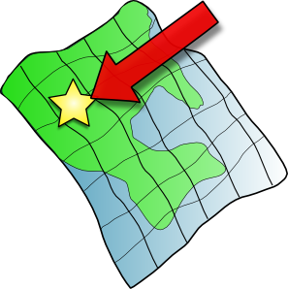
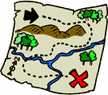
Key Concepts That Define Geography
Location—the position of something on earth’s surface
Space—the physical gap or distance between two objects

Slide 4
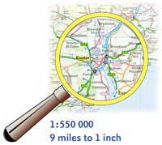
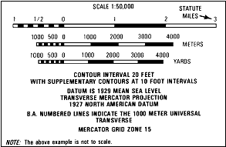
Key Concepts That Define Geography
Scale—the relationship between the size of an object or distance between objects on a map and the size of the actual object or distance on earth’s surface

Slide 5
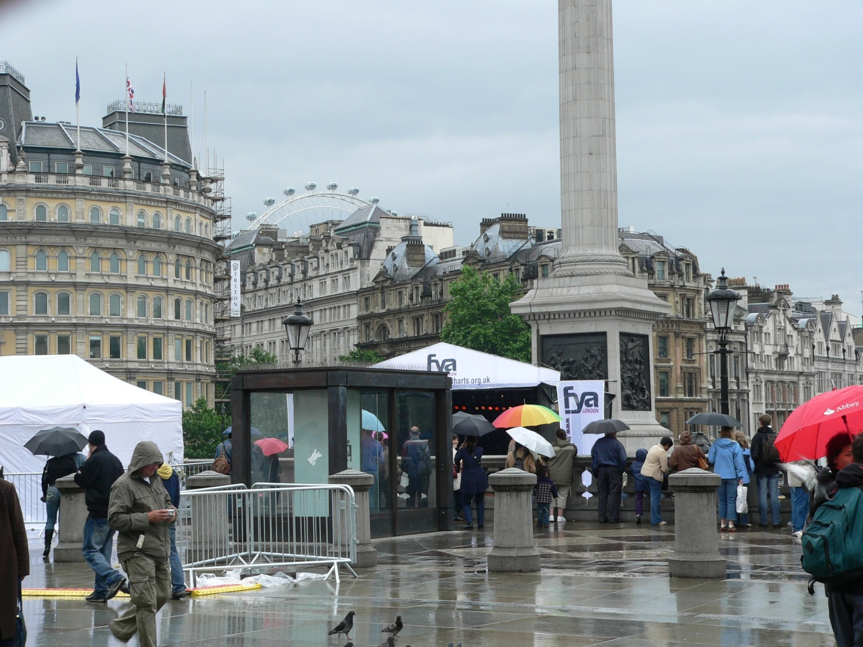
Key Concepts That Define Geography
Place—a specific point on earth with human and physical characteristics

Slide 6
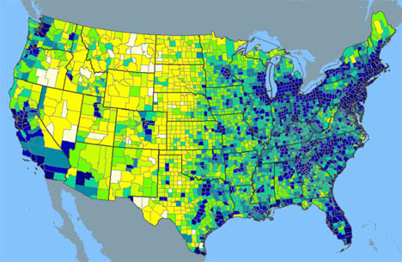
Key Concepts That Define Geography
Pattern—the arrangement of objects on earth’s surface in relationship to one another

Slide 7

Key Concepts That Define Geography
Regionalization—the organization of earth’s surface into distinct areas that are viewed as different from other areas
Globalization—the expansion of economic, political, and cultural activities to the point that they reach and have impact on many areas of the world

Slide 8

SPATIAL ORGANIZATION
WHAT IS SPATIAL ORGANIZATION?
Spatial organization is the location of places, people, and events, and the connections among places and landscapes.
WHAT IS A LANDSCAPE?
Landscape is the overall appearance of an area that is shaped by both human and natural influences.
WHY DO SPATIAL PATTERNS OCCUR?
Geographers believe that the “why of where” is critical!

Slide 9

All of these concepts help us to understand the importance of spatial organization.

Slide 10
Patterns and places
The “why of where” explains why a spatial pattern occurs.
Specific places become distinct from all other places when patterns occur.
Often these patterns and places combine into regions.
What are regions? Regions are large areas that may be compared to other large areas.
Spatial organization defines human life on earth, with all of its similarities and differences.

Slide 11

Geography as a field of study

Slide 12
geography…the beginning
Geography as a discipline was first given structure by the Greeks.
Geo means “the earth.”
Graphein means “to write.”
The Greeks laid the foundation for cartography.
Cartography is defined as “the art and science of map-making.”

Slide 13
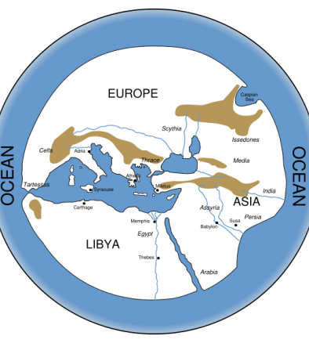
Hecataeus’s Map of the World
Maps around Greece were more accurate than maps of the rest of the world.
The Greeks understood that the earth was round.
Ptolemy, a Greek, estimated that the circumference of the earth was about 16,000 miles. He was about 9,000 miles short of reality, an assumption that led Columbus to believe that he was near Asia when he first landed in the Americas.

Slide 14
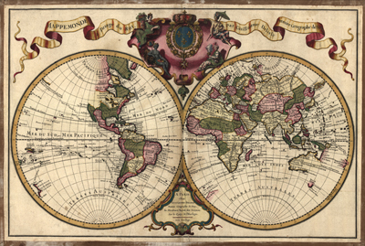
Interest in Geography grew throughout the World
WHO?
Ancient Chinese
Europeans during the Middle Ages
Muslim scholars in the Middle East
Geographers tended to be mostly concerned in practical knowledge of:
  Locations
  Places
  Products

Slide 15
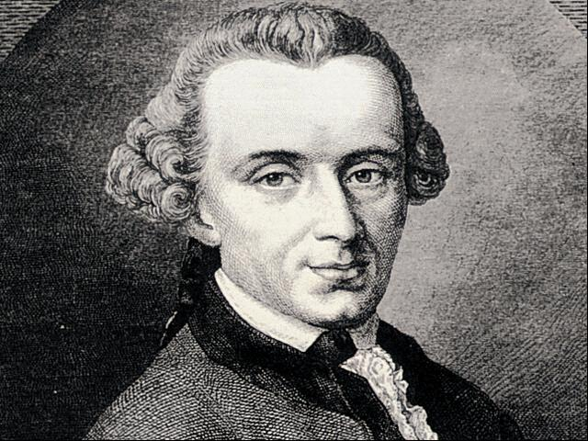
The Rebirth of Geography
17th century Europe: Europeans broadly studied both physical landscapes and the roles that humans play in shaping them.
Modern scientific study of geography
  Began in Germany
  Immanuel Kant
  defined geography as the
  “study of interrelated spatial
  patterns—the description and
  explanation of differences and
  similarities between one region
  and another.”

Slide 16
By the Turn of the 20th Century…
Geography became a distinct discipline in European universities.
Many sub-fields of geography started to emerge:
  Cultural
  Social
  Urban
  Population
  Economic
  Political
Today, however, there are two main branches—physical and human geography.

Slide 17
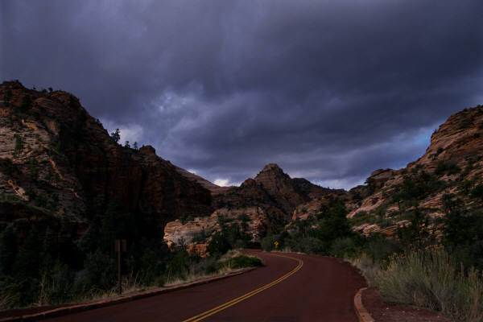
What’s the difference?
Physical Geography
Human Geography
Focused on the natural environment
Inextricably linked to the study of human geography
Focused on people
Who are they?
How are they alike and different?
How do they interact?
How do they change the natural landscape and how do they use them?

Slide 18

What’s the difference?
Physical Geography
Human Geography
What are some of the topics studied?
  landforms
  climate
  vegetation
  soils
  earth’s internal forces
  What are some of the topics studied?
    culture (folk and popular)
    agriculture and rural land use
    urban growth
    industrialization
    demographics (e.g. migration)
    politics
    economics

Slide 19
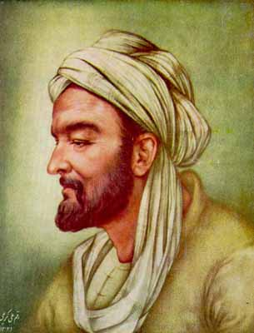
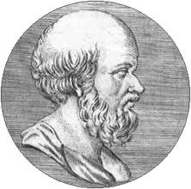
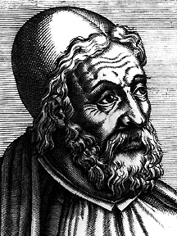
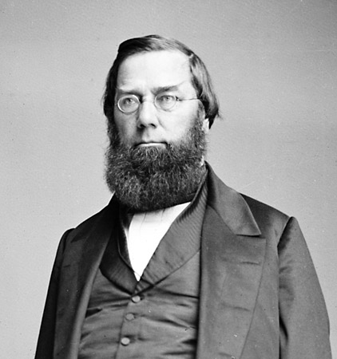
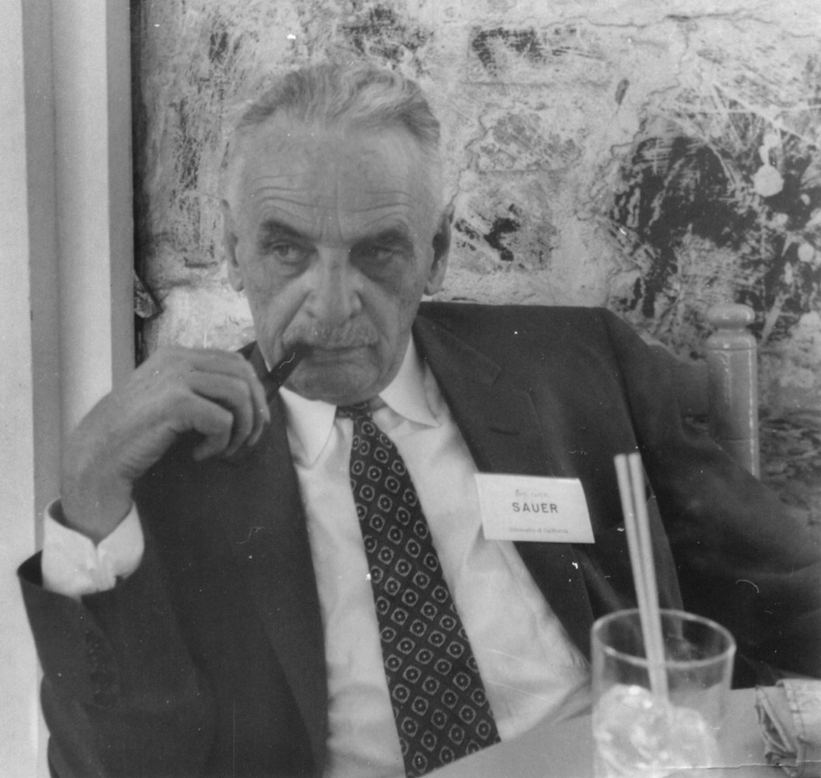
Some Famous Geographers

Slide 20
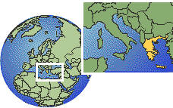
Eratosthenes
Greek scholar
3rd century B.C.E.
Accurately calculated the circumference of earth
Used geometry to conclude the circumference of earth based on the distance between the two cities of Alexandria and Syene and the angle of the sun at each place

Slide 21

Ptolemy
Greek scholar
Lived 500 years after Eratosthenes
Recalculated the circumference of Earth incorrectly (9000 miles short)
His Guide to Geography included many maps
Developed a global grid system that was a forerunner to our modern system of latitude and longitude

Slide 22
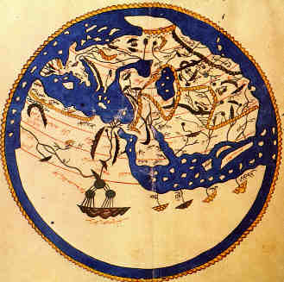
Idrisi
Arab geographer
11th century
Directed an academy of geographers
  Gathered data
  Consulted mariners and travelers
  Scientific expeditions
His final map of the world was lost, but many partial maps have survived.

Slide 23

George Perkins Marsh
American geographer
19th century
Best known for his classic work, Man and Nature (1864)
Focused work on impact of human actions on the natural environment
Well known quote: “Conserve the earth, or live to pay the disastrous consequences.”

Slide 24
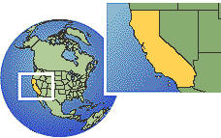
Carl Sauer
Geographer from California
20th century
Argued that cultural landscapes should be the main focus of geographic study
His study is basic to environmental geography.

Slide 25
Key Points to Remember from this session…
Concepts that define geography
  Location
  Space
  Scale
  Place
  Pattern
  Regionalization
  Globalization
Patterns and places
  Spatial organization
  The “why of where”
Geography as a field of study
  Cartography
  Immanuel Kant
  Sub-fields of geography
  Differences between physical and human geography
Famous geographers
  Eratosthenes
  Ptolemy
  Idrisi
  George Perkins Marsh
  Carl Sauer

