Slide 1

Advanced Placement
Human Geography
Unit One
Geography: Its Nature
and Perspectives
Session 2

Slide 2
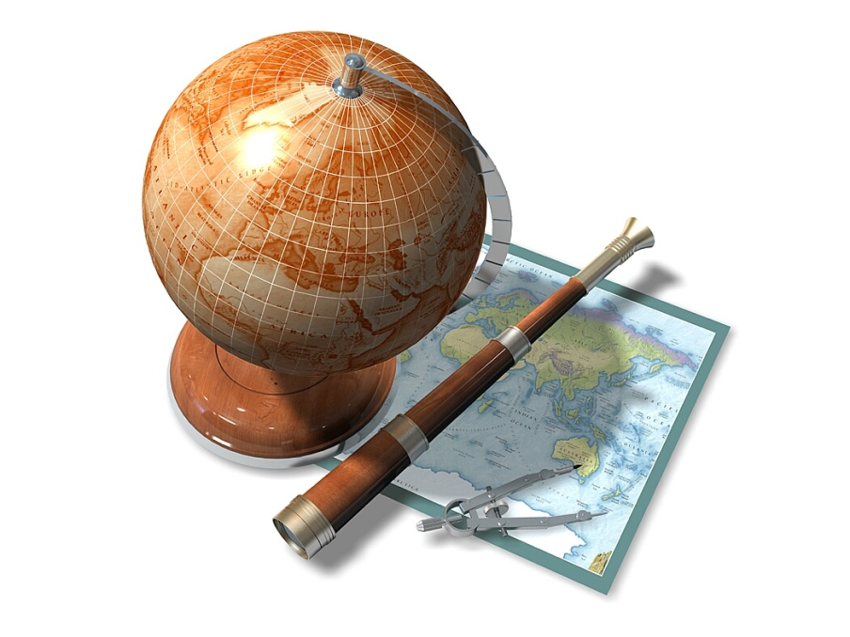
Key Geographical Skills

Slide 3
Using Maps to understand
Spatial Perspective
Location: Where is it?
Absolute location
  Precise position of a place on the globe (e.g. latitude and longitude; other grid systems; street address)
    Important historical example: The U.S. Land Ordinance of 1785 (Much of the U.S. was divided into a system of townships to facilitate the sale of land in the West.)

Slide 4
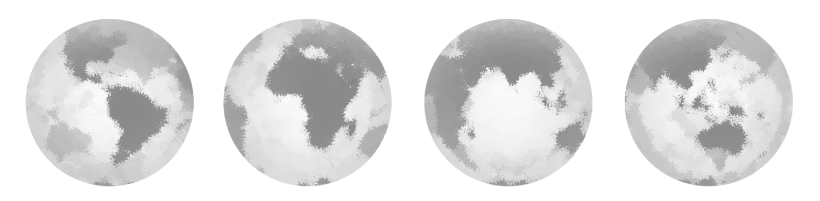
Using Maps to understand
Spatial Perspective
Absolute location continued…
Meridians and Parallels
  Meridian: an arc between the North and South Poles used to measure longitude
    The prime meridian is located at the observatory in Greenwich England at 0°.
    The meridian at the opposite side of the globe at 180° is called the International Date Line.
  Parallel: a circle drawn around the globe that is parallel to the equator; parallels measure latitude
    The equator is at 0° latitude.

Slide 5
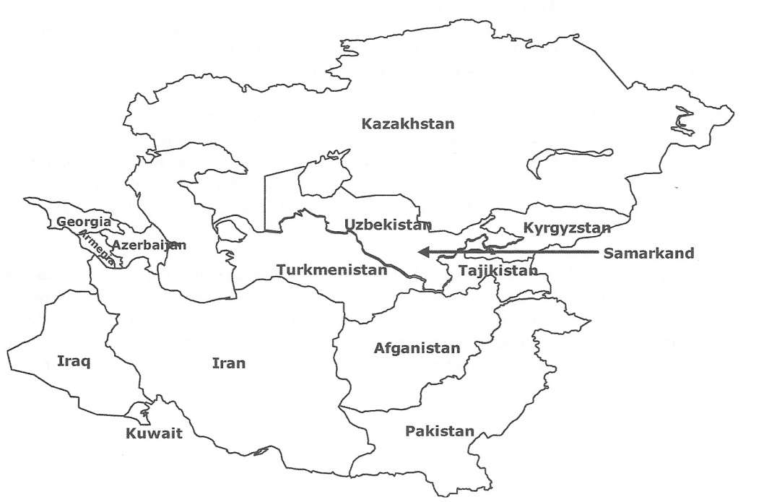
Using Maps to understand
Spatial Perspective
Relative location: the location of a place in relation to other human and physical features on the landscape
  Compared to absolute location, it is subject to modification. An example is Samarkand.

Slide 6
Samarkand
Relative location defines a place in terms of how central or isolated it is in relation to other places.
Central Asia—13th century
  Samarkand lay on a major trade route called the Silk Road making the city central to Eurasian trade.
  The relative location changed when sea-based trade became faster and more efficient.
  Samarkand became a more isolated place.
  Absolute location remained the same, but relative location changed.

Slide 7
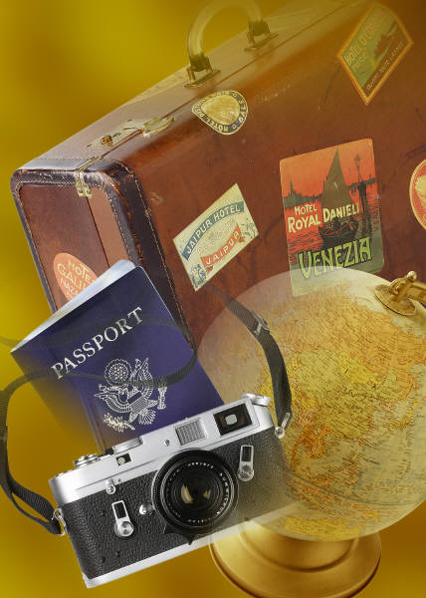
Use of Maps and
Map Projections

Slide 8
Use of Maps
Reference Material
Communications/Education
Efficient tools for storing information
  Show roads or waterways
  Show connections
Used to explain spatial perspectives to others
  Thematic
  Examples: soil types; economic prosperity; spatial arrangements

Slide 9
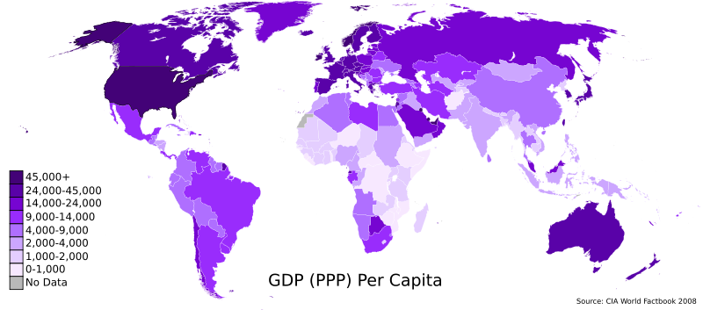
Example of map used to communicate and educate

Slide 10
What is a Map Projection?
Definition: A map projection is a way to represent the round earth on a flat surface.
No map projection is as accurate as a globe!

Slide 11

Map Projections and Distortions
Some distortions (inaccuracies) are evident in ALL map projections!
Types of distortion:
  Distance
  Direction
  Shape
  Area
  Scale

Slide 12
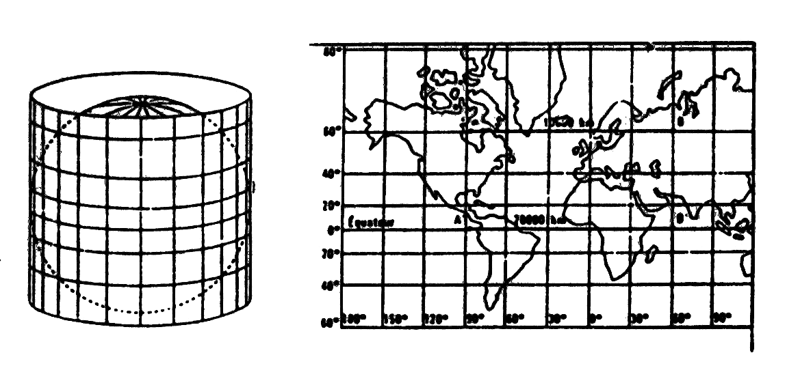
Types of Map Projections
Mercator Projection
  Designed in 1569 for a specific purpose—to navigate across the Atlantic Ocean between Europe and the Americas
  Perfect for “true” direction
  Distorts size of areas, particularly close to North and South Poles

Slide 13
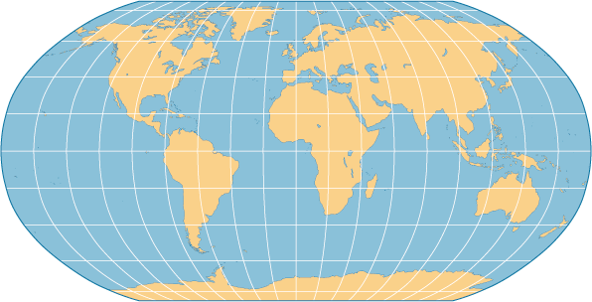
Types of Map Projections
Robinson Projection
  An attempt to balance all distortions by making errors in all four ways: shape, size, distance, and direction
  Good projection for general use; often found in classrooms

Slide 14
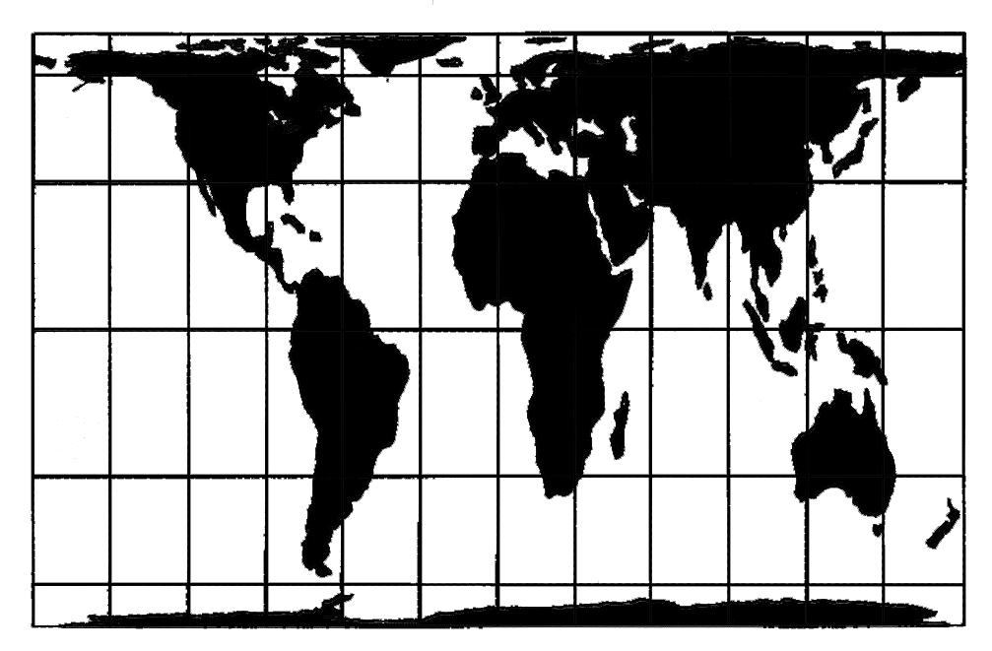
Types of Map Projections
Peters Projection
  Introduced by historian and geographer Arno Peters
  Focuses on keeping land masses equal in area
  Shapes are distorted

Slide 15
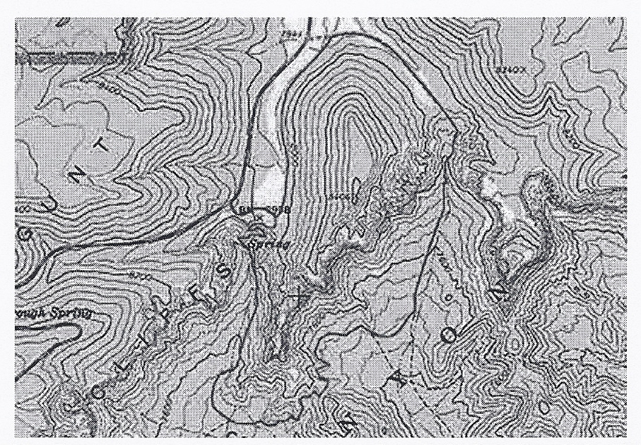
Contour Maps
Designed to show the nature of local topography (the natural land surface)
Contour lines are drawn to represent a consistent height above sea level.

Slide 16
Scale

Slide 17
Scale
Refers to the size of the unit studied
  The phenomena as it exists on different levels, from small to large
  Local, regional, or global scales
Example: Mt. St. Helens, Washington (1980)
        * The eruption began as an immediate local concern for the immediate area (local scale).
        * Ash and volcanic flow eventually affected the region region (regional scale).
        * Volcanic matter eventually spread to other areas
        of the globe (global scale).

Slide 18

Scale
Also refers to the mathematical relationship between the size of an area on a map and its actual size on earth’s surface.
Examples:
  Fraction
    1/24,000 (translation: 1 inch on the map = 24,000 inches on earth’s surface; both numerator and denominator must be the same unit of measurement)
  Ratio
    Example: 1:24,000
    Note: The unit on the left refers to the distance on the map and the number on the right always refers to the same unit of distance on earth’s surface.

Slide 19
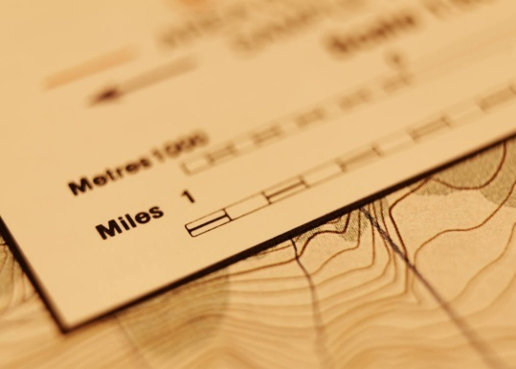
Scale
Graphic/Bar Scale
  Safest to use because it will “shrink” or “grow” if the size of the map is altered when photocopied or scanned
Verbal/written statement
  Example: 1 inch equals 1 mile
  Varies greatly if the size of the map is altered during photocopying or scanning

Slide 20
Small Scale maps v. Large Scale Maps
Small scale maps show large areas.

Slide 21
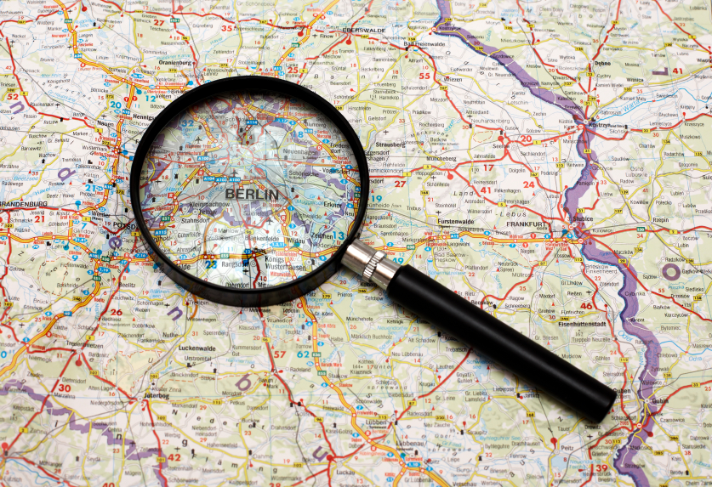
Small Scale maps v. Large Scale Maps
Large scale maps show small areas.

Slide 22
Local-Global Continuum
We often separate scale into local, regional, and global levels.
In reality, the levels interact in a local-global continuum, in which phenomenon at one level influence those at other levels.

Slide 23
Time Zones

Slide 24

Time Zones
What is a time zone? A time zone is a region that has adopted the same standard time, usually referred to as the local time.
Because the sun hits the earth at different times as it spins on its axis, time zones are meant to make time more uniform.
Longitude plays an important role in calculating time. The earth is divided into 360 degrees of longitude.

Slide 25
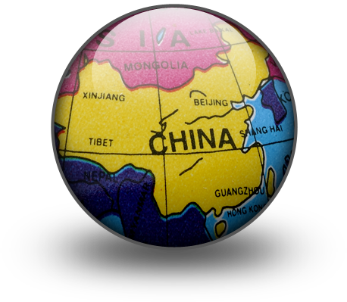
Time Zones
Lines of longitude are placed 15° apart, subdividing the earth into 24 sections. Time zones often follow lines of latitude.
Neighboring zones are exactly one hour apart.
Sometimes meridians stray and follow political borders. An example is China (one time zone).

Slide 26

Time zones
Daylight Savings Time
  The clock is pushed ahead one
  hour in the spring.
  Clock is set back to the original time in the fall.

Slide 27
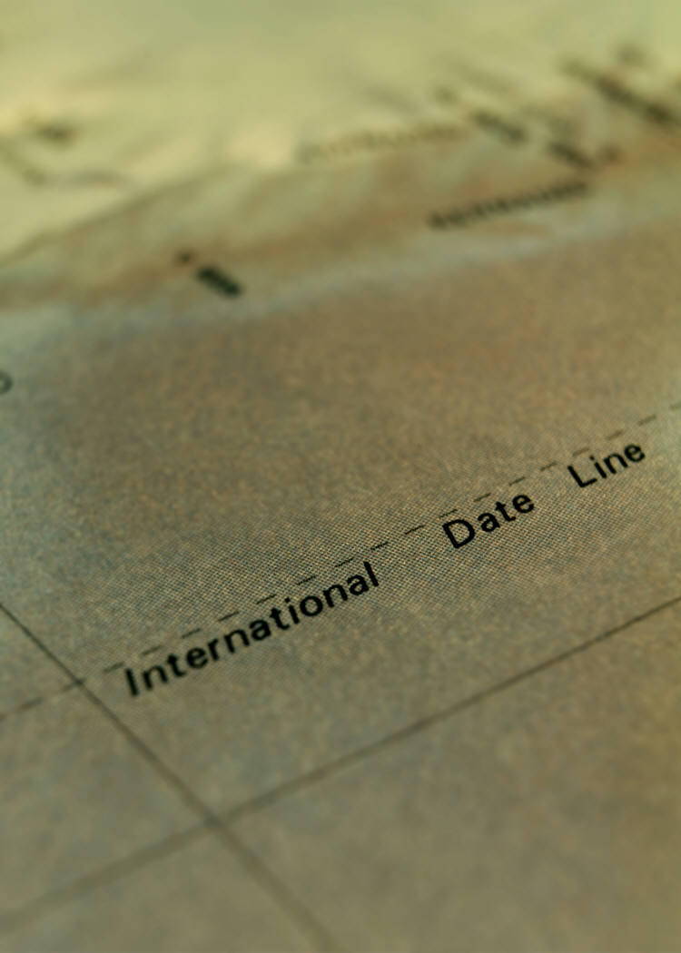
Time zones
International Date Line
  Consequence of world time zones
  Satisfies the need for the date to change somewhere on earth
  Occurs at 180° longitude
  Divides the world from pole to pole through the Pacific Ocean

Slide 28
Solar Time
Used before adoption of time zones
Based on the position of the sun in the sky as the day progresses
Became problematic once railways and communications connected people in different regions during the 19th century

Slide 29
Time Zones in U.S. (set in 1883)
Pacific, Mountain, Central, and Eastern Standard Time Zones

Slide 30
Key Points to Remember from this session…
Geographic Skills
  Location
  Absolute and relative location
  Historic examples
Maps and Map Projections
  Reference materials
  Communication and/or education
  Types of map projections
Scale
  Definition
  Types:
    Fraction
    Ratio
    Graphic/bar
    Verbal/written
    Small scale v. large scale
    Local-global continuum
Time Zones
  Purpose
  Solar time

