Slide 1

Advanced Placement
Human Geography
Unit One
Geography: Its Nature
and Perspectives
Session 3

Slide 2
Interpretation of places and patterns

Slide 3
PLACE: The Geographic Term
Place is deceptively complex.
Place describes the unique location of a geographic feature.
Each point on earth is different from all others.
Place may be identified in four ways:
  Place name
  Site
  Situation
  Absolute location

Slide 4
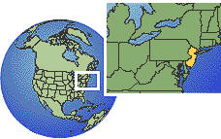
Place Names
Toponym is another term for a place name.
Humans name places to distinguish them from other places, an action that helps to define the uniqueness of each place.
Examples:
  Three Rivers (descriptive)
  Medicine Hat—Alberta (history)
  New Jersey (historical migration)

Slide 5
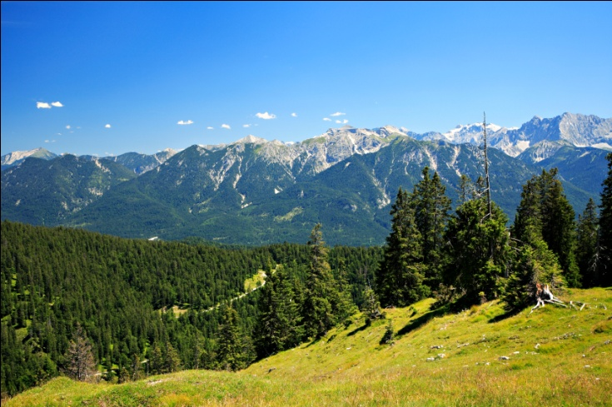
Site
What is it? Site is the sum of physical and human-transformed characteristics of a place.
Physical site characteristics include:
  Climate
  Topography
  Soil
  Water
  Resources
  Vegetation
  Elevation
Humans transform sites to suit their needs so that the sites are part of the human mosaic, not the physical site itself.

Slide 6
Situation
Situation refers to relative location.
Situation is important in determining the centrality or isolation of a place.
Situation helps us to find an unfamiliar place by comparing its location to a place that we know.

Slide 7
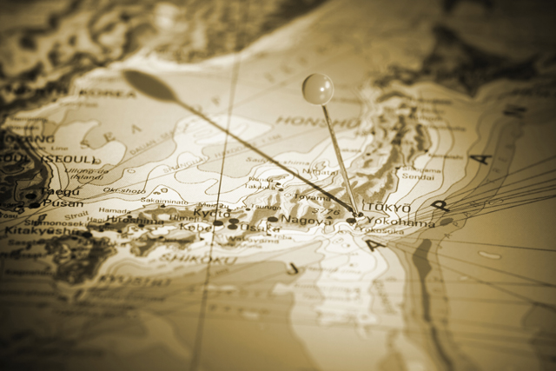
Absolute Location
Mathematical location
Use of parallels and meridians to determine location
Absolute location is unique for every place on earth.

Slide 8
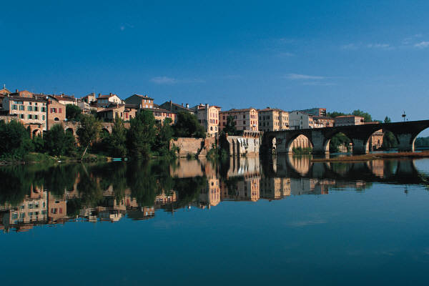
Patterns: The arrangement of things across earth’s surface
●
●
●
●
●
A linear pattern: found along rivers, streets, or railroad tracks

Slide 9
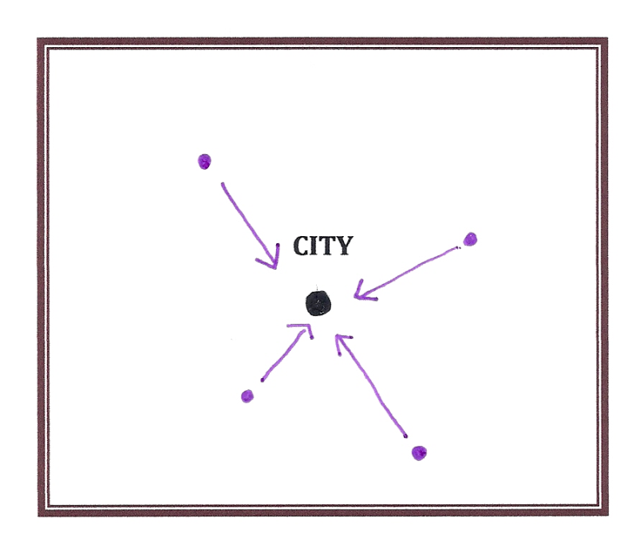
Patterns: The arrangement of things across earth’s surface
Centralized Pattern: found in many cities where houses and public buildings may circle around the mosque or house of worship

Slide 10
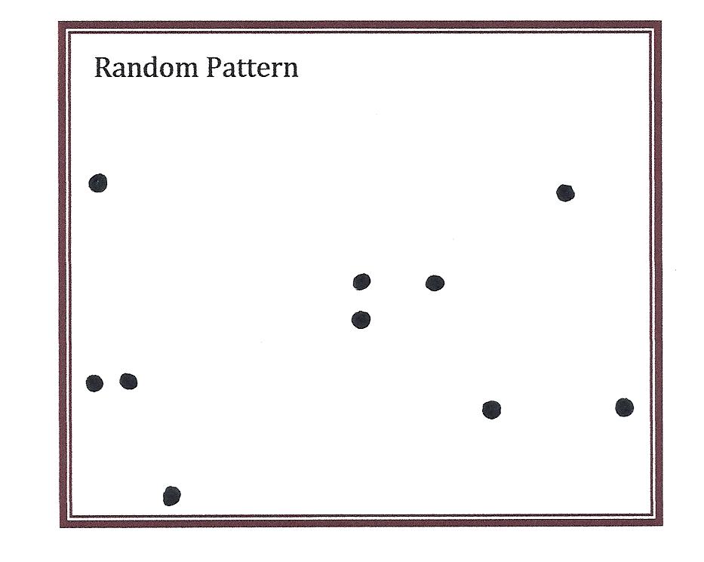
Patterns: The arrangement of things across earth’s surface
Random pattern: no apparent regular distribution

Slide 11

Patterns: The arrangement of things across earth’s surface
Rectilinear pattern: reflects a rectangular system of land survey adopted in much of the country under the Land Ordinance of 1785; towns laid out on a grid; checkerboard rural pattern

Slide 12
Regions and Regionalization

Slide 13
Regionalization: What is it ?
Regionalization is the organization of earth’s surface into distinct areas that are viewed as
different from other areas.

Slide 14
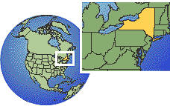
Types of Regions
Formal Regions
Formal regions are also called uniform regions.
Formal regions are similar in terms of one or a few physical or cultural features.
Characteristics may be predominant but not universal.
  Examples: a state; an area in which Islam is the predominant religion

Slide 15

Types of Regions
Functional Regions
Functional regions are also called nodal regions.
A functional region has a center that directs movement.
A core area has distinct characteristics when there is movement toward the periphery.
  Examples: followers of a baseball team; broadcast area of a radio station

Slide 16

Types of Regions
Perceptual Regions
Perceptual regions are also called vernacular regions.
Perceptual regions are places that people believe to exist as part of their cultural identity.
Almost all human beings define their lives by thinking about perceptual regions.

Slide 17
Identify these types of regions…
The broadcast area of a local television news station
  Functional/nodal
An area in which the majority of people practice Islam
  Formal/uniform
Your “hometown”
  Perceptual/vernacular
The “Sunbelt”
  Formal/uniform
Regions identified by the U.S. Census Bureau for data collection
  Formal/uniform

Slide 18
Interconnections among places

Slide 19
Places connect to form patterns. It’s all a matter of scale!

Slide 20

Globalization
Globalization is the expansion of economic, political, and cultural activities to the point that they reach and have impact on many areas of the world.
Critics:
  Globalization is a threat to regional and local uniqueness.
Proponents:
  Local and regional uniqueness show few signs of disappearing.
  The world is a web of interconnected places.

Slide 21
Interconnectedness
Time-space convergence
results from the rapid increase
in the use technology and transportation
in the late 20th century.
Time-space compression
refers to the social and psychological effects of living in a world in which time-space convergence has rapidly reached a high level of intensity.

Slide 22
New Geographic
Technologies

Slide 23
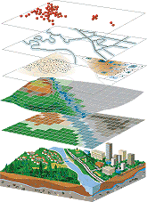
Geographic Information System (GIS)
Captures, stores, analyzes, and displays data
Data may be manipulated to create an image or map that is more accurate than anything drawn by hand
Example:
One layer may show soil composi- tion, another may show forest cover, and yet another may show a road system.

Slide 24

Global Positioning System (GPS)
Uses a series of satellites, tracking stations, and receivers to determine absolute locations on earth
Variety of uses such as mapping vegetation arrangements and even navigating airplanes and ships
Recently used in automobiles to guide drivers

Slide 25
How Geographers work:
Field and Census Data

Slide 26
Geography as a Career
Teachers
Government workers
  Largest employer: U.S. Census
  Bureau
Environmental workers
Consultants
  Architects
  Builders
  Politicians
  Transportation officials

Slide 27

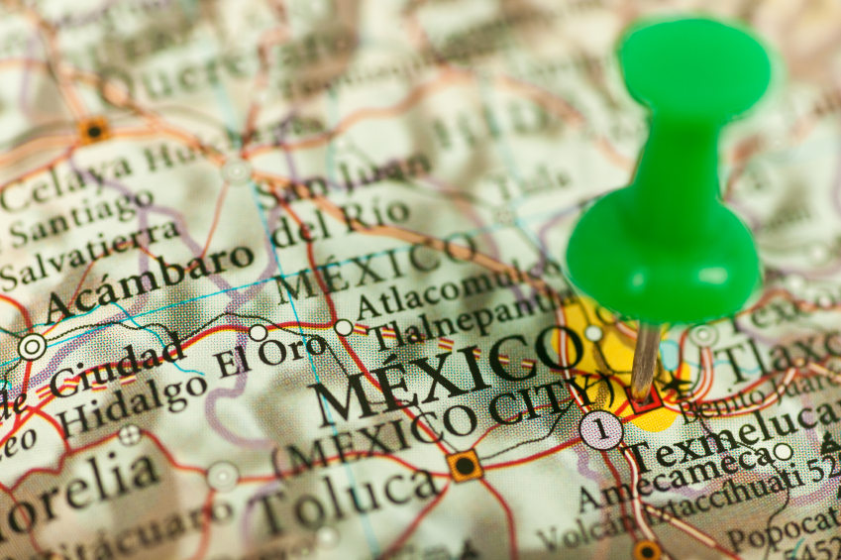
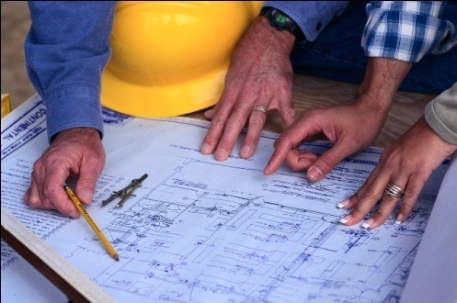
Field-based Skills and Observations
Ability to manipulate and interpret GIS
Ability to use remote sensing data and GPS
Cartography and computer mapping
Data analysis and problem-solving

Slide 28
More than anything, geographic skills are based on careful observations of the world at different scales, a curiosity about why objects are where they are, and the desire to see the world through a geographer’s eyes.

Slide 29
Key Points to Remember from this session…
Places and Patterns
  Toponyms
  Site
  Situation
  Absolute location
  Patterns
    Linear
    Centralized
    Random
    rectilinear
Regions and Regionalization
  Definition
  Formal
  Functional
  Perceptual
  Examples of each type
Interconnections
  Globalization
  Time-space convergence
  Time-space compression
Geographic Technologies
  GIS
  GPS
How Geographers Work
  Careers
  Field observations

