Slide 1

Advanced Placement
Human Geography
Unit Two: Population
Session 1

Slide 2
Advanced placement human geography review sessionS: Unit two
By Geri Flanary
To accompany
AP Human Geography: A Study Guide
3rd edition
By Ethel Wood

Slide 3
Geographical Analysis of Population

Slide 4

What is demography?
It is the scientific or statistical study of population.
It comes from the Greek word demos (populace or people) and graph (to describe).

Slide 5
Population geography
Special emphasis on spatial organization
      Location of
        Places
        People
        Events
        Connections between people and landscapes
Population geography focuses on the number, composition, and distribution of human beings on earth’s surface.
        Population changes
        How changes relate to earth’s environment and natural resources

Slide 6
Distribution
Distribution: refers to the arrangement of locations on the earth’s surface where people live.
Distribution of the world’s population is uneven.
Some lands are nearly uninhabited while others are densely populated.
Distribution is best shown with a dot map.
Half of the world’s people live near cities.

Slide 7

DENSITY AND scale
Population density (definition): the number of
people divided by the total land area; a measure used often by geographers
Population maps are drawn at different scales:
        Largest scale (example): In a rural county in U.S., a dot may actually show the location of every individual.
        Medium scale (example): In a single country, a dot may represent 5000 people.
        Smallest scale (example): On a world map, a dot may represent 100,000 people.

Slide 8
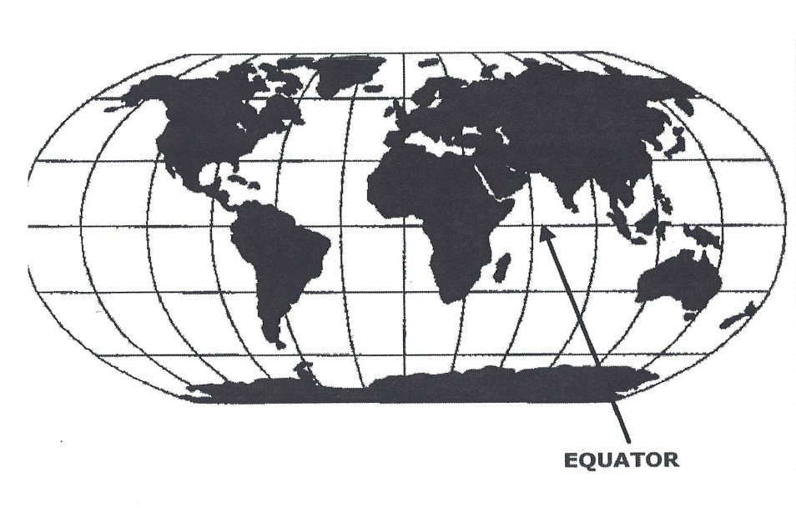
SCALE
Conclusions about population distribution on a
global scale:
Almost 90% of all people live north of the equator.

Slide 9
SCALE
Conclusions about population distribution on a
global scale:
More than half of all people live on about 5% of the land, and almost 9/10 on less than 20% of the land.
Rapidly growing urban areas increasingly dominate the globe.
Most people live in areas close to sea level.
Most arable land is at lower latitudes.

Slide 10
SCALE
Conclusions about population distribution on a
global scale:
About 2/3 of the world population is concentrated within 300 miles of the ocean.
Many who live inland settle in river valleys.
Human beings have long settled around bodies of water. That pattern is still evident today.

Slide 11
Arithmetic and Physiological population density
Used to describe population distribution in comparison to natural resources

Slide 12
Arithmetic and Physiological population Density:
A comparison
Arithmetic
(crude) Density
Physiological Density
Total number of people divided by land area
Measure used most often by geographers
Does not tell us anything about population distribution in individual countries
Gives us only a broad idea about the strain the population might put on the land areas
Measures the pressure that people place on the land to produce enough food
Divides the number of people into square km of arable land
Arable land = land suitable for agriculture

Slide 13
A look at egypt…
Egypt has a relatively sparse population.
Arithmetic density for the country is 74.
Its physiological density, however, is 3500!
Since much of Egypt is desert, its people put a great deal of pressure on the arable land.
As a result, the country has a very high physiological density.

Slide 14
Comparative arithmetic population density
Country Arithmetic Density (Per square km)
Monaco 23,660
Singapore 6,333
South Korea 480
United Kingdom 246
Nigeria 142
Turkey 97
Nicaragua 42
United States 34
Argentina 13.9
Canada 3.2

Slide 15
Carrying capacity

Slide 16
Carrying capacity: what is it?
Definition: the number of people an area can support on a sustained basis
How does carrying capacity relate to overpopulation?
The circumstance of too many people for the land to support is known as overpopulation.

Slide 17
Carrying capacity depends on an area’s level of technology.
Example: A region whose farmers make use of irrigation and fertilizers can support more people than regions that do not.
Example: An industrial society is able to import raw materials from other places, convert them into finished products, and export them.
Example: Japan
        An industrial country with a very high carrying capacity
        Relatively small land space
        Able to buy food it cannot produce at home from profits earned by exporting finished products

Slide 18
Population pyramids

Slide 19
Population pyramids
What do they do?
        Population pyramids represent a population’s age and sex composition.
The pyramids take different shapes according to the distribution of males and females at each age level.
What affects the shape of a country’s population pyramid?
        Level of health care
        Impact of war
        Availability of birth control
        Level of economic development

Slide 20
Example: Afghanistan
Pyramid narrows as it goes up in age group.
Few people live above the age of 75.
Hospitals are likely to encounter health issues among young people.
Example: problems of women in childbirth

Slide 21
Example: france
In older age groups, France has more women than men.
France has fewer people in the age group of 0—4 years olds than Afghanistan.
France is more likely to specialize in treating diseases of middle and older age groups.

Slide 22
Population concentrations

Slide 23
Population concentrations: where?
East Asia
About 1/5 of all humans live in East Asia.
Region consists of:
        China
        Islands of Japan
        Korean Peninsula
        Island of Taiwan

Slide 24
East asia
China: world’s most populous country
Chinese population is concentrated near the Pacific Coast and in several river valleys, such as the Huang and Yangtze.
Much of the western part of China is sparsely inhabited due to deserts and mountains.

Slide 25
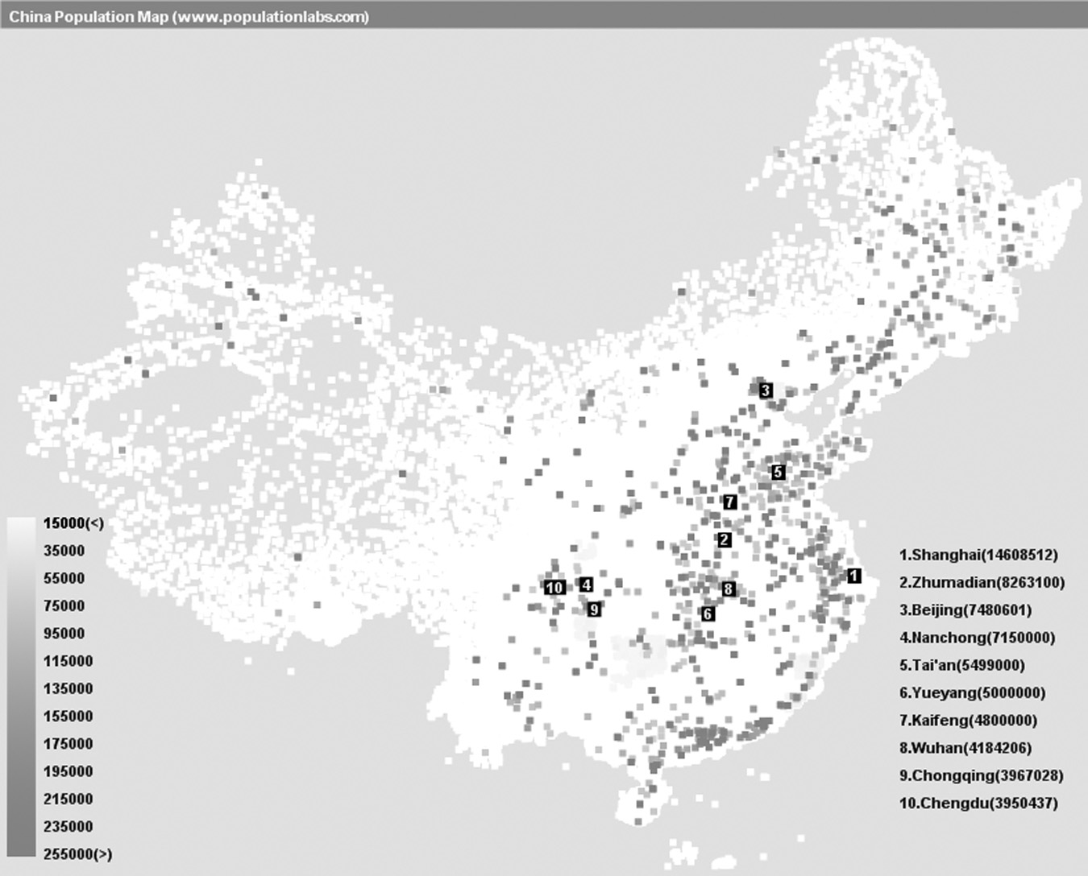
The vast majority of China’s people live in urban areas in the east with many cities located along rivers and in coastal areas. Large stretches of mountains and deserts make the western and northern parts of the country less habitable.

Slide 26
East asia: urban and rural areas
China has more than 150 growing cities, each with at least 1 million inhabitants.
Two-thirds of China’s inhabitants still live in rural areas.
About three-fourths of all Japanese and Koreans live in urban areas.

Slide 27
South asia
One-fifth of the world’s population lives in South Asia.
Much of the population is concentrated in the Indus and Ganges River Valleys and along India’s coastlines.
Most regions are rural.
Only about 25% of population in this region live in cities.
South Asia includes:
India
Pakistan
Bangladesh
Island of Sri Lanka

Slide 28
Southeast asia
About 500 million people live in this region.
The region contains the world’s fourth most populous country—Indonesia, consisting of thousands of islands.
Region includes such places as:
Vietnam Borneo
Thailand Papua New Guinea
Myanmar (Burma) Philippines
Java
Sumatra

Slide 29
europe
Europe is the only non-Asian area of population concentration.
Population is concentrated primarily in urban areas.
Less than 20% of inhabitants are farmers.

Slide 30
europe
European terrain and environment are not as closely related to population distribution as in Asia.
An axis of densely populated areas follows the location of Europe’s coal fields, indicative of the importance of industrialization as it relates to population growth.

Slide 31
Population Patterns: race and ethnicity

Slide 32
Race and ethnicity…What’s the difference?
Race: a category composed of people who share biologically transmitted traits that members of a society consider important
Ethnicity: less based on physical characteristics and emphasizes a shared cultural heritage, such as
        language
        religion
        customs

Slide 33
Race and ethnicity…What’s the difference?
Because many people live in areas or neighborhoods with people of the same race and/or ethnicity, patterns of population distribution are often determined by these two characteristics.

Slide 34
A look at canada…
Two largest ethnic groups:
    British Isles origin
    French origin
A study of population distribution in Canada shows a significant division based on language-based ethnicity.
One result: movement in Quebec to be a separate country from the rest of Canada

Slide 35
Language-based ethnicity in canada

Slide 36
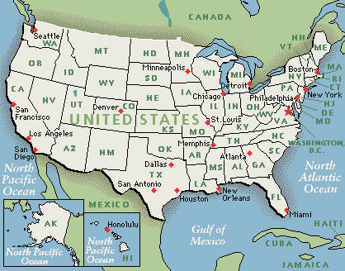
The U.s. census bureau
Census (count of the population done every 10 years)
Maintains detailed population statistics based on race and ethnicity
Questionnaire done by residents asks everyone to self-identify race and national ancestry
Great variety reported by those responding

Slide 37
Population change in the u.s.

Slide 38
Key questions to consider from session 1
What is demography?
What is the difference between distribution and density?
What is the difference between physiological density and arithmetic density?
What is the relationship between carrying capacity and overpopulation?
What areas/regions of the world are the most densely populated?
Distinguish between the terms “race” and “ethnicity.”

