Slide 1

Advanced Placement
Human Geography
Unit Two: Population
Session 2

Slide 2
Population growth and decline

Slide 3
Historically, What has caused populations to decrease or increase?
decreases
increases
War
Disease
Famine
Times of peace
Health
Plenty

Slide 4
Historically speaking…
Until 8000 B.C.E. (Before the Common Era): natural increase rate was close to zero.
Agricultural Revolution (Neolithic Revolution) changed that!
Domestication of plants and animals allowed population to increase.
Stable sources of food led to rapid population growth
Doubling rate was long.

Slide 5
Historically speaking…
Around 1750, things began to change…why?
The Industrial Revolution began in England and later diffused throughout Europe and to North America.
The Industrial Revolution brought about major improvements in technology that created an unprecedented amount of wealth.

Slide 6
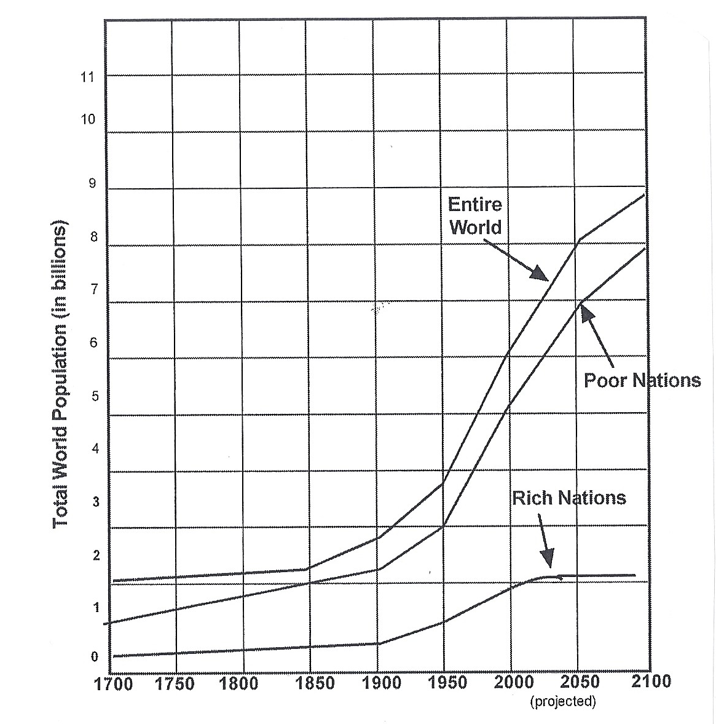
Increase in World population: 1700-2100
This chart illustrates the population explosion, or trend of rapid population increase since 1750.
Sharp increases are predicted in poor nations in the 21st century.
Rich nations are expected to level off, especially with aging populations.

Slide 7
Theories of population growth

Slide 8
Calculating future population growth
End of 18th century - Observers calculated population growth and predicted dire consequences.
Late 20th century - Zero population growth (ZPG) movement set a goal of leveling off world’s population; an effort to ensure sustainability.

Slide 9
Calculating future population growth
Historically, theorists
      analyzed patterns of growth in the past
      assessed conditions of the present
      projected consequences for the future

Slide 10
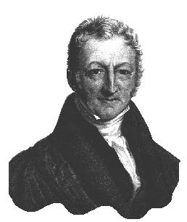
The first alarm
Exponential growth
v.
Linear growth
Population increases exponentially (geometric rate).
Illustrated: 2, 4, 8, 16, 32…etc.
Food supplies increase at arithmetic rate.
Illustrated: 2, 3, 4, 5, 6…etc.
Thomas Malthus
British Economist
Population growth would outpace food supply!

Slide 11
Thomas malthus
Nicknamed the “Gloomy Parson”
Recognized that population growth could be stopped by birth control and/or abstinence
        Morally objected to birth control
        Considered abstinence unlikely

Slide 12
Thomas malthus
Malthus saw a future in which famine would prevail, accompanied by disease and war.
These “negative checks” would be the forces that keep population growth contained.

Slide 13
Criticisms of malthus
Increased colonization and immigration from Europe in the 19th century eased population pressure.
Malthus was not correct about linear increase of food production.

Slide 14
Criticisms of malthus
Food production has grown because of technological innovations:
        seed production and hybridization
        advanced farming methods and equipment
        improved use of fertilizers
Some argue that food production is keeping up with population increase

Slide 15
Neo-malthusians
View popularized by Paul Ehrlich in 1968: The Population Bomb
Support international programs for population limitation by birth control and family planning

Slide 16
Vocabulary of population theory

Slide 17
The vocabulary of population theory
Crude Birth Rate (CBR) is the total number of live births in a year for every 1000 people alive in the society
Example: CBR = 30 (For every 1000 people in a country, 30 babies are born during a one-year period)

Slide 18
The vocabulary of population theory
Total Fertility Rate (TFR) is the average number of children a woman will have during her childbearing years (ages 15—49)
Examples:
      Sub-Saharan Africa = 6.4
      Western Europe = 2

Slide 19
The vocabulary of population theory
About fertility rates…
What do they tell us?
      Fertility rates give us a better idea than death rates about the size of families and consequences for young women and men.
      Rates are falling almost everywhere.
      Most dramatic decrease has been in China (due to the one child policy).

Slide 20
The vocabulary of population theory
About fertility rates…
NOTE: Despite a decline in fertility rates, a developing country will usually continue to experience population growth.
Demographic momentum occurs when, despite a falling fertility rate, a country with a large percentage of young people experiences continued population growth.

Slide 21
The vocabulary of population theory
Crude Death Rate (CDR) , also called mortality rate, is the total number of deaths in a year for every 1000 people alive in the society.
Example: CDR = 30 (For every 1000 people in a country, 30 deaths occur during a one-year period)
Rates have been dramatically reduced in developing
countries in recent years due to:
        Antibiotics
        Vaccinations
        Pesticides

Slide 22
The vocabulary of population theory
About death rates and Europe…
As birth rates have declined in Europe, countries with a high proportion of elderly people have experienced higher death rates (CDRs) than those with a high proportion of young people.

Slide 23
The vocabulary of population theory
Infant mortality rate (IMR) is the number of death among infants under one year of age for each 1000 live births in a given year.
IMR is significant because it is at THIS age that greatest declines in mortality have occurred.
IMR is an indicator of the quality of health services.

Slide 24
The vocabulary of population theory
Natural increase rate (NIR) is the difference between the number of births and the number of deaths during a specific period.
To compute: CDR – CBR, after first converting to percentages
NIR excludes migration, or movement in and out of a country’s borders.

Slide 25
The vocabulary of population theory
Life expectancy measures the average number of years a newborn infant can expect to live at current mortality levels.
From the CIA World Factbook:
        Longest: Andorra (83.53 years)
        Shortest: Swaziland (31.99 years)
Life expectancy rates are different for men and women, with women outliving men in almost all countries.

Slide 26
Demographic transition theory
Patterns of increase, fertility, and mortality vary across the globe.
These variations have a pattern, according to the demographic transition theory.
Why? Levels of technological development differ , but all countries go through four stages.
Countries are at different points as they move through the “transition.”

Slide 27
Demographic transition theory
Stage 1: Low Growth
Pre-industrial, agrarian societies
Children desirable because large families enhance farm work
Death rates high—low standards of living; little medical technology
NIR close to zero
Characterized earth’s population until mid-18th century

Slide 28
Demographic transition theory
Stage 2: High Growth
Brought on by industrialization (c. 1750)—greater food supplies; scientific medicine
High birth rates
Drop in CDR in mid-19th century—known as “mortality revolution” or “epidemiological transition”

Slide 29
Demographic transition theory
Stage 2: High Growth
Fatal epidemic diseases became endemic.
New machines helped with food production.
Most of the world’s poorest country’s today are in this stage of transition.

Slide 30

Demographic transition theory
Stage 3: Moderate Growth
Mature industrial economy accompanies this stage.
Birth rates drop.
TFR decreases because more children survive to adulthood.

Slide 31
Demographic transition theory
Stage 3: Moderate Growth
Improved health standards and accessibility to health care characterize this stage.
Raising children becomes expensive; children become economic liabilities rather than assets
Smaller families are made possible by birth control.

Slide 32
Demographic transition theory
Stage 4: Low Growth
Post-industrial economy accompanies this stage.
Birth rates continue to fall.
More women work outside of the home.

Slide 33
Demographic transition theory
Stage 4: Low Growth
Women delay marriage and child rearing because of higher levels of education.
Birth rate trends are accompanied by steady death rates.
Population grows very slowly or even decreases.

Slide 34
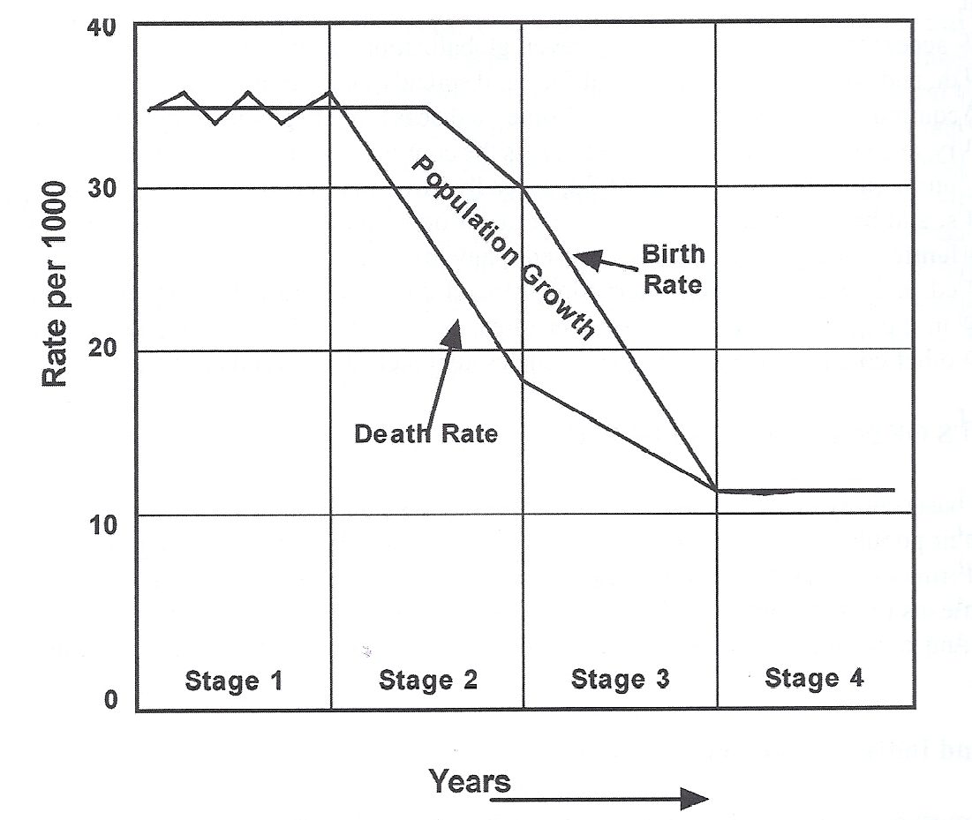
Demographic transition theory
(illustrated)

Slide 35
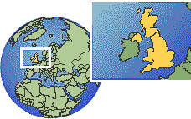
Demographic transition theory
This cycle of growth has occurred in the United Kingdom and much of Europe, where population growth is close to zero (ZPG).
Critics of the theory:
It is unwise to assume that all countries’ demographic cycles will follow the sequence experienced by industrializing Europe.
Example: Size of China’s population growth has been checked by the one-child policy.

Slide 36
Predicting the future…
Many demographers predict that populations in most countries will stop growing during the 21st century. Populations will reach stationary population level (SPL).
Predictions are under constant revision.
No one knows for sure if and when the
  population explosion will end.

Slide 37
Key points to remember from this session…
Reasons for population increases and decreases
Revolutions that led to population growth
Malthus’s theory about population growth
Criticisms of Malthus
Role of Neo-Malthusians in international population programs
Key vocabulary terms: CBR, CDR, fertility rate, increase rates, life expectancy, demographic momentum
Demographic Transition Theory

