Slide 1

Advanced Placement
Human Geography
Unit Two: Population
Session 3

Slide 2
Population and natural hazards

Slide 3
Population fluctuations
Population fluctuations can occur because of the natural environment.
Historically:
      Favorable/good climate = sufficient food supply = population increases
      Population decreases occurred across Eurasia during the “Little Ice Age” of the 17th century.

Slide 4
Adjusting to climate conditions
Historically, humans have adapted their lifestyles to fit climate conditions.
Examples:
        Warmer housing
        Better methods of heating spaces

Slide 5
Environmental disasters cause Negative impacts on population levels
Drought
Hurricanes
Typhoons
Tsunamis

Slide 6
Natural hazards and their
Relationship to malthus
Two of Malthus’ “negative checks” – famine and disease – have often resulted from natural hazards that impact food production.
In modern times, human endeavors have lessened “negative checks” through better health care and more control over food production.

Slide 7
Natural hazards and their
Relationship to malthus
Many diseases have been eradicated or controlled in modern times.
Food distribution is still a problem in some parts of the world due to famine; however, many countries have access to nutritious foods.

Slide 8

Role of globalization
With more contact among peoples of the earth, the potential for rapid spread of communicable diseases has grown.
        A widespread epidemic is call a pandemic.

Slide 9
Examples of widespread diseases
Examples:
        AIDS (Acquired Immune Deficiency Syndrome) -- a disease that began in central Africa during the late 20th century; spread to many countries by the end of the century
        Asian bird flu —a deadly virus concentrated in China and Southeast Asia; spread from birds to humans; potential to be a major outbreak if not contained to localities
        Swine flu (H1N1) —began in Mexico in 2009 and spread to other countries

Slide 10
Effects of population policies

Slide 11
Population policies over the past century
Many countries seek to influence the overall growth rate of their populations.
Most governments today seek to reduce the rate of natural increase through restrictive population policies that range from:
        Tolerations of officially banned means of birth control
        Actual prohibition of large families

Slide 12
Population policies over the past century
INTERNATIONAL POLICY EFFORTS
Since the 1990s: The United Nations and other international organizations have taken an interest in controlling population growth on a global scale.
For the first time, population policy was officially tied to women’s empowerment, especially when it came to the number of children that they have.

Slide 13
Quote from the United nations Population
Information NEtwork
“Improving the status of women also enhances their decision-making capacity at all levels in all spheres of life, especially in the area of sexuality and reproduction. This, in turn, is essential for the long-term success of population programmes. Experiences shows that population and development programmes are most effective when steps have simultaneously been taken to improve the status of women.”

Slide 14
International policy efforts
1994: The International Conference on Population
and Development, held in Cairo
        Recommended that national governments pass laws that allow women to combine family roles with participation in the workforce

Slide 15
International policy efforts
1995: United National Fourth World Conference on Women, held in Beijing
        Included women from less developed countries
        Affirmed the importance of women’s ability to control their own fertility
        Education and employment opportunities emphasized

Slide 16
Population policies of china and india

Slide 17
China and india: national population policies
Two most populous countries in the world
Each has taken a very different approach to population growth.
Contrasting policies have resulted in different population patterns and problems, as well as predictions for the future.

Slide 18
china
Chinese leader: Mao Zedong
1965: over-expanding population a “good thing”
1974: denounced population policies as “imperialist tools” designed to weaken developing countries

Slide 19
china
1976: At the time of Mao’s death, China’s population was approximately 850 million with a birth rate of 25.
Successors recognized that population growth was consuming one-half of the annual increase in China’s gross domestic product (GDP).
        China introduced a campaign advocating the “two-child family.”
        Government provided services—including abortions—supported the program.
        Result? The birth rate dropped to 9.5 by late 1970s.

Slide 20

china
1979: Deng Xiaoping, new leader
Instituted “one child policy”
Included both incentives and penalties to assure that couple had only one child
To families that followed the policy:
        Late marriages encouraged
        Free contraceptives
        Abortions
        Free sterilizations

Slide 21
china
Families that did not follow policy:
        Steep fines
1984: Policy relaxed in rural areas, where children’s labor was still important
2002: Policy reinstated in rural areas—many rural births had not been reported to the government

Slide 22
China
In Chinese cities…
        Generally more accepting of “one child policy” since it suited urban living
1986: the birth rate had fallen to 18 (much less than in other developing countries)
Unintended consequences of the policy:
        Rise in female infanticide (killing of baby girls) since male children are preferred

Slide 23
china
Population pyramid: lopsided number of young adult males to young adult females
A serious issue: young men unable to find women to marry

Slide 24
china
Projection: China’s population numbers will start falling by mid-21st century.
If change occurs—There will be too few sons to carry on the tradition of taking care of elderly parents.
Problem: What will China do to take care of its elderly citizens?

Slide 25
india
Unlike China, India has difficulty coordinating a centralized population policy.
India is a culturally and politically diverse federation of 28 states and 7 “union territories.”
National government cannot force its will on the states and territories with various problems and policies.

Slide 26
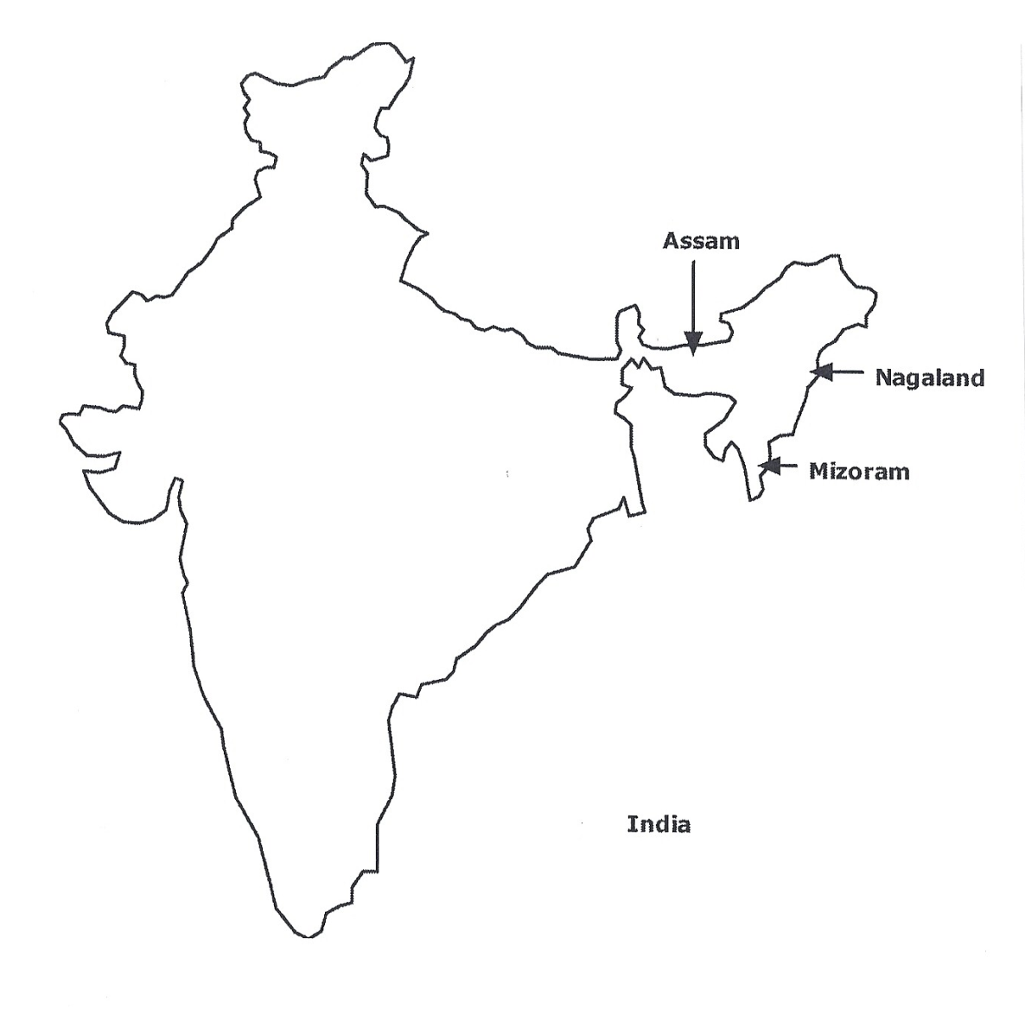
INDIA
Population growth characterizes the entire country, but population pressures are greater in Assam, Nagaland, and Mizoram.

Slide 27
india
1950s: Population planning began
        Limited funds for family planning clinics and programs
        Did little to stop population growth
1960s: national program; states encouraged to join
Rapid population growth continued

Slide 28
india
Today…
Indian state governments use advertising to encourage families to have fewer children.
Network of clinics established to aid women in small villages.

Slide 29
Contrasting india and china…
India…
Despite coordination problems, India’s birth rate has dropped more than half in 35 years.
Most demographers predict that before 2050 India will become the most populous country in the world.
Does not have resources necessary to curtail population growth.

Slide 30
Key questions to consider from this session
Why do populations fluctuate?
How do natural hazards impact population ?
How do people adjust to their environments/climate?
What role has globalization played in the spread of disease?
What international efforts have been made to curtail population growth?
What is the population policy of China?
What is the population policy of India?
What has been the impact of the population policies on India and China?

