Slide 1

Advanced Placement
Human Geography
Unit Two: Population
Session 4

Slide 2
Population movement

Slide 3
Vocabulary
People move from one place to another constantly, usually within a small land space.
Circulation is short-term repetitive movement that occurs on a regular basis.
Migration is a different type of mobility because it involves a permanent move to a new location, either within a single country or from one country to another.

Slide 4
vocabulary
What interests geographers more?
Geographers tend to be more interested in migration than circulation , because migration produces important changes for individuals and the regions they move to and from.

Slide 5
vocabulary
Spatial interaction is a broad geographical term for the movement of peoples, ideas, and commodities within and between areas, whether it is circulation or migration.
The demographic equation summarizes the population change over time in an area by combining natural change (death rate subtracted from birth rate) and the net migration.
Net migration is the difference between emigration and immigration.

Slide 6
vocabulary
Emigration: migration FROM a location
Immigration: migration TO a location
BOTH types of migration usually occur at once.

Slide 7
Ravenstein’s laws of migration

Slide 8
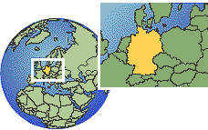
Ernst ravenstein
Ravenstein was a British demographer.
In 1885, he wrote 11 migration laws based on his study of internal migration in England.
Internal migration is permanent movement of people within a country’s borders.
Many laws still hold true today!

Slide 9

Ravenstein’s laws of migration
The majority of migrants move only a short distance.
Distance decay is the decline of an activity or function with increasing distance from the point of origin. It describes the tendency of people to stay fairly close to home.
The scale of migration has increased in recent years with modern transportation and communication systems. It is now possible for people to migrate to distant lands.

Slide 10
Ravenstein’s laws of migration
The majority of migrants move only a short distance.
Step migration is long-distance migration done in stages.
        Example: A person or family may move from a rural area to a small town; later a move from the small town to a city may be made, resulting in long-distance migration, but only short distances at one time.

Slide 11
Ravenstein’s laws of migration
The majority of migrants move only a short distance.
An intervening opportunity describes a favorable opportunity to settle before reaching a destination.
        Example: Migrants from a rural area on the way to a big city settle in a town along the way because they find employment.

Slide 12

Ravenstein’s laws of migration
Migrants who move longer distances tend to choose cities as their destinations.
Most who move leave rural areas and move to urban locations.
        Currently many internal migrations within developing countries are from rural to urban areas

Slide 13
Ravenstein’s laws of migration
Each migration flow produces a counterflow.
When one group moves into an area, another group moves out.
        Example: European immigrants moved into cities in the Eastern U.S. Once they prospered, they moved to better neighborhoods. Then, the newest immigrants took over the old neighborhoods.
        Result: Back and forth flow means that net migrations are small, disguising the large amount of movement actually taking place.

Slide 14

Ravenstein’s laws of migration
Families are less likely to make international moves than young adults, and most international migrants are young males.
This law has changed in recent years.
Young adults now have fewer restrictions on their movements.
Historically, women have had less freedom to travel by themselves. Now more women migrate.

Slide 15
Ravenstein and the gravity model
The Gravity Model
IMPORTANT: Ravenstein noted the inverse relationship between the volume of migration and the distance between the source and destination!
What is it?
        A measure of the interaction of places
Spatial interaction—excluding migration—is directly related to the size of the populations and inversely related to the distance between them.

Slide 16
Related to the gravity model
Critical distance is the distance beyond which cost, effort, and means strongly influence willingness to travel.
Critical distance will eventually prevent a migration from occurring.
So…
  a large city has a greater gravitational pull than a small one.

Slide 17
Reasons for migrating

Slide 18
Why migrate?
Migration may be forced or voluntary.
Example of forced (involuntary) migration: transport of 10 million Africans to the Western Hemisphere at beginning of 16th century
Example of voluntary migration: many examples, but most are economic

Slide 19
Why migrate?
Push factors (Centrifugal)
Pull factors (Centripetal)
Encourage people to move from the region where they live
Attract people to new region
Migration is usually a combination of
push and pull factors.

Slide 20
Economic factors
Push factors
Pull factors
Farmers may be pushed off land because of drought, invasion, or landlords.
Pull of cities is enhanced by industrial growth and jobs.
Both the push factors from the farm and pull factors of the city encourage farmers to migrate.
Economic factors help explain worldwide movement of people from rural to urban areas in the 19th and 20th centuries.

Slide 21
Cultural push factors
Include many involuntary migrations
Example: Refugees are people forced to migrate from their homes who cannot return for fear of persecution because of religion, race, nationality, or political opinions.
Current examples:
        Palestinians left Israel after the country was created in 1948 and areas were taken over by Israel in 1967.
        Afghanistan fled during the extended war with Soviet Union that began in 1979.
Flag of Israel

Slide 22
Cultural push factors
Other examples from history:
Indian subcontinent in 1947—most migration based on religion
        Muslims migrating to the newly created Pakistan
        Hindus migrating out of Muslim areas
Africa
        Many refugees because of intense ethnic conflicts (e.g. Rwanda and Darfur)

Slide 23

Cultural pull factors
Germany
Early 19th century— Germans fled to the U.S. to escape fear of retribution from authoritarian government (push factor). They were attracted by the democratic government in the United States (pull factor).
Eastern Europeans
1990s—Countries broke free from Soviet control (push), allowing citizens to go to Western Europe in search of better jobs (pull).

Slide 24
environmental factors
Push factors
Pull factors
Climate:
Unpleasant and uninhabitable climates
Elevations:
Middle and higher latitudes with high elevations where climate tends to be colder
Climate:
Preference for humid and sub-humid tropics, sub- tropics, or mid-latitudes
Elevations:
higher elevations in tropics as relief from heat

Slide 25
Environmental factors
Pull Factors (Centripetal)
Seacoasts:
People tend to settle on near the seacoast, especially in Eurasia, Australia, and South America (major cities clustered on rims of continents).

Slide 26
Environmental factors
Push factors (Centrifugal)
Disease:
Examples from history--
Fall of Ancient Roman Empire—malaria epidemic
Animal diseases—affect human choices for settlement since people depend on animals for sustenance
Modern medicine has altered this factor considerably, causing fewer to migrate.

Slide 27
Environmental factors
The environment may create intervening obstacles—physical features that halt or slow migration from one place to another
Examples:
Wide plains
Mountains
Deserts

Slide 28
Impact of major migrations
Major migrations impact both the region that people leave and the region that is their destination.
Example:
During the 16th, 17th, and 18th centuries, European migration to the Americas relieved population growth pressures in Europe.
However, European contacts exposed Native Americans to disease, decimating their populations.

Slide 29
Major migrations at different scales

Slide 30
Migrations at different scales
Migrations occur on all scales—local to global.
Can be:
Internal—within a country
        Interregional (between regions)
        Intraregional (within one region)
International
        Forced (involuntary)
        Voluntary (choose to move)

Slide 31
Global migration patterns
Net out-migration: Asia, Latin America, and Africa—means that more people emigrate from them than immigrate to them
Net in-migration: North America, Europe, Oceania—means that more people immigrate to them than emigrate from them
People are migrating FROM Less developed TO more developed countries.

Slide 32
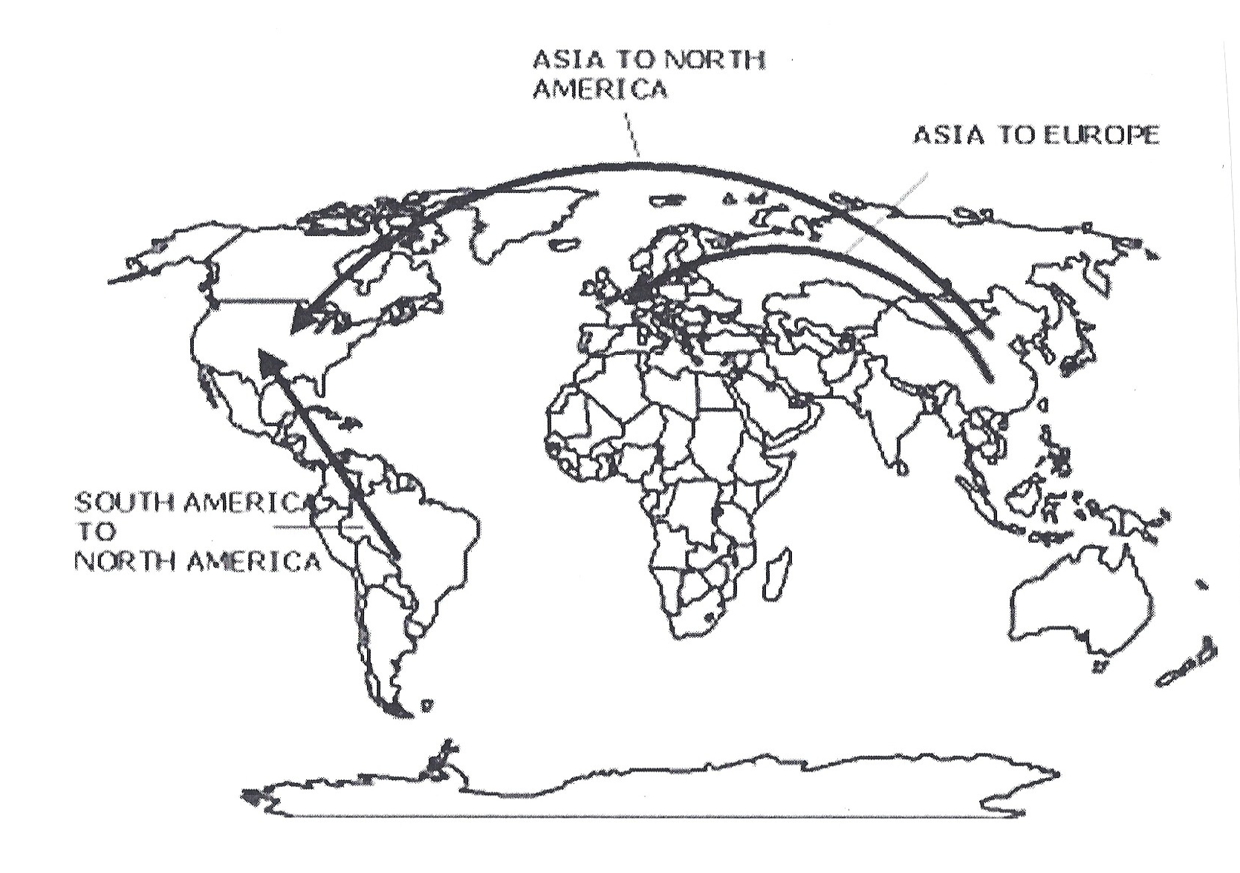
The largest flows of people in the modern world are from Asia to North America, Asia to Europe, and South American to
North America.

Slide 33

Key Points to remember from this session:
Difference between circulation and migration
Difference between emigration and immigration
Definition of net migration
Ravenstein’s Laws of Migration
Gravity Model
Push factors and pull factors—How do they differ? What are some examples of each from history?
Intervening obstacles
Migration at different scales—from local to global

