Slide 1

Advanced Placement
Human Geography
Unit Two: Population
Session 5

Slide 2

u.s. immigration patterns
The United States
This country is an important example for studying migration since many of its citizens are direct descendants of immigrants.
It is the third most populous country in the world.
70 million people have migrated to the U.S. since 1820.
30 million current residents are immigrants.

Slide 3
Three main eras of immigration in u.s.
Initial settlement of colonies
  Majority of immigrants were from Great Britain.
      They also came from:
        Netherlands
        Sweden
        France
        Germany and the Iberian peninsula
        Africa (forced migration; slavery)

Slide 4
Three main eras of immigration in u.s.
Emigration from Europe to the U.S.
During the 1840s and 1850, the two largest groups came from Ireland (economic conditions—push factors) and Germany (political conditions—push factors).
In the late 1800s, immigrants came from Northern and Western Europe (pull factor: Industrial Revolution).
In the early 1900s, large numbers came from Southern and Eastern Europe (Italy, Russia, and Austria-Hungary). Population had increased in those countries and immigrants sought economic opportunities in the U.S. (pull factor); Also, Russian Jews fled persecution by government (push factor).

Slide 5
Three main eras of immigration in u.s.
Immigration since 1945
Changes in immigration laws created a new mix of immigrants.
1986 Immigration Reform and Control Act allowed the government to issue visas to several hundred thousand people who had previously entered the country illegally.
Major pull factor---ECONOMIC!
Large numbers of immigrants from Asia and Latin America.

Slide 6

Impact of immigration waves on U.S.
Immigration waves have created much cultural diversity.
Influences continue today with immigrants from Asia and Latin America.

Slide 7
Intraregional migrations

Slide 8
Why do some intraregional migrations occur?
For example, within the United States:
African Americans migrated from the South to the North during World War I because of increasing job opportunities in the North.
Countertrend began in the 1970s because of pull factors:
        Changing civil rights patterns
        Increasing job opportunities in the South
Push factors :
        Deteriorating living conditions in the urban North

Slide 9
Why do some intraregional migrations occur?
Some intraregional migrations result from dislocation of people forced from their homes due to ethnic strife, war, or natural disasters.

Slide 10
South asia
Example:
Refugees fled from Afghanistan after the events of September 11, 2001 when the U.S. retaliated against terrorist bases .
Many fled to neighboring Pakistan.

Slide 11
Southeast asia
Examples:
Civil war in Cambodia caused refugees to escape to camps in Thailand.
Refugee camps were created in Myanmar (Burma) for minorities who escaped repressive military rule.

Slide 12
The balkans
Example:
        After Yugoslavia collapsed, the area broke into small countries in an effort to solve problems, but many people are still dislocated today.
        Serbs
        Macedonians
        Bosnians
        Albanians

Slide 13
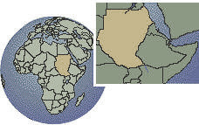
Sub-saharan africa
Examples:
In Rwanda, the conflict between Hutus and Tutsis resulted in one million deaths in 1994. Refugees spilled into Congo, Tanzania, and Uganda.
In Sudan, civil war between the Arabs of the north and the Africans of the south created the worst refugee crisis of the early 21st century.

Slide 14
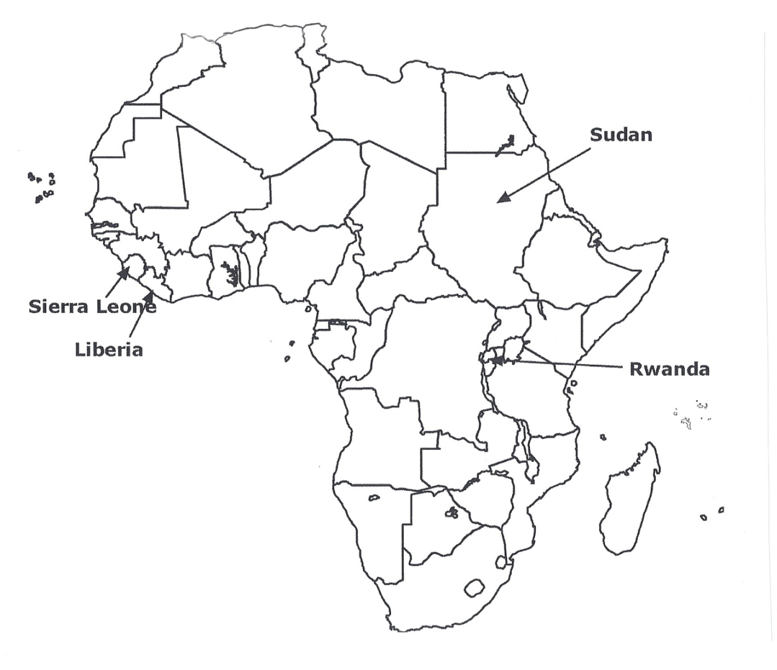
The map shows areas of ethnic strife that have caused refugees to move within each country and across borders into neighboring countries.

Slide 15
Migration selectivity

Slide 16
Migration selectivity
Defined: the tendency of certain types of
people to move
Not everyone is equally likely
to migrate, even if they are influenced by the same push and pull factors.

Slide 17
Migration selectivity
Influenced by
Age —young people more likely to migrate (ages 18 and 30)
Life changes affect decision to migrate. Examples:
        attend school
        marriage
        take a job
        join military

Slide 18
Migration selectivity
Influenced by
Education --People with higher levels of education are MORE likely to move than those with less education
Examples:
        Brain Drain (loss of highly educated people)
        Highly qualified candidates follow careers.
        Going away to college often means traveling a good distance from home.

Slide 19

Migration selectivity
Influenced by
Kinship and friendship ties – Many settle near family and friend to adjust to new location.
Example: Chain migration –A stream of people leave an area after first movers communicate with people back home and stimulate others to follow later.
Example: “Little Italy” or “Chinatown”

Slide 20
Short term circulation and activity space

Slide 21
Short term circulation and activity space
Short term circulation (defined): movement that does not involve relocation of residence
Activity space (defined): area in which an individual moves about as he or she pursues regular, day-to-day activities

Slide 22
Factors that influence trips within an activity space
Age group
School-age children are dependent on parents for long distance transportation; when alone, they travel by foot or bicycle.
Teenagers begin to drive, which increases their activity space.
Wage-earning adults travel to work and back.
Older people often see their activity space shrink once they retire from work.

Slide 23
Factors that influence trips within an activity space
Ability to travel
No accessibility to cars results in a fairly small activity space.
Movement is related to income levels, with poorer people having smaller activity spaces.
Suburbs often are spread out, increasing sizes of activity spaces to take care of daily needs.

Slide 24

Factors that influence trips within an activity space
Opportunities to travel
Awareness of space may be limited, and minimal knowledge of opportunity locations may discourage travel beyond the normal activity space.
Poverty and physical isolation may contribute to a lack of awareness space.

Slide 25
Space-time prism
All people live within a space-time prism that sets the limits of their activities.
People have only so much time to be mobile.
Space is limited by the ability to move.
Example: People must choose jobs that lie within their space-time prism.

Slide 26
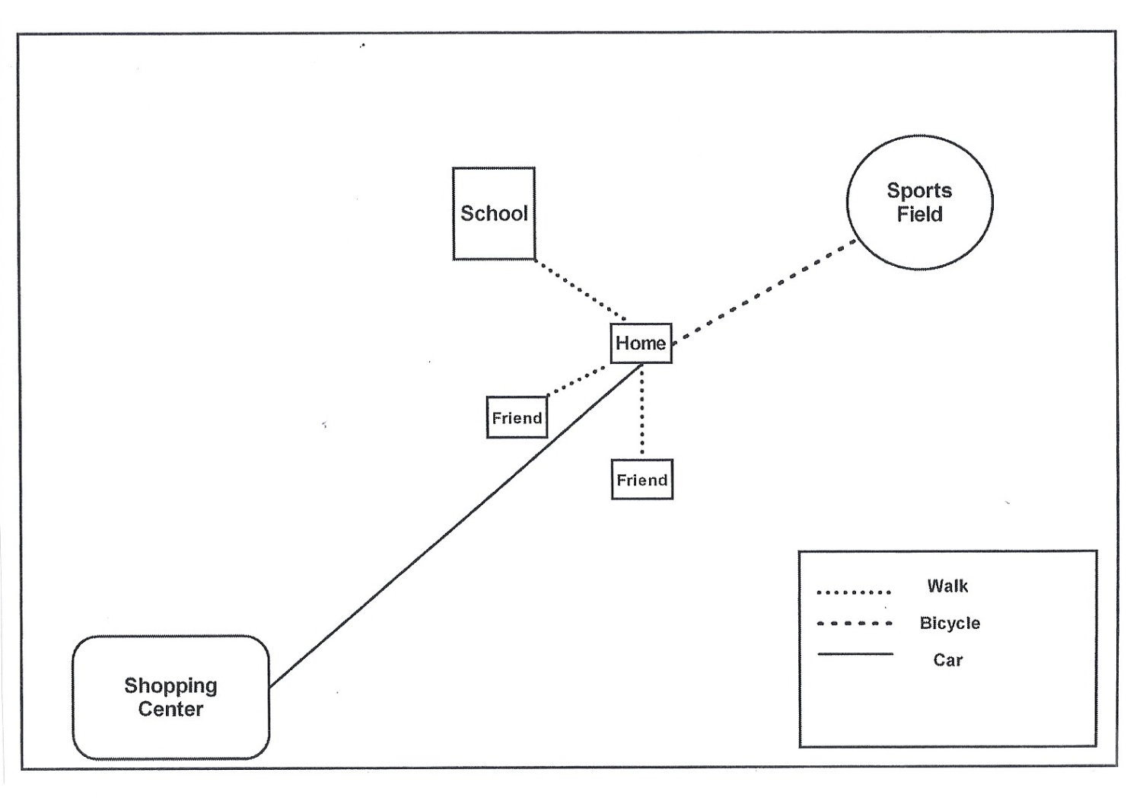
Activity space of an 8-year old boy who lives
in suburban U.S.

Slide 27
Key Terms and concepts from this session
Immigration patterns
Intraregional migrations
Dislocation
Migration selectivity
Chain migration
Short term circulation
Activity space
Awareness space
Space-time prism

