Slide 1
Advanced Placement Human Geography
Unit 3:
Cultural Patterns
Session 1

Slide 2
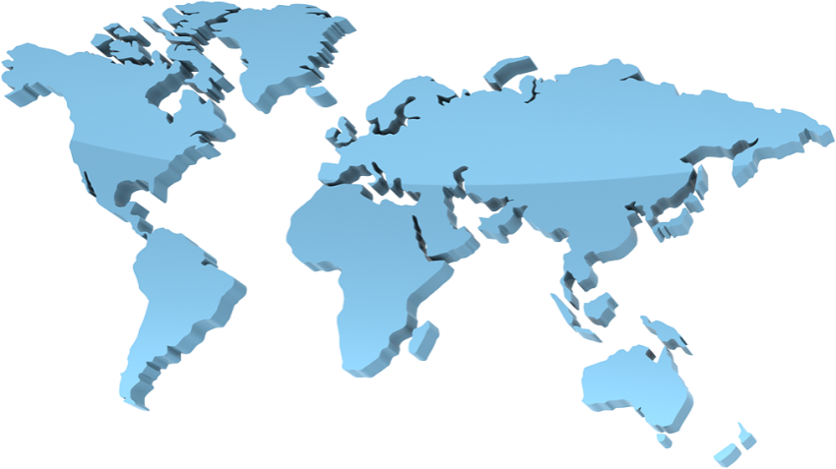
Advanced Placement
Human Geography
Review Sessions: Unit Three
By Geri Flanary
To accompany AP Human Geography: A Study Guide
3rd edition
By Ethel Wood

Slide 3
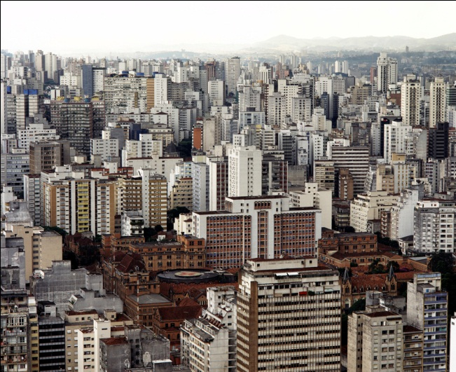
Cultural Geography: An Introduction
Cultural Geography is an important component of the human geography course.
The modification of the natural landscape by human activities is known as the cultural landscape. Examples of the human imprint on earth include:
        Cities
        Houses
        Road systems
        Suburbs

Slide 4
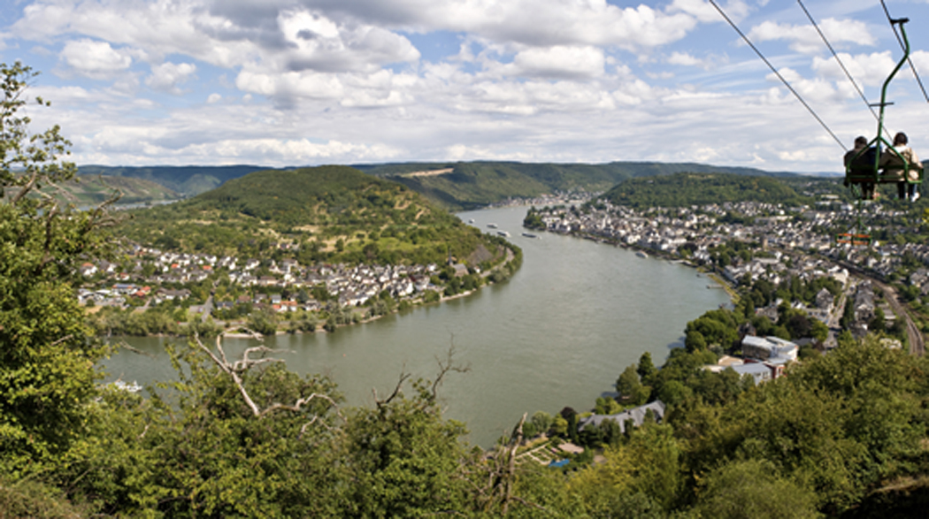
Cultural Ecology
The field that studies the relationship between the natural environment and culture is known as cultural ecology.
The cultural landscape offers clues about:
  cultural practices.
  priorities of inhabitants, both present and past.

Slide 5
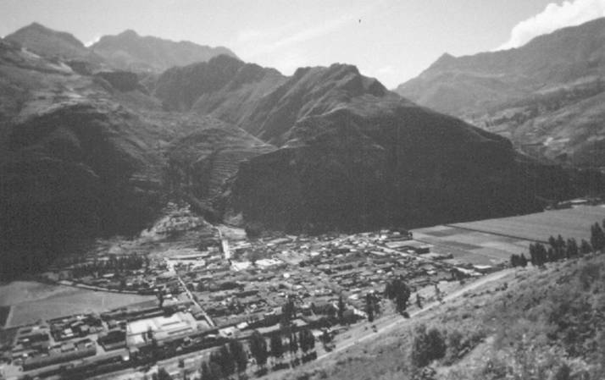
Cultural Landscape in Peru
This view of the Sacred Valley near Cuzco reflects cultural adaptation to the natural environment of mountain valleys.

Slide 6
SCHOOLS OF THOUGHT IN
CULTURAL GEOGRAPHY

Slide 7

Environmental Determinism
Environmental determinism is the belief that the physical environment, especially the climate and terrain, actively shapes cultures.
Human responses are molded almost entirely by the environment.

Slide 8
Environmental Determinism
Similar environments produce similar cultures.
Example: People who live near coasts focus on fishing and navigating waterways.

Slide 9

Environmental Determinism
Another example: Temperate (mild) climates produce inventive, industrious, and democratic societies that are most likely to control others.

Slide 10
Environmental Determinism
This school of thought was popular during the early 20th century, especially among English-speaking geographers who used their perspective to explain why Britain came to dominate the globe.

Slide 11
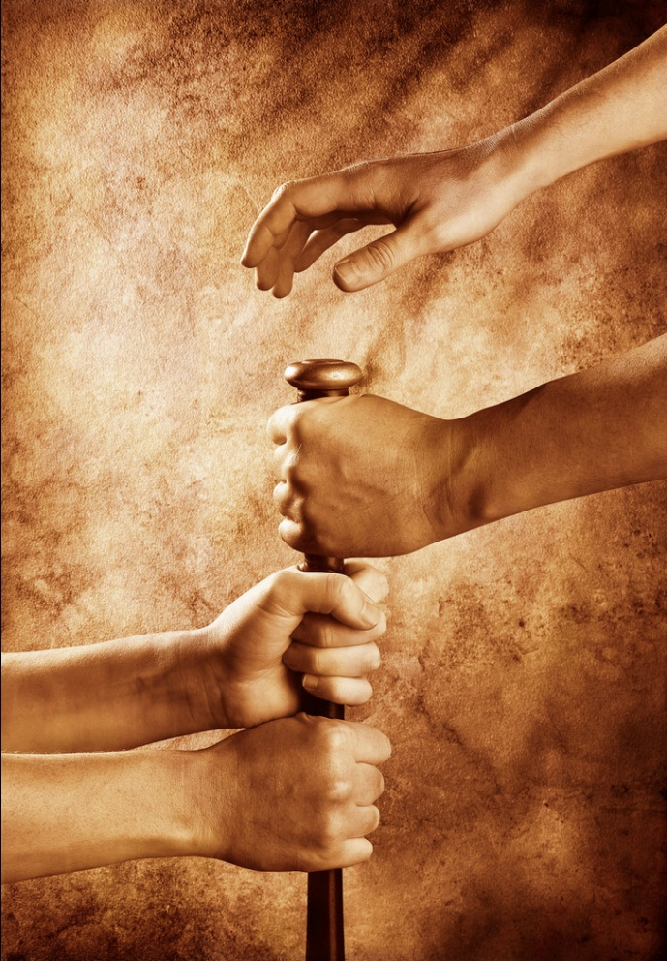
Possibilism
This school of thought holds that cultural heritage is as important as the physical environment in terms of shaping human behavior.
The physical environment offers many possibilities for a culture to develop but PEOPLE are the primary architects of culture.

Slide 12
Possibilism
People make choices based on their environment, BUT they are also guided by their cultural heritage.
Possibilists believe that technology increases the number of options people have.
So…technologically advanced cultures have more control over their physical surroundings.

Slide 13
Environmental Perception
This school of thought emphasizes the importance of human perception of the environment, rather than the actual character of the land.
For instance, how do humans view natural disasters?
  Cultures shape our view of hazards and natural disasters.
  As a result, human reactions to these events vary.

Slide 14
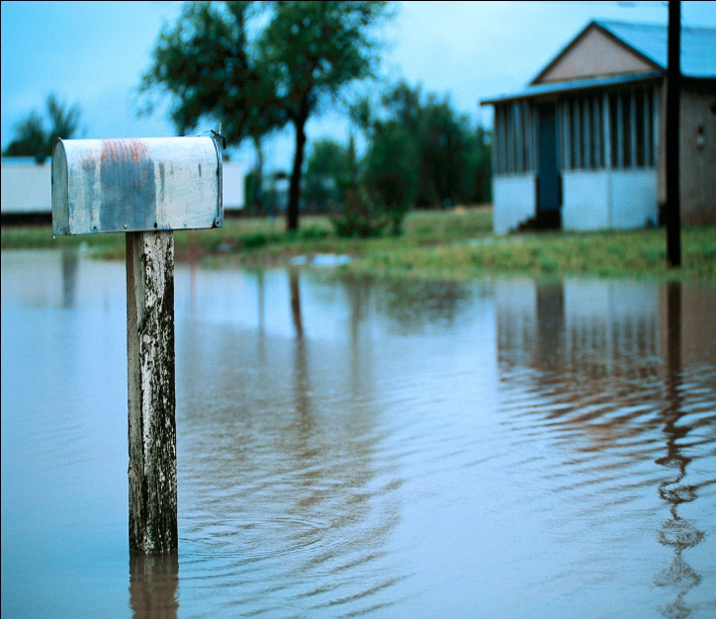
Environmental Perception
Examples:
If people believe that a flood was caused by the gods, they are likely to try to please the gods (e.g. build an altar).
If other people believe that the flood was a natural disaster, then they may work to prevent future damage (e.g. flood walls).

Slide 15
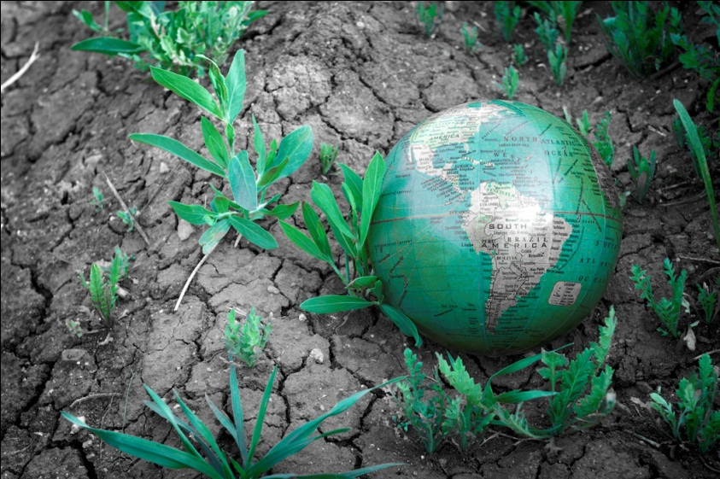
Cultural Determinism
This perspective emphasizes human culture as ultimately more important than the physical environment in shaping/molding human actions.
Some cultural determinists have seen humans as in opposition to the environment, and if nature is not controlled, humans will die.

Slide 16

Cultural Determinism
Modern movements encourage action to reverse global warming, air and water pollution, or the destruction of rain forests.

Slide 17
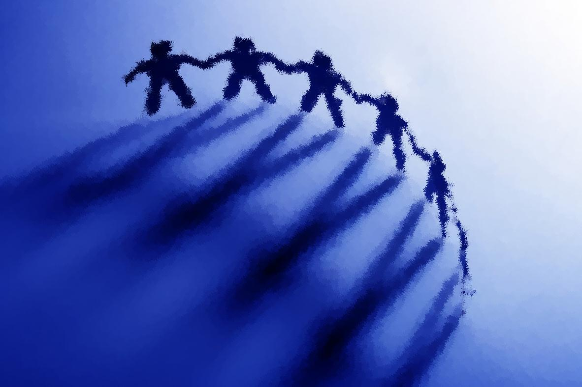
Concepts of Culture

Slide 18
What is culture?
Culture is the complex mix of values, beliefs, behaviors, and material objects that together form a people’s way of life.

Slide 19
What is culture?
Geographers specialize in the way that culture affects the natural environment, as well as the spatial organization that culture stimulates.
Culture is divided into two types:
non-material and material.

Slide 20
Non-material Culture
This type of culture consists of abstract concepts of values, beliefs, and behaviors.
  Values: culturally defined standards that guide the way people assess goodness and beauty and serve as guidelines for moral living
  Beliefs: specific statements that people hold to be true
  Behaviors: actions that people take

Slide 21
Material Culture
This type of culture includes concrete human creations called artifacts.
Artifacts reflect values, beliefs, and behaviors.
Material culture is reflected in a variety of ways, from the way homes are constructed to what equipment is used for construction and arrangement of roadways.

Slide 22
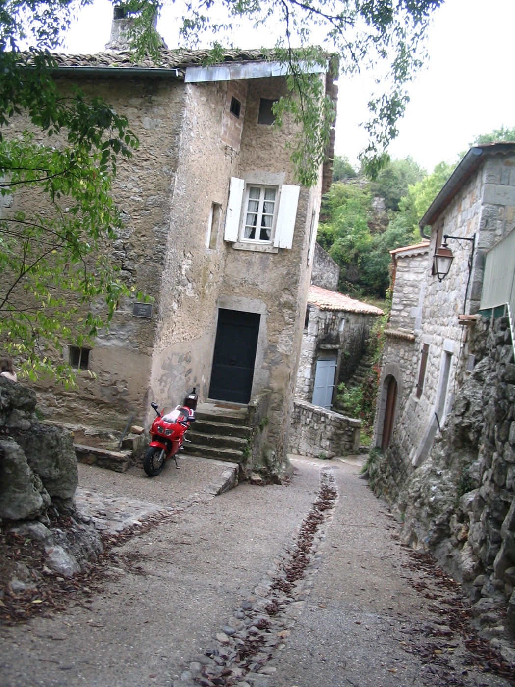
Material Culture: Past and Present
This is a photo of a modern day French village. The narrow streets were built in an earlier time when people traveled by foot, animal, or wagon. The motorcycle parked by its owner’s door is a reflection of modern technology’s adaptation to material culture (winding streets, houses without garages) from the past.

Slide 23
Key points…
Non-material culture
Material culture
Abstract concepts
Consists of
  Values
  Beliefs
  Behaviors
  Norms: the rules and expectations by which a society guides the behavior of its members
Concrete human creations
Consists of artifacts such as
  Houses
  Churches
  Roadways
  The arrangement of buildings on the cultural landscape

Slide 24
Culture Videos
Guinea Pig Festival in Peru - https://www.youtube.com/watch?v=l98aBSXYz7U
Oktoberfest – Germany: 183rd Oktoberfest kicks off in Munich - https://www.youtube.com/watch?v=8NXsUD5ZY78
Switzerland – Alpabzug (Cow Parade) Sumiswald, Switzerland - https://www.youtube.com/watch?v=zKWApHm9ypM
Grape stomp - https://www.youtube.com/watch?v=P9bl0SWEy7E / https://www.youtube.com/watch?v=aMS0O3kknvk (grape ladyfalls)
Cheese Rolling - https://www.youtube.com/watch?v=6v-SI4VJYhY
Tomato Throwing - https://www.youtube.com/watch?v=xdMzMdfDJ1A
Running of the Bulls - https://www.youtube.com/watch?v=9-vZbT8BCjI - history of running of the bulls https://www.youtube.com/watch?v=x87sTiWDB00 – running of the bulls kicked off
Hurling/Gaelic football - https://www.youtube.com/watch?v=CV0t36dyEBk / https://www.youtube.com/watch?v=suSiMIXN1SA
Road Bowling - https://www.youtube.com/watch?v=OwjNenO259Q

Slide 25
Cultural Regions, Traits, and Complexes

Slide 26

Culture Regions
Culture ties DIRECTLY to geography’s emphasis on space with the concept of culture region.
What is a culture region? It is an area marked by culture that distinguishes it from other regions.

Slide 27

Culture Traits
A culture trait is a single attribute of a culture.
A culture region consists of countless interrelated traits.

Slide 28
Culture Traits and Culture Regions
Example– Andes Mountains in South America
  These traits help to shape the culture region:
    Colorful clothing with the group’s skillful weave and design
    Building of roads and bridges across mountain ranges
    Construction of buildings without mortar
    Terracing of land for crop growth
Terracing →

Slide 29
About culture traits…
Culture traits are NOT necessarily confined to a single culture.
Example: People in many cultures use brushes to clean their teeth.
However, the trait combines with others in a distinctive way so that a culture complex is formed.

Slide 30
Culture Complex
A culture complex consists of common:
  values
  beliefs
  behaviors
  artifacts

Slide 31
Culture Complex
A country may possess many cultural complexes.
Example: China
  Modern city of Xi’an combines religions and beliefs such as Buddhism, Islam, and Confucianism in ways that makes it a separate culture complex.
  However, certain traits, such as Confucianism, are shared by other complexes around Xi’an.

Slide 32
Culture System
Any area with strong cultural ties that binds its people together forms a culture system.
A culture system is a group of interconnected culture complexes.

Slide 33
Cultural Hearths

Slide 34

Cultural Hearths
A hearth is a point of origin.
Cultural hearths are the areas where civilizations first began. They radiated the customs, innovations, and ideologies that transformed the world.

Slide 35
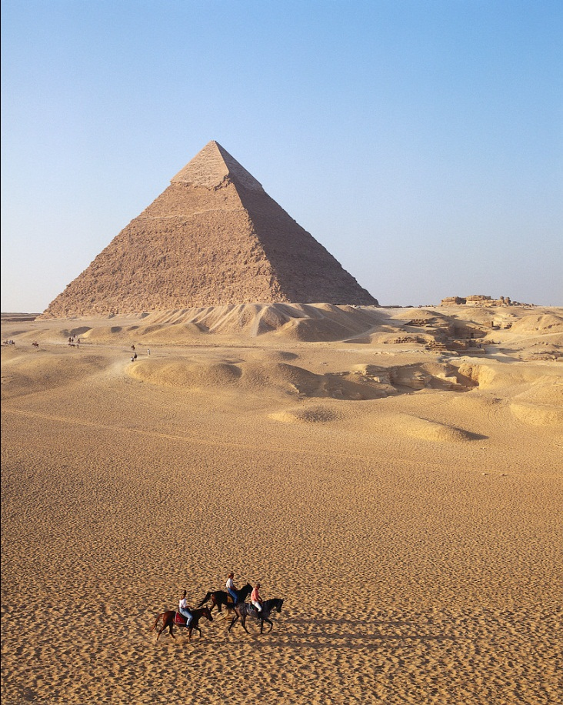
Cultural Hearths
Early cultural hearths developed in:
  Southwest Asia
  North Africa
  South Asia
  East Asia

Slide 36
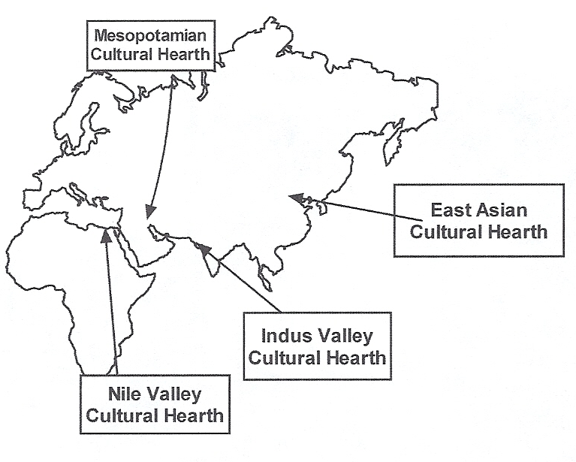
Cultural Hearth
Earliest Cultural Hearths. The earliest cultural hearths were almost completely determined by their geographical locations. All were in river valleys where the soil was the most fertile and water most available for growing crops and transportation.

Slide 37
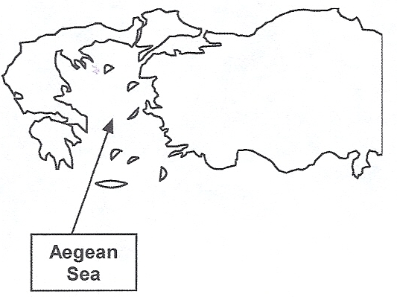
Cultural Hearth
Early Aegean Cultural Hearth. This cultural hearth differed from earlier hearths in that it centered on the Aegean Sea, not on a river valley. The sea is calm and the islands numerous, allowing for easy transportation so that Ancient Greeks could trade for goods that their natural environment did not provide.

Slide 38

Cultural Hearths
From their centers cultural hearths grew until they came into contact with each other.
The ability to travel and come into contact with one another was limited by distance and level of technology.

Slide 39
Cultural Hearths
Cultural hearths have shifted greatly over time.
Example: The Industrial Revolution of the 18th and 19th centuries shifted cultural hearths to Europe and North America, with modern shifts in the 21st century continuing to occur.

Slide 40
Cultural Diffusion

Slide 41

About cultural diffusion…
What is it? It is the process whereby culture spreads from its hearth to other areas.
The long and complicated spread of culture often makes it difficult to trace the origin, spread, and timing of a particular trait.

Slide 42
About cultural diffusion…
Developments, occasionally, CAN be traced to a specific civilization. These developments are known as independent inventions.
Example: The democratic process of gathering assemblies to discuss and vote on issues is often seen as an independent invention of the Ancient Greeks.

Slide 43
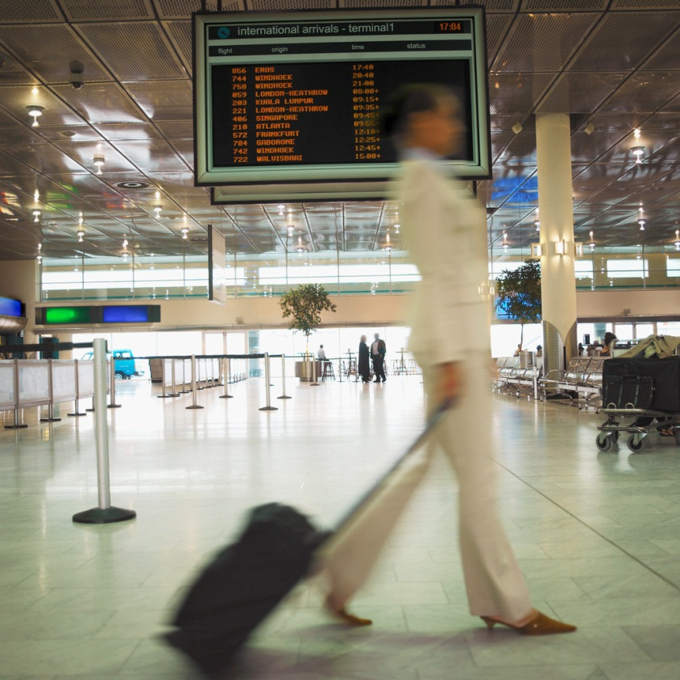
When does diffusion occur?
Diffusion occurs through the movement of:
  people
  goods
  ideas

Slide 44
Famous Geographers and Diffusion
Carl Sauer
  1952
    Agricultural Origins and Dispersals
    Focused on process of diffusion
Torsten Hagerstrand
  Wrote about diffusion approximately the same time as Sauer

Slide 45

Categories of diffusion
Expansion diffusion
Relocation diffusion

Slide 46
Expansion Diffusion
Expansion diffusion occurs when an innovation or idea develops in a source area and remains strong there while spreading outward.

Slide 47

Types of Expansion Diffusion
Contagious diffusion
  Almost all individuals and areas adjacent to the source region are affected.
  Direct contact between those in the source region and those in outlying areas is important.
  Example: contagious diseases such as the H1N1 virus or AIDS

Slide 48
Types of Expansion Diffusion
Hierarchical diffusion
  Ideas and artifacts spread first between larger places or prominent people and only later to smaller places or less prominent people.
  Example: Sub-Saharan Africa
    As Islam diffused to the regions, kings and nobility adopted the religion. Later, their subjects converted to Islam after giving up their native religions.

Slide 49
Types of Expansion Diffusion
Stimulus diffusion
  Stimulus diffusion occurs when a basic idea, but not the specific traits, spreads to another area or region.
  It stimulates imitative behavior within a population.
  Example: Mainland Asia to Japan
    As Buddhism diffused from the mainland to Japan, the Japanese imitated designs for Buddhist temples. However, interpretations of colors were from verbal or written descriptions and often differed from temples in China.

Slide 50

Relocation Diffusion
Relocation diffusion: Individuals or populations migrating from the source areas physically carry the innovation or idea to new areas.
Example: Christian Europeans carried their faith to the Americas, where they often actively sought to convert natives.

Slide 51
A Form of Relocation Diffusion
A particular form of relocation diffusion is migrant diffusion, which occurs when the spread of cultural traits is slow enough that they weaken in the area of origin by the time they reach other areas.
Example: Contagious diseases that reached the Native Americans in the New World

Slide 52

The Rate of Diffusion
Diffusion can occur instantly.
However, the rate of diffusion is influenced by time-distance decay.
This means that the influence of the cultural traits weakens as time and distance increase.

Slide 53
Key Terms from this Session
Cultural geography
Cultural landscape
Cultural ecology
Environmental determinism
Possibilism
Environmental perception
Cultural determinism
Culture
Non-material culture
Material culture
Culture regions
Culture traits
Culture complex
Culture hearths
Cultural diffusion
Independent invention
Expansion diffusion
Relocation diffusion
Contagious diffusion
Stimulus diffusion
Migrant diffusion
Time-distance decay

