Slide 1
Advanced Placement Human Geography
Unit 3:
Cultural Patterns
Session 2

Slide 2
Acculturation
When cultures come into contact, one culture often dominates the other.

Slide 3
What is acculturation?
Acculturation occurs when the less dominant culture adopts some of the traits of the more influential one.
It typically takes place when immigrants take on the following in their new country:
    values
    attitudes
    customs
    speech

Slide 4

What is assimilation?
If over time, immigrants lose their native customs, including religion and language, assimilation has occurred.
This means that the dominant culture completely absorbs the less dominant one.
It sometimes occurs over the course of several generations.

Slide 5

What is transculturation?
Sometimes two-way flows of culture reflect a more equal exchange of cultural traits, a process called transculturation.

Slide 6
Example of transculturation
Buddhism originated in India but diffused throughout Eastern Asia and came into contact with Confucianism.
Both forces were strong, and transculturation occurred.
Buddhism and Confucianism remained in place to influence large populations throughout East Asia.

Slide 7
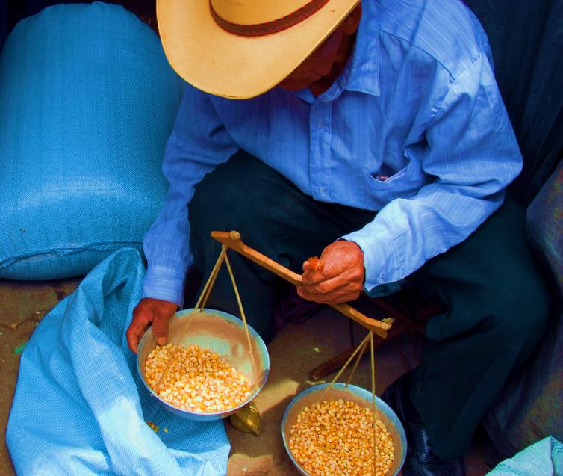
Ethnocentrism and Cultural Relativism

Slide 8
What’s the difference?
Ethnocentrism
Cultural Relativism
Ethnocentrism is the practice of judging another culture by the standards of one’s own culture.
Cultural relativism is the practice of evaluating a culture by its own standards.

Slide 9

Ethnocentrism
Ethnocentrism can sometimes generate misunderstanding and conflict.
On a smaller scale, ethnocentrism is necessary for people to be emotionally attached to their way of life.
If one culture considers itself to be superior, conflict could occur.

Slide 10

Example of ethnocentrism
Europeans and North Americans sometimes refer to China as the “Far East,” because China is far east of Europe and North America.
This term is unfamiliar to the Chinese who sometimes refer to their country as the “Middle Kingdom” because they perceive China to be at the center of the world.

Slide 11

Cultural Relativism
Those who practice cultural relativism believe that seeking to understand other cultures in the modern world is crucial because of increasing contact with one another.

Slide 12

Critics of Cultural Relativism
Critics, however, point out the problems that come with accepting all actions and values as EQUAL.
Their belief is that cultural relativism could lead an individual to ignore or dismiss those behaviors or ideas that are clearly harmful or unjust.

Slide 13
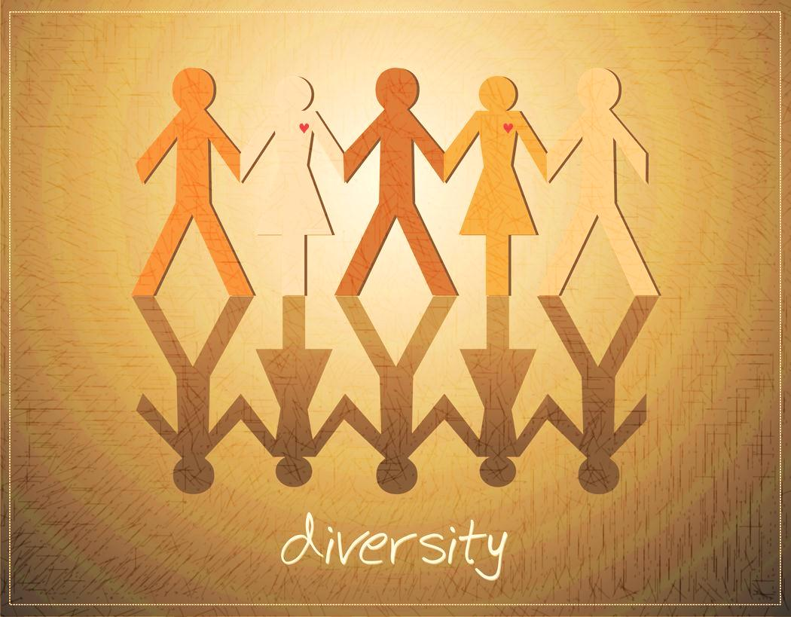
Cultural Differences

Slide 14
Syncretism
What is it? Syncretism is the fusion of the old and the new.
It helps to explain how and why cultural changes occur.

Slide 15
These changes lead to a wide range of differences, including languages and religions.

Slide 16
Language

Slide 17
Language
What is it? Language is a systematic means of communicating ideas and feelings through the use of signs, gestures, marks, or vocal sounds.

Slide 18
Language
Language is the KEY to the world of culture.
NO OTHER single culture trait more commonly binds people together BECAUSE language is a set of symbols that allows people to communicate with one another.

Slide 19

Language
Even the basic rules for writing differ among cultures.
Example:
  Most people in Western societies write from left to right, but people in Northern Africa and Western Asia write from right to left, and people in Eastern Asia write from top to bottom.

Slide 20
Language and Preservation of Culture
Language also helps to ensure the continuity of culture, or cultural transmission, from one generation to the next.
Every society transmits culture through speech, and most today also pass it along through writing.
The preservation of culture is more likely to last if people in a society can read and write.

Slide 21
Language
Linguists (those who study languages) estimate that between 5000 and 6000 languages are in use in the world today, with some much more widely used than others.

Slide 22
Most Commonly Spoken Languages
(Percentages for first language speakers only)
Chinese 12.44%
Spanish 4.85%
English 4.83%
Arabic 3.12%
Hindi 2.68%
Bengali 2.66%
Portuguese 2.62%
Russian 2.12%
Japanese 1.8%
Standard German 1.33%
Source: The CIA Factbook, 2009 estimates

Slide 23
Language
The most commonly spoken languages have diffused in many ways:
  trade
  conquests
  migrations

Slide 24
Language
Languages are often grouped into families with a shared, but fairly distant origin.
Example: Indo-European family
  Languages in this family are spoken by more than one-half of the world’s people.
  English is the most widely used language in this family.

Slide 25
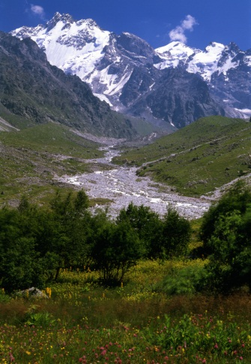
Language
Some areas of the world are characterized by linguistic fragmentation, a condition in which many languages are spoken, each by a relatively small number of people.

Slide 26
Language
Example of linguistic fragmentation: Caucasus region of Eastern Europe
  Many different culture groups have settled here and retained their languages.
  Today several thousand languages are spoken by fewer than 2 million people.

Slide 27
Language
Romance languages are part of the Indo-European language family.
They form a sub-family, with origins in Latin, including Spanish, French, and Italian.

Slide 28

Language
Theorists differ as to how languages originally diffused.
Some analysts believe it was by conquest.
Others argue that it was the diffusion of agricultural practices.
The Black Sea is believed to be the heart of Indo-European languages.

Slide 29
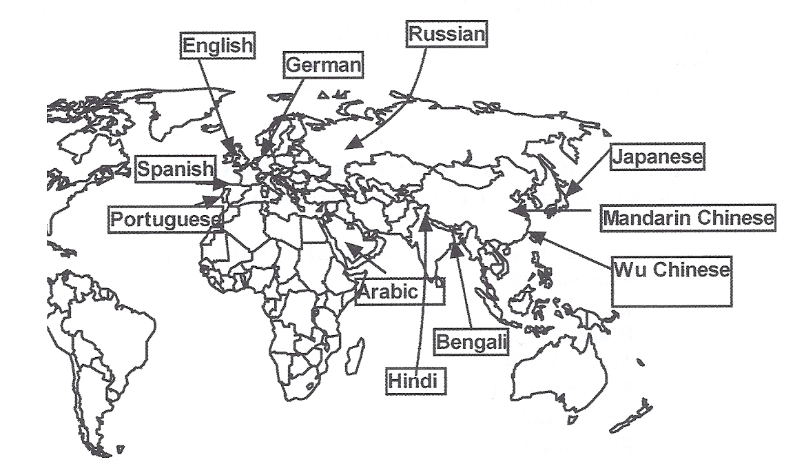
Sources of Ten Major World Languages
Although there are thousands of languages spoken today, the majority of people in the world speak one of the languages indicated on the map below. The map shows the origins of these languages before they diffused to many other areas of the world.

Slide 30

Language
Standard Languages
Official Languages
Recognized by the government and the intellectual elite as the norm for use in schools, government, media, and other aspects of public life
Often the dialects identified with a country’s capital city or center of power
The language endorsed and recognized by the government as the one that everyone should know and use

Slide 31

Language
Dialects are regional variants of a standard language.
Dialects reflect differences in:
  vocabulary
  pronunciation
  pace of speech (faster or slower)
  different phrases

Slide 32

Language
An isogloss is a boundary within which certain languages or dialects are spoken.
An isogloss is not a clear line of demarcation, however, with the use of particular words fading as the boundary is approached.

Slide 33

Coping with Language Barriers
Bilingualism is the ability to communicate in two languages.
Multilingualism is the ability to communicate in more than two languages.

Slide 34
Coping with Language Barriers
Long-term contact between less skilled people sometimes results in the creation of a pidgin, a collection of languages that borrows words from several.
Pidgin is essentially a hybrid language.
Example: Lingala
  Lingala is a hybrid of Congolese dialects that the French invented to aid in communication among 270 ethnic groups.

Slide 35
Coping with Language Barriers
A lingua franca is an established language that comes to be spoken and understood over a large area.
Contemporary example: English
  A language of international communication
  Often used in international business affairs

Slide 36
The modern area around the Mediterranean Sea. Most of the area around the Mediterranean Sea was dominated by the Roman Empire by the early 2nd century C.E. As political power spread, Latin became the lingua franca of the area. Once the empire fell, the area reverted to cultural practices of its various ethnicities, as reflected in the country and city names on the modern map. Latin blended with native tongues to create modern languages of Spanish, French, Italian, Romanian, and Portuguese.

Slide 37
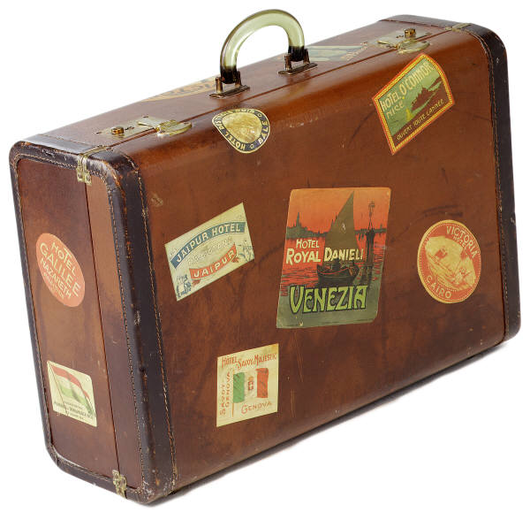
Toponymy
Toponymy is the study of place names, a special interest of linguistic geographers.
A careful study of a map can reveal cultural identities and histories by simply noticing names of geographical and political figures.

Slide 38
Toponymy
Place names may:
  honor kings, queens, or heroes (e.g. Virginia for the Virgin Queen Elizabeth).
  reflect geographical origins (e.g. “York” as in New York).
  be descriptive (e.g. Rocky Mountains).
  denote incidents or events (e.g. Battle Creek, Michigan).
  commemorate religious figures (e.g. St. Louis).

Slide 39
Language Extinction
Extinct languages were once in use but are no longer spoken or read in daily activities by anyone in the world.
The process of extinction seems to be accelerating in modern times due to communication and transportation improvements.
Example of extinct language: Gothic

Slide 40
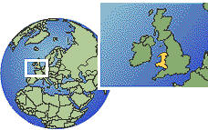
Example of Attempt to Preserve a Language
Ethnic groups have pushed for measures to preserve their languages, such as the movement in Wales to continue to teach Welsh, not just English, in their schools.

Slide 41

Other attempts at Preserving Languages
European Union’s Bureau of Lesser Used Languages
  Provides financial support to preserve languages
  Special efforts made to preserve Celtic languages

Slide 42
Other attempts at Preserving Languages
Peru and Quechua
  Spanish has been the dominant language in Peru since it was conquered by Spain in the 16th century.
  The use of Quechua, the native language, has declined in recent years.
  The native language has been in use mainly in rural areas.

Slide 43
Other attempts at Preserving Languages
Peru and Quechua
  On a national level, legislators have delivered speeches before Peru’s Congress in Quechua.
  On an international level, Google has launched a version of its search engine in the native language.
  Microsoft has added translations in Quechua to its Windows and Office programs.

Slide 44
Other attempts at Preserving Languages
Peru and Quechua
  In 2006 Peru’s president signed a law making discrimination on the basis of language a criminal offense.

Slide 45
Key Terms from this Session
Language family
Language sub-family
Standard language
Official language
Dialects
Isogloss
Bilingual
Multilingual
Pidgin
Lingua franca
Toponymy
Extinct language
Acculturation
Assimilation
Transculturation
Ethnocentrism
Cultural relativism
Syncretism
Language
Cultural transmission
Linguist
Linguistic fragmentation

