Slide 1
Advanced Placement Human Geography
Unit 3:
Cultural Patterns
Session 3

Slide 2

Religion

Slide 3

Religion
Religion distinguishes itself from other belief systems by its emphasis on the sacred and divine.
Religions usually explain the relationship of the individual to the world, as well as the meaning of life and death.

Slide 4
Religion
In recent years other ideologies have replaced religion as a key cultural component in some societies.
Example: humanism
  Emphasizes the ability of human beings to guide their own lives
Example: Marxism
  Transformed communism into a central ideology in many areas in the 20th century

Slide 5

Universalizing Religions
The three main universalizing religions are:
  Christianity
  Islam
  Buddhism
Each attempts to be global in its appeal to all people, not just to those living in one location.

Slide 6
Universalizing Religions
Each universalizing religion is divided into subgroups:
  Branches are large basic divisions within a religion.
  Denominations are divisions of branches that unite local groups in a single administrative body.
  Sects are relatively small groups that do not affiliate with the more mainstream denominations.

Slide 7
Major Religions of the World as a Percentage of World Population
There are many different religions in the world, but most people who call themselves religious adhere to the few religions identified on the chart. 60% of the world’s population identifies with Christianity, Islam, or Buddhism.

Slide 8
Religion
Christianity
This universalizing religion has the most followers and the most widespread distribution.
It is the predominant religion in:
  North America
  South America
  Europe
  Australia

Slide 9
Religion
Christianity has three major branches:
  Roman Catholic—50% of the world’s Christians; concentrated in Latin America, Quebec, Central Africa, and Southern and Eastern Europe
  Protestant —18% of world’s Christians; strong in North America; Northern Europe, Britain, South Africa, and Australia
  Eastern Orthodox—12% of world’s Christians; prevalent in Eastern Europe and Russia
  The remaining 15% are affiliated with a variety of African, Asian, and Latin American churches that cannot be categorized within the three major branches.

Slide 10
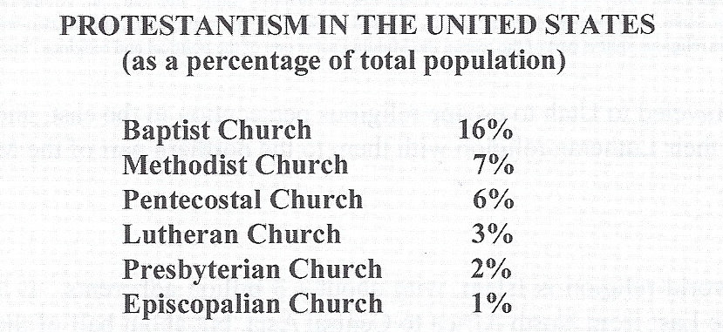
About 50% of the U.S. population is Protestant, but they belong to hundreds of different denominations and sects. Even the major denominations listed below are divided into different churches.
Christianity in the United States

Slide 11
Religion in the United States
There are regional differences which means that most people live in communities where one denomination predominates.
  Baptists: southern states
  Methodists: Northeast and Southwest
  Lutherans: Minnesota and North Dakota
  Mormons: Utah

Slide 12

Religion in the United States
Patterns have been determined PRIMARILY because of migration/settlement patterns.

Slide 13
Religion
Islam
It is the second largest religion in the world.
It is the predominant religion in:
  Middle East from North Africa to Central Asia
  Indonesia
  Pakistan
  Bangladesh
It is also the youngest of the world religions.
The religion is diffusing rapidly to other areas.

Slide 14
Religion
Islam
There are two branches of Islam:
  Sunni—83% of all Muslims; largest branch in the Middle East and Asia; country with largest concentration is Indonesia
  Shiite —16% of all Muslims; most live in Iran; also followers in Pakistan, Iraq, Turkey, Azerbaijan, Afghanistan, and Yemen

Slide 15
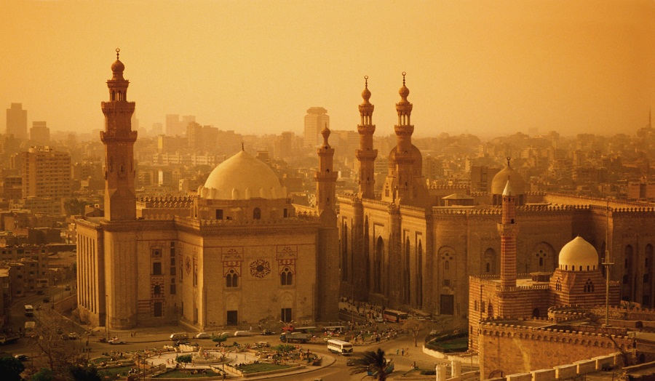
Religion
Islam
The split between the Sunni and Shiite branches occurred over the rightful successor to Muhammad, the religion’s founder.
Al-Rifa'i Mosque
Egypt

Slide 16
Religion
The Sunni believed that Muhammad’s successor should be chosen by agreement among the religion’s leaders.
The Shiite believed that the successor should be a member of Muhammad’s family.
Differences led to conflict that created hostilities that have continued through the years.

Slide 17
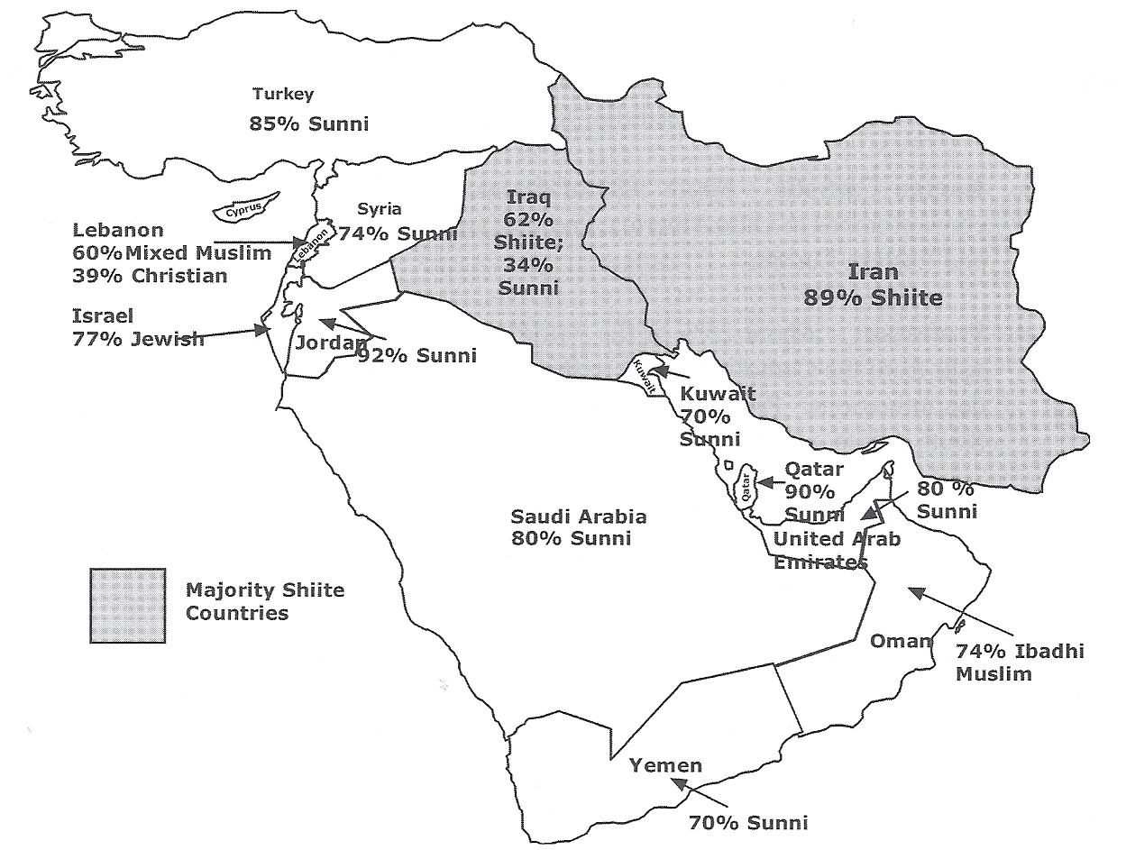
Only two countries in the Middle East are majority Shiite: Iran and Iraq. All the rest, with the exception of Lebanon and Israel, are majority Sunni. Historically, there have been many tensions between the two groups.
Sunnis and Shiites in
the Middle East

Slide 18

Religion
Buddhism
It is the third largest universalizing religion.
The hearth of the religion was India where its founder, Siddharta (the Buddha) lived.

Slide 19
Religion
Buddhism
The religion diffused along the Silk Road across the Indian Ocean to East and Southeast Asia primarily.
Today, the predominant religion in India is Hinduism.

Slide 20
Religion
Buddhism
Buddhism has three main branches:
  Mahayana—56% of Buddhists; characterized by broad inclusion of ideas and deities from other religions as it spread across East Asia
  Theraveda—38% of Buddhists; stricter adherence to Buddha’s teachings; strong in Southeast Asia
  Tantrayana—6% of Buddhists; emphasis on magic and meditation; found primarily in Tibet and Mongolia

Slide 21
Other Universalizing Religions
Sikhism stresses continual improvement and movement toward perfection through individuals taking responsibility for their own actions.
  It combines Hinduism and Islam but centers its teaching on the founder, Nanak.
  Followers are concentrated in the Punjab region of India.

Slide 22
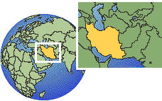
Other Universalizing Religions
Baha’i is a relatively new faith founded in Iran in 1844.
Most followers live in Iran.

Slide 23
Ethnic Religions
These religions appeal primarily to one group of people living in one place.
Followers do not seek converts outside the group that gave rise to the religion.
These religions tend to be spatially concentrated.
Exception: Judaism
  Adherents are widely scattered.

Slide 24
Ethnic Religions
Hinduism
It is the world’s third largest religion.
Most adherents live in India.
It is generally regarded as the world’s oldest organized religion.

Slide 25
Ethnic Religions
Hinduism
The religion has no central god or single holy book.
There is a belief in the existence of a universal spirit (Brahman) that manifests itself in many shapes and forms, including Vishnu and Shiva.

Slide 26

Ethnic Religions
The Chinese Religions
Buddhism often blends with local belief systems, including Confucianism and Daoism, both of which are often viewed as philosophies.

Slide 27
Ethnic Religions
The Chinese Religions
Confucianism provides a code of moral conduct based on humaneness and family loyalty.

Slide 28
Ethnic Religions
The Chinese Religions
Daoism holds that human happiness lies in maintaining proper harmony with nature.

Slide 29
Ethnic Religions
Shintoism
It is a native ethnic religion of Japan.
It focuses on nature and reverence of ancestor.
Although it is no longer the state religion of Japan, it still thrives in the country.
Prayers are offered to ancestors, and shrines mark reverence for house deities.

Slide 30
Ethnic Religions
Judaism
It is one of the world’s oldest religions founded by Abraham in the lands bordering the eastern Mediterranean Sea.
Its members are widely distributed across the earth because of diaspora, or forced exodus from their lands of origin.

Slide 31
Ethnic Religions
Judaism
It is the first recorded monotheistic religion, centered on the belief in one God.
Christianity and Islam have their roots in Judaism.
Jesus was born a Jew and Muhammad traced his ancestry to Abraham.

Slide 32
Ethnic Religions
Shamanism
Shamanism is an ethnic religion in which people follow their shaman, a religious leader and teacher who is believed to be in contact with the supernatural.
Shamanism is reflected on the “totem poles” of North American natives. →

Slide 33
Ethnic Religions
Shamanism
Shamans in East Asia are believed to be in contact with the ancestors.
In Africa, shamanism takes the form of animism, the belief that inanimate objects (rocks, rivers, plants) have spirits and conscious life.

Slide 34

Ethnic Religions
Traditional Religions
Traditional religions are an integral part of a local culture and society.
Example: Shamanism
Example: Native African religions

Slide 35
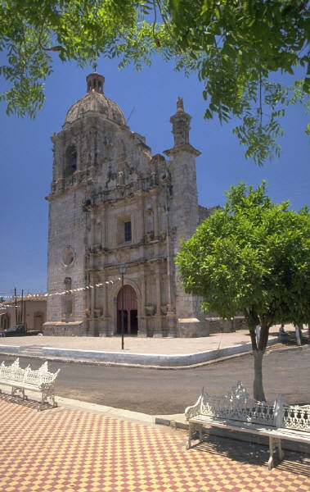
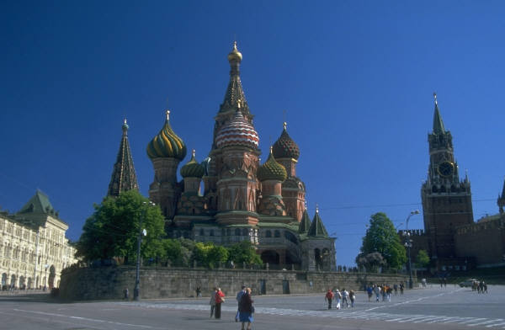
The Spatial Impact of Religions
In large cities around the world, the tallest, most centralized, and elaborate buildings are often religious structures.

Slide 36
The Spatial Impact of Religions
Many structures are arranged around religious buildings.
Example: The Hindu cultural landscape is dotted with shrines that impose minimal disruption to the natural landscape.

Slide 37
The Spatial Impact of Religions
Shrines are located near water, because water is part of sacred rituals.
It is believed that gods will not venture far from water.

Slide 38
The Spatial Impact of Religions
Bodhi trees are protected in Buddhist lands, marking the cultural landscapes of many villages and towns.

Slide 39

The Spatial Impact of Religions
An important religious land use that impacts the cultural landscape has to do with disposing of the dead.
Practices include:
  cemeteries
  cremations

Slide 40
Key Terms from this Session
religion
humanism
Marxism
universalizing religion
erthnic religion
branch
denomination
sect

Slide 41
Religions to Know from this Session
Christianity
  Roman Catholicism
  Protestantism
  Eastern Orthodoxy
Islam
  Sunnni
  Shiite
Buddhism
  Mahayana
  Theraveda
  Tantrayana
Sikhism
Baha’I
Hinduism
Confucianism
Shintoism
Judaism
Shamanism
  animism
Traditional religions

