Slide 1
Advanced Placement Human Geography
Unit 3:
Cultural Patterns
Session 4

Slide 2

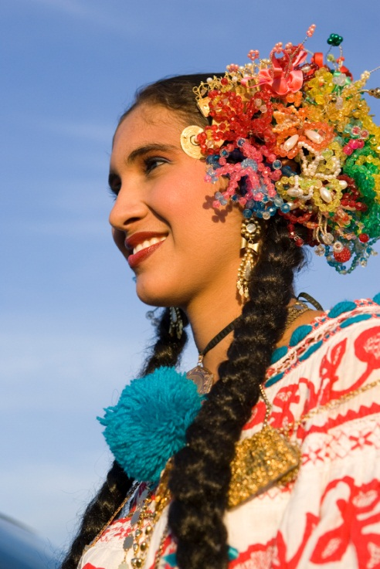
Popular and Folk Culture

Slide 3
What is the difference between folk culture and popular culture?
Folk Culture
Popular Culture
Traditionally practiced by small, homogeneous groups living in isolated rural areas
Controlled by tradition and resistance to change is strong
Most groups self-sufficient
Tools, food, and music mostly homemade
Found in large heterogeneous societies that are bonded by a common culture despite the many differences among the people who share it
General mass of people conforming to and then abandoning ever-changing cultural trends

Slide 4

More about folk culture…
Folk life is the composite culture, both material and non-material, that shapes the lives of folk societies, such as those in rural areas during the early settlement of the U.S.

Slide 5
More about folk culture…
Today, true folk societies no longer exist in the U.S. although the Amish are one of the least altered folk groups in the country.

Slide 6
More about folk culture…
The Amish
  They reject the use of electricity, cars, and modern dress.
  The areas the live in provide good examples of folk culture regions, where people live in a land space and share at least some of the same folk customs.

Slide 7
More about folk culture…
The Amish
  The largest concentrations of this folk group are in Pennsylvania, Ohio, and Indiana.
  The Amish farms are identifiable on the landscape because of buggies and horses and a lack of electrical lines, and people dress in traditional styles.

Slide 8
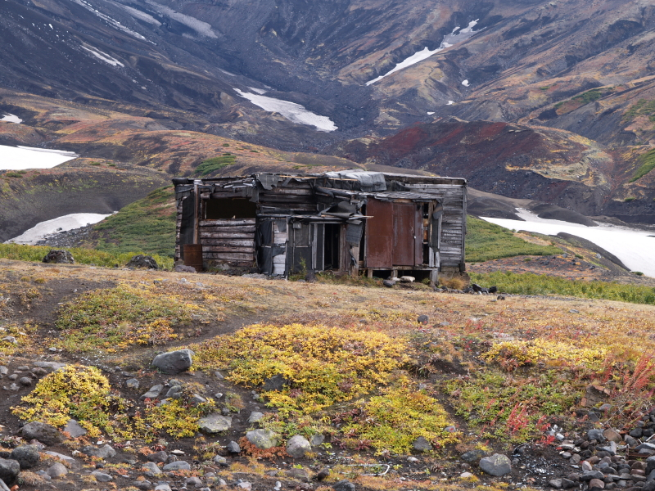
More about folk culture…
Folk cultures contribute to diversity because they are relatively isolated.
They MAY diffuse to other locations, but generally the diffusion is slow because people often do NOT leave the areas where they grew up.

Slide 9

More about folk culture…
The Physical Environment
  Since folk societies are usually agricultural with limited technology, they are particularly responsive to the environment.
  Methods for dealing with the environment vary from culture to culture.

Slide 10
More about folk culture…
Example of a folk culture coping with the physical environment:
  The Netherlands
    Wooden shoes are worn to cope with working in the wet fields.
    Not all cultures in the world that have wet fields have used wooden shoes. Therefore, the Netherlands is unique.

Slide 11
More about folk culture…
Food habits derive from the environment according to the climate and growing season.
Folk societies prepare and cook foods in various ways, and they even differ in what they consider to be edible.

Slide 12
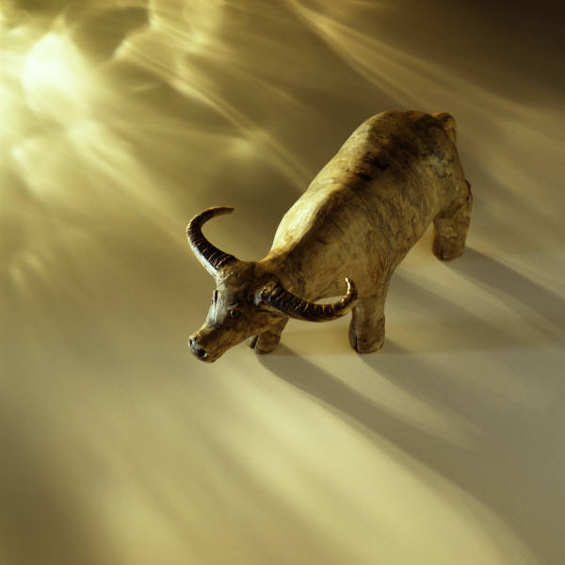
More about folk culture…
Food taboos and folk culture
  Example—Hindu culture
    There is a taboo against eating cows, which deprives some of a readily available food source.
    However, the taboo makes environmental sense because oxen are needed to clear fields each year.

Slide 13
More about folk culture…
Housing Styles
  They reflect both cultural and environmental influences.
  Folk societies are limited in their building materials by the resources available in the environment.
  Example: If trees are available, wooden houses will be built.

Slide 14
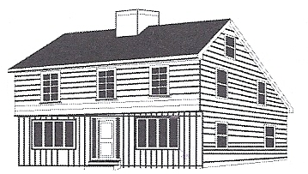
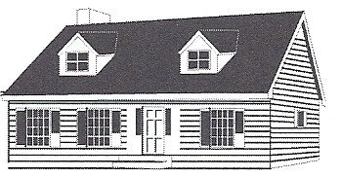
New England Houses
On the top right (# 1) is the saltbox house style originating in New England around 1650 and commonly built by the early 18th century.
On the bottom right (# 2) is the “Cape Cod” style house, also a New England Style, that originated in the late 17th century.
Both styles diffused west and south through New York, Pennsylvania, New Jersey, Ohio, and Michigan by the late 19th century.
# 1→
# 2→

Slide 15
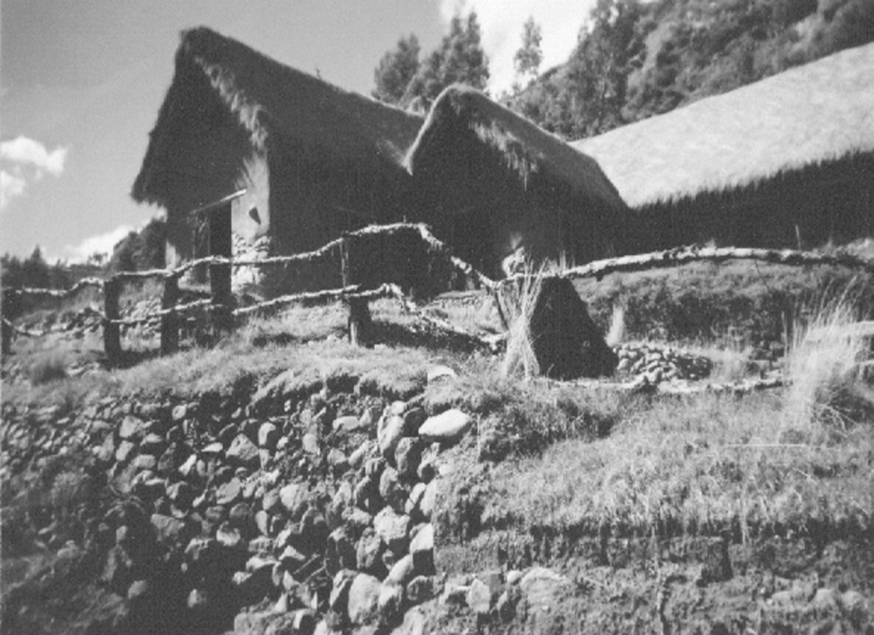
Traditional House in Peru
The thatched-roof house in this modern-day photo on the right provides evidence that housing styles still may reflect folk cultures. Thatched roofs appear in other cultures, but this style is particular to the Andes Mountain valleys in South America.

Slide 16
Folk Music
North American folk music began as immigrants carried their songs to the New World, but the imported songs became “Americanized” and new songs were added to the American experience.

Slide 17
Folk Music Culture Regions
The Northern Song Area
Found in
  Maritime Provinces of Canada
  New England
  Middle Atlantic States
Its ballads are close to English originals, a characteristic reinforced by new immigrants.
Use of:
  fiddles
  fife-and-drum bands

Slide 18
Folk Music Culture Regions
The Southern and Appalachian Song Area
Region extends
  Westward to Texas
The words speak of hard lives and backwoods style, which form the roots of “country” music.

Slide 19
Folk Music Culture Regions
The Western Song Area
Found west of the Mississippi River
This regional music reflects the experiences of cowboys, plains farmers, river people, and gold seekers.

Slide 20
Folk Music Culture Regions
The Black Song Style Family
This style grew out of the slave experiences in the rural South.
It features both choral and instrumental music, a strong beat, and deep-pitched mellow voices.

Slide 21
Folk and Pop Music
https://www.youtube.com/watch?v=hlWTASnnft4
https://www.youtube.com/watch?v=CbIRtkCg2fQ

Slide 22

More about popular culture…
Popular culture involves the vast majority of a population, exposing them to similar consumer and recreational choices that lead them to behave in similar ways.
Popular culture breeds homogeneity.

Slide 23
More about popular culture…
Popular culture began to replace traditional culture in everyday life in industrialized societies with the development of:
  Mechanization
  Mass production
  Mass distribution (stores; mail order)

Slide 24

National Uniformities and Globalization
Landscapes of uniformity through popular culture tend to take on a national character.
Ways of life differ from country to country or region to region.
Example: Many chain stores have globalized such as those in America.

Slide 25
National Uniformities and Globalization
The globalization of popular culture is resented by many people.
It sometimes is seen as a type of dominance by the West.
The influence of popular culture through globalization is even regulated by some governments (e.g. Iran).

Slide 26
Environmental Impact of Popular Culture
Some environmental consequences of popular culture include:
  Uniform landscapes
    Not only do buildings look alike, but the streets are arranged the same regardless of location (e.g. fast food restaurants are located near convenience stores).

Slide 27
Environmental Impact of Popular Culture
  Some environmental consequences of popular culture include:
  Demand for natural resources increases.
  Fads may increase demands for animal skins or foods that are not easy to produce quickly.

Slide 28
Environmental Impact of Popular Culture
  Some environmental consequences of popular culture include:
  Pollution
    One of the most significant problems of modern mass society is the pollution created by a high volume of wastes.

Slide 29
Cultural Landscapes and Cultural Identity

Slide 30
Each culture region develops a distinctive cultural landscape as people modify the environment to their specific needs, technologies, and lifestyles.

Slide 31
Landscapes and Values
The value systems of cultures affect the ways people use the natural environment.
Example: the buffalo
  Native Americans of the Central Plains used every part of the animals and killed them because it was necessary for survival.
  Europeans saw buffalo as a source of hides to sell or trade and left carcasses to rot.

Slide 32
Landscapes and Identity
People express cultural beliefs through transforming elements of the world into symbols that carry a particular meaning recognized by people who share a culture.
Examples:
  monuments
  flags
  slogans
  religious icons

Slide 33

Cultural Identity through Mascots
The above drawings of a bear, a blue jay, and a bobcat represent some common mascots for sports teams. The symbols represent more than the team; they reflect the cultural identity of a school that often draws from a culture region. The cultural landscape around the school often makes common use of the symbols, and students even wear them on their clothing and book bags.

Slide 34
Regional Identity
Geographers who study the cultural landscape recognize that the concept of regional identity can be problematic as symbols clash with values of people in other regions.
Example: The Muslim practice of never depicting Allah or Muhammad in paintings or drawings clashed with the western value of freedom of the press when a Danish cartoonist broke the ban in 2005.

Slide 35
Symbolic Landscapes
All landscapes can be seen as symbolic, but the signs and images found on the landscape convey messages that urge interpretation.
Although many symbols today are international, others reflect regional cultures that give people a sense of place.

Slide 36
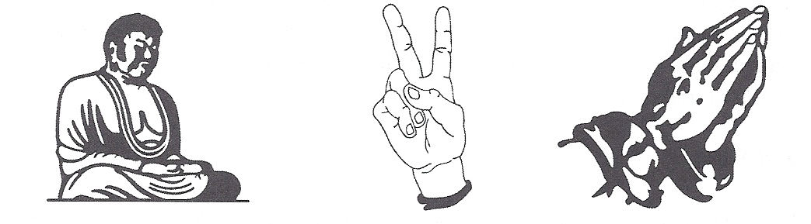
Symbols
The three symbols above represent various cultural landscapes and help to form cultural identities. The Buddha statue on the left is a complex symbol central to many Buddhist beliefs; in many western countries, the hand gesture in the middle symbolizes victory; and the hand gesture on the right symbolizes prayer.

Slide 37
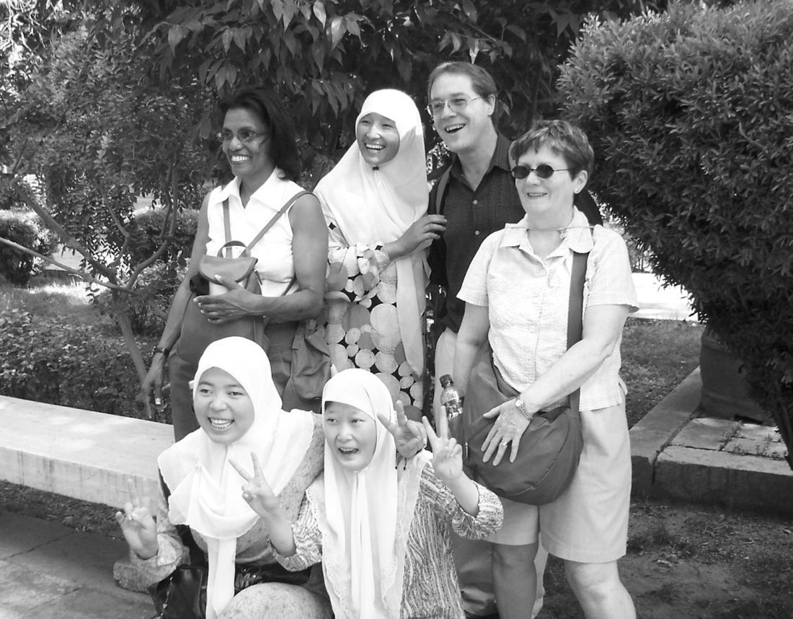
Universal Symbols
The photo taken in Xi’an, China, of three Americans and three Muslim Chinese illustrates the point that symbols may cross cultures and have international meaning.

Slide 38
Key Terms and Concepts from this Session
Folk culture
Popular culture
Folk life
Food taboos
Saltbox house style
“Cape Cod” house style
Homogeneity
Globalization
Symbols
Regional identity
Symbolic landscapes

