Slide 1
Unit 4:
Political Organization of Space
Advanced Placement Human Geography
Session 1

Slide 2
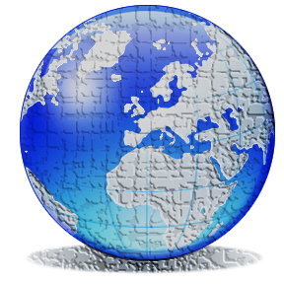
Political Geography
study of the political organization of the planet, a constantly changing collage of countries that once were kingdoms or parts of empires, or perhaps scatterings of independent tribes.

Slide 3
Political geography
One thing to remember:
  Almost from the beginning of history, humans have divided their living space into political units or territories.

Slide 4
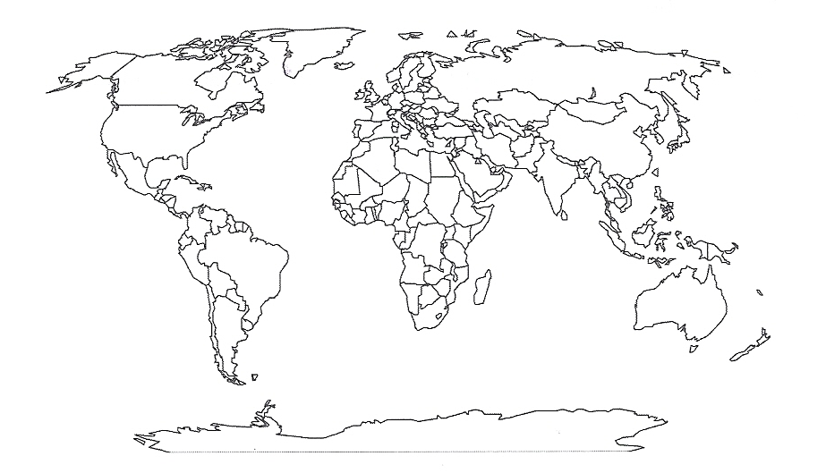
Political Map of the World
The emphasis of the map below is on the political organization of the world’s countries.

Slide 5
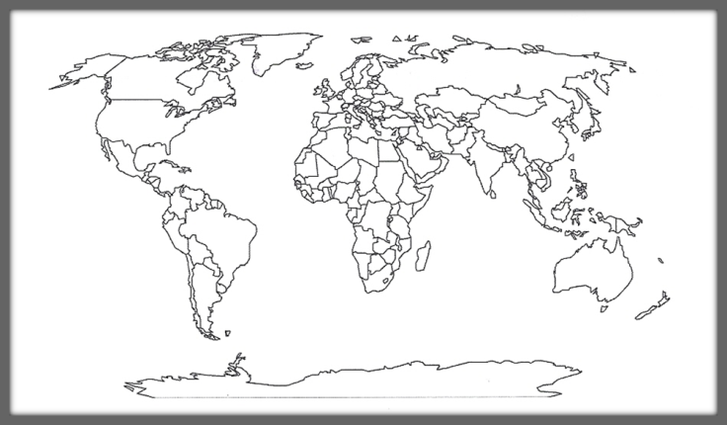
Political Organization of the World Map
The modern state system (reflected on the world map) is the product of a political-territory order with European roots.
At the core of the system are the concepts of:
  territoriality
  sovereignty
  the “nation-state”

Slide 6
The concept of territoriality
What EXACTLY is politics? Politics is basically all about power.
      Who has the power to make decisions?
      How did they get the power?
      What challenges do leaders face from others?

Slide 7
The concept of territoriality
What interests geographers?
The politics of place—how land space is organized according to who asserts power over what areas.

Slide 8
The concept of territoriality
What is territoriality?
It involves efforts to control pieces of the earth’s surface for political and social ends.
The rules of territoriality reflect attitudes toward land and territory as defined by the political culture of a place.

Slide 9
The concept of territoriality
Political culture is the collection of political beliefs, values, practices and institutions that serves as the basis of government.

Slide 10
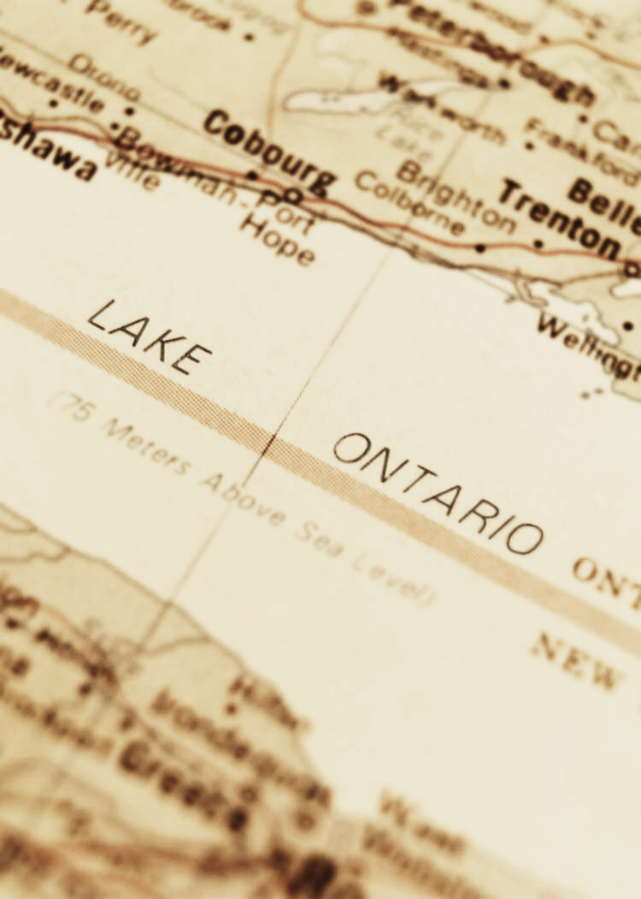
The nature and meaning of boundaries
Boundaries are invisible lines that mark the extent of a state’s territory and the control that its leaders have.

Slide 11
The nature and meaning of boundaries
What determines the location of boundaries?
  Physical features
  Negotiations or war with neighboring regions or countries

Slide 12

The nature and meaning of boundaries
Boundaries completely surround an individual state to mark its outer limits, giving it a distinctive shape.

Slide 13
The nature and meaning of boundaries
Because boundary lines mark the place where two or more states come into direct contact, they have the potential to create conflict among them.

Slide 14
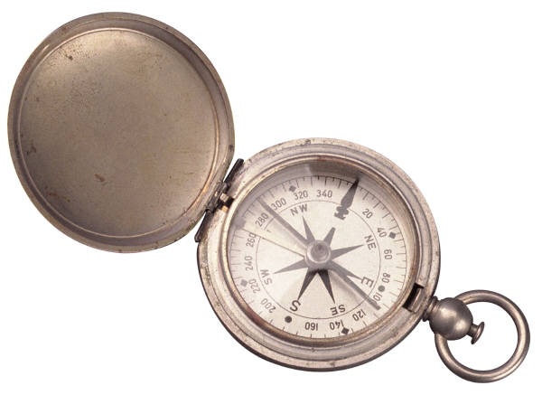
About Frontiers…
Frontiers
Historically, frontiers rather than boundaries separated states.
A frontier is a geographic zone where no state exercises power.
A boundary is a thin, imaginary line.

Slide 15
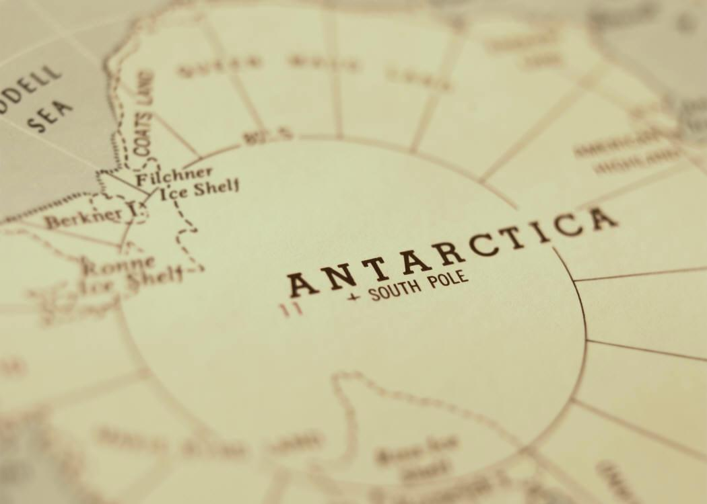
About Frontiers…
Example of Frontiers
France and England fought over frontier areas in North America during the French and Indian War.
Frontier land has all but disappeared from earth. Only Antarctica and the Arabian Peninsula have significant neutral zone areas.

Slide 16
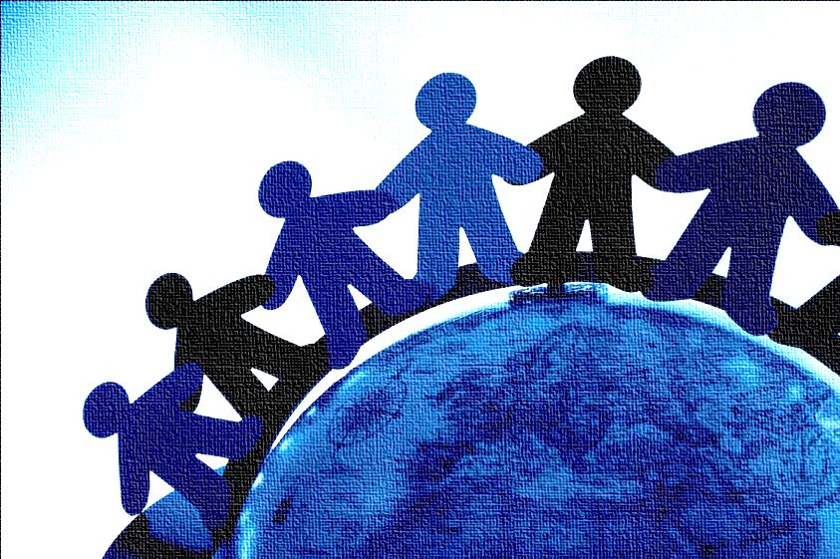
Types of boundaries
Physical Boundaries
Physical features are easy to see so they often make good boundaries.
However, they are not always permanent or reliable.

Slide 17
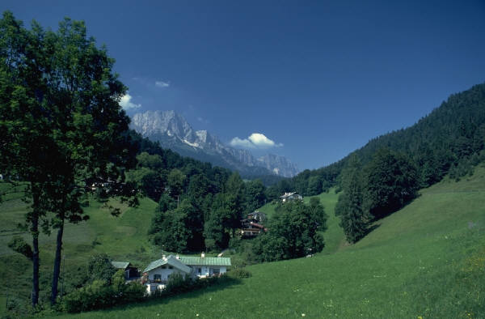
Types of boundaries
Example of Physical Boundary
Mountains
  limit contact between people living on opposite sides
  usually have sparse populations

Slide 18
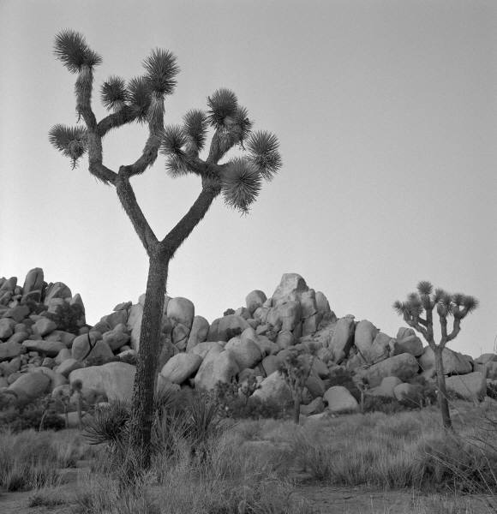
Types of boundaries
Example of Physical Boundary
Deserts
  Generally prove to be reliable and relatively permanent
  Common in Africa and Asia
  Often have boundaries that are difficult to spot in reality

Slide 19
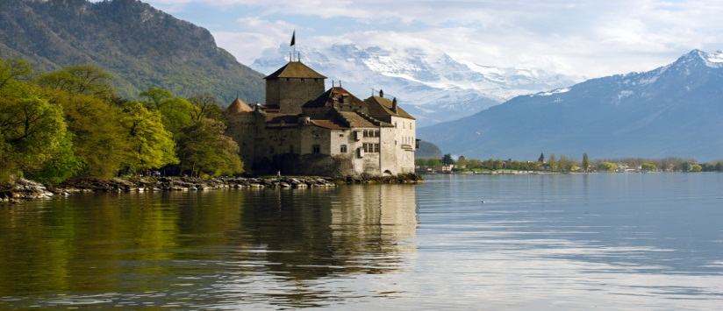
Types of boundaries
Example of Physical Boundary
Rivers, lakes, and oceans
  Most commonly used as boundaries
  Visible and relatively unchanging
  Boundaries typically set in the middle of the water (median-line principle)

Slide 20
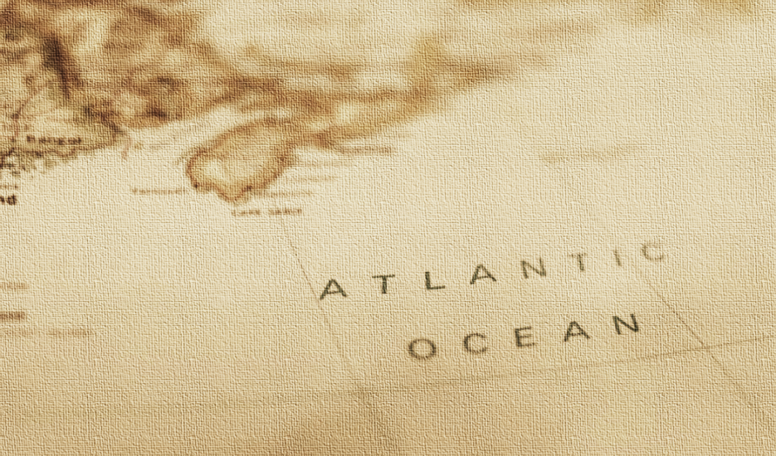
Types of boundaries
Example of Physical Boundary
Ocean boundaries cause problems because states generally claim that the boundary lies not at the coastline but out at sea.

Slide 21
Types of boundaries
Example of Physical Boundary
The U.N. Law of the Sea standardized territorial limits for most countries at 12 nautical miles and gave rights to fish and other marine life within 200 miles.

Slide 22

Types of boundaries
Cultural Boundaries
Cultural boundaries are also called consequent boundaries.
Cultural boundaries can be based on:
  Religion
  Language
  Ethnicity

Slide 23
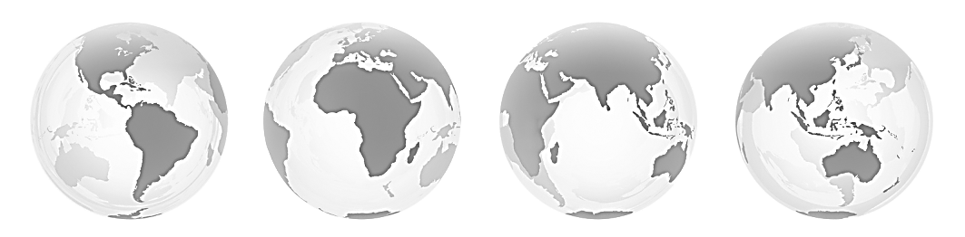
Types of boundaries
Cultural Boundaries
Example of religious boundary:
The Partition of Pakistan from India in 1947
  The borders for Pakistan were drawn around Muslim portions of the subcontinent, in an effort to separate Muslim from Hindus. Conflicts between the two groups persist today.

Slide 24
Types of boundaries
Cultural Boundaries
Example of language boundary:
Boundaries in Europe have been historically important since cultural identities are often based on language.

Slide 25
Types of boundaries
Cultural Boundaries
Example of ethnic boundary
After World War I the Allied Leaders tried to redraw the map of Europe based on ethnic lines.
  They carved several small ethnically-based states, including Bulgaria, Hungary, Poland, and Romania from the large empire of Austria-Hungary.

Slide 26
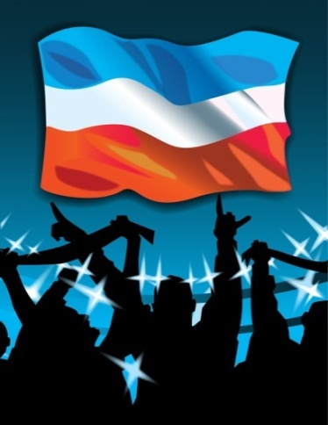
Types of boundaries
Cultural Boundaries
Important term: “Balkanization”
  The term comes from the situation that occurred in the Balkans area, which was once united as Yugoslavia. The country fell apart during the 1990s into several ethnically based countries.

Slide 27
Types of boundaries
Cultural Boundaries
The Balkans are also an example of a region that formed a shatter belt.
  Shatter belts (defined) are zones of great cultural complexity containing many small cultural groups who find refuge in the isolation created by rough terrain.
  Shatter belts are often areas of cultural tension that spread to other areas.

Slide 28
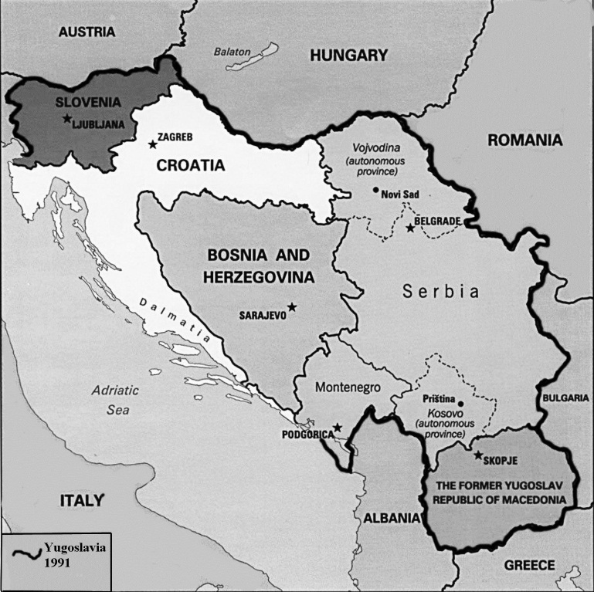
The Balkans
This area between the Adriatic and Black Seas has historically diverse ethnicities that were combined into one country called “Yugoslavia” after World War I. The union lasted until the 1990s when ethnic tensions exploded, leading to the creation of new ethnically-based small states, a process called “balkanization.”

Slide 29
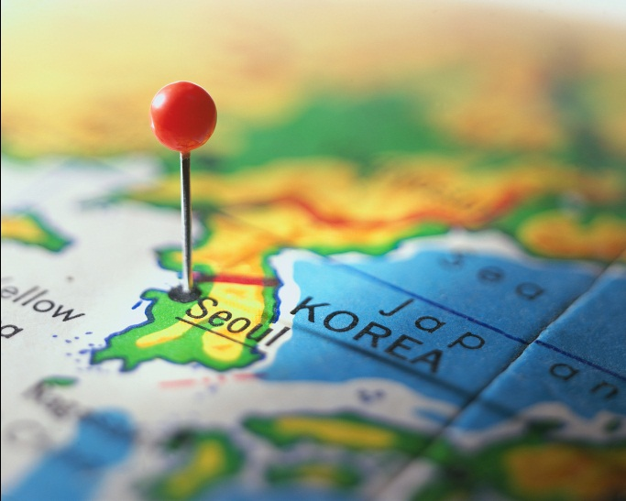
Types of boundaries
Geometric Boundaries
These are imaginary lines that generally have a good reason behind their creation.
Example:
  North and South Korea along the 38th parallel
38th Parallel

Slide 30

Shapes, Size, and Relation Locations of States
Territorial Morphology
Describes the following about states:
  shapes
  sizes
  relative locations
Helps to determine opportunities and challenges faced by a country

Slide 31

Shapes, Size, and Relation Locations of States
Shape affects:
  cultural identity
  social unity
  the ease or difficulty that government has in ruling its subjects

Slide 32
Compact states
Distance from the center is about the same to any boundary.
Shape is similar to a circle.
Shape promotes effective communication.
Example: France

Slide 33
PRORUPTED STATES
A prorupted state is compact with a large projecting extension.
Prorupted states often exist in order to reach a natural resource.
Example:
Democratic Republic
of the
Congo

Slide 34
Elongated state
An elongated state has a long and narrow shape.
These states tend to have communication and transportation problems. This is especially a problem if the capital city is not centralized.
Example:
Chile

Slide 35
Fragmented states
A fragmented state has several discontinuous pieces of territory.
Any state composed of islands is fragmented.
A state is also fragmented if a piece of the territory is separated by another state.
Example:
Indonesia

Slide 36
Perforated states
A stated that completely surrounds another state is a perforated state.
Example:
South Africa

Slide 37
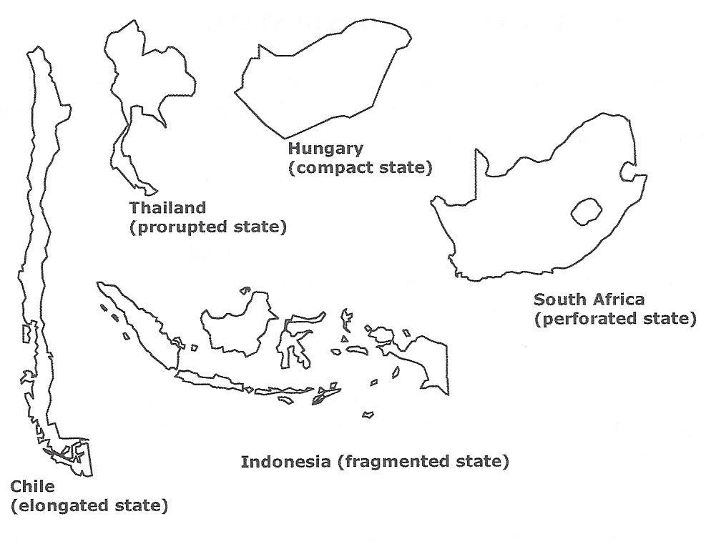
Examples of Shapes of States

Slide 38
Key Terms to Review from this session
Political geography
Politics
Politics of place
Territoriality
Political culture
Boundaries
Frontier
Physical boundaries
Cultural boundaries
Geometric boundaries
Balkanization
Shatter belt
Territorial morphology
Compact state
Prorupted state
Elongated state
Fragmented state
Perforated state

