Slide 1
Unit 4:
Political Organization of Space
Advanced Placement Human Geography
Session 2

Slide 2
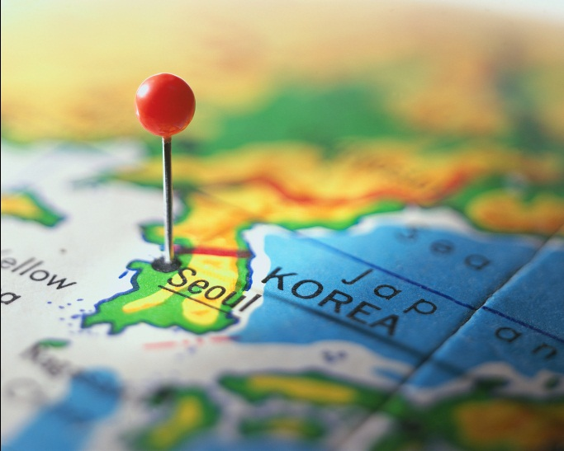
Types of boundaries
Geometric Boundaries
These are imaginary lines that generally have a good reason behind their creation.
Example:
  North and South Korea along the 38th parallel
38th Parallel

Slide 3

Shapes, Size, and Relation Locations of States
Territorial Morphology
Describes the following about states:
  shapes
  sizes
  relative locations
Helps to determine opportunities and challenges faced by a country

Slide 4

Shapes, Size, and Relation Locations of States
Shape affects:
  cultural identity
  social unity
  the ease or difficulty that government has in ruling its subjects

Slide 5
Compact states
Distance from the center is about the same to any boundary.
Shape is similar to a circle.
Shape promotes effective communication.
Example: France

Slide 6
PRORUPTED STATES
A prorupted state is compact with a large projecting extension.
Prorupted states often exist in order to reach a natural resource.
Example:
Democratic Republic
of the
Congo

Slide 7
Elongated state
An elongated state has a long and narrow shape.
These states tend to have communication and transportation problems. This is especially a problem if the capital city is not centralized.
Example:
Chile

Slide 8
Fragmented states
A fragmented state has several discontinuous pieces of territory.
Any state composed of islands is fragmented.
A state is also fragmented if a piece of the territory is separated by another state.
Example:
Indonesia

Slide 9
Perforated states
A stated that completely surrounds another state is a perforated state.
Example:
South Africa

Slide 10
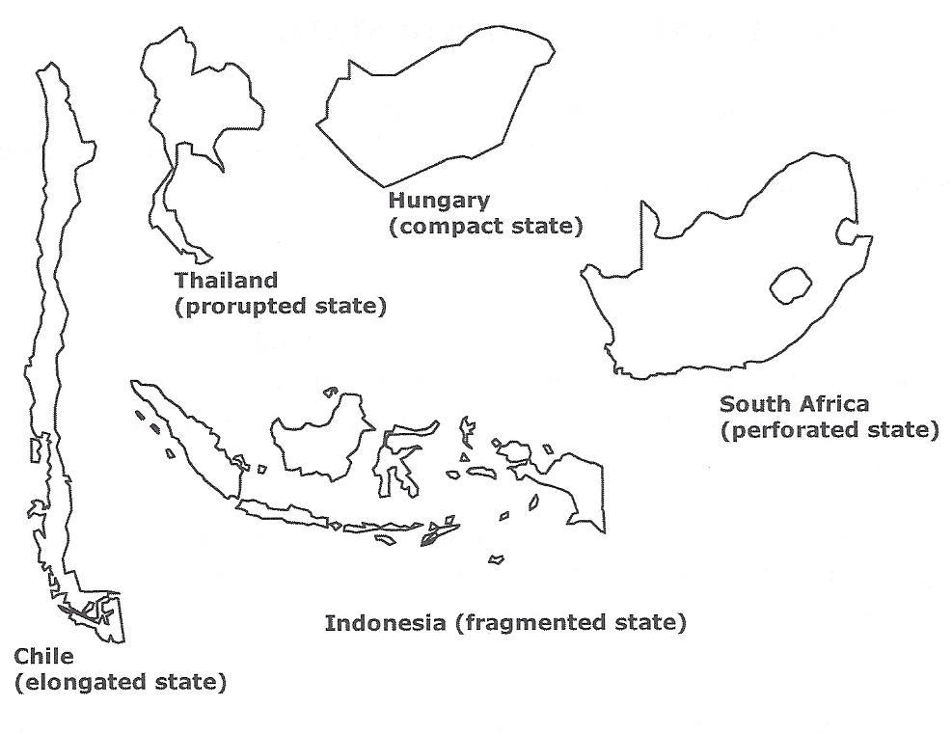
Examples of Shapes of States

Slide 11
Key Terms to Review from this session
Political geography
Politics
Politics of place
Territoriality
Political culture
Boundaries
Frontier
Physical boundaries
Cultural boundaries
Geometric boundaries
Balkanization
Shatter belt
Territorial morphology
Compact state
Prorupted state
Elongated state
Fragmented state
Perforated state

Slide 12

More about the Territorial dimensions of politics

Slide 13
Shapes of states created by boundaries can create…
Exclaves
Enclaves
Small bits of territory that lie on coasts separated from the state by the territory of another state
Example: Cabinda, part of Angola separated by another country, the Democratic Republic of the Congo
Landlocked within another country, so that the country totally surrounds it
Example: Nagorno- Karabakh
  an enclave of Armenian Christians surrounded by Muslim Azerbaijan
  Region of major tension between Azerbaijan and Armenia

Slide 14
Size of states
States’ sizes vary greatly
  Largest: Russia
  6.5 million square miles
  11% of Earth’s surface
  Smallest: Microstates such as Liechtenstein, Andorra, and San Marino

Slide 15
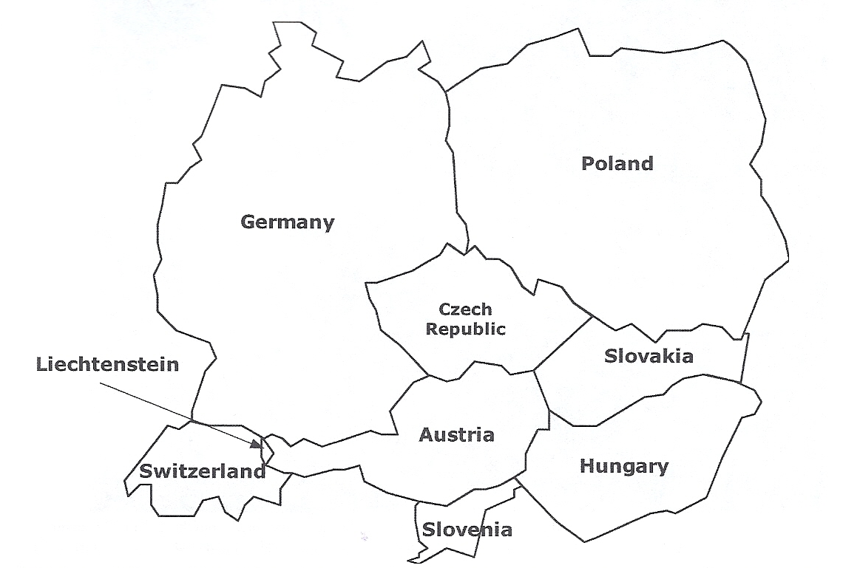
Liechtenstein
Liechtenstein is one of the world’s smallest states, called a “microstate.” It only encompasses a few square miles and is tucked in between two relatively small states, Switzerland and Austria.

Slide 16
Large states
Advantages
Disadvantages
Although it depends on location, large size increases the chances of having important natural resources
  mineral ores
  fertile soil
Location can affect accessibility of natural resources.
Examples: Russia and Canada
  So far north that much of their land is frozen
  Parts of the countries impossible to do farming or mining

Slide 17
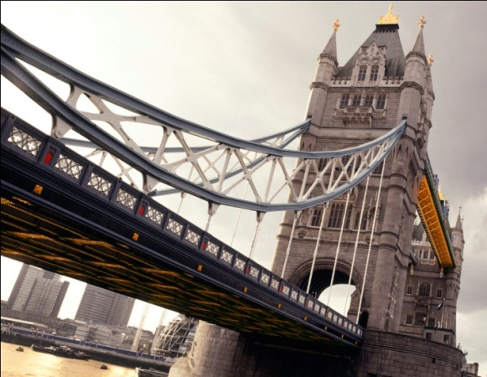
Small states
Advantages
They are more likely to have a homogeneous population so conflict is minimized.
They may also wield power beyond their size.
Example:
Britain, with its many natural and human resources

Slide 18
Size of states
Size alone is not critical in determining a country’s power and stability, but it is a contributing factor.

Slide 19

Absolute and Relative location
The significance of size and shape as factors in national well-being can be modified by a state’s location, both absolute and relative.

Slide 20
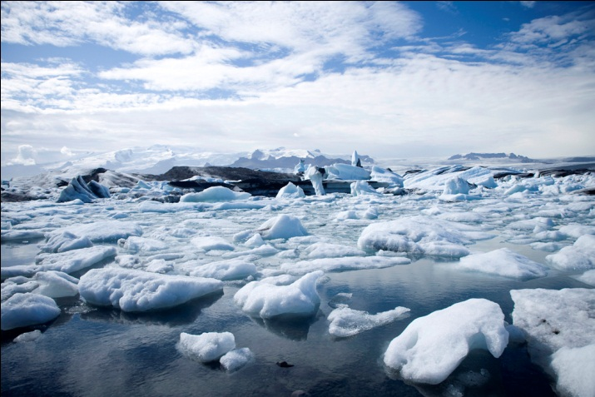
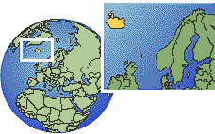
Absolute location
Example of country affected by its absolute location: ICELAND
Advantage: Iceland has a compact shape.
Disadvantage: Its location at 65° N latitude means that most of the country is uninhabited. Settlement is confined to the coastlines.

Slide 21
Relative location
Landlocked states, those lacking ocean frontage and surrounded by other states are at a disadvantage for:
        Trade
        Sea resources
        Transportation
        Communication

Slide 22
Landlocked states
Some Examples
South America:
Paraguay
Bolivia
Asia:
Nepal
Mongolia
Laos
Bhutan
Former Soviet Union:
Moldova
Uzbekistan
Belarus
Africa:
Chad
Botswana
Rwanda
Zimbabwe

Slide 23
Relative location
Sometimes relative location can be an asset for a state.
Example: Singapore
  At the crossroads of international travel that links East Asia to South Asia
  Used its location to build industry and communication links
  One of the most prosperous states in the world today

Slide 24
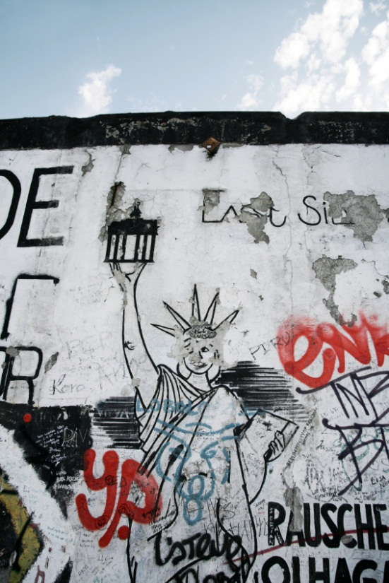
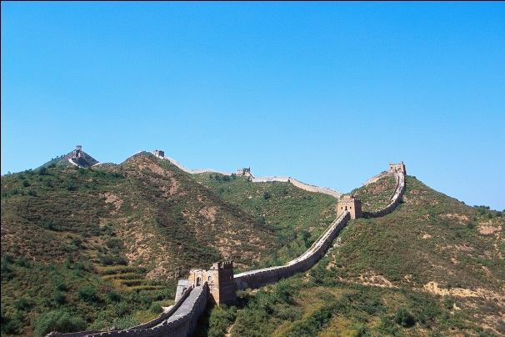
Functions of boundaries
Historically, states and empires have built walls to mark the limits of their governmental control.
The Great Wall of China
←The Berlin Wall

Slide 25
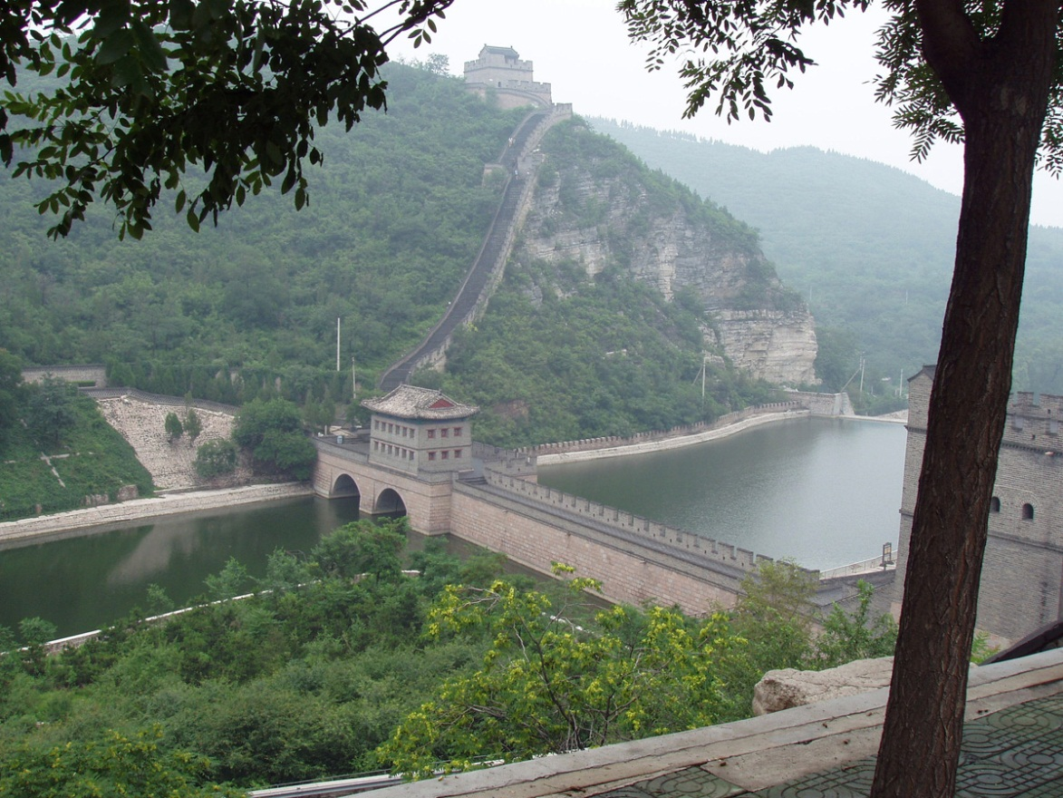
The Great Wall of China
The Great Wall as we see it today was built during the Ming Dynasty that ruled from the 13th to 17th centuries C.E. A much earlier wall was built starting in the 3rd century B.C.E., but little of that older wall remains today. For centuries, the wall served as the northern boundary of the Empire of China.

Slide 26
boundaries
Today, boundaries still mark the limits of state jurisdiction.
Boundaries also serve as symbols of sovereignty, the ability of the state to carry out actions or policies within its borders independently from interference either from the inside or the outside.

Slide 27
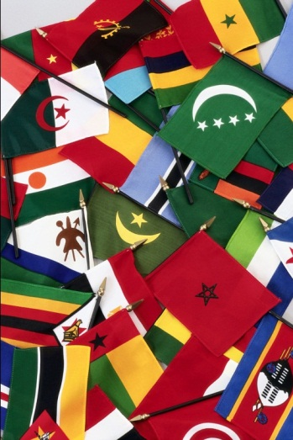
Boundaries and nationalism
The shape of a country’s territory comes to represent a national consciousness, or nationalism.
Modern nationalism is a sense of unity with fellow citizens and loyalty to the state to promote its culture and interest over those of other nations.

Slide 28
Internal boundaries
Many modern countries divide their interiors into sections marked by internal boundaries.
Examples:
  United States: 50 states
  Canada: 10 provinces, 2 federal territories, and one self-governing homeland

Slide 29
Boundary disputes
Since Word War II, almost half of the world’s sovereign states have been involved in border disputes with their neighbors.
The more neighbors a state has, the greater the likelihood of conflict.

Slide 30
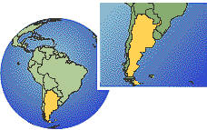
Categories of boundary disputes
Positional (definitional) disputes
  These occur when states argue about where the border actually is located.
    Example: The boundary between Argentina and Chile
      It follows the crest of the of the Andes Mountains and the watershed, which do not always coincide.

Slide 31
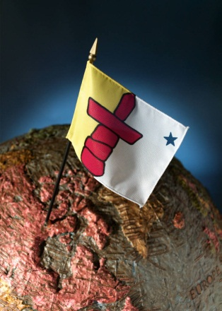
Categories of boundary disputes
Territorial disputes
  These arise over the ownership of a region, usually around mutual borders.
  Conflicts arise if people of one state want to annex territory whose population is ethnically related to them.

Slide 32
Categories of boundary disputes
Territorial disputes
  20th century example:
    German invasion of Czechoslovakia and Poland, areas with German minorities
    This type of expansionism is called irredentism.

Slide 33
Categories of boundary disputes
Resource (allocational) disputes
  These disputes involve natural resources that lie in border areas.
  Resources include:
    mineral deposits
    fertile farmland
    rich fishing groups
  Example: The U.S. and Canada have feuded over fishing grounds in the Atlantic Ocean.

Slide 34
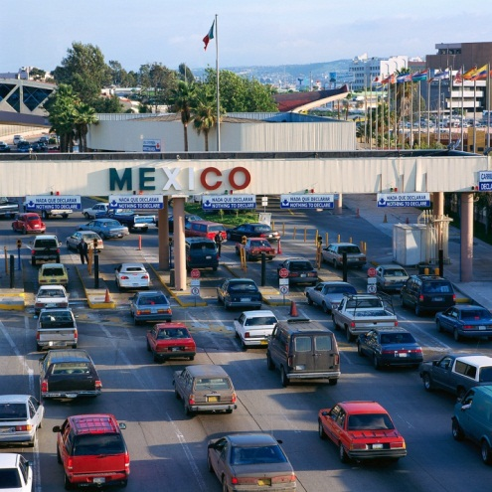
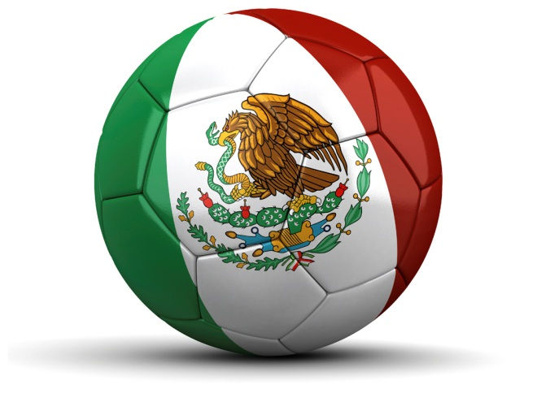
Categories of boundary disputes
Functional (operational) disputes
  These arise when neighboring states cannot agree on policies that apply in a border area.
  Example: the ongoing immigration debate between the U.S. and Mexico

Slide 35

Evolution of the Contemporary Political Pattern

Slide 36
History has seen many different types of
political organizations.
    City-states
    Empires
    Caliphates
    Kingdoms
    Feudalism

Slide 37

states
In today’s world, power is territorially organized into states, or countries.

Slide 38
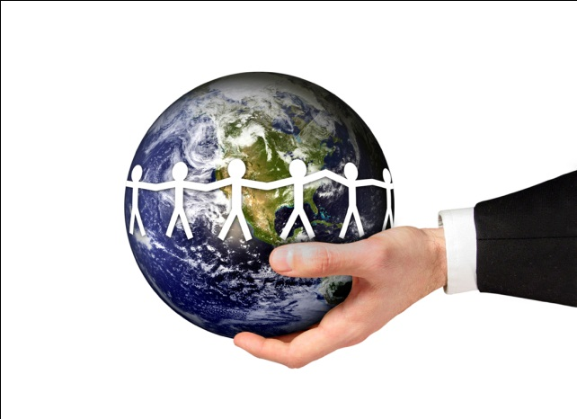
states
What do states do?
  They define who can and cannot use weapons and force.
  They include institutions that help to turn political ideas into policy.
  They exercise sovereignty, the ability to carry out actions or policies within their borders.

Slide 39

Nations v. nation-states
Nations
A group of people bound together by a common political identity
Nation-states
Refers to a state whose territorial extent coincides with that occupied by a distinct nation or people

Slide 40
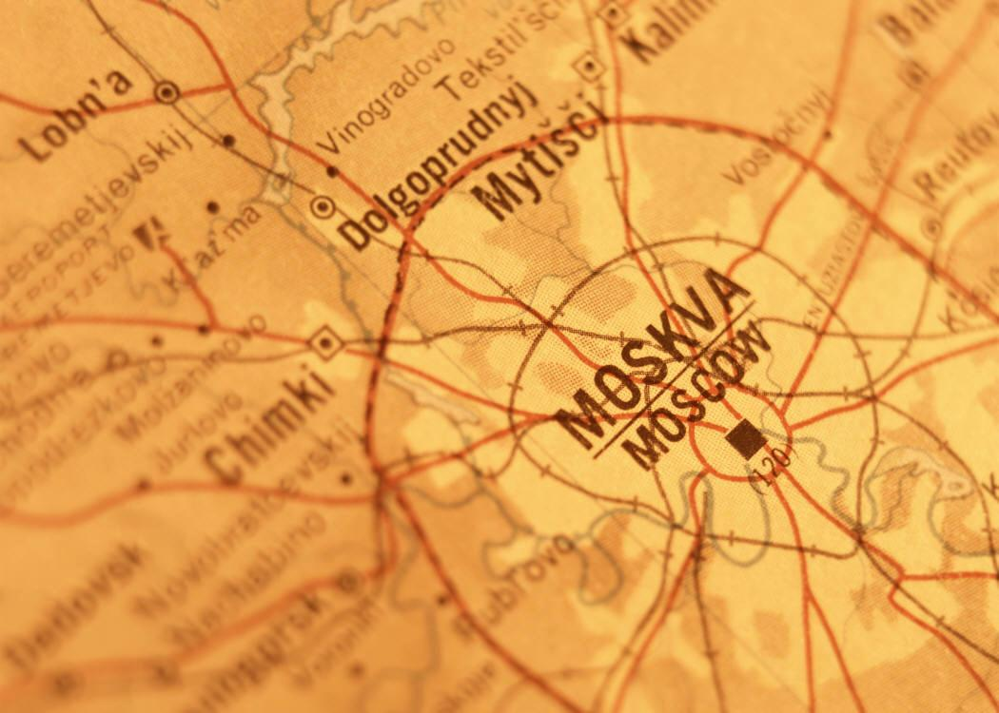
Variations of the nation-state
A binational or multinational state is one that contains more than one nation.
Example: The Former Soviet Union
When the country fell apart in 1991, it fell along ethnic boundaries into independent nation-states. Today Russia (one of the former soviet republics) remains a large multinational state that governs many ethnic groups.

Slide 41
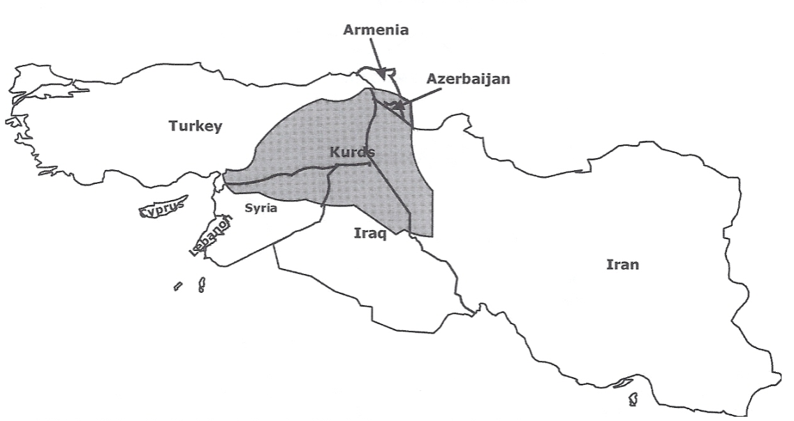
Variations of the nation-state
Stateless nations are a people
without a state.
A stateless nation. The Kurds have had a national identity for many centuries, but they have never had a state. Instead 20 million Kurds are spread in an area that crosses the borders of six countries: Turkey, Syria, Iraq, Iran, Armenia, and Azerbaijan.

Slide 42
Key Terms to Review from this session
Exclaves
Enclaves
Landlocked states
Boundaries
Sovereignty
Nationalism
Internal boundaries
Positional disputes
Territorial disputes
Irredentism
Resource (allocational) disputes
Functional disputes
States
Nations
Nation-states
Stateless nations

