Slide 1
Unit 4:
Political Organization of Space
Advanced Placement Human Geography
Session 3

Slide 2

More on the evolution of the contemporary political pattern

Slide 3
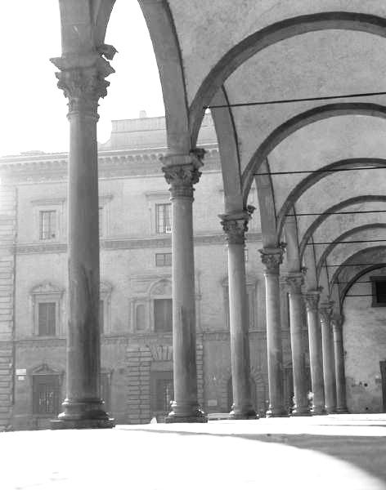
The organization of states
Two important geographical clues to understanding how states are organized are its core area(s) and the size and functions of its
capital city.

Slide 4
Core areas
Most of the early nation-states grew from core areas, expanding outward along their frontiers.
Growth generally stopped when they bumped into other nation-states, causing them to define boundaries.

Slide 5

Core areas
Today most European countries still have the same core areas, and many countries in other parts of the world also have well defined core areas.
Examples:
  Paris Basin in France
  Japan Kanto plain, centered on Tokyo

Slide 6
Core areas
Core areas can be identified on a map by examining:
  population distributions.
  transportation networks.
As you travel away from the core area into a state’s periphery (outlying areas):
  towns get smaller.
  there are fewer factories.
  open land is more common.

Slide 7
Core areas
States with more than one core are
known as multicore states.
This can be problematic.
  Example: Nigeria
    Nigeria’s northern core is primarily Muslim.
    The southern core is primarily Christian.
    To compensate for the country’s tendency to separate, the capital city was moved from Lagos to Abuja.
    REGIONAL DIFFERENCES THREATEN THE EXISTENCE OF THE STATE!

Slide 8
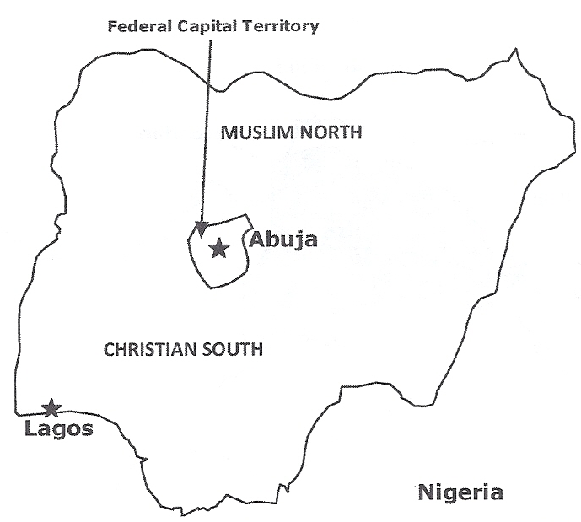
Nigeria’s Core Areas
Nigeria was a British colony in West Africa until its independence in 1960, but its borders encompass numerous ethnic groups with clear cultural differences.

Slide 9
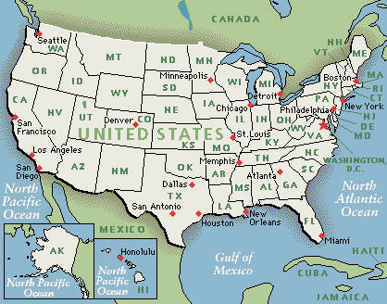
Core areas
A multicore character is NOT always problematic for a country.
Example: The United States
  Primary core: Northeastern coast→Boston to D.C.
  Secondary core: West coast→San Diego to San Francisco
  Other cores: Chicago and Atlanta

Slide 10

The capital city
In most states the capital city not only houses the government, but serves as the economic and cultural center as well.

Slide 11
The capital city
Primate City
Forward Capital
Must have great influence in the country in terms of
  Politics
  Culture
  Economics
Serves as a model for a country’s economic development and future hopes
  Example: Brasilia, Brazil

Slide 12

Electoral geography

Slide 13
Electoral geography
In democracies an important connection between citizen and state is the electoral process, the methods used in a country for selecting its leaders.
  Example: United States→ People may vote directly for a president and representatives to their legislatures.
  Example: Great Britain→ People may vote only for legislators who in turn select the prime minister.

Slide 14
Electoral geography
Electoral geography is the study of how the spatial configuration of electoral districts and voting patterns reflect and influence social and political affairs.

Slide 15
Electoral geography
Electoral Geography and
The United States
  Boundaries separate 435 legislative districts, with each electing one representative to the lower house of the legislature—the U.S. House of Representatives.
  The U.S. Census, a count of the population, is conducted every 10 years. Afterwards, boundaries are redrawn to ensure that representation is fair.

Slide 16
Electoral geography
Electoral Geography and the United States
Boundaries for districts are usually drawn by state legislatures.
There the political party in control—either Democrats or Republicans—usually attempts to redraw boundaries to improve the chances of its supporters to win seats, a process called gerrymandering.
Republican
Mascot→
←Democrat Mascot

Slide 17
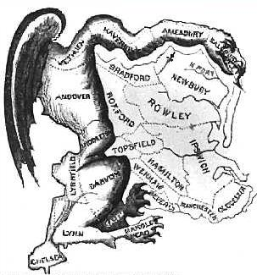
Origin of gerrymandering
Gerrymandering originated in 1812 from the shape of an electoral district in Massachusetts while Elbridge Gerry was governor.
A political cartoon gave certain animal features and the district was shaped like a salamander.
Political Cartoon→

Slide 18

Gerrymandering continues to be an issue today.

Slide 19
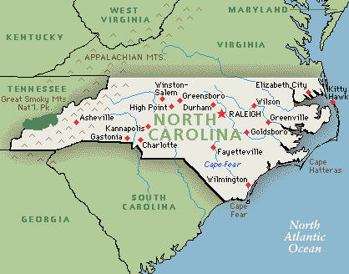
More on gerrymandering…
Minority/majority districting involves rearranging districts to allow a minority representative to be elected.
  This occurred in North Carolina after 1990 census.
  Justice Department ordered North Carolina’s 12th District to redraw its proposed boundaries in order to allow for the election of a black representative.

Slide 20
More on gerrymandering…
Minority/majority districting involves rearranging districts to allow a minority representative to be elected.
  This action resulted in a Supreme Court case in which the Justice Department was accused of reverse discrimination.
  The Supreme Court ruled that the district lines has to be redrawn according to Justice Department standards.

Slide 21
More on gerrymandering…
Several cases involving racial gerrymandering were brought to the U.S. Supreme Court in the 1990s.
2001: The Court ruled that race MAY be a factor in redistricting, but NOT the “dominant and controlling” one.
Result: There has been a substantial increase in the number of Black and Latino representatives in the U.S. House of Representatives.

Slide 22
Why do geographers care about gerrymandering?
The important thing for geographers is that voting patterns can help reinforce a sense of regionalism and can shape a government’s response to issues in the future.

Slide 23
Colonialism and imperialism

Slide 24
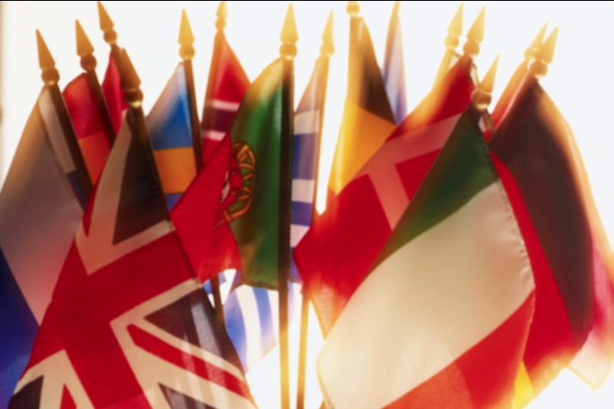
The modern state
The modern state is the basic concept that people owe allegiance to a state and the people it represents rather than to its leader.
European expansion during the 17th, 18th, and 19th centuries spread the new type of organization to:
  the Americas
  Asia
  Africa

Slide 25
colonies
Usually colonies, or dependent areas, were created first by the Europeans.
    They were given fixed and recorded boundaries where none had formally existed before.
    In most cases, the new divisions were not based on meaningful cultural or physical lines but on the limits of the colonizing empire’s power.

Slide 26
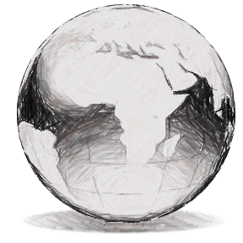
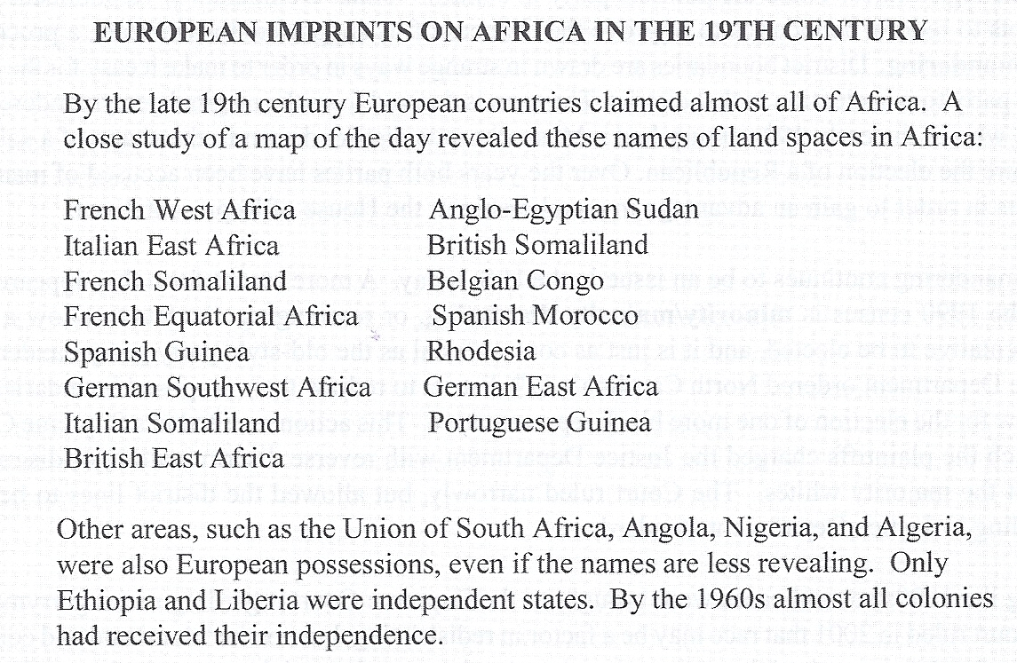

Slide 27


imperialism
The European colonization of Africa and Asia is often termed imperialism, or empire building, and it characterized the political landscape during the 19th and 20th centuries.
Africa
Asia

Slide 28

imperialism
Most African and Asian colonies became independent after World War II, partly because the war greatly weakened the ability of European countries to maintain their overseas possessions.

Slide 29

Gaining independence
As former colonies gained independence, they kept the idea of the state to organize their new political systems.
They often retained the borders established by their former European rulers.
    Consequently, states’ borders many times ignored cultural differences among populations.

Slide 30

An increasing number of states…
1776: About 35 empires, kingdoms, and countries existed in the entire world.
Since 1945: The number increased to about 200 nations as a result of independence movements.
1991: The dissolution of the Soviet Union created independent states in Eastern Europe and Central Asia.
Late 1990s: Several new states were created in the Balkans from Yugoslavia.

Slide 31
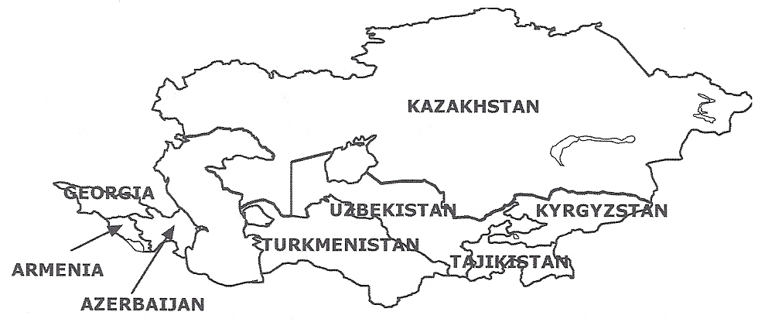
Former Soviet States in Central Asia
Until 1991 states like Kazakhstan, Azerbaijan, Armenia, Georgia, Turkmenistan, Uzbekistan, Tajikistan, and Kyrgyzstan were part of the Soviet Union. When the Soviet Union fell apart, 15 independent nation-states were created.

Slide 32
Federal and unitary states

Slide 33
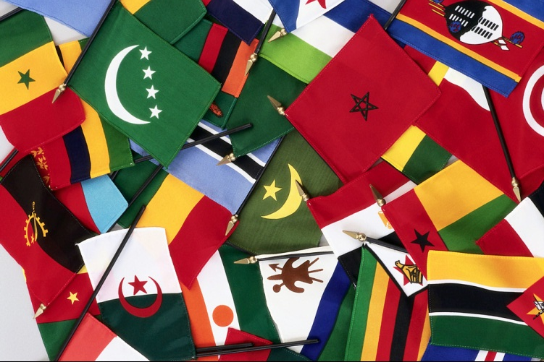
Characteristics of a well-integrated state
Stable, clearly bounded territory
Well-developed institutions
Effective administrative framework
Productive core area
Influential capital city

Slide 34

Categories of states
Every state has multiple levels of authority, though the geographic distribution of power varies widely.

Slide 35

Unitary system
A unitary system concentrates all policy-making powers in one central geographical place.
Historically, most European governments were highly centralized and even though local governments developed, they had no separate powers.
As a result, most European governments today remain unitary states.
Europe

Slide 36
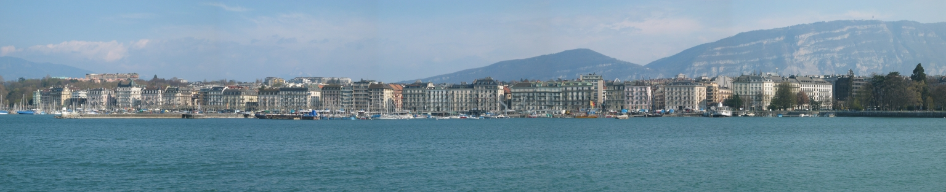
Confederal system
A confederal system spread the power among many sub-units (such as states) and has a weak central government.
Most attempts at a confederal system have not been long-lasting (e.g. Confederate States of America).

Slide 37
Confederal system
The modern government of Switzerland has very strong
sub-governments and comes close to a modern confederation.

Slide 38
Federal system
A federal system divides the power between the central government and sub-units.
Federalism accommodates regional interests by allowing for diverse needs and preferences but ALSO features a central government that is strong enough to keep the countries from falling apart.
Examples:
  United States
  Canada
  Australia

Slide 39
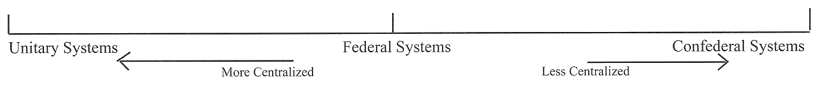
ABOUT POLITICAL SYSTEMS TODAY…
All political systems fall on a continuum from the most concentrated amount of power to the least. Unitary governments may be placed on the left side, according to the degree of concentration; confederal governments are placed to the right; and federal governments fall in between.

Slide 40
Key Terms to Review from this session
Core areas
Capital cities
Periphery
Multicore states
Primate city
Forward capital
Electoral process
Electoral geography
Gerrymandering
Minority/majority districting
Racial gerrymandering
Modern state
Colonies
Imperialism
Well-integrated state
Unitary system
Confederal system
Federal system

