Slide 1
Unit 4:
Political Organization of Space
Advanced Placement Human Geography
Session 5

Slide 2

Supranational organizations: changing the meaning of sovereignty

Slide 3

Supranational organizations
Supranational organizations are not new, but their nature is changing.
This could have implications for the sovereignty of individual states.

Slide 4
Historic examples of supranational organizations
Concert of Europe was an effort to restore a balance of power in Europe after the fall of Napoleon Bonaparte.
League of Nations: Although the global effort to prevent further world wars failed, the League of Nations was an attempt to form a lasting international organization.

Slide 5
United nations
The original charter for the U.N. was signed in 1945 by its 49 members.
Currently, there are 192 member states of the U.N.
Membership is voluntary, and the organization plays an important part in geopolitics.
United Nations Headquarters in New York City

Slide 6

United nations
The U.N. changes the nature of sovereignty by applying the concept to an organization with collective membership, not just to individual nation-states.
Flag of the
United Nations

Slide 7

United nations
An important power of the U.N. is that its members can vote to establish a peacekeeping force in a “hotspot” and request states to contribute military forces.
The body responsible for making the peacekeeping decisions is the Security Council. Its permanent members are:
  U.S.
  Britain
  France
  China
  Russia

Slide 8
United nations
U.N. forces are supposed to remain neutral, and they usually have restrictions on their abilities to use weapons.
U.N. Forces have been sent to:
  Eastern Europe
  the Middle East
  Sub-Saharan Africa

Slide 9
United nations
Despite its limitations, the United Nations is a forum where most of the states of the world can meet and vote on issues without resorting to war.

Slide 10
United Nations
The U.N. includes many sub-organizations that:
  promote the general welfare of the world’s citizens.
  monitor world trade.
  aid world trade and other economic contacts.

Slide 11
United nations
Examples of U.N. sub-organizations:
  The World Bank
  The International Court of Justice
  UNESCO (United Nations Educational, Scientific, and Cultural Organization)

Slide 12

Regional organizations

Slide 13
Regional organizations
Regional organizations have been formed for several reasons:
  Military
  Economic
  Social or cultural
  Political

Slide 14
Regional organizations
Example: North Atlantic Treaty Organization
(NATO)
  NATO was formed during the Cold War with 14 European members, the U.S. and Canada.
  An opposing alliance—the Warsaw Pact—began in 1955 and was composed of the Soviet Union and 6 Eastern European countries.

Slide 15
Regional organizations
Example: North Atlantic Treaty Organization
(NATO)
  The Warsaw Pact was disbanded following the breakup of the Soviet Union.
  NATO expanded after the dissolution of the Warsaw Pact to include many of its former members.

Slide 16

Regional organizations
Other examples:
  The Organization of American States (OAS) was created to promote social, cultural, political, and economic links among member states in the Western Hemisphere.
  The Arab League was founded to promote the interests and sovereignty of countries in the Middle East.

Slide 17
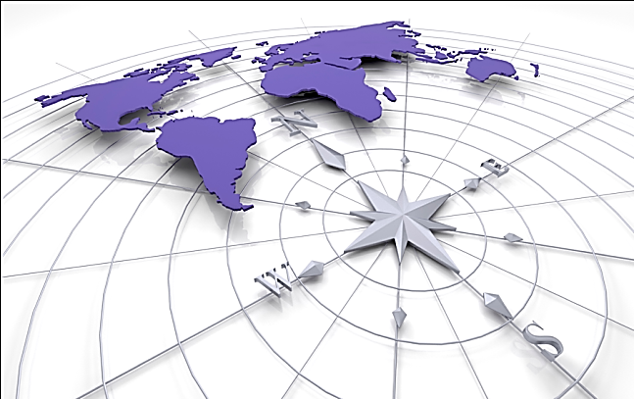
The european union
The European Union is a regional organization that promises to redefine the meaning of sovereignty.
All the countries of Europe are deeply affected by a trend toward integration.

Slide 18
The european union
Integration is a process that encourages states to pool their sovereignty in order to gain political, economic, and social clout.
Integration binds states together with:
  common policies
  shared rules

Slide 19
The european union
The organization has gone through several name changes, but until 1991 its goals were exclusively economic.
The Maastricht Treaty created the modern organization and gave it authority in new areas:
  monetary policy
  foreign affairs
  national security
  transportation
  the environment

Slide 20
The european union
The Maastricht Treaty established three pillars (spheres of authority) for the E.U.:
  Trade and other economic matters, including economic and monetary union into a single currency, and the creation of the European Central Bank
  Justice and home affairs, including policy governing asylum, border crossing, immigration, and judicial cooperation on issues involving crime and terrorism
  Common foreign and security policy, including joint positions and actions, and common defense policy

Slide 21

The european union
The E.U. has set European monetary policy, or the control of the money supply.
Today the euro has replaced old national currencies, although there are some exceptions:
  Britain
  Sweden

Slide 22

The european union
The power to set basic interest rates and other fiscal (monetary) policies is being passed from national banks and governments to the European Monetary Union.

Slide 23
Difficulties faced by the eu
There are many difficult issues faced by the
European Union:
  Organizational: It is difficult to operate 27 countries smoothly.
  Expansion: Many former communist countries had weak economies at the end of the 20th century.
  Border protection: Older member states worry that immigrants from the east will flood their labor markets.

Slide 24

Difficulties faced by the eu
Supporters of the E.U. fear that its difficulties will overshadow the benefits of:
  common markets
  currencies
  political policies
  defense

Slide 25
Difficulties faced by the eu
The EU has recently tried to establish a European Constitution, which would recognize the E.U.’s sovereignty.
However, countries such as France and the Netherlands, were not supportive and voted it down in 2005.

Slide 26

Difficulties faced by the eu
2007: The European Council decided to start negotiations on a Reform Treaty as a replacement for a constitution.

Slide 27
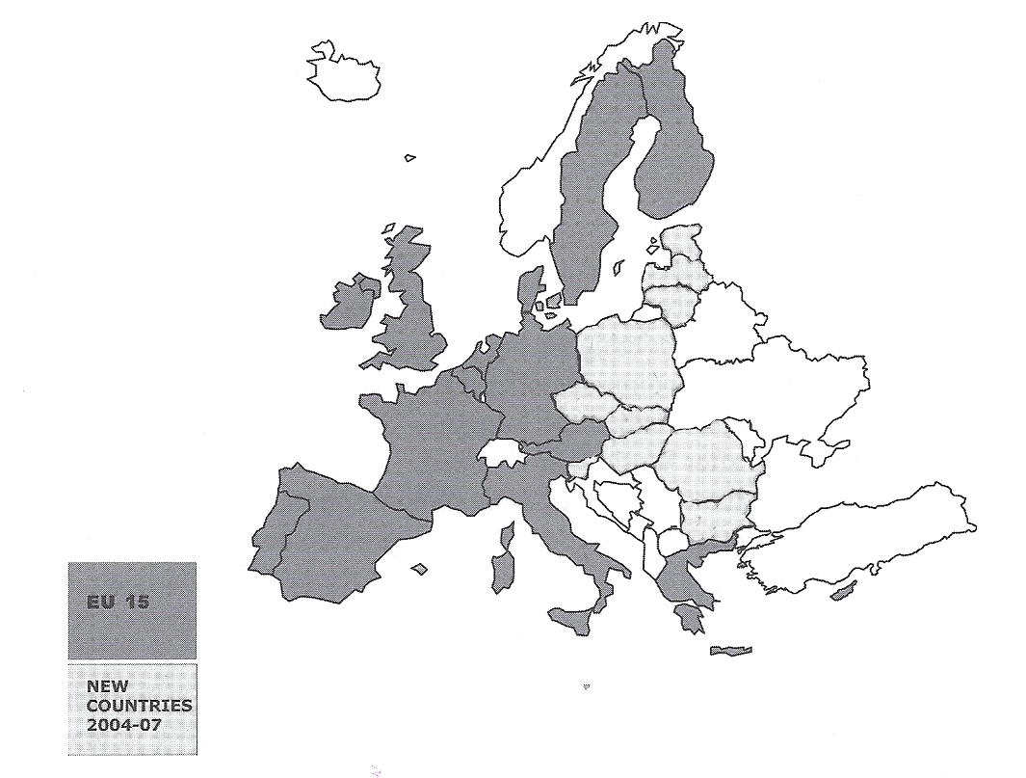
The European Union

Slide 28
Stop!! This is the end of Session 5.

Slide 29
Forces of change: globalization, democratization, and religious politics

Slide 30

globalization
There are a growing number of commonalities among the nations of the world, a process known as globalization.

Slide 31
democratization
More nations are turning toward some form of popular government.
Democracy is the existence of competitive elections that are
  regular
  free
  fair
In other words, an incumbent government could be defeated.

Slide 32

Characteristics of liberal democracies
Civil liberties (e.g. freedom of belief, speech, and assembly)
Rule of law that provides equal treatment of citizens and due process
Neutrality of the judiciary and other checks on the abuse of power

Slide 33
Characteristics of liberal democracies
Open civil society that allows citizens to lead private lives and mass media to operate independently from government
Civilian control of the military that restricts the likelihood of the military seizing control of the government

Slide 34
Illiberal democracies
Countries that have elections but miss qualities such as civil liberties and the rule of law are known as illiberal democracies.
Examples:
  Russia
  Nigeria
  Indonesia

Slide 35
Democratization and samuel huntington
Political scientist Samuel Huntington asserts that the modern world is now in a “third wave” of democratization that began in the 1970s.

Slide 36
Waves of democratization
The First Wave developed gradually over time, beginning with late 18th century revolutions, such as those in the United States and France.

Slide 37
Waves of democratization
The Second Wave occurred after the allied victory in World War II.
  It continued until the 1960s and was characterized by de-colonization across the globe.

Slide 38
Waves of democratization
The Third Wave is characterized by the defeat of dictators and totalitarian rulers from South America to Eastern Europe to some parts of Africa.
Africa
South America
Eastern Europe

Slide 39
Why has democratization occurred?
The loss of legitimacy by both right and left wing authoritarian regimes has led to democratization.
The expansion of an urban middle class in developing countries has also been a contributing factor.

Slide 40

Why has democratization occurred?
There has been a new emphasis on “human rights” by the U.S. and the European Union.
The “snowball” effect→ When one country in a region becomes democratic, it influences others to do so.

Slide 41

Obstacles to democratization
The greatest obstacle is poverty.
It blocks citizens from participating in
government.

Slide 42
Huntington’s standard for gauging democratic stability
Democracy may be declared when a country has had at least two successive peaceful turnovers of power.

Slide 43
marketization
Many political economists today declare that the economic competition between capitalism and socialism that dominated the 20th century is now part of the past.

Slide 44
marketization
What type of market economy is likely to be most successful in today’s world?
  Will it be one that allows for significant control from the central government –a “mixed economy”?
  Will it be an economy that does not allow much control from the central government—a pure market economy?
OR

Slide 45
marketization
Marketization is the term that describes the state’s re-creation of a market in which property, labor, goods, and services can all function in a competitive environment to determine their value.
Privatization is the transfer of state-owned property to private ownership.

Slide 46
marketization
Because central political control of economies has decreased during the 20th century, some believe that market economies promote the move toward the democratization of political institutions.
However, China and Russia have developed capitalist economies even though their governments have remained highly authoritarian.

Slide 47
Revival of ethnic or cultural politics
Fragmentation occurs when there are divisions based on ethnic or cultural identity.
A few year ago nationalism seemed to be declining in favor of increasing globalization.

Slide 48
Revival of ethnic or cultural politics
The politicization of religion (the use of religious principles to promote political ends and vice versa) has dominated world politics in the early 21st century.

Slide 49
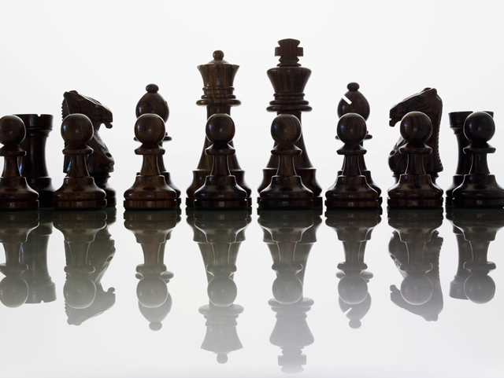
Revival of ethnic or cultural politics
Samuel Huntington argues that the most important and dangerous conflicts in the future will be based on clashes of civilizations, NOT on socioeconomic or even ideological differences.

Slide 50
Revival of ethnic or cultural politics
Huntington divided the world into culture regions that threaten world peace:
  The West
  The Orthodox world (Russia)
  Islamic countries
  Latin America
  Africa
  The Hindu world
  The Confucian world
  The Buddhist world
  Japan

Slide 51
Criticism of huntington
Some believe that Huntington underestimated the importance of cultural conflicts WITHIN nations.

Slide 52
Revival of ethnic or cultural politics
The revival of ethnic or cultural politics tends to emphasize differences among nations rather than commonalities.

Slide 53
Key Terms to Review from this session
Concert of Europe
League of Nations
Peacekeeping force
Security Council
World Bank
International Court of Justice
UNESCO
NATO
Warsaw Pact
OAS
Arab League
European Union
Maastricht Treaty
Fiscal policies
Globalization
Democratization
Civil liberties
Rule of law
Liberal democracies
Illiberal democracies
Marketization
Market economy
Privatization
Fragmentation
Politicalization of religion

