Slide 1
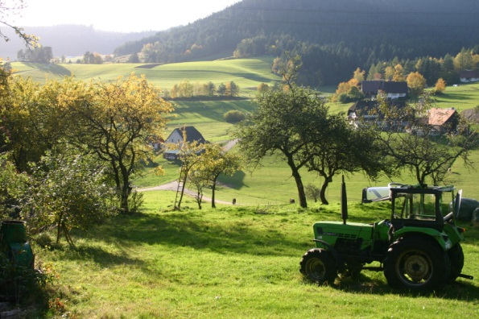
UNIT FIVE
AGRICULTURE:
PRIMARY ECONOMIC ACTIVITIES
ADVANCED PLACEMENT HUMAN GEOGRAPHY
Session 1

Slide 2
Overview

Slide 3
A crucial influence on the organization of the earth’s surface is the way that people make a living.
Economic activities can be organized
as follows:
primary
secondary
tertiary

Slide 4
THE PRIMARY SECTOR
The primary sector is the part of the economy that draws raw materials from the natural environment.
Examples:
agriculture
raising animals
fishing
forestry
mining

Slide 5
THE PRIMARY SECTOR
The primary sector is the largest sector of the economy in low-income, pre-industrial nations.

Slide 6
THE SECONDARY SECTOR
The secondary sector is the part of the economy that transforms raw materials into manufactured goods.
Examples:
Refining petroleum into gasoline
Turning metals into tools and automobiles

Slide 7
THE SECONDARY SECTOR
The secondary sector grows quickly as
societies industrialize.

Slide 8
THE TERTIARY SECTOR
The tertiary sector is the part of the economy that involves services rather than goods.
  Construction
  Trade
  Finance
  Real estate
Private services
Government
Transportation

Slide 9
THE TERTIARY SECTOR
The quaternary sector is often seen as a subset of the tertiary sector.
It includes jobs concerned with:
    research and development
    management and administration
    processing and disseminating information

Slide 10
THE TERTIARY SECTOR
The tertiary sector grows with industrialization and comes to dominate post-industrial societies, or countries where most people are no longer employed in industry.

Slide 11
COMPARATIVE ECONOMIC SECTORS
(as percentage of labor force by occupation)
Country | Primary (agriculture) | Secondary (industry) | Tertiary (service)
China | 38% | 46.9% | 43%
Iran | 25% | 31% | 45%
Mexico | 13.7% | 23.4% | 62.9%
Nigeria | 70% | 10% | 20%
Russia | 10% | 31.9% | 58.1%
United Kingdom | 1.4% | 18.2% | 80.4%
United States | .7% | 20.3% | 79%

Slide 12
ECONOMIC ACTIVITIES
For thousands of years agriculture was the main economic activity of most people on earth, until the Industrial Revolution transformed economies first in Europe and North America, and eventually influenced most countries in the world.

Slide 13

Because the sectors represent necessary economic activities, most countries today have some people employed in ALL economic sectors.

Slide 14
The Origin and Spread of Agriculture

Slide 15
What is agriculture?
Agriculture is the deliberate tending of crops and livestock in order to produce food and fiber.

Slide 16
About agriculture…
Agricultural production in the world today is at an all-time high, mainly because the nature of farming has changed with:
  mechanization
  farm consolidation
  These changes have had the most impact in
  industrial and post-industrial countries.

Slide 17
How does culture relate to agriculture?
In ALL countries, the processes that determine the production, distribution, and consumption of food form an important part of culture.
Other cultural factors affect agriculture:
  the ways that land is distributed
  functions of livestock
  consumption of food from crops and animals

Slide 18
How does culture relate to agriculture?
Example :
  Hindus do not eat beef and Muslims do not eat pork.
  Therefore, the two religions greatly impact the nature of agriculture in regions where they have many adherents.

Slide 19
HUNTERS AND GATHERERS

Slide 20

Hunters and Gatherers
The first humans probably emerged in eastern Africa as a result of:
  availability of food
  domesticable animals
  favorable climate
Eastern
Africa

Slide 21
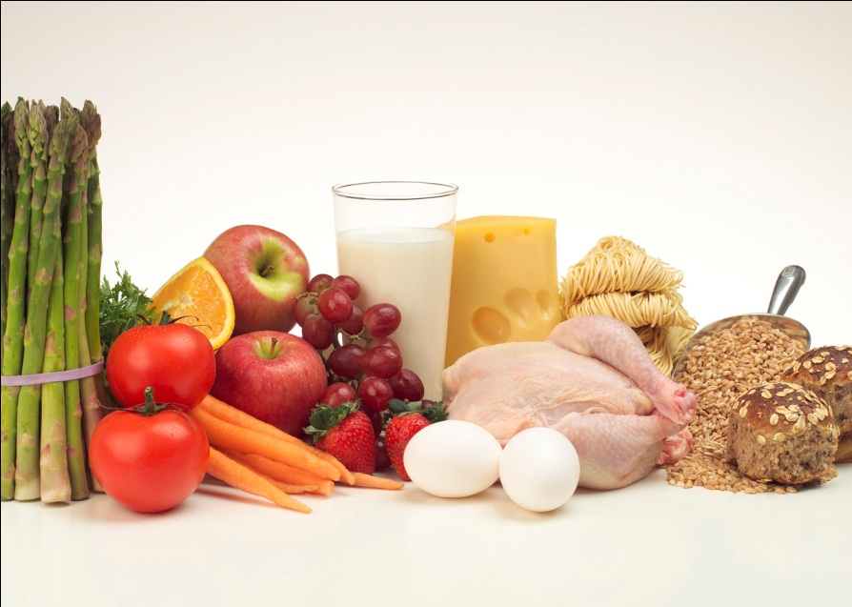
Hunters and Gatherers
Hunters gained skills in capturing and killing animals.
Gatherers learned which plants and fruits were edible and nutritious.

Slide 22
Hunters and Gatherers
Generally, technological inventions supported the activities of hunters and gatherers:
  Stone
  Metals

Slide 23

Hunters and Gatherers
The groups traveled frequently, establishing new home bases or camps.
Their migration patterns depended on the movement of game and the seasonal growth of plants.

Slide 24
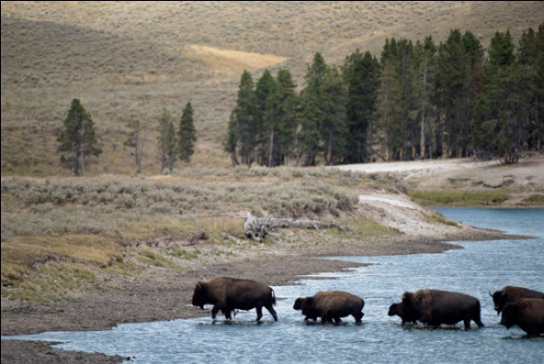
Hunters and Gatherers
By 8000 B.C.E., humans had migrated to many areas, probably following herds and other food sources.
Major migrations include:
  Eastern Africa to Australia, the Middle East, Europe, and Asia
  Asia across the land bridge to the Americas

Slide 25
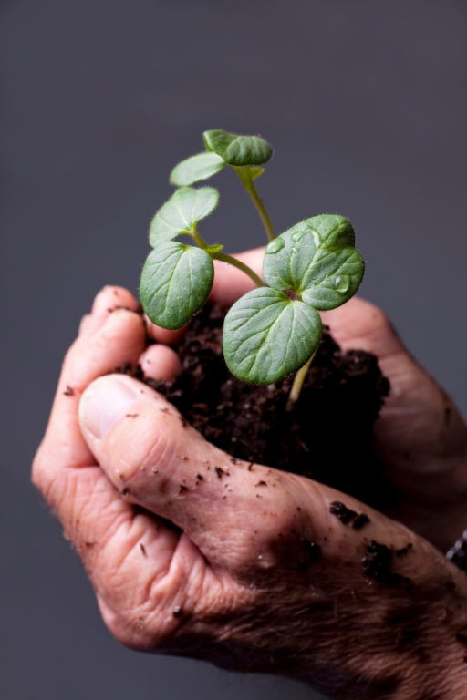
THE NEOLITHIC REVOLUTION

Slide 26

When and how did people give up their wandering and settle to live in one place?

Slide 27
Settlements
The ability to settle was based almost entirely on the cultivation of plants and the domestication of animals.
These drastic changes in human life are known collectively as the NEOLITHIC REVOLUTION (8000 B.C.E.).

Slide 28
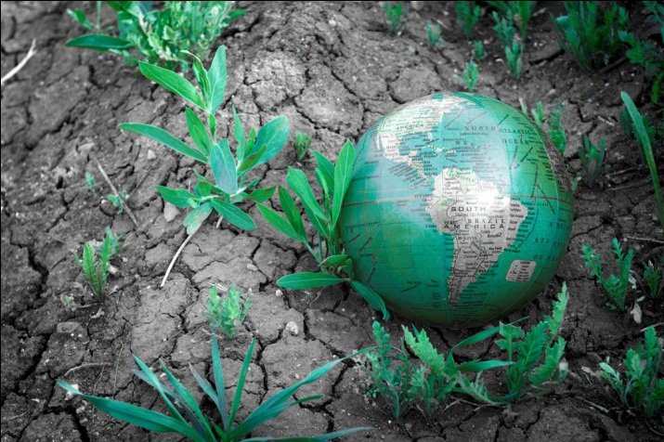
Settlements
Agricultural hearths developed independently in several regions of the world over a long period of time.
From these agricultural hearths, farming practices diffused across the earth.

Slide 29
Changes that resulted from the Neolithic Revolution
Increase in reliable food supplies
Rapid increase in total human population
Job specialization
Development of distinction between settled people and nomads
Widening of gender-specific activities
  Men→agricultural production and domestication of animals
  Women→child-rearing, food preparation, care of home

