Slide 1
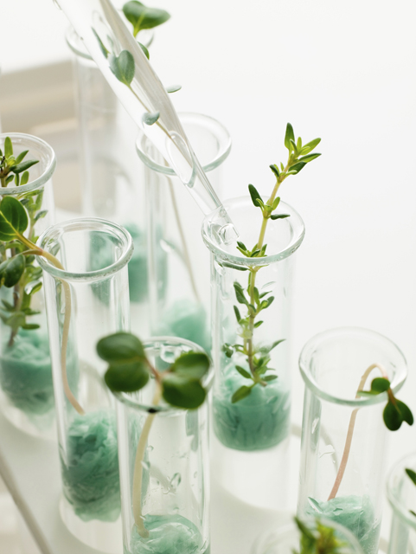
Carl Sauer
Sauer, a cultural geographer, believed that the earliest form of plant cultivation was vegetative planting, in which new plants were produced from existing plants, such as cutting stems and dividing roots.

Slide 2
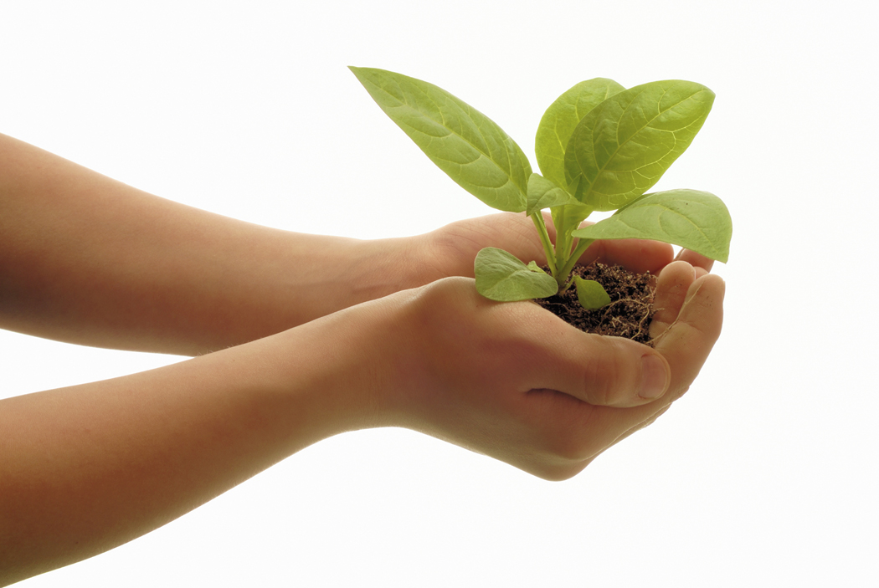
How did people first learn to farm?
People first learned to farm by deliberately dividing and transplanting plants that were already growing wild.
Seed agriculture, or the production of plants through annual planting of seeds, came later.
Most farmers TODAY practice seed agriculture.

Slide 3
Vegetative Planting
Carl Sauer believed that vegetative planting probably originated in the diverse climates and topography of Southeast Asia.
The people there did more fishing than hunting and were probably more settled. Therefore, they were more likely to experiment with plants.

Slide 4
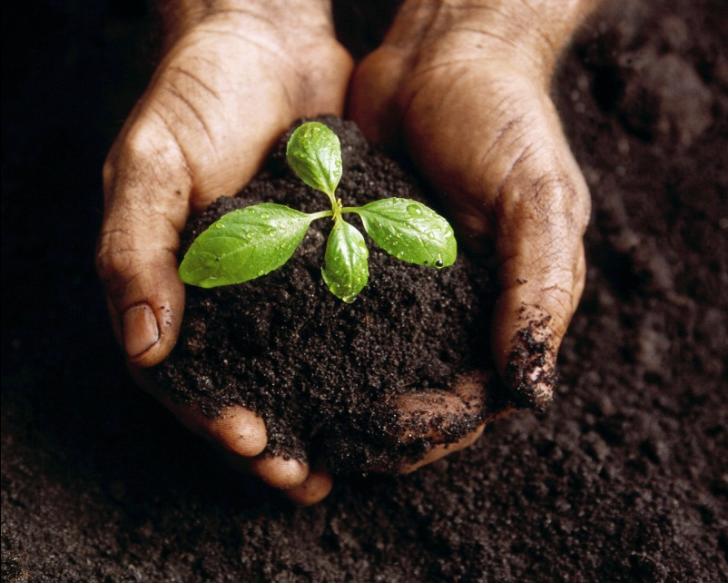
Vegetative Planting
Sample plants that were domesticated in Southeast Asia:
      taro
      yams
      bananas
      palm trees

Slide 5
Diffusion of Vegetative Planting
The first vegetative planting diffused from the Southeast Asian hearth:
  northward and eastward to China and Japan.
  westward through India, Southwest Asia, tropical Africa, and the area around the Mediterranean Sea.

Slide 6
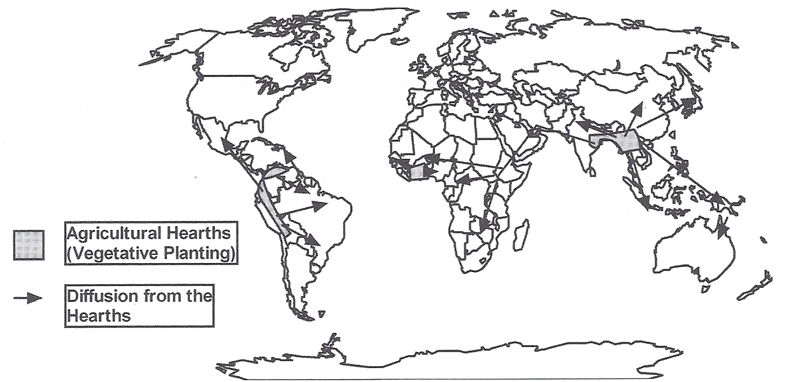
Origin and Diffusion of Vegetative Planting
The earliest hearth was probably Southeast Asia, with other early hearths in West Africa and South America.

Slide 7
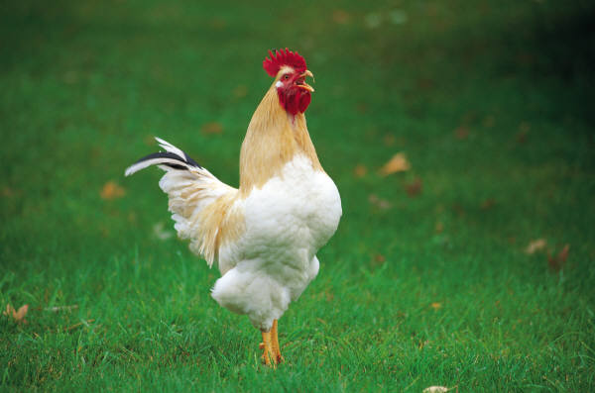
Domestication of Animals
The first domesticated animals were probably
  dogs
  pigs
  chickens

Slide 8
Vegetative Planting
Other early hearths:
  West Africa: palm trees and yams
  Northwestern South America: manioc, sweet potatoes, and arrowroot

Slide 9
Seed Agriculture
Carl Sauer identified three hearths for seed agriculture in the Eastern Hemisphere.
Those hearths were:
  western India
  northern China
  Ethiopia

Slide 10
Seed Agriculture
Hearths of crops:
  Southwest Asia: barley and cattle
  Ethiopia: millet and sorghum

Slide 11
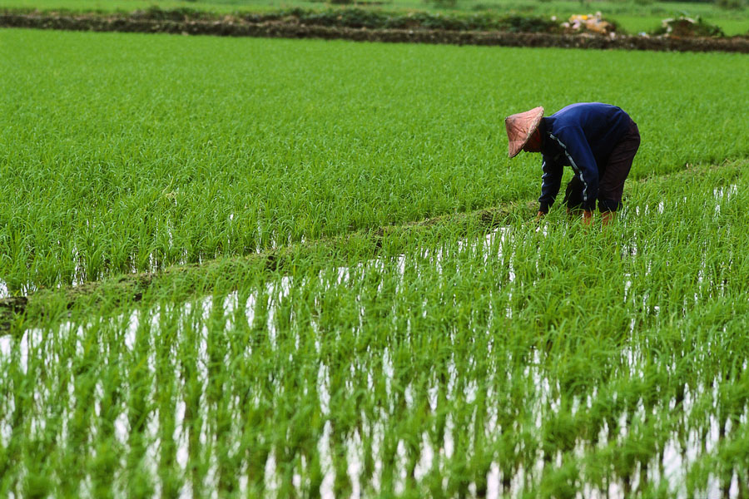
Seed Agriculture
The cultural hearth of rice is unknown, but it probably was Southeast Asia.

Slide 12

Seed Agriculture
Two independent seed agriculture hearts originated in the Western Hemisphere:
  southern Mexico
  northern Peru

Slide 13
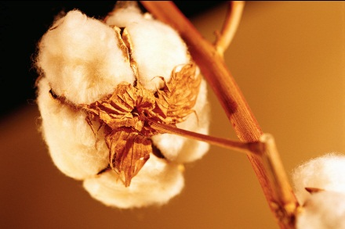
Seed Agriculture
Origin of crops
  Southern Mexico: squash and maize (corn)
  Peru: beans, cotton, squash

Slide 14
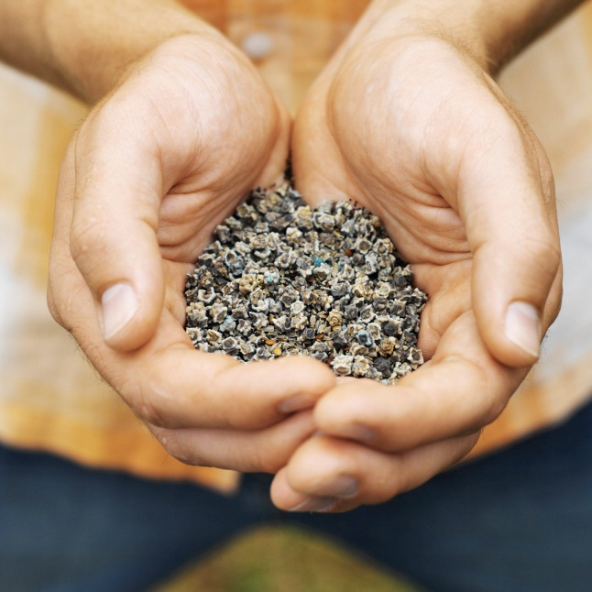
Seed Agriculture
Over the years many innovations increased the chances of success for seed agricultural practices.

Slide 15
Seed Agriculture
These innovations included:
  irrigation (the channeling of water to fields)
  plowing to loosen and turn the soil
  fencing to keep animals out of fields
  building terraces to provide level field on hillsides
  fertilizing with plant and animal waste
  weeding

Slide 16

Vegetative Planting and Seed Agriculture
The diffusion of both vegetative planting and seed agriculture from their multiple hearths created a wide variety of food raised and consumed around the world.

Slide 17
THE COLUMBIAN EXCHANGE

Slide 18
The Columbian Exchange
Food in the Western and Eastern Hemispheres was almost completely different until the Columbian Exchange during the late 15th and 16th centuries.
Products were carried both ways across the Atlantic and Pacific Oceans.

Slide 19
The Columbian Exchange
The European exploration and conquest of the Western Hemisphere during the late 15th and 16th centuries led to the exchange of products between Western and Eastern Hemispheres, with new trade routes across the Pacific and Atlantic Oceans connecting to established trade routes. For the first time in world history, trade routes encircled the globe.

Slide 20
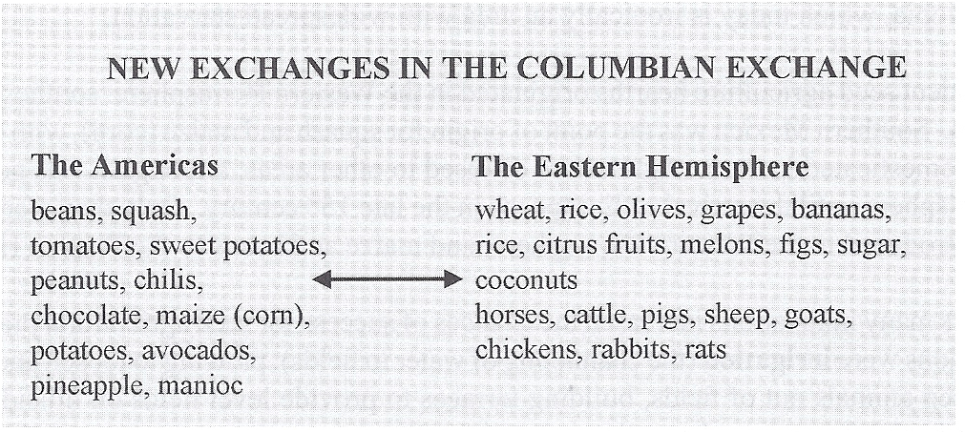
The Columbian Exchange

Slide 21
THE SECOND AGRICULTURAL
REVOLUTION

Slide 22
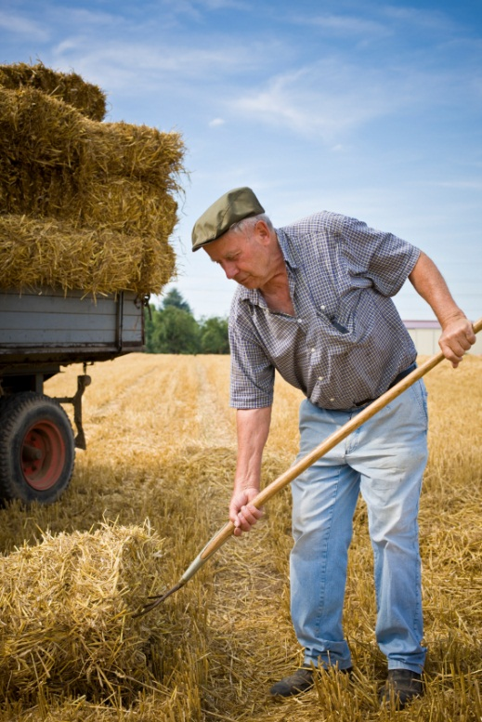
Second Agricultural Revolution
A second agricultural revolution began in Western Europe in the 1600s.
It promoted higher yields per acre and per farmer.
It preceded the Industrial Revolution, making it possible to feed rapidly growing cities.

Slide 23
Second Agricultural Revolution
Innovations included:
  increased use of fertilizers
  improved collars for draft animals to pull heavier plows

Slide 24
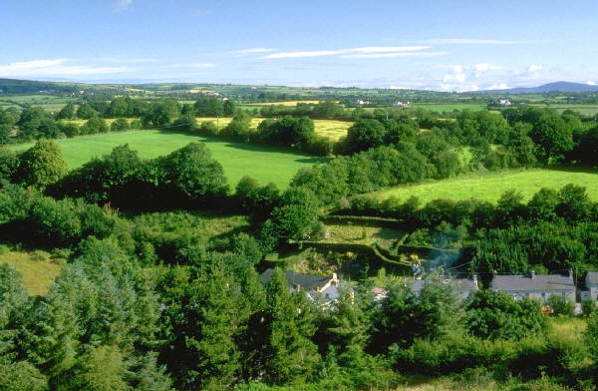
Second Agricultural Revolution
Wealthy landowners in England began to enlarge their farms through enclosure: fencing or hedging blocks of land for experiments with new techniques of farming.
Previously, the land had been held in “common” and shared by all.

Slide 25
Second Agricultural Revolution
These scientific farmers:
  improved crop rotation, which carefully controlled the nutrients in soil
  bred better livestock
  invented such machines as the seed drill for more effectively planting seeds (Jethro Tull)

Slide 26
Second Agricultural Revolution
Farmers pushed out of their jobs by the enclosure movement either became tenant farmers or they moved to cities.

Slide 27
Second Agricultural Revolution
Better nutrition boosted England’s population, creating the first necessary component of the Industrial Revolution: LABOR!

Slide 28
Second Agricultural Revolution
Once the Industrial Revolution began, farming methods became more efficient.
Examples:
  Tractors for plowing soils
  Reapers for cutting crops
  Threshers for separating grain
  from stalks
  Motors for pumping water

Slide 29
Second Agricultural Revolution
Transportation for and storage of crops improved, especially with the invention of refrigerated cars and ships.
Industrially-produced chemicals for fertilizers, weed killers, and pesticides were also introduced in the 20th century.

Slide 30
KEY TERMS TO REVIEW FROM THIS SESSION
Agricultural hearths
Vegetative planting
Seed agriculture
Plant and animal domestication
Irrigation
Yields
Enclosure movement
Hedging
Crop rotation
Seed drill
Primary activity
Secondary activity
Tertiary activity
Pre-industrial societies
Quaternary activities
Post-industrial societies
Agriculture
Hunters and gatherers
Neolithic Revolution

