Slide 1
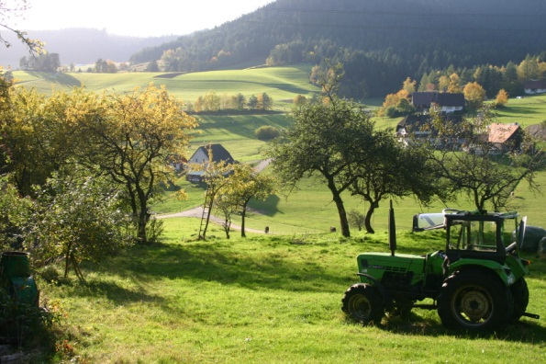
UNIT FIVE
AGRICULTURE:
PRIMARY ECONOMIC ACTIVITIES
ADVANCED PLACEMENT HUMAN GEOGRAPHY
Session 2

Slide 2
MAJOR AGRICULTURAL PRODUCTION REGIONS

Slide 3

Agricultural Practices
Agricultural practices vary widely across the globe.
The most basic distinctions in agricultural products are made between less developed countries (LDCs) and more developed countries (MDCs).

Slide 4
Agricultural Practices
Subsistence agriculture is the production of only enough food to feed the farmer’s family with few or no surpluses to sell.
It is most prevalent in LDCs.

Slide 5
Agricultural Practices
Commercial agriculture is the production of food surpluses with most crops destined for sale to people outside the farmer’s family.
It is practiced primarily in MDCs.
Commercial farmers generally do not sell produce directly to consumers but to food processing companies.

Slide 6
Agricultural Practices
Agribusiness occurs when big companies sign contracts with commercial farmers to buy their grain, cattle, pigs, chickens, and other products that they, in turn, package to sell through food outlets to consumers (e.g. grocery stores).
Agribusiness is found primarily in MDCs.

Slide 7
A Comparison…Percentage of Farmers in the Labor Force
Subsistence Agriculture
A high percentage of people are engaged in farming.
With no surplus, all people produce their own food to survive.
Example: Many countries in Africa
  60% of citizens of citizens are engaged in agriculture.
Commercial Agriculture
A smaller percentage of people are farmers.
Surplus is available to sell.
Examples: U.S. and Canada
  Less than 2% of citizens are farmers.

Slide 8
Use of Machinery
Commercial Agriculture in MDCs
  Machinery is used to speed up production.
      tractors
      combines
      planters

Slide 9
Use of Machinery
Commercial Agriculture in MDCs
  Transportation is important to facilitate the ability to get goods to consumers.
        Railroads
        Highways
        Rapid sea travel
        Air travel

Slide 10
Use of Machinery
Commercial Agriculture in MDCs
  Scientific advances boost crop yields and the health of animals.
      Fertilizers
      Herbicides
      News breeds of plants and animals

Slide 11
A Comparison…Farm Size
Subsistence Farms
Commercial Farms
The farms are small in size.
Commercial farmers have equipment that helps them to manage farms that are very large in size.
Commercial Farm

Slide 12
SUBSISTENCE FARMING:
SUBREGIONS

Slide 13
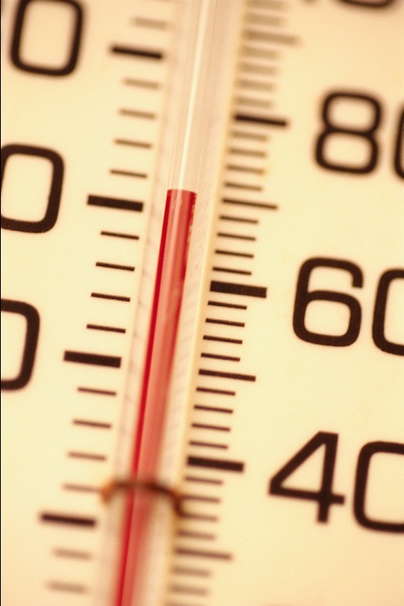
Subsistence Farming: Subregions
Subsistence farming varies according to adaptations to varying climates.

Slide 14
Subsistence Farming: Subregions
Subregions for subsistence farming include:
    intensive subsistence agriculture
    shifting cultivation
    pastoral nomadism

Slide 15
Intensive Subsistence Agriculture
Intensive subsistence agriculture yields a large amount of output per acres through concentrated farming but still only provides a subsistence living for farmers.
Sometimes farmers may sell a little to others, but usually they raise crops for their own consumption.

Slide 16
Intensive Subsistence Agriculture
Intensive subsistence farming is found in heavily populated areas of East and South Asia.
A little less than half of the world’s people are engaged in this type of farming.
Population densities are high.

Slide 17
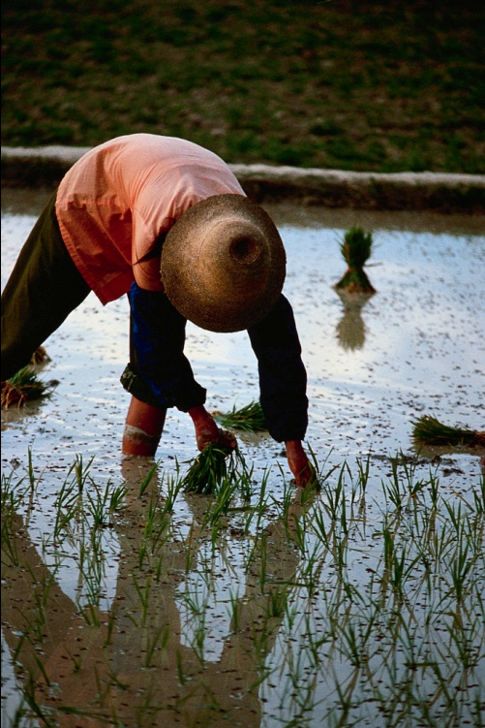
Intensive Subsistence Agriculture
East and South Asia
  Wet, or low land, rice is dominant in many areas.
  Wet rice is planted on dry land in a nursery and then moved as seedlings to a flooded field to promote growth.
  The crop requires much attention and time but it can produce large amounts of food.

Slide 18
Intensive Subsistence Agriculture
Labor intensive agriculture employs large numbers of people and requires relatively little capital to produce food.
Most work is done by hand.
Although the crops the farmers raise form the basis of their diets, they often link to other regions for specialized products.

Slide 19
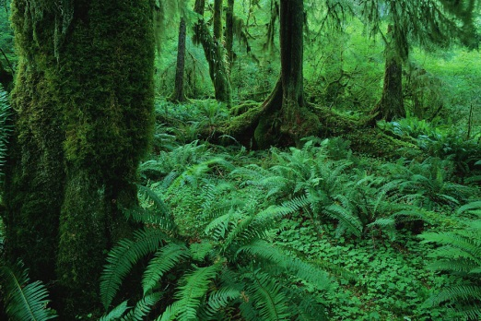
Shifting Cultivation
Shifting cultivation is often referred to as “slash and burn” or swidden agriculture.
This farming method exists primarily in rain forest zones of:
  Central and South America
  West Africa
  Eastern and Central Asia
  much of southern China and Southeast Asia

Slide 20
Shifting Cultivation
Shifting cultivation still consumes a large percentage of arable land on the planet.
People who practice shifting cultivation generally live in small villages and grow food on the surrounding land.

Slide 21
Shifting Cultivation
Intertillage—the growing of various crops —is common with shifting cultivation.
Farming is done almost exclusively by hand, and plows and animals are generally used.
The main fertilizer is potash from burning the debris when the site is cleared.

Slide 22

Shifting Cultivation
When nutrients are depleted from the soil after a few years, villagers identify another site and clear it.
They allow the old site to return to its natural vegetation, although they do not entirely abandon it.
Villagers return to the original site after a few years to resume their farming.

Slide 23
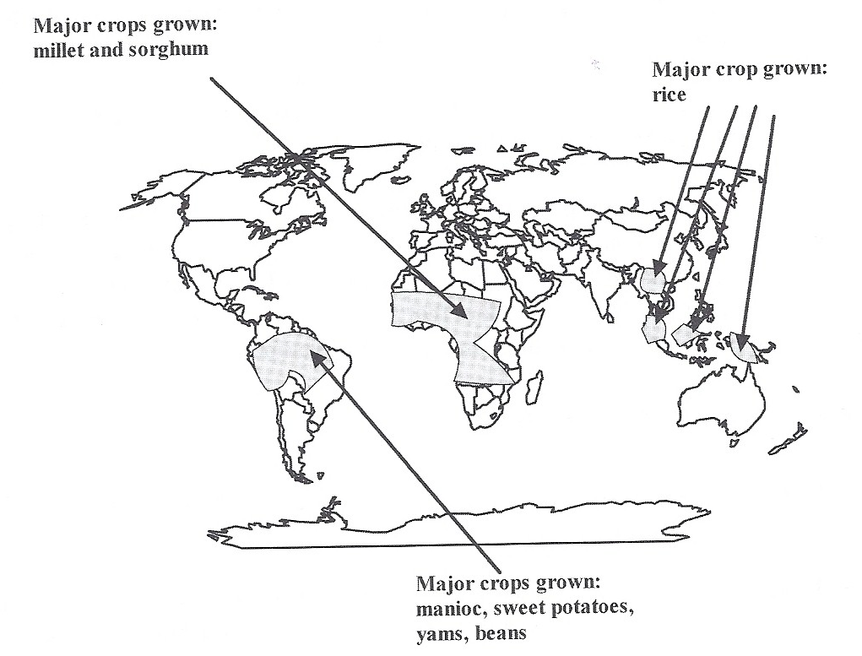
Major Regions of Shifting Cultivation
Shifting cultivation is best suited to rain forest regions, where farmers fertilize the relatively infertile rain forest soils by burning the undergrowth and using the ash to allow cultivation of crops.

Slide 24
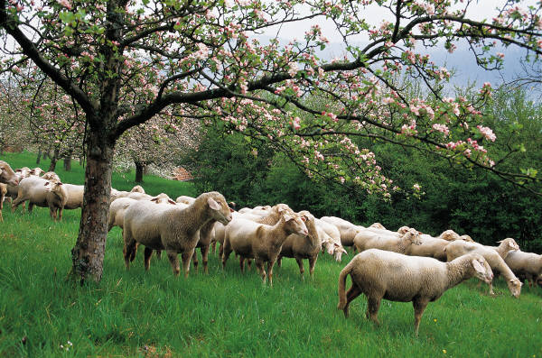
Pastoral Nomadism
Pastoral nomadism is characterized by following the herds, just as earlier hunters and gatherers did.
Today, domesticated herds consist of:
  sheep
  goats
  cows
  reindeer
  camels
  horses

Slide 25
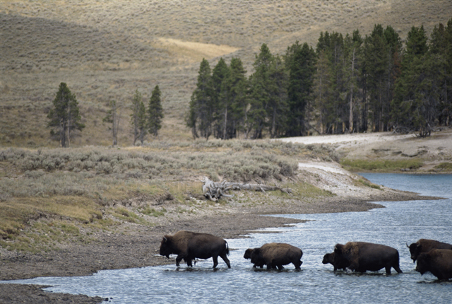
Pastoral Nomadism
Nomadism is the practice of moving frequently from one place to the other, as dictated by the need for pasture for the animals.

Slide 26
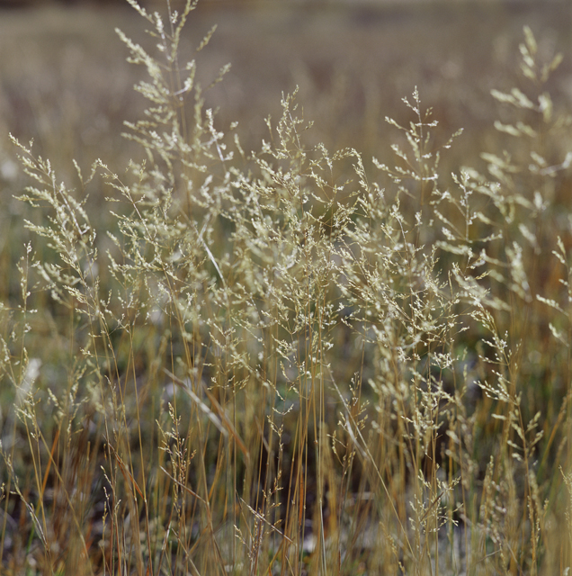
Pastoral Nomadism
This life style first developed across the grassy plains of central Eurasia and nearby desert areas of the Arabian Peninsula and Sudan.

Slide 27
Pastoral Nomadism
The animals provide subsistence for the herders with:
  milk
  cheese
  meat
  hair, wool, and skins for clothing and shelter

Slide 28
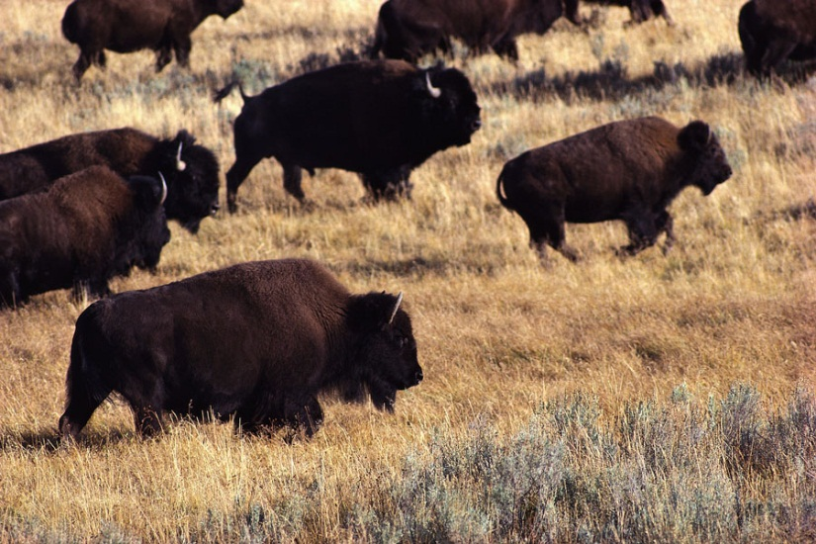
Pastoral Nomadism
The herds follow seasonal availability of pasture.
Extended stays by herders are neither possible nor desirable.

Slide 29
Extensive Subsistence Agriculture
Both shifting cultivation and pastoral nomadism are referred to as extensive subsistence agriculture.
They involve large areas of land and minimal labor per land unit.

Slide 30
A major issue for subsistence farmers today is the need to intensify farming because of rapidly growing populations.

