Slide 1
Ester Boserup
Boserup was an economist who believed that subsistence farmers
  intensify production by leaving land fallow for shorter periods.
  adopt new farming methods.

Slide 2
Ester Boserup
In order to farm land more efficiently,
  plows must be used.
  more weeding must take place.
  more ditches for irrigation must be dug.

Slide 3
Ester Boserup
The increase in population provides more people for weeding and digging ditches, so yield per acre increases, and land may be left fallow for shorter periods of time.

Slide 4
COMMERCIAL FARMING:
SUBREGIONS

Slide 5
Commercial Agriculture
Commercial farmers are part of a large, complex economy that includes industrial and service sectors as well.

Slide 6
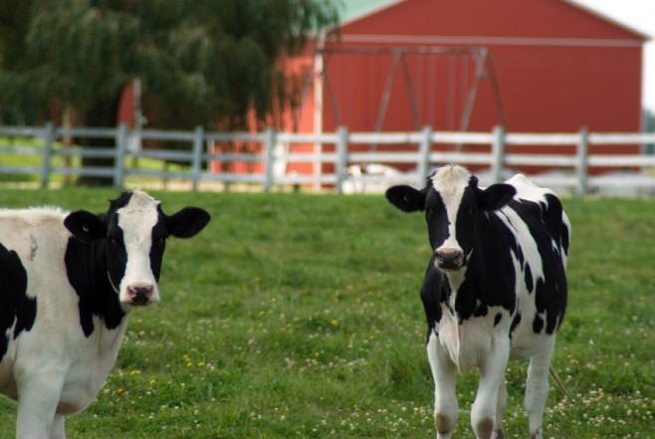
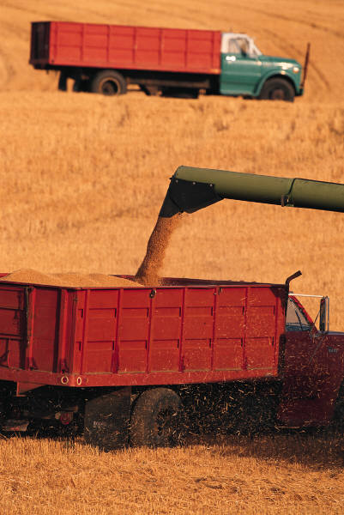
Commercial Agriculture: Categories
Intensive Types
Extensive Types
Dairy farming
Truck farming
Large grain farms
Livestock farms

Slide 7
Commercial Agriculture:
Mixed Crop and Livestock Farming
Mixed crop and livestock farming is the most common form of commercial agriculture in:
  the United States west of the Appalachian Mountains.
  much of Europe from France to Russia.

Slide 8
Commercial Agriculture:
Mixed Crop and Livestock Farming
Farmers grow crops and raise livestock on the same land spread, with most of the crops fed to animals rather than people.
Most income comes from the sale of animal products such as:
  beef
  milk
  eggs

Slide 9
Commercial Agriculture:
Mixed Crop and Livestock Farming
Most farmers practice crop rotation where each field is planted on a planned cycle.
Different crops take different nutrients from the soil.
Commercial farmers make efficient use of soil.

Slide 10
Commercial Agriculture:
Mixed Crop and Livestock Farming
At any given time, commercial farmers will have almost half of their fields planted but with different crops from previous years.

Slide 11
Commercial Agriculture:
Mixed Crop and Livestock Farming
Example of crop rotation:
  One cycle might consist of cereal grains (e.g. oats).
  A second cycle might feature a root crop (e.g. turnips).
  A third cycle would be a “rest” crop such as clover. It restores the field but may be eaten by cattle.
  Then the farmer can start over with a cereal grain.

Slide 12
Commercial Agriculture:
Dairy Farming
Dairy farms must be closer to market than other products because milk spoils quickly.
A ring of milk production called a milkshed surrounds a major city.

Slide 13
Commercial Agriculture:
Dairy Farming
Today refrigerated rail cars and trucks have extended the reach of the milksheds so that nearly every farm in the U.S. Northeast and Northwest Europe is within the milkshed of at least one urban area.

Slide 14
Commercial Agriculture:
Dairy Farming
Dairy farms also produce butter and cheese, with many specializing in one product or another.
Since cheese and butter keep fresh longer than milk, farms further away from urban centers tend to favor these products over milk.

Slide 15
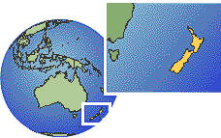
Commercial Agriculture:
Dairy Farming
A Look at New Zealand…
  New Zealand is the world’s largest producer of dairy products.
  New Zealand farmers devote only a small share of their work to liquid milk because they are too far away from North America and Western Europe to hold the milk market.
New Zealand

Slide 16
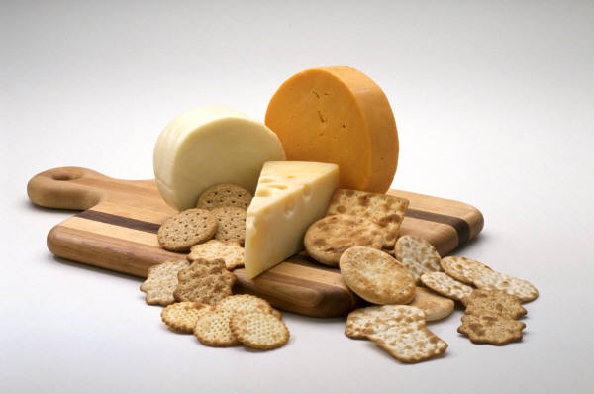
Commercial Agriculture:
Dairy Farming
Dairy farmers usually do not sell their products directly to consumers but to wholesalers or to butter and cheese manufacturers.

Slide 17
Commercial Agriculture:
Dairy Farming
The number of dairy farms has decreased significantly since 1980.
Dairy farmers cite long work and too little profit as reasons for giving up their farms.
HOWEVER, overall dairy production has risen, indicating that farms still in existence are producing more.

Slide 18
Commercial Agriculture:
Dairy Farming
A disadvantage of dairy farming is the expense of feeding cows in winter.
Dairy farmers must purchase all feed, making it less likely that they will make a profit.
Dairy farming is also labor intensive. For example, cows must be milked twice daily.

Slide 19
Commercial Farming:
Grain Farming
The most important grain –producing areas in the world are in three regions in the United States.

Slide 20
Commercial Farming:
Grain Farming
Region One: winter wheat area
  Kansas, Colorado, Oklahoma
  The crop is planted in the autumn, survives the winter, and ripens the following summer.

Slide 21
Commercial Farming:
Grain Farming
Region Two: spring wheat area
  The Dakotas
  Montana
  In this region, winters are too severe for winter wheat.
Region three: the Palouse Region
  Washington state

Slide 22
Commercial Farming:
Grain Farming
  Other grain-producing countries:
    Canada
    Australia
    Argentina
    France
    United Kingdom

Slide 23
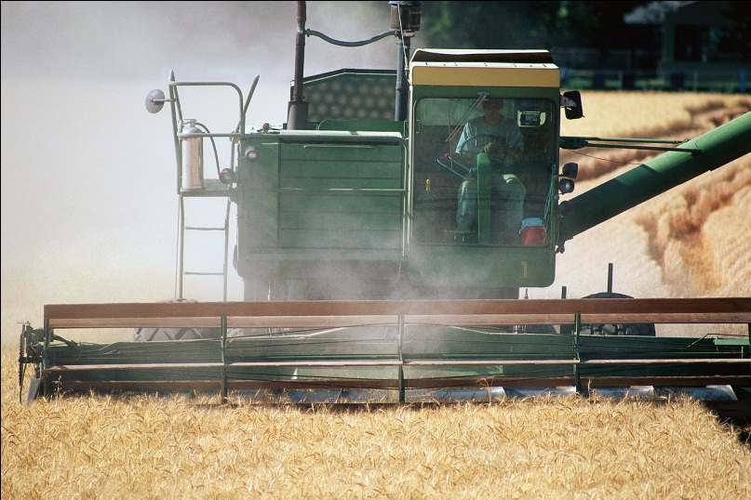
Commercial Farming:
Grain Farming
Large-scale grain production, like other forms of commercial agriculture, is heavily mechanized on large farms.

Slide 24
Commercial Farming:
Grain Farming
Much wheat finds its way into the international market, where it serves as the world’s leading export crop.
As a result, the prairies of North America are often referred to as the “world’s breadbasket.”

Slide 25
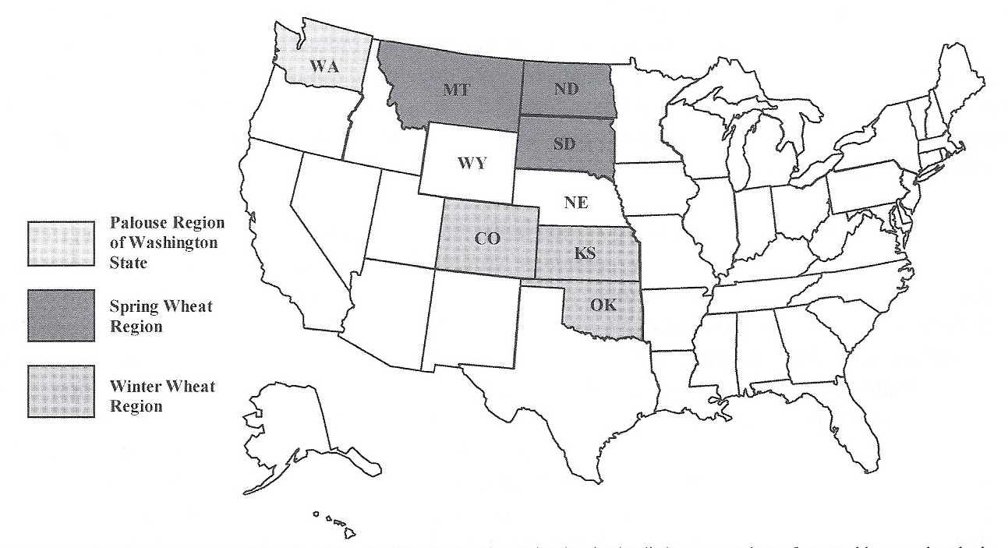
States likes Wyoming and Nebraska that lie between regions often are able to produce both winter and spring wheat.
Major
Grain-producing
Regions
of the U.S.

Slide 26
Commercial Farming:
Livestock Ranching
Ranching is the commercial grazing of livestock over an extensive area.
It is often practiced in arid or semi-arid regions where climate conditions make crop production impractical.

Slide 27
Commercial Farming:
Livestock Ranching
Cattle ranching extends over much of the western United States, where the patterns of life associated with it have shaped the popular image of the West through stories of cowboys, round-ups, and trail-herding.

Slide 28
Commercial Farming:
Livestock Ranching
By the late 19th century, cattle ranching became more sedentary as more railroads covered the landscape and farmers claimed more western lands.

Slide 29
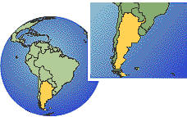
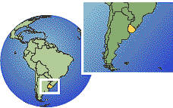
Commercial Farming:
Livestock Ranching
In South America, a large portion of the pampas (prairie) of Argentina, southern Brazil, and Uruguay are devoted to grazing cattle and sheep.
Brazil
Argentina
Uruguay

Slide 30
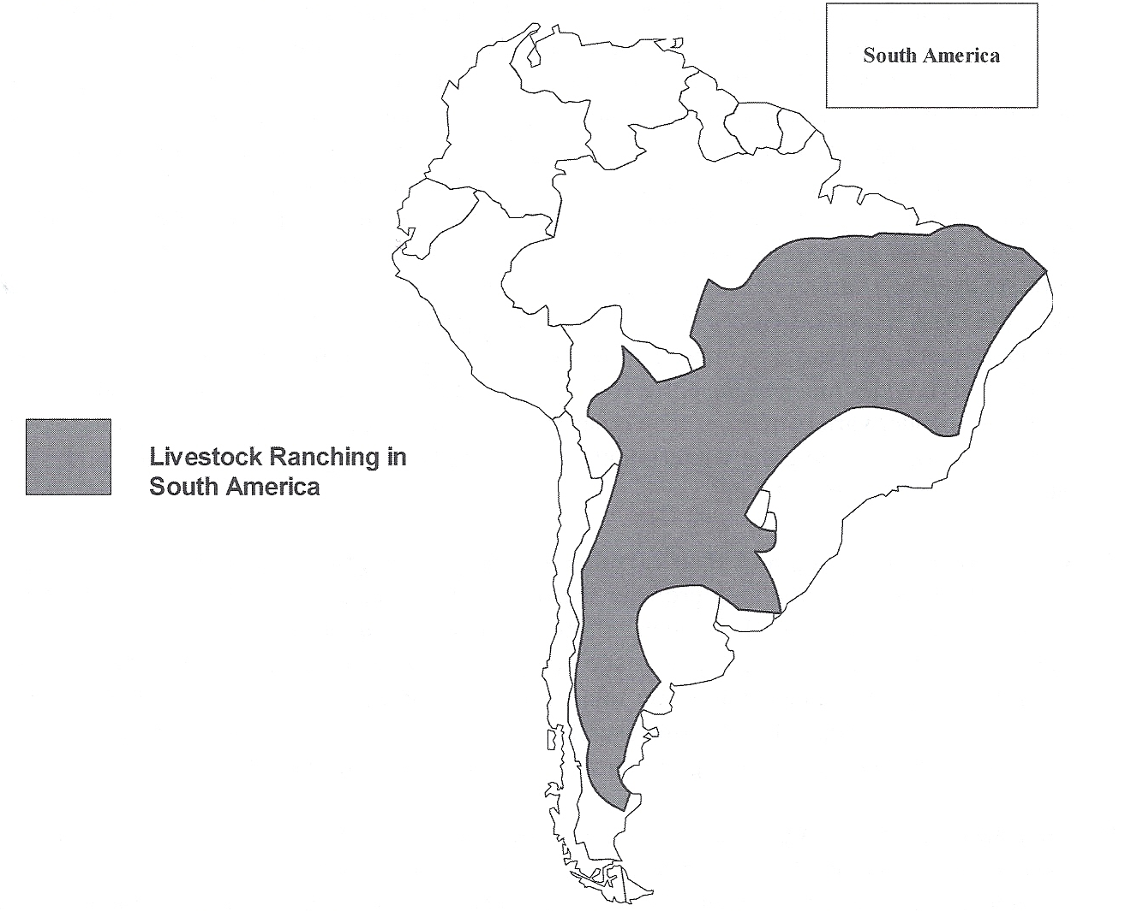
The shaded area on the map shows where livestock ranching is prevalent in South America.

Slide 31
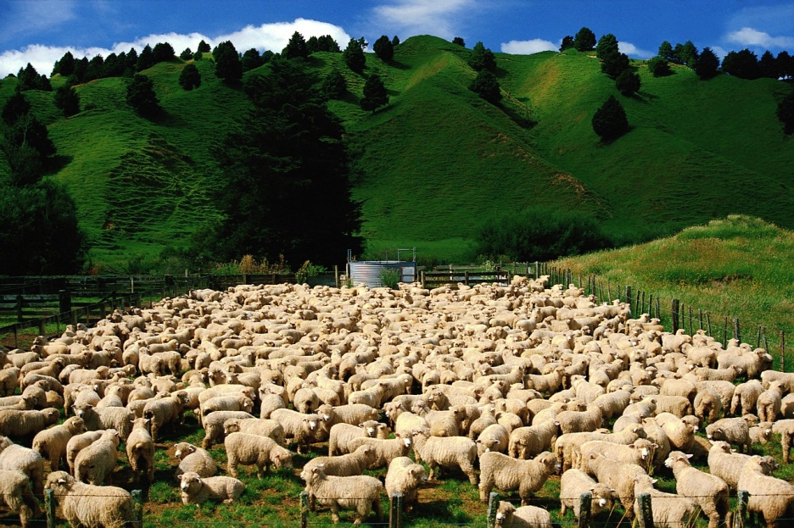
Commercial Farming:
Livestock Ranching
Ranches in the following places are more likely to raise sheep than cattle:
  Australia
  New Zealand
  Middle East
  South Africa

Slide 32
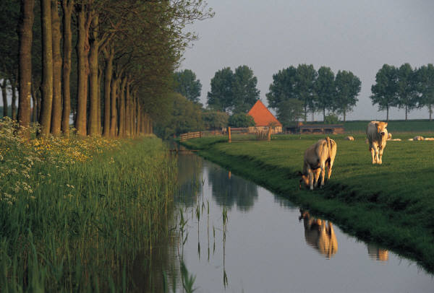
Commercial Farming:
Livestock Ranching
Irrigation has allowed conversion of ranch land to crops, with the remaining ranches experimenting with new methods of breeding, feeding, and watering in order to stay profitable.

Slide 33
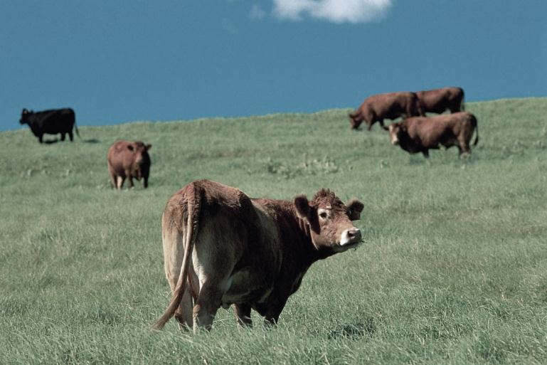
Commercial Farming:
Livestock Ranching
While livestock raised in the U.S. is sold primarily in the domestic market, livestock raised in other areas is more likely to be exported to high consumption developed countries.

Slide 34
Commercial Farming:
Mediterranean Agriculture
Mediterranean agriculture is practiced in the following places:
  lands that border the Mediterranean Sea
  California
  Central Chile
  southwestern part of South Africa
  southwestern Australia

Slide 35
Commercial Farming:
Mediterranean Agriculture
These areas share a similar physical environment.
They:
  border seas.
  are on the west coasts of continents.
  have moisture provided by prevailing sea winds.
  have moderate winter temperatures.
  have hot and dry summers.

Slide 36
Commercial Farming:
Mediterranean Agriculture
Horticulture is the growing of fruits, vegetables, and flowers.
Horticulture forms the commercial base of Mediterranean agriculture.

Slide 37
Commercial Farming:
Mediterranean Agriculture
Mediterranean Sea
California
The most important cash crops for this region are:
  olives
  grapes
Two-thirds of the world’s wines are produced here.
This region produces grapes, (wine), citrus fruits, and tree nuts.
This region produces a wider variety of crops because of the extensive use of irrigation.

Slide 38
Commercial Farming:
Commercial Gardening and Fruit Farming
Commercial gardening and fruit farming predominate in the U.S. Southeast, a region with a long growing season and humid climate.
The region also has accessibility to the markets of the Northeast.

Slide 39
Commercial Farming:
Commercial Gardening and Fruit Farming
This type of agriculture is often called truck farming.
“Truck” originally meant “bartering” in the English language.
Truck farms usually rely on:
  machinery
  fertilizers
  migrant workers

Slide 40
Commercial Farming:
Commercial Gardening and Fruit Farming
Products from truck farms include:
  apples
  asparagus
  cherries
  lettuce
  mushrooms
  tomatoes
  Some produce is sold fresh to consumers but most is sold to large processors for canning or freezing.

Slide 41
Commercial Farming:
Plantation Farming
A plantation is a large farm that specializes in one or two crops and is found today in:
    Latin America
    Africa
    Asia

Slide 42

Commercial Farming:
Plantation Farming
Almost all crops are raised for export to high-consumption developed countries.
These exports are called cash crops because they are raised to make money for their owners.

Slide 43
Commercial Farming:
Plantation Farming
Crops that are usually grown on plantations include:
  cotton
  sugarcane
  coffee
  rubber
  tobacco

Slide 44
Commercial Farming:
Plantation Farming
Plantations are colonial legacies that persist in poorer, primarily tropical, countries along with subsistence farming.
Until the 19th century, slave labor was employed, but today the workers are paid, although their room and board constitutes a large part of their salaries.

Slide 45
Commercial Farming:
Plantation Farming
Today many plantations in former colonies are still owned by Western corporations or individuals.

Slide 46
Key Terms to Remember from this Session
Less developed countries
More developed countries
Subsistence agriculture
Commercial agriculture
Agribusiness
Intensive subsistence agriculture
Wet rice
Labor intensive agriculture
Shifting cultivation
“slash and burn”
Swidden agriculture
Intertillage
Potash
Pastoral nomadism
Nomadism

Slide 47
Key Terms to Remember from this Session
Extensive subsistence agriculture
Intensive commercial agriculture
Extensive commercial agriculture
Mixed crop and livestock farming
Crop rotation
Dairy farms
Milkshed
Grain farming
Livestock ranching
Mediterranean agriculture
Horticulture
Truck farming
Plantations

