Slide 1
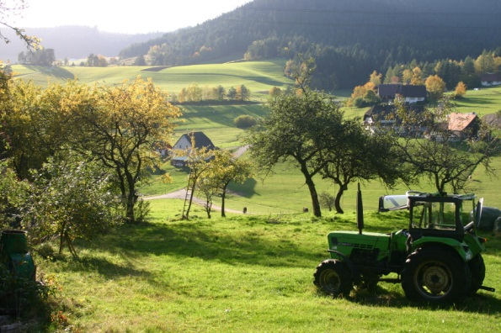
UNIT FIVE
AGRICULTURE:
PRIMARY ECONOMIC ACTIVITIES
ADVANCED PLACEMENT HUMAN GEOGRAPHY
Session 3

Slide 2
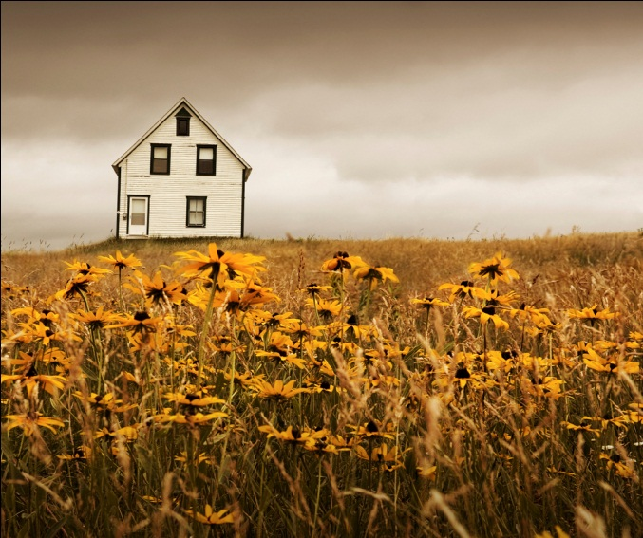
RURAL LAND USE AND SETTLEMENT PATTERNS

Slide 3
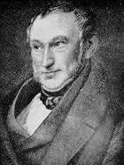
THE VON THÜNEN MODEL
Johann Heinrich von Thünen, a German farmer, developed a famous model for rural land use in the early 19th century.
He studied the space around Rostock, Germany.

Slide 4
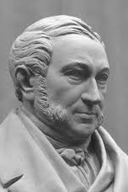
Von Thünen’s model was the FIRST effort to analyze the spatial character of economic activity.
Von Thünen published his model in The Isolated State in 1826.

Slide 5
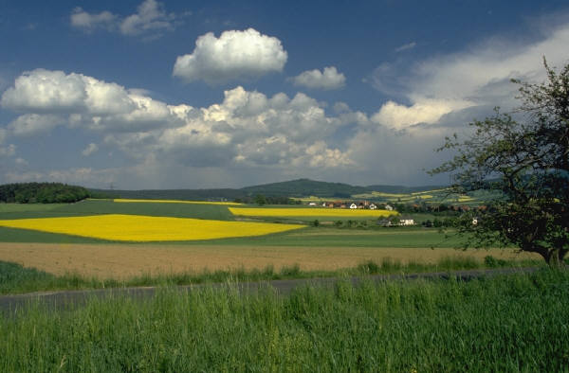
THE VON THÜNEN MODEL
Von Thünen noticed a pattern on the landscape as one crop gave way to another.
There was no visible change in:
  soil
  climate
  terrain

Slide 6
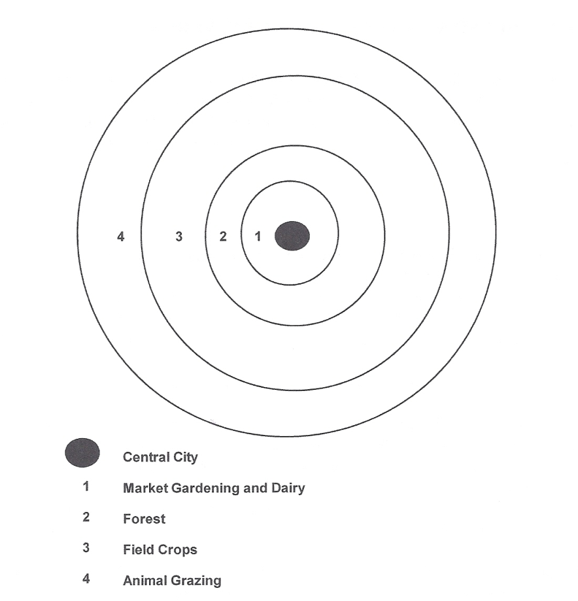
THE VON THÜNEN MODEL
Each town was a market center surrounded by a set of roughly concentric rings that featured different crops.
Von Thünen identified four rings that surrounded market centers.

Slide 7
THE VON THÜNEN MODEL
RING ONE: Market gardening and dairy
  Nearest to the town
  Perishable products
  Expensive to deliver and must reach
  market quickly
  Examples:
    garden vegetables
    milk

Slide 8
THE VON THÜNEN MODEL
RING TWO: Forest
  Source of fuel and construction
  Trees heavy to transport

Slide 9
THE VON THÜNEN MODEL
RING THREE: Field crops
  Used for less perishable crops
  Crops rotated yearly
  Examples:
    wheat
    other grains

Slide 10
THE VON THÜNEN MODEL
RING FOUR: Animal Grazing
  The outermost ring was devoted to livestock grazing.
  Grazing requires much space.
  Beyond this ring, it generally became unprofitable to farm commercially because the transportation costs became too high.

Slide 11
Intensive v. Extensive Agriculture
Intensive Agriculture
Intensive agriculture methods needs to be applied in the rings that are closest to the market center.
Land closer to the market center is subdivided into relatively small units.
Dairy and truck farmers sought smaller plots of relatively expensive land close to cities.
Extensive Agriculture
Land far from markets in rings three and four may be farmed extensively and in larger units.
Grain farmers and ranchers settled on larger, less expensive land farther away from urban areas.

Slide 12

LOCATION THEORY
Location theory explains how an economic activity is related to the land space where goods are produced.
Von Thünen identified the interplay of transportation costs and value of the products on rural land use. This connection is still at the heart of location theory.

Slide 13
TRANSPORTATION
Von Thünen’s model comes in to play in assessing rural land use for organic foods.
Example:
  On a regional level, fresh organic chicken served in a New York City restaurant would most likely have a more limited area of profitability than chicken that is non-organic.

Slide 14
ON A GLOBAL SCALE…
Von Thünen’s model is useful for understanding broad patterns of land use.
Factors that affect rural land use include:
  varying climate
  various soil conditions
  farming methods
  technology
  historical influences

Slide 15
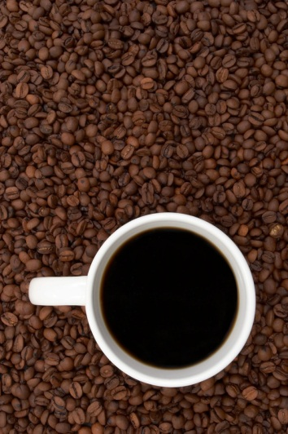
ON A GLOBAL SCALE…
Many poor countries today still grow commercial crops – such as coffee and bananas – on soil that might be used for food for their own consumption.
The historical roots of this practice are in colonial times, when plantations were used for commercial agriculture by European countries and/or the U.S.

Slide 16
PATTERNS OF SETTLEMENT

Slide 17
What affects density of housing in rural areas?
Dispersed settlement patterns
  These patterns are found in areas where extensive agriculture is practiced.
  Individual farmhouses lie far apart.
  They may also exist in areas where machinery makes intensive cultivation of large areas possible.

Slide 18
What affects density of housing in rural areas?
Nucleated settlement patterns
  Villages are located close together with small surrounding fields.
  Land use is intense, but people and animals do the work.
  This is the MOST common pattern of agricultural settlement.

Slide 19
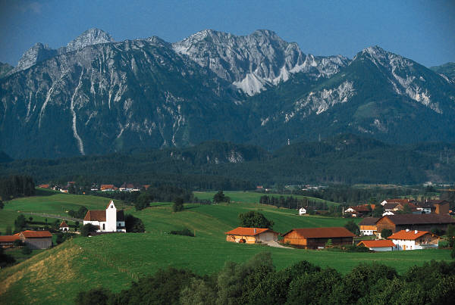
What affects density of housing in rural areas?
Nucleated settlement patterns
  Here you will find houses grouped together in hamlets, or small clusters of buildings.
  Slightly larger settlements are called villages.
  These settlements reflect the historical need to band together for protection.

Slide 20
HOUSING STYLES
AND GEOGRAPHY

Slide 21
Geography and Housing
Geography has always influenced the types of houses that people build for shelter.
Examples:
  People in flood-prone areas learned how to build houses on stilts.
  People in areas with lots of snow learned to build steep-sided roofs.

Slide 22
Geography and Housing
Lifestyles have also determined house styles.
  Examples:
    Light-weight transportable materials are used by nomadic people for shelter.

Slide 23
Geography and Housing
Until recently, people were limited by their physical environments in their building materials for housing.
  Example:
    Early settlers in the Midwestern U.S. built sod houses because trees were not readily available.

Slide 24
Geography and Housing
Today migrations have carried housing styles far away from their origins.
Building materials are shipped for long distances.
As a result, many areas have
mixed housing styles.

Slide 25
Housing Styles and Rural Areas
Rural areas tend to have more traditional housing than urban areas do.
Villages have mixtures of traditional and modified housing.

Slide 26
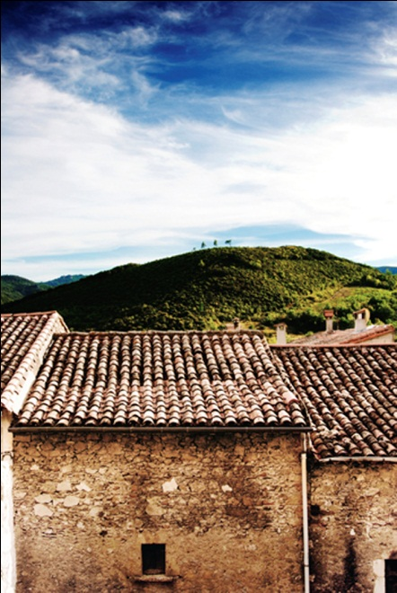
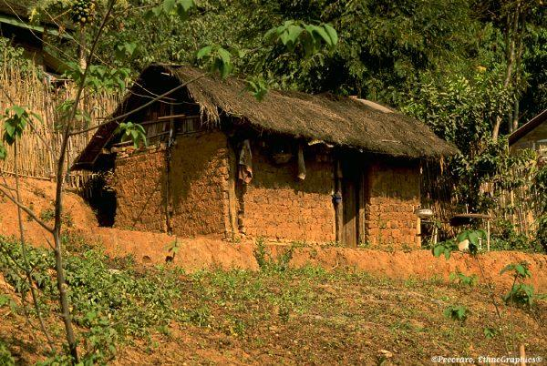
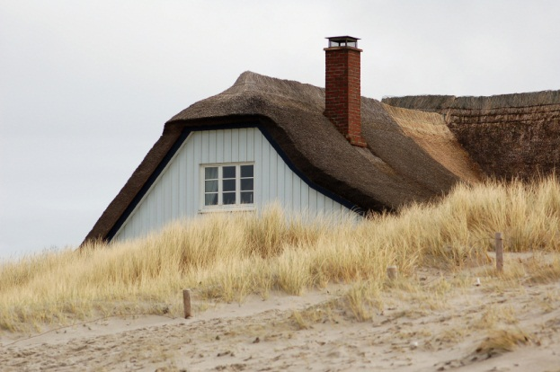
Traditional Housing in Rural Areas
Examples:
  Sod-covered roofs in Scandinavia
  Hand-cut stone houses in the Andes Mountains
  Mud-walled houses in China

Slide 27
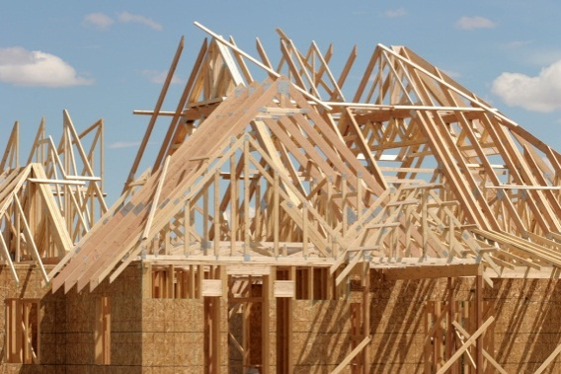
BUILDING MATERIALS
Wood
  Historically, the use of wood has been linked to close proximity to forests.
  Wood is now shipped to most corners of the globe.

Slide 28
BUILDING MATERIALS
Wood
  The log house probably originated in northern Europe where forests were plentiful.
  The use of wood spread to North America when Europeans first settled there.

Slide 29
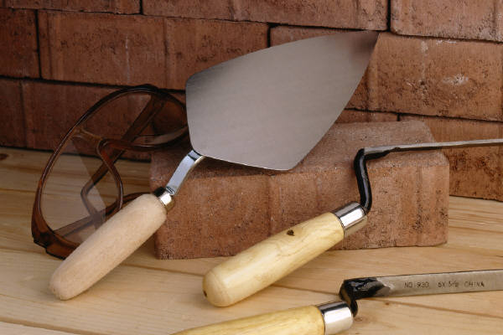
BUILDING MATERIALS
Brick
  In the U.S. bricks are oven-baked blocks of cement.
  In other parts of the world, brick is made from different materials.
  Today brick is a major element of
  modern construction all over the
  world.

Slide 30
BUILDING MATERIALS
Brick
  Sun-dried brick, wet mud mixed with straw, is used in many parts of the world including:
    the Middle East
    Northern China
    Mexico
    the southwestern U.S.

Slide 31
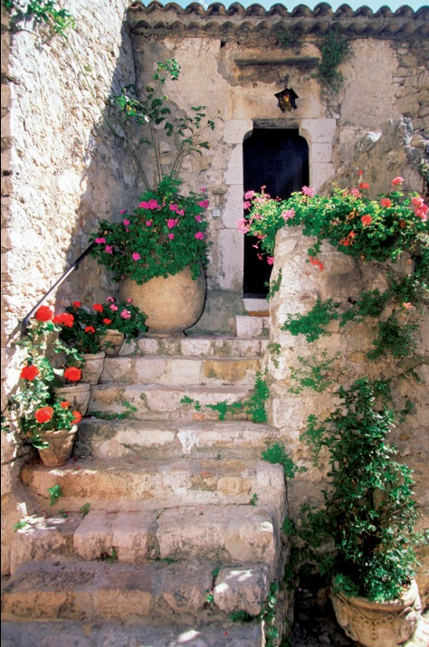
BUILDING MATERIALS
Stone
  Natural stone has long been used in home construction.
  Typically, natural stone is built with cement mortar.
  However, in the Andes Mountains buildings have no mortar and are stacked like puzzle pieces.

Slide 32
BUILDING MATERIALS
Wattle
  Wattle consists of poles and sticks woven tightly together and then covered with mud.
  Many African houses are constructed with wattle and a thatched roof.
  Other regions, such as Southeast Asia, may use bamboo, sticks, bark, and leaves for building.

Slide 33
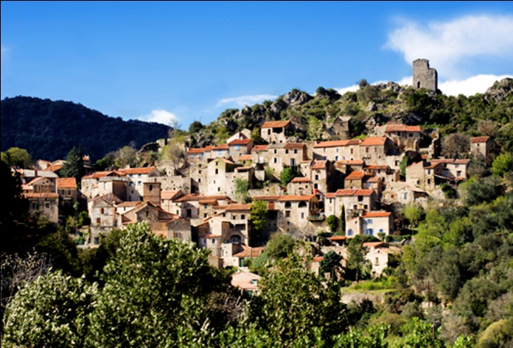
VILLAGES

Slide 34
Villages
The definition of a village varies throughout the world.
It usually describes a small number a people who live in a cluster of houses in a rural area.
Other structures found in villages include:
  government buildings
  markets
  places for religious gatherings

Slide 35
Villages
Another way to define a village is by the occupation of its people.
Most people work in the primary economic sector as:
  farmers
  herders
  fishers
  specialized workers

Slide 36
Village Forms
Round village
  This type features houses that circle around a central corral for animals with fields extending outside the ring of houses.
  Round villages are found in
    East Africa
    Parts of Europe
  Why was this design developed?
    To protect domesticated animals

Slide 37
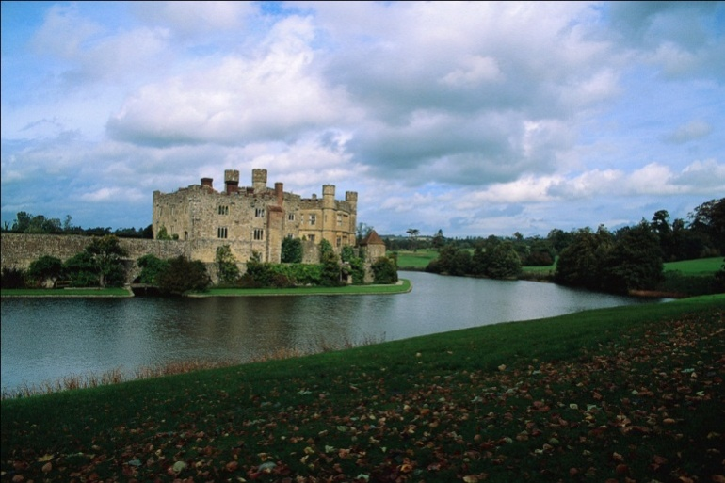
Village Forms
Walled village
  This type was developed in ancient days in order to protect villagers from attack.
  In Europe the villages were often surrounded by moats as well.

Slide 38
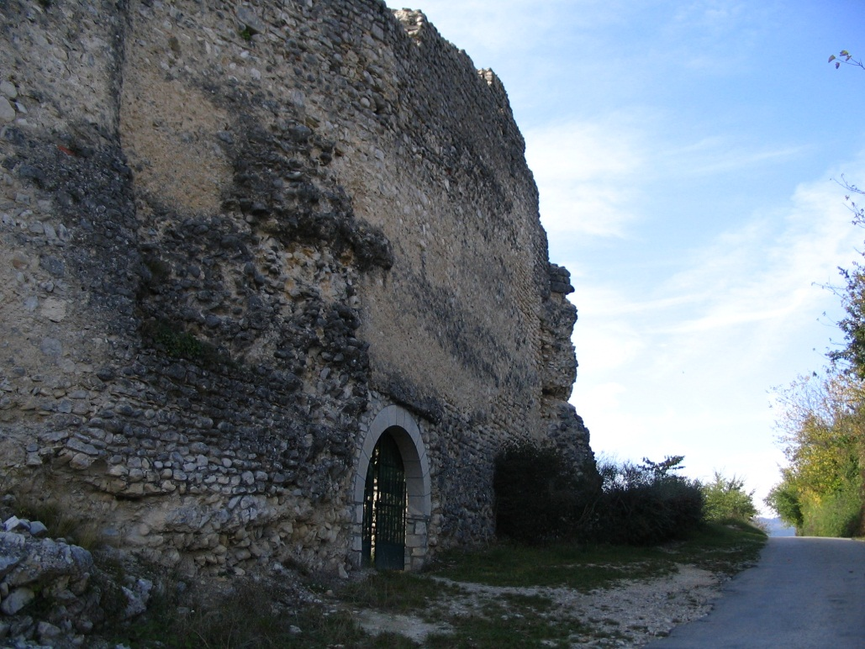
Remains of a Village Wall
This photo shows the remains of the wall and an old city gate that led to the city of Die in France.
The wall provided protection from attack, and the gate was heavily fortified.

Slide 39
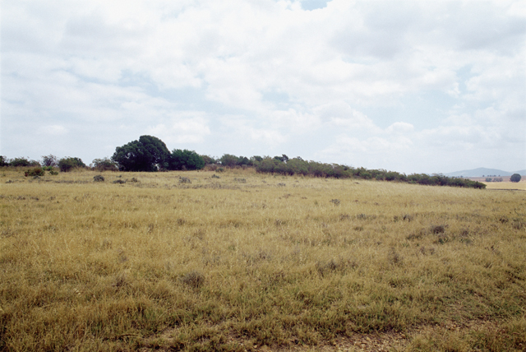
Village Forms
Grid village
  The grid village is more modern and is laid out in straight street patterns that run in parallel and perpendicular lines.
  It works best in areas with flat land.

Slide 40
Village Forms
Linear village
  This modern settlement follows major roads.
  There is often one single thoroughfare lined with:
    houses
    businesses
    public buildings

Slide 41
Village Forms
Cluster village
  This type of settlement may have more than one major road that inhabitants build along.
  It may also have housing that clusters around large public buildings such as:
    churches
    temples
    mosques
    grain bins
    livestock corrals

Slide 42
THE INFLUENCE OF LAND OWNERSHIP AND SURVEY TECHNIQUES

Slide 43
Land Ownership
One of the most important influences on land settlement patterns is land ownership.
Property lines divide one person’s land from another’s.
Rules about property inheritance often determine land distribution.

Slide 44
Land Ownership
Primogeniture
  Primogeniture is practiced in areas where all land passes to the eldest son, resulting in land parcels that are large and tended individually.
  Primogeniture is found in:
    Northern and southern Europe
    the Americas
    South Africa
    Australia and New Zealand

Slide 45
Land Ownership
Survey methods
  Surveys were first used in areas where settlement was regulated by law.
    Example: The U.S. government used the rectangular survey system to encourage settlers to disperse evenly across interior farmlands.
    These grid-like patterns that were formed during this process are still found in the U.S. today.

Slide 46
Land Ownership
Other survey systems
  The metes and bounds approach uses natural features to mark irregular parcels of land. This approach has been used along the eastern coast of the U.S.

Slide 47
Land Ownership
Other survey systems
  The long-lot survey system divides land into narrow parcels that extend from rivers, roads, or canals.
  This system has been used in:
    Quebec
    Louisiana
    Texas

Slide 48
Key Terms to Remember from this Session
Von Thünen Model
concentric rings
perishable crops
commercial crops
dispersed settlements
nucleated settlements
hamlets
villages
primary economic sector
round villages
walled villages
grid villages
linear villages
cluster villages
primogeniture
survey methods
metes and bounds approach
long-lot survey system

