Slide 1
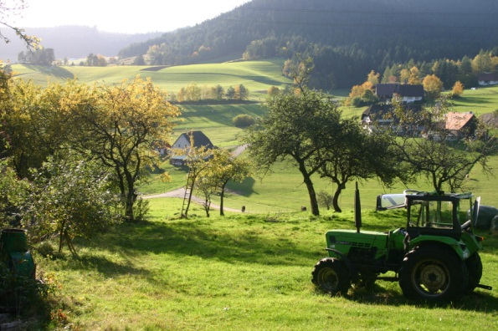
UNIT FIVE
AGRICULTURE:
PRIMARY ECONOMIC ACTIVITIES
ADVANCED PLACEMENT HUMAN GEOGRAPHY
Session 4

Slide 2
MODERN COMMERCIAL
AGRICULTURE

Slide 3
Modern Commercial Agriculture
Modern commercial agriculture has its roots in the commercial revolutions started during the 18th century in Europe.

Slide 4
The Role of Mercantilism
Mercantilism, an economic system, was developed by the British and Dutch, with private companies under charter from the governments carrying out the trade.
The main goal was to benefit the mother country by trading goods to accumulate precious metals and enrich the country.

Slide 5
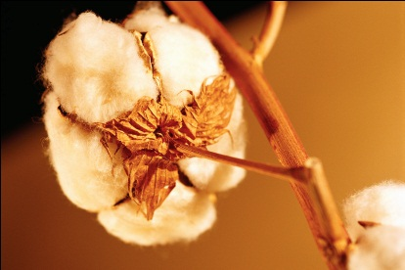
The Role of Mercantilism
Major products included…
Tobacco and cotton
from the American
colonies
Cotton from Egypt, Sudan, and India
Sugar from the plantations in the
Caribbean and Brazil

Slide 6

The Role of Mercantilism
These goods were marketed mainly in Europe, but sometimes they were manufactured in European factories and then sold back to the colonists.

Slide 7

Changes over time…
Modern global agricultural patterns still follow colonial patterns.
Poor countries still produce raw materials, including food, for consumption by those living in richer countries.
Examples:
  Colombians still produce coffee.
  Guatemala’s economy is supported by the sale of bananas.

Slide 8
Currently…
The production of cash crops in poor countries continues because many of them MUST repay loans from international organizations such as:
    The World Trade Organization (WTO)
    The International Monetary Fund (IMF)
    The World Bank

Slide 9
THE DIFFUSION OF
INDUSTRIAL AGRICULTURE

Slide 10
Industrial Agriculture
Today industrial agriculture is a stage in the commercial agriculture process which is just one step in a multiphase industrial process.
The process begins on the farm and ends on the consumer’s table.

Slide 11
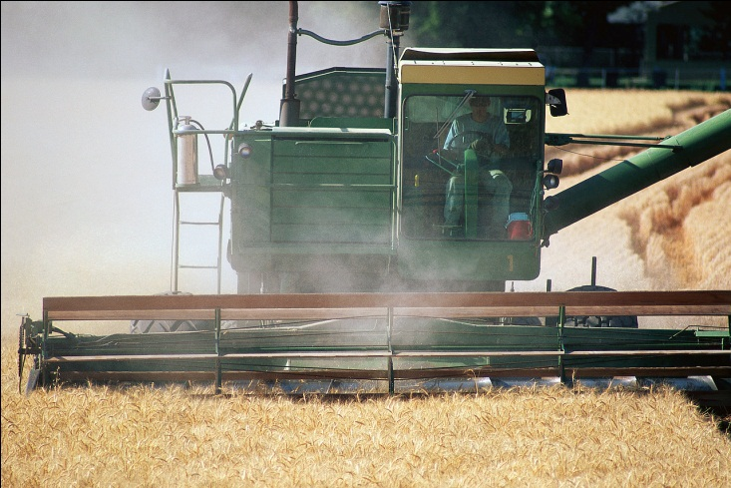
Industrial Agriculture
Commercial agriculture has spread to almost all areas of the world.
It has spread through global trade and exchange markets.
Almost all economies have adjusted to it in one way or the other.

Slide 12
Industrial Agriculture
Farmers not only produce for their own subsistence but for a market that is part of a complex system that includes the following:
      mining
      manufacturing
      processing
      service activities

Slide 13
Industrial Agriculture
Farmers must act within the constraints of the market that set prices based on supplies and demands of the global economy, and NOT on their own immediate needs.

Slide 14
Specialization
Agriculture is now characterized by specialization, the growing of specialized crops because they seem to be more profitable.
Farmers must weigh the costs of production such as:
    machinery
    fuel
    fertilizer
    labor
Farmers must also deal with unpredictable weather and/or disease.

Slide 15
Specialization
In the United States, farmers sought to minimize their risks during the 1950s by signing agreements with buyer-processors, who specified exact times and weights of products to be delivered, including :
  chicken
  cattle
  wheat
  potatoes
  other basic food

Slide 16
Agribusiness
Agribusiness is now spreading to developing countries where small-size farmers are linking with foreign sources for:
    advice
    seeds
    fertilizers
    machinery
    profitable markets at stable prices

Slide 17
Agribusiness: Criticisms
Poorer Countries
Agribusiness is seen as exploitive of small farmers who receive too little money for their products.
Wealthier Countries
Farmers in these countries are also concerned that competition from farms in less developed countries will drive down market prices.
Some governments have placed controversial import taxes on foreign produce in order to protect their own farmers.

Slide 18
THE THIRD AGRICULTURAL
REVOLUTION

Slide 19
The Third Agricultural Revolution
This revolution began in the mid-20th century and is still going on today in the form of industrial agriculture.
Modern farming refers to the industrialized production of:
  livestock
  poultry
  fish
  crops

Slide 20
The Third Agricultural Revolution
Methods of industrial agriculture include:
  innovation in agricultural machinery and methods
  genetic technology
  techniques for achieving economies of scale in production
  the creation of new markets for consumption
  global trade

Slide 21
The Third Agricultural Revolution
Most of the meat, dairy, eggs, fruits, and vegetables available in supermarkets are produced using the methods of industrial agriculture.

Slide 22
The Third Agricultural Revolution
Industrial agriculture is based on new, higher-yielding varieties of crops developed in laboratories and plant nurseries through biotechnology.
Biotechnology is the use of genetically altered crops in agriculture and DNS manipulation in livestock in order to increase production.

Slide 23
The Third Agricultural Revolution
THE DEVELOPMENT OF MIRACLE GRAINS
  The experiments began with hybrid rice initiatives in the U.S. Midwest in the 1930s.
  Hybrids were developed and by the 1980s, “IR36” was developed.
  This led to:
    higher quantities of larger grains
    a shorter growing cycle
    a crop that was more resistance to pests

Slide 24
The Third Agricultural Revolution
More recently, scientists have developed new high-yield variations of corn.

Slide 25
THE GREEN REVOLUTION

Slide 26
The Green Revolution
By the 1970s, the collection of new agricultural techniques was called the Green Revolution, which involved two important practices:
  the use of new higher-yield seed
  the expanded use of fertilizers

Slide 27
The Diffusion of the Green Revolution
1. The Green Revolution has resulted in agricultural production outpacing population growth by the late 20th century.
2. The dramatic changes brought about the Green Revolution have been both praised and criticized.

Slide 28
The Green Revolution
Praise
Criticisms
Famines that have occurred throughout history can now be avoided, since agricultural production now outpaces population growth.
Poor farmers cannot always afford the items necessary to get new foods to citizens such as:
  machinery
  seeds
  fertilizers

Slide 29
The Green Revolution
Praise
Nitrogen-based fertilizers have increased farm productivity in many countries of the world.
Criticisms
Farmers in poorer countries cannot afford the fertilizers.
Fertilizers have also led to groundwater pollution and the reduction of organic matter in the soil.

Slide 30
The Green Revolution
Praise
Scientists continue to invent new food sources including:
  higher-protein cereals
  cultivating the oceans
  improving the palatability of rarely consumed foods
Criticisms
Many fishing areas are over-fished.
Cultural preferences shape food consumption and production of rarely eaten foods will not change eating habits.

Slide 31
The Green Revolution
Praise
Higher productivity is primarily responsible for reducing dependency on imports in Asia, including China and India.
In both areas populations are balanced fairly well with food resources.
Criticisms
Many people in Sub-Saharan Africa are not getting enough to eat, with millions of people facing famine.
Green Revolution techniques have made too few inroads, and population is increasing faster than food production.

Slide 32
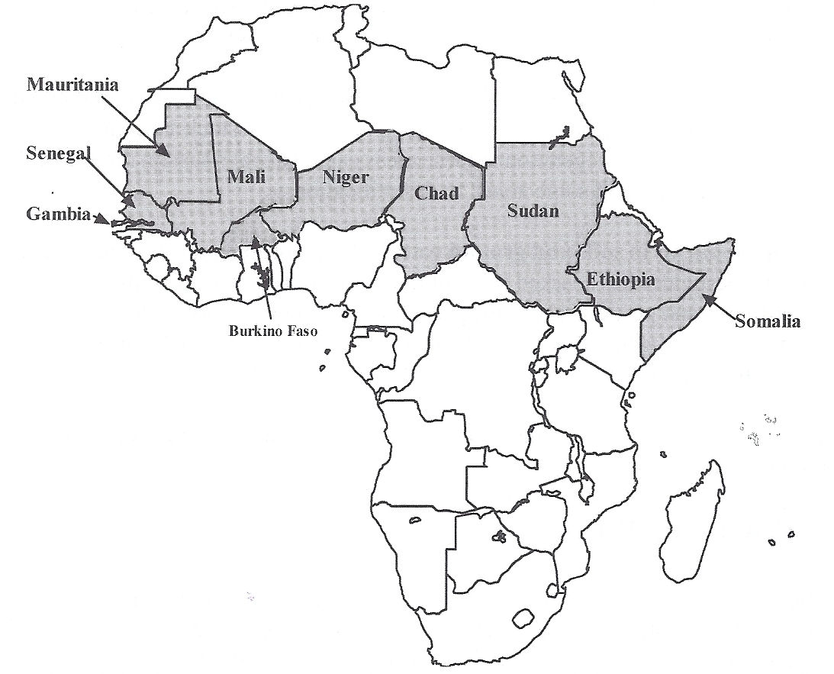
Food Supply Crisis in Africa
Production of most food crops is lower today in Africa than it was 40 years ago, at the same time that populations are increasing.

Slide 33

The Green Revolution: Desertification
Traditionally, the Sub-Saharan region has supported limited agriculture, with pastoral nomadism prevailing.
The land has now been overgrazed by animals, and soils have been exhausted from overplanting.
These practices have led to desertification, with the Sahara Desert claiming more land space.

Slide 34
The Green Revolution:
Desertification
Soil erosion has become a problem.
The limited number of trees have been cut for wood and charcoals for urban cooking and heating.
Government policies have traditionally favored urban populations by keeping food prices low, giving farmers little incentive to increase their productivity.

Slide 35
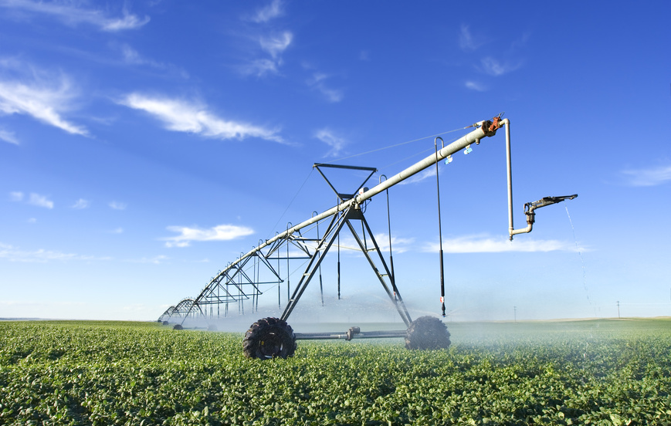
The Green Revolution
Praise
New irrigation processes have greatly increased crop yields.
Criticisms
Irrigation has led to serious groundwater depletion, negatively impacting water supplies for urban populations.

Slide 36
The Green Revolution
Praise
Agribusiness has increased the productivity of cash crops.
This increased productivity has yielded profits for farmers and raised large amounts of basic crops to feed the world.
Criticisms
Agribusiness often means that land is devoted to raising one type of crop, rather than the variety needed for a balanced diet.
This practice is especially true in poorer countries.

Slide 37
ENVIRONMENTAL IMPACTS OF
MODERN AGRICULTURE

Slide 38
Environmental Impacts of Modern Agriculture
The industrialization and commercialization of agriculture has strengthened agriculture’s impact on the environment.

Slide 39
Environmental Impacts of Modern Agriculture
Erosion
  Lands cleared for agriculture almost immediately begin to erode.
  When the surface area has been stripped, it is subject to flooding, and loose soil clogs irrigation and drainage channels.

Slide 40
Environmental Impacts of Modern Agriculture
Changes in the organic content of soil
  Crops take nutrients from the soil.

Slide 41
Environmental Impacts of Modern Agriculture
Depletion of natural vegetation
  Depletion is an increasing problem as commercial agriculture expands into marginal environments.
  Example: When livestock moves into arid or semi-arid areas, the natural vegetation cannot always sustain the herds.
  This depletion can lead to desertification.

Slide 42
Environmental Impacts of Modern Agriculture
Presence of chemicals in soils and ground water
  Concern about the use of chemicals from fertilizers and pesticides has sparked a recent trend toward organic agriculture.

Slide 43
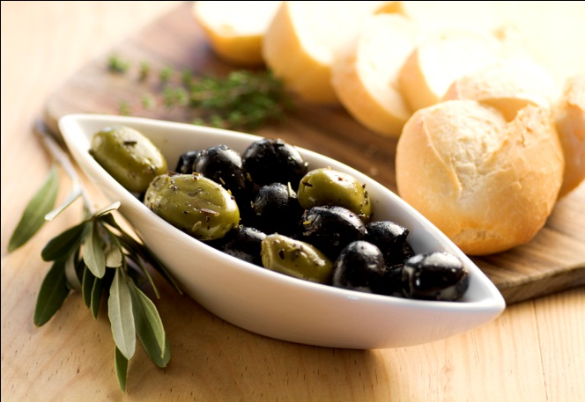
Environmental Impacts of Modern Agriculture
Organic agriculture involves growing crops without fertilizers and pesticides, ensuring that the consumer will not suffer adverse health effects from them.
Sale of organic products has increased primarily in these parts of the world:
  the United States
  Western Europe
  Japan

Slide 44

SUSTAINABLE
AGRICULTURE

Slide 45
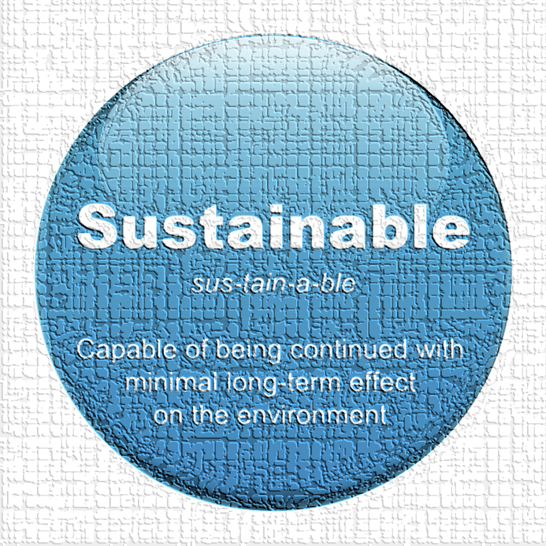
Sustainable Agriculture
What is sustainable agriculture?
  It attempts to integrate plant and animal production practices that will protect the ecosystem over the long term.
  It promotes the idea that human needs can be met without sacrificing environmental quality and depleting natural resources.

Slide 46
Sustainable Agriculture
What is emphasized?
  Soil quality and water quality are emphasized!
  How?
    Recycling crop waste and livestock manure
    Growing peanuts or alfalfa to enrich soil with nitrogen
    Long-term crop rotations

Slide 47
Sustainable Agriculture
In areas requiring irrigation…
  Water resources may be depleted.
  Improvements in water well drilling technology and submersible pumps combined with drip irrigation have made it possible to increase crop yields.
  HOWEVER…
  In some areas, these practices deplete water faster than it rate of recharge.

Slide 48
Sustainable Agriculture
What steps support drought resistant farming?
  Improving water conservation and storage measures
  Providing incentives for selection of drought-tolerant crop species
  Using reduced-volume irrigation systems
  Managing crops to reduce water loss

Slide 49
FUTURE FOOD
SUPPLIES

Slide 50
Future Food Supplies
Today several strategies are used to ensure and improve the production and distribution of adequate food products around the world.

Slide 51
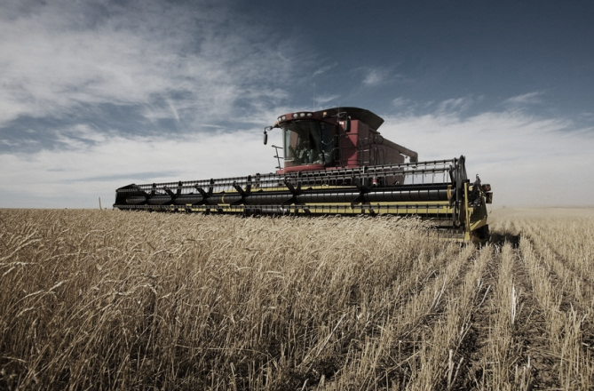
Future Food Supplies
Expansion of agricultural land
  The historical method of increasing food production has been to clear and plow land for planting. However, this method is not as likely to increase food supplies as it once was.
  Only about 11% of the world’s land area is currently cultivated, but most of the remaining land is not arable.

Slide 52
Future Food Supplies
Expansion of agricultural land
  Some land has been lost due to desertification, a deterioration of the land because of over-grazing and over-planting.
  Irrigation can also ruin land in dry areas because hard soils do not allow proper drainage.

Slide 53
Future Food Supplies
Expansion of agricultural land
  Urbanization also cuts down on available land space, as farms are replaced by:
      homes
      roads
      shops

Slide 54
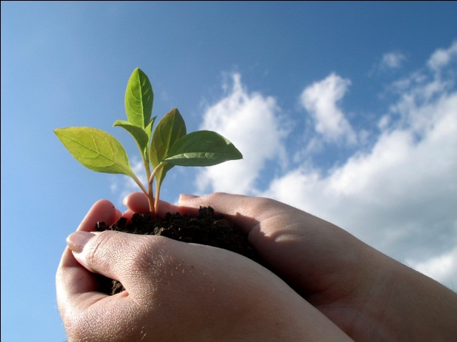
Future Food Supplies
Increase in land productivity
  The Green Revolution made this alternative for increasing the food supply a viable one.
  New hybrids and nutrients are added to the soil through fertilizer, and more crops are produced, and more animals are supported.

Slide 55

Future Food Supplies
Identification of new food sources
  With improved access to ocean food away from the shore, more food sources may be found.
  Many people avoid food for social reasons, but other nutritious products may become popular.
    Example: soybeans

Slide 56
Future Food Supplies
Improved distribution of food
  The top three export grains are
    wheat
    corn
    rice
  Most of those grains come from the U.S.
  Thailand has replaced the U.S. as the leading exporter of rice.

Slide 57
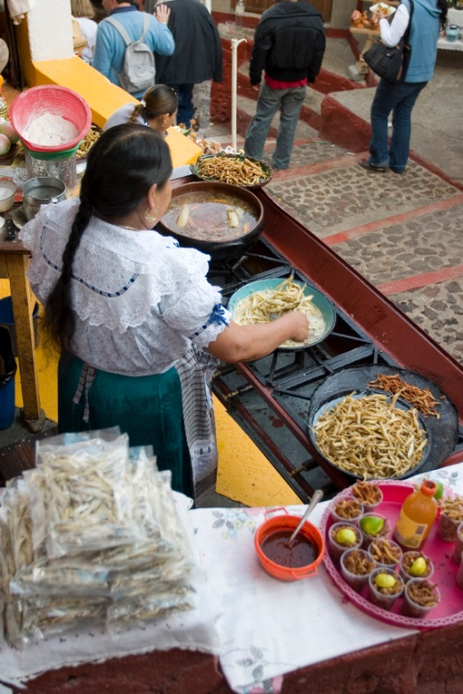
Future Food Supplies
Improved distribution of food
  In countries that export, food sometimes goes to waste, either because markets are not coordinated properly or because the government subsidizes crops.
  Meanwhile, countries that need food cannot buy it, either from lack of resources or poor coordination of markets.

Slide 58
Summary
Farming is still the major occupation in less developed countries.
  In more developed countries, fewer people are farmers, but many are employed in the food business, including plants, supermarkets, restaurants, and food wholesalers.

Slide 59
Summary
Farming continues to alter the earth’s landscape, leaving the human imprint deeply ingrained on the land.

Slide 60
Key Terms and Concepts to Remember
Commercial agriculture
Mercantilism
Global agricultural patterns
Industrial agriculture
Specialization
Agribusiness
Third Agricultural Revolution
Biotechnology
Miracle grains
Green Revolution
Yield
Overgrazing
Overplanting
Desertification
Organic agriculture

