Slide 1
Unit Six:
INDUSTRIALIZATION
Advanced Placement
Human Geography
Session 1

Slide 2
ECONOMIC GEOGRAPHY

Slide 3
Economic Geography
What is it?
  Economic geography studies the impact of economic activities on the landscape and investigates reasons behind the locations of economic activities.

Slide 4
Why is economic geography interesting to geographers?
Geographers are interested in
  the changes that industrialization has brought to the cultural and social landscapes
  the different patterns of wealth created by industrialization
  the gap between rich and poor people of the world that became more pronounced after industrialization

Slide 5
KEY CONCEPTS IN INDUSTRIALIZATION
AND DEVELOPMENT

Slide 6
Definition
Industrialization
Industrialization is the process by which economic activities on earth’s surface evolved from producing basic, primary goods to using factories for mass-producing goods for consumption.

Slide 7
Industrialization
Industrialization involves the production of goods using advanced sources of energy to drive large machinery and specialized labor to produce standardized goods.

Slide 8
The Industrial Revolution
The Industrial Revolution began in England in the late 18th century.
Economic development, the process of improving the material conditions of people through the diffusion of knowledge and technology, has occurred as a result of industrialization.

Slide 9
Types of Economic Activities
Economic development may be traced by examining three types of economic activities:
  the primary sector (agriculture)
  the secondary sector (industry)
  the tertiary sector (services)

Slide 10
The Primary Sector
This is the part of the economy that draws raw materials from the natural environment.
It consists of
    agriculture
    raising animals
    fishing
    forestry
    mining

Slide 11
The Primary Sector
This sector of the economy is largest in low-income, pre-industrial nations.
Even though it originated 10,000 years ago, farming is still the major occupation in many countries of the world.

Slide 12
The Secondary Sector
The secondary sector is the part of the economy that transforms raw materials into manufactured goods.
This sector grows quickly as societies industrialize and includes the following operations:
  refining petroleum into gasoline
  turning metals into tools and automobiles

Slide 13
The Secondary Sector
As industrialization diffused to other areas of the world, economic activities dramatically changed along with:
    lifestyles
    values
    beliefs
    customs

Slide 14
The Secondary Sector
This sector was first created during the late 18th century by the Industrial Revolution.
Human and animal muscle was replaced with energy generated by machines.

Slide 15

The Tertiary Sector
This sector is the part of the economy that involves services rather than goods.
Tertiary activities grow with industrialization and come to dominate post-industrial societies, or countries where most people are no longer employed in industry.

Slide 16
The Tertiary Sector
Post-industrial production is based on computers and other electronic devices that create, process, store, and apply information.
Occupational structure changes significantly with post-industrialism.

Slide 17
The Tertiary Sector
Examples of tertiary sector jobs:
  construction
  trade
  finance
  real estate
  private services
  government
  transportation

Slide 18
The Tertiary Sector
The quaternary sector is often seen as a subset of the tertiary sector.
This sector includes service jobs concerned with research and development, management and administration, and processing and disseminating information.

Slide 19
Categorizing Countries by
Economic Activities
More Developed Countries
(MDCs)
Less Developed Countries
(LDCs)
These countries have experienced industrialization.
These countries have not experienced industrialization.
Most countries in the world belong in this category.

Slide 20
Categorizing Countries by
Economic Activities
Some LDCs may be subcategorized as newly-industrialized countries.
  These countries are found mostly in Asia and Latin America.

Slide 21

Categorizing Countries by
Economic Activities
The process experienced by these countries is sometimes called compressed modernity.
  This means that the country has experienced:
    rapid economic and political change
    a growing economy
    an expanding web of nongovernmental institutions

Slide 22

Categorizing Countries by
Economic Activities
Examples of newly industrialized countries:
  South Korea developed as one of the world’s largest economies during the last 50 years. It was once a poor agricultural country.
  Mexico has had dramatic economic growth that began in the late 1980s because of an abundance of oil.

Slide 23
ECONOMIC INDICATORS OF DEVELOPMENT

Slide 24
Economic development may be measured in several ways.

Slide 25
Gross Domestic Product Per Capital (GDP)
GDP is the value of the total output of goods and services produced in a country during a year.
Dividing the GDP by total population creates the GDP per capita, a measure of the average person’s contribution to a country’s wealth in a year.

Slide 26
Gross Domestic Product Per Capital (GDP)
In MDCs, the annual GDP per capita exceeds $20,000.
In LDCs, the annual GDP per capita is approximately $1,000.
The annual GDP per capita in newly industrialized countries falls between $1,000 and $20,000.

Slide 27
Gross Domestic Product Per Capital (GDP)
GDP is strongly related to many social characteristics, since economic development is dependent on a skilled work force.
Social characteristics include:
    literacy rates
    education levels

Slide 28
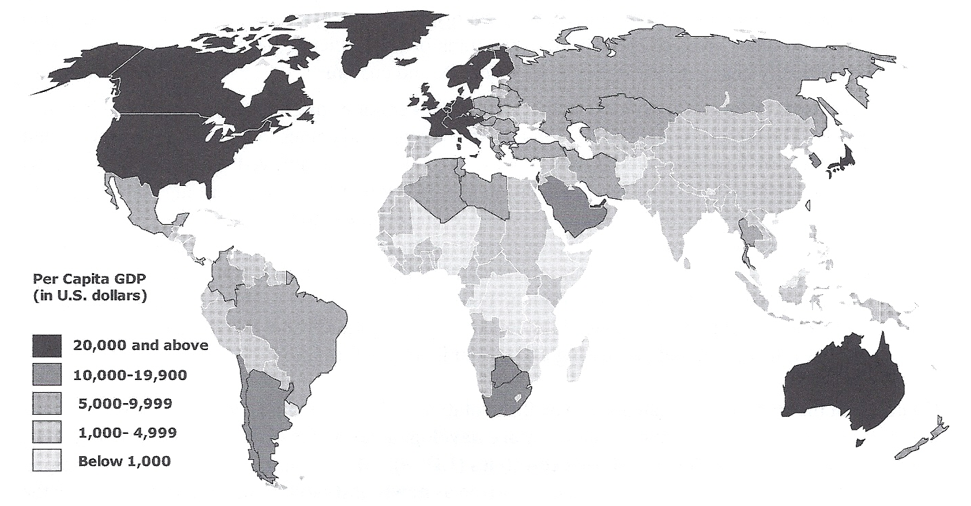
Annual Gross Domestic Product (GDP)
Per Capita

Slide 29
Types of jobs
MDCs usually have the fewest workers in the primary sector, and the most in the tertiary sector.
LDCs have a larger percentage of workers in the primary sector, generally occupied as farmers.

Slide 30
Types of jobs
Middle income nations have workers spread among the three economic sectors:
    primary
    secondary
    tertiary

Slide 31
Worker Productivity
Workers in MDCs are more productive than those in LDCs, largely because they have access to more:
    machines
    tools
    equipment
Workers in LDCs rely more on animal and human power.

Slide 32
Worker Productivity
Productivity can be measured by the value added by each worker.
Value added in manufacturing may be figured by subtracting the costs of raw materials and energy from the gross value of the product.

Slide 33
Worker Productivity
The value added in MDCs is much higher than in LDCs.

Slide 34
Access to Raw Materials
Development requires access to raw materials than can be transformed into useful products.
Raw materials include:
  minerals
  trees

Slide 35
Access to Raw Materials
Energy to operate factories is also necessary.
Energy takes the form of:
  oil
  coal
  water
  natural gas

Slide 36
Access to Raw Materials
During the 19th century, an important motivation for European empires was control of natural resources in other areas.
Today countries have access to raw materials through world trade.

Slide 37
Availability of Consumer Goods
MDCs have wealth for both essential and nonessential goods.
Essential goods include:
    food
    shelter
    clothing
Nonessential goods include:
    cars
    telephones
    televisions

Slide 38
Availability of Consumer Goods
The production and sale of nonessential goods in MDCs are vital to the economy.
Few people in LDCs have the means to buy nonessential goods. Therefore, the growth potential of economies is limited.

Slide 39
Economic Development
Economic development is often accompanied by social development such as:
    high rates of literacy
    access to formal education
    good health care

Slide 40

Economic Development
Economic development also changes demographic characteristics such as:
    life expectancy
    birth rates
    death rates

Slide 41
Key Terms and Concepts to
Review for this Session
Economic geography
Cultural landscape
Social landscape
Industrialization
Mass production
Industrial Revolution
Primary sector
Secondary sector
Tertiary sector
Quaternary sector
Post-industrialism
MDCs
LDCs
Newly industrialized countries
Compressed modernity
Economic indicators
GDP
GDP Per Capita
Value added
Essential goods
Nonessential goods
Consumer goods

