Slide 1
Unit Six:
INDUSTRIALIZATION
Advanced Placement
Human Geography
Session 3

Slide 2
GROWTH AND DIFFUSION OF INDUSTRIALIZATION

Slide 3
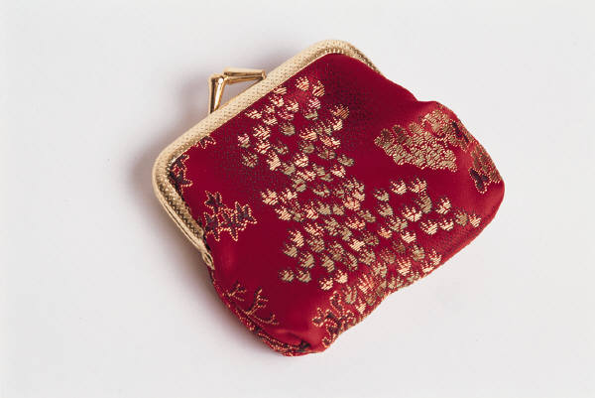
The Existence of Industry
Prior to the Industrial Revolution, industrial centers existed in:
    China: silk factories
    India: metal workshops

Slide 4
The Production of Goods
Most work was done by hand and powered by water and/or wind prior to the
Industrial Revolution.

Slide 5
A Big Breakthrough!
The invention of the steam engine was a huge breakthrough for industry.
It was invented by James Watt.
The engine could pump water more efficiently than water mills used at the time.

Slide 6
A Big Breakthrough!
New methods for smelting iron were discovered that transformed coal into high-carbon coke.

Slide 7
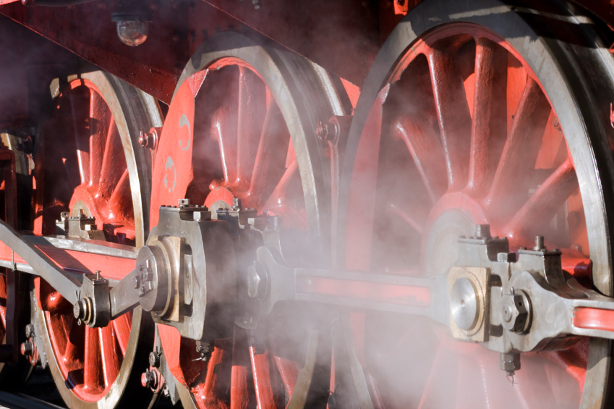
THE INDUSTRIAL REVOLUTION

Slide 8

The Textile Industry
The textile industry was one of the FIRST to benefit from new steam-powered machines and smelting processes.
New inventions helped to weave cloth.
British factories began to demand more raw materials such as:
      wool
      linen
      cotton

Slide 9
The Textile Industry
The textile industry was transformed from home-based industries to a small number of large factories centered in a
few locations.

Slide 10

What helped to diffuse industries?
Britain had:
  a stable government
  wealth from overseas ventures
  an abundant supply of coal
  good transportation and
  communications systems

Slide 11
What helped to diffuse industries?
The first railroad in England was opened in 1825, and soon major cities were connected by rail.

Slide 12
What helped to diffuse industries?
Ships benefited from steam engines.
England expanded its industrial power as steam-powered vessels began crossing the Atlantic Ocean.

Slide 13
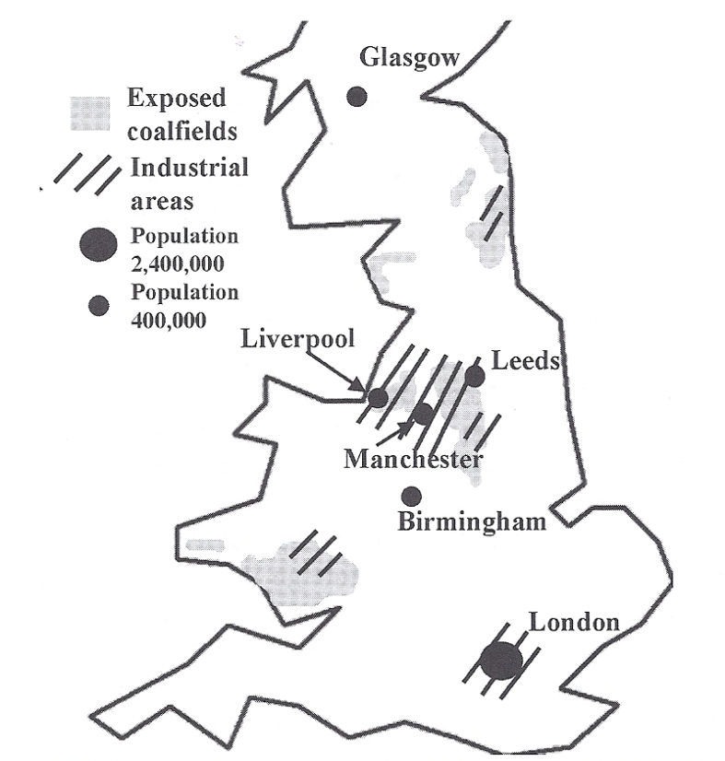
INDUSTRIAL BRITAIN BY 1850
The first industries arose in northern and western England around abundant coal and iron-ore deposits. Railroads connected the major cities to one another and to the coast for shipping.

Slide 14
Industrialization Through the Early 20th Century

Slide 15
As Industrialization Diffused During the 19th Century…
Britain had an enormous comparative advantage over other areas.
Britain’s creator role in the Industrial Revolution allowed expansion of its colonial empire to further its prosperity and power.

Slide 16
As Industrialization Diffused During the 19th Century…
The new industries transformed England’s landscape.
Cities grew dramatically, especially in north-central England where a belt of major coalfields was located.

Slide 17
As Industrialization Diffused During the 19th Century…
Mainland Europe: Another industrial belt developed around coalfields that stretched through…
    northern France
    southern Belgium
    the Netherlands
    Germany
    Poland

Slide 18

As Industrialization Diffused During the 19th Century…
Iron ore was found in the industrial belt in mainland Europe.
Economic activity developed accordingly.

Slide 19
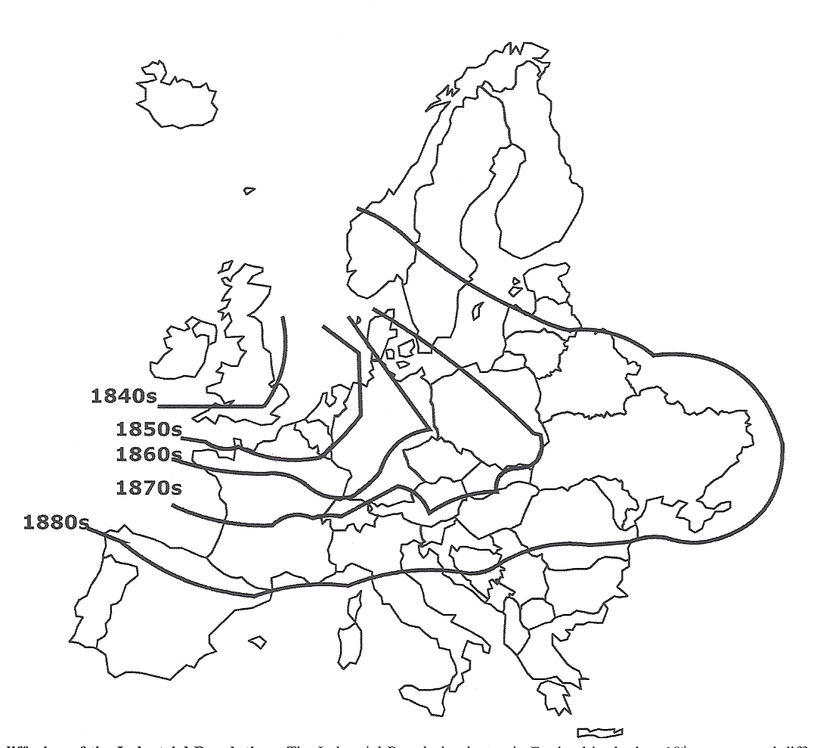
THE DIFFUSION OF THE INDUSTRIAL REVOLUTION
The Industrial Revolution began in England in the late 18th century and diffused across Europe, following belts of coalfields and iron ore.

Slide 20
Western Europe’s Industrial Success
Although Western Europe had abundant raw materials, France, Britain, and the Low Countries had access to resources from their colonial empires.
Europe also had skilled laborers as well as established trade routes to facilitate exchange of new products.

Slide 21

By the turn of the 20th century…
Industry had diffused as far as northern Spain, southern Scandinavia, and the Ukraine.
This shows the area of diffusion.

Slide 22

By the turn of the 20th century…
Industrialization had diffused westward across the Atlantic to North America.
Natural resources and available land space encouraged economic development in this region.

Slide 23
North America and the
Industrial Revolution
The first U.S. textile mill was built in Rhode Island in 1791 by Samuel Slater.
Slater was a former worker in an English factory.

Slide 24

North America and the
Industrial Revolution
Industry grew because of government protection through embargoes on European trade.
Most early industry grew in the northeastern United States.

Slide 25

North America and the
Industrial Revolution
The area lacked abundant natural resources.
However, there was a large population from Boston to Washington, D.C.
As a result, the Northeast provided a large market for consumption of industrial products.

Slide 26
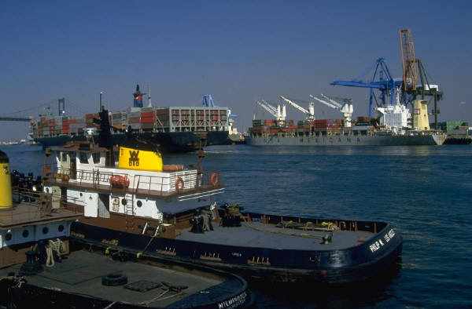
North America and the
Industrial Revolution
New York City became one of the world’s great ports.
The city had a large skilled and semiskilled labor force.

Slide 27
North America and the
Industrial Revolution
New York also had a natural harbor for break-of-bulk, where cargo was transferred from one type of carrier to another. Example: Goods could be transferred from ships to trains and trucks and vice versa.

Slide 28
By the start of World War I…
Europe had developed a huge industrial base.
The United States was rapidly catching up to Europe.
However, industrialization had NOT diffused to the rest of the world, except for areas settled by Europeans (e.g. Australia).

Slide 29

20th Century Industrialization after World War I

Slide 30

The Mid-20th Century…
The use of coal as an energy source diminished.
The use of oil and natural gas greatly increased.

Slide 31
The Mid-20th Century…
Industrialized nations needed these products to run their:
      power plants
      machinery
      cars
      airplanes
      ships

Slide 32
The Mid-20th Century…
Oil and natural gas became common forms of energy for heating homes and providing household conveniences, such as heating water.

Slide 33
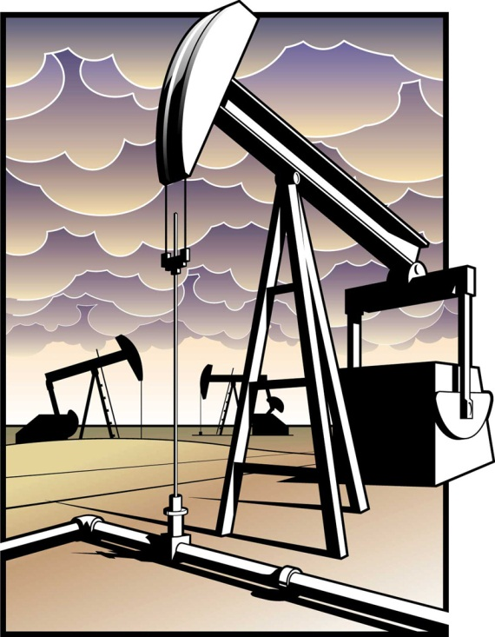
The Mid to Late 20th Century…
The U.S. and industrialized Europe turned to foreign countries for their energy needs.
Those countries included:
  Saudi Arabia
  Kuwait
  Iran
  Russia
  China
  Mexico
  Venezuela
  Nigeria

Slide 34

The Mid to Late 20th Century…
Oil enriched countries that played host to American and European multinational companies.

Slide 35
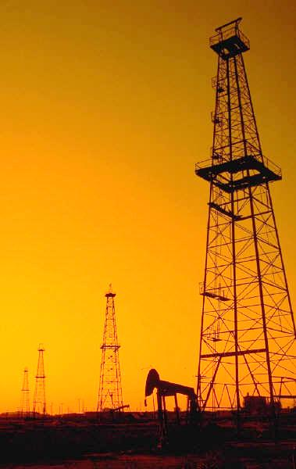
The Mid to Late 20th Century…
Most oil-rich nations signed agreements with these companies that allowed a great deal of wealth to return to the U.S. and Europe.
These agreements have produced international tensions between developing countries and the established industrialized powers.

Slide 36
Key Terms and Concepts to
Review for this Session
Industrial centers
Water and wind power
Steam engine
James Watt
Home-based industries
Importance of railroads
Comparative advantage
Industrial belt
Raw materials
Skilled laborers
Semiskilled laborers
Samuel Slater
Embargoes
Break-of-bulk
Multinational companies

