Slide 1
Unit Six:
INDUSTRIALIZATION
Advanced Placement
Human Geography
Session 4

Slide 2
THE EVOLUTION OF ECONOMIC CORES
AND PERIPHERIES

Slide 3

Why did industrial growth occur in some areas and not others?
Location theory explains the locational pattern of economic activities by identifying factors that influence this pattern.

Slide 4
Why did industrial growth occur in some areas and not others?
The patterns formed by primary and secondary industries divide the world into regions based on economic activities.

Slide 5
Primary Industry
Primary industry develops around the location of natural resources.
Example: the industrial belt in the British Midlands.

Slide 6
Secondary Industry
As transportation improves, secondary industry develops.
Secondary industry is less dependent on resource location.
Raw materials may be transported to factories for manufacturing.

Slide 7
Secondary Industry
Variable costs
  Energy, labor, and transportation are less expensive in some areas than others. Low costs encourage industries to develop.
Location depends on several factors.

Slide 8
Secondary Industry
Location depends on several factors.
Distance decay
  As distance increases, business activity decreases until it becomes impractical to do business.

Slide 9

So…
Where are industries more likely
to serve markets?
In nearby places, largely because of friction of distance.

Slide 10
IMMANUEL WALLERSTEIN

Slide 11

The Core-Periphery Model
Immanuel Wallerstein first used the following terms in 1974:
  core
  periphery
  semiperiphery

Slide 12
The Core-Periphery Model
He used the terms to promote dependency theory among nations.
Many economic geographers now use the core-periphery model to describe economic spatial patterns in general.

Slide 13

The Core-Periphery Model
Core regions have concentrations of primary and secondary industries.
Peripheral regions do not.
Semiperipheral regions have some industries in contrast to peripheries, but not as many as the core regions.

Slide 14

The Core-Periphery Model
Even within core countries wealthy urban cores lie in contrast to depressed rural peripheries.

Slide 15

The Core-Periphery Model
Example: modern-day United States
  “High tech” concentrations create wealth that contrasts to rural areas or “rust belt” industrial areas that provide few job opportunities for young people.
  “High tech” areas include the Pacific coastline, the Northeast, some interior cities (e.g. Austin, Texas).

Slide 16
The Core-Periphery Model
With more jobs in the service sector, people move to areas where those jobs are provided, leaving the peripheral areas with even fewer resources than they had before.

Slide 17
The Core-Periphery Model
A look at India…
  This country has clear core/peripheral distinctions.
  High tech jobs are often outsourced by Western companies and are growing rapidly in urban centers.
  Urban centers contrast to peripheral areas that still adhere to traditional customs and occupations.

Slide 18
WEBER’S MODEL FOR THE LOCATION
OF INDUSTRIES

Slide 19
Alfred Weber
In his Theory of the Location of Industries published in 1909, Weber developed a model for the location of secondary industries.
Weber identified points for particular inter-related activities, such as:
  manufacturing plants
  mines
  markets

Slide 20
Alfred Weber
Weber’s industrial model has been compared to Von Thünen’s agricultural model.
Both are examples of location theory that explain patterns of economic activities.

Slide 21
Weber’s Least Cost Theory
The least cost theory explains the location of industries in terms of three factors:
  transportation
  labor
  agglomeration

Slide 22
Transportation
The site of industry is chosen in part by the cost of moving raw materials to the factory and finished products to the market.
Business owners look for the least expensive transportation costs.

Slide 23
Transport Media
Truck transport is cheapest over short distances.
Railroads are most cost efficient over medium distances.
Ships are cheapest over long distances.
Transportation involves terminal costs which vary considerably.
Terminal costs are least expensive for trucks and most expensive for ships.

Slide 24
Labor
The cost of labor is important when determining the location of secondary industries.
Cheap labor may allow an industry to make up for higher transportation costs.

Slide 25

Labor
Example: A factory may relocate from the U.S. to Mexico where transportation costs to market increase but are more than made up by cheaper labor costs.

Slide 26
Agglomeration
If several industries cluster in one city, they can provide support by sharing
  talents
  services
  facilities

Slide 27

Agglomeration
A restaurant needs furniture and equipment, and the companies that provide those products have workers that bring business to the restaurant.
AN EXAMPLE…

Slide 28

Agglomeration
All the workers need clothes that may be provided by a clothing store that also needs furniture and equipment and employs people who eat in the restaurant.
AN EXAMPLE…

Slide 29
Agglomeration
The point of agglomeration explains location of industry.
Excessive agglomeration may lead to an increase in labor and transportation costs. This is called deglomeration, or the exodus of businesses from a crowded area.

Slide 30

Criticism of Least Cost Theory
The substitution principle suggest that business owners can juggle expenses such as:
  labor
  land rents
  transportation
This balancing of expenses allows a business to be profitable within a larger area than Weber’s model suggests.

Slide 31
LOCATIONAL INTERDEPENDENCE THEORY

Slide 32
Locational Interdependence Theory
Another approach to location theory is locational interdependence, or the influence on a firm’s locational decision by locations chosen by its competitors.

Slide 33
Locational Interdependence Theory
This model is concerned with variable revenue analysis, or the firm’s ability to capture a market that will earn it more customers and money than its competitors.

Slide 34
Locational Interdependence Theory
An example of this theory was provided by the economist, Harold Hotelling:
  Two ice cream vendors on a beach sold identical products and had a fixed demand for ice cream from their customers (those on the beach).
  Where should each vendor locate?

Slide 35
Locational Interdependence Theory
Example (continued):
  In reality, what generally happens is that both vendors on the beach will cluster in the middle.
  That way each can have half but can also compete for those customers located in the middle.
  This maximizes the customer base.

Slide 36
Locational Interdependence Theory
Example (continued)
  The problem is that some customers will have to walk farther to get ice cream.
  They may then change their minds and not want ice cream.
  If that happens, the vendors might have to relocate.

Slide 37
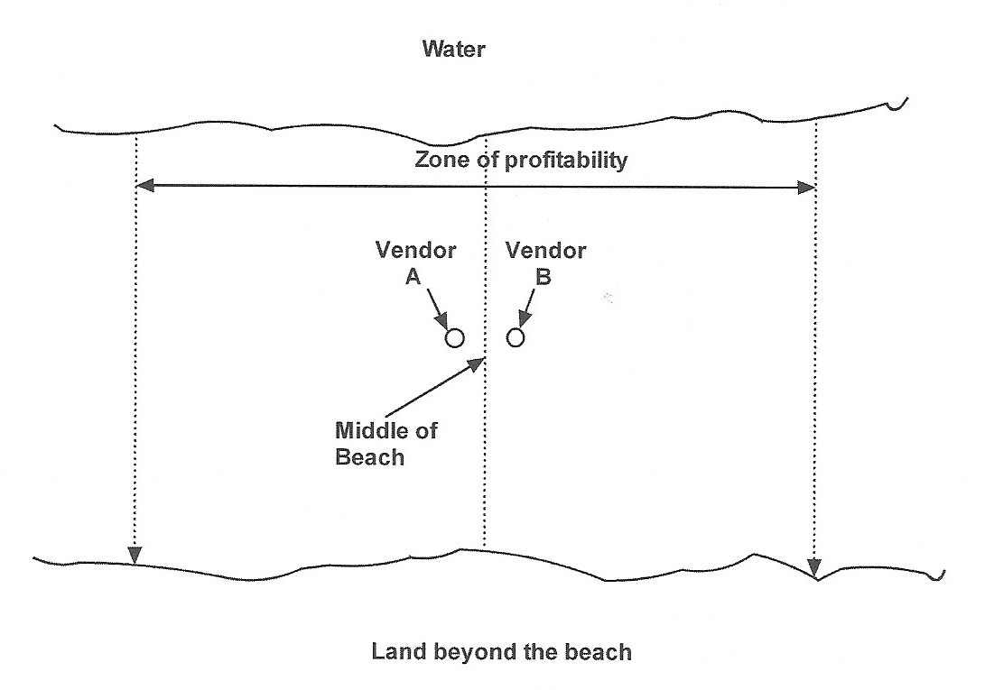
Below is an illustration of locational interdependence using the example of two vendors on a beach.

Slide 38
SITUATION AND SITE FACTORS

Slide 39

Geography provides companies with two types of production costs: situation and site factors

Slide 40
Situation Factors
Situation factors have to do primarily with transportation —bringing raw materials or parts into a factory and shipping the finished goods to consumers or retailers.

Slide 41
Situation Factors
Bulk-reducing industries usually locate factories close to raw materials because the raw materials are heavier and bulkier than the finished products.
Examples: North American copper industry; U.S. steel industry

Slide 42
Situation Factors
Factories for bulk-gaining industries usually determine location by accessibility to the marketplace.
Examples: canned food; beverage products
Weight is gained and transportation costs are increased so being close to consumers is important!

Slide 43
Situation Factors
Single-market manufacturers also cluster near their markets.
Example: clothing manufacturers who ship their goods to New York City

Slide 44
Situation Factors
Von Thünen noted for farmers that perishable products need to be close to large urban markets.

Slide 45
Site Factors
Site factors are particular to a geographic location and focus on varying costs of:
  land
  labor
  capital

Slide 46
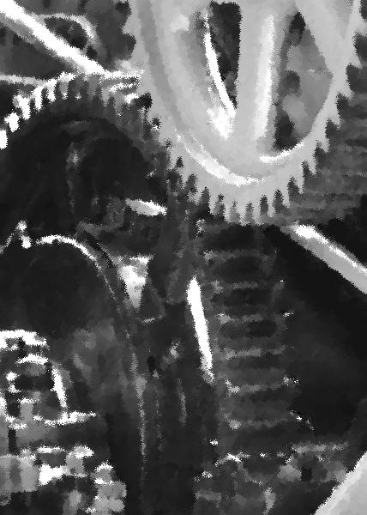
Site Factors
Modern factories are located in suburban or rural areas, and NOT in center cities, where land costs are prohibitive for the space necessary for production.

Slide 47
Site Factors
Climate may also impact location decisions, with some industries drawn to relatively mild climates and opportunities for year-round outdoor recreation activities.

Slide 48
Site Factors
The cost of labor is another consideration, especially for labor-intensive industries.
Examples:
  fiber-spinning
  weaving
  cutting and sewing fabric into clothing

Slide 49
Site Factors
Textile industries require skilled workers and so they often choose locations where labor costs are low.
Example: China and other Asian countries have cheaper labor.

Slide 50
Site Factors
Sometimes businesses are influenced by the willingness of banks in a geographical location to provide loans to entrepreneurs.
Example: California’s Silicon Valley
  Banks offered large incentive packages to persuade businesses to locate within their city limits.

Slide 51

Footloose Industries
Footloose industries are neither resource nor market-oriented.
Example: Both parts and finished products in the manufacture of computers are expensive, so transportation is only a small part of total production costs.

Slide 52
Key Terms and Concepts to
Review for this Session
Location theory
Core
Periphery
Semi-periphery
Variable costs
Friction of distance
Distance decay
Core-Periphery Model
Immanuel Wallerstein
Dependency theory
Alfred Weber
Least Cost Theory
Agglomeration
Transport media
Deglomeration
Locational interdependence theory
Hotelling

Slide 53
Key Terms and Concepts to
Review for this Session
Situation
Site
Bulk-gaining industries
Bulk-reducing industries
Single market manufacturers
Footloose industries

