Slide 1
Unit Six:
INDUSTRIALIZATION
Advanced Placement
Human Geography
Session 5

Slide 2
CONTEMPORARY PATTERNS AND IMPACTS OF INDUSTRIALIZATION AND DEVELOPMENT

Slide 3
Globalization
Globalization means that every country’s industrial development is related to conditions in the global economy.
The position of places in the global web is also crucial.

Slide 4
Globalization
Site and situation factors are important when studying economic activities.
The role of agglomeration in location decisions, for instance, has reached new dimensions as urban areas have grown much larger and international contacts have increased.

Slide 5
Globalization
Space-time compression describes the reduction in the time it takes to diffuse something to distant places as a result of improved communications and transportation systems.

Slide 6
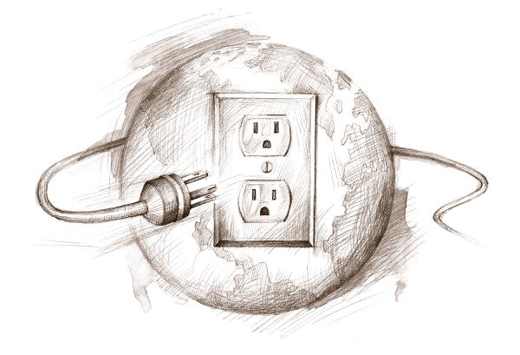
Globalization
Infrastructure is made up services that support economic activities.

Slide 7
MAJOR INDUSTRIAL REGIONS

Slide 8

Global Distribution of Industries
Why is global distribution of industry uneven?
  historical patterns of development
  colonization
  current power relations among nations
  geographical context

Slide 9
Global Distribution of Industries
Only a few countries have become major industrial economies because they have:
  abundant natural resources
  favorable relative location
  stable political circumstances

Slide 10
Global Distribution of Industries
Only a few countries have become major industrial economies because they have :
  economic leadership
  high levels of educated and trained
  executives and workers

Slide 11
Primary Industrial Regions
The four areas of the world with the largest agglomeration of industry:
    Western and Central Europe
    Eastern North America
    Russia and the Ukraine
    Eastern Asia

Slide 12
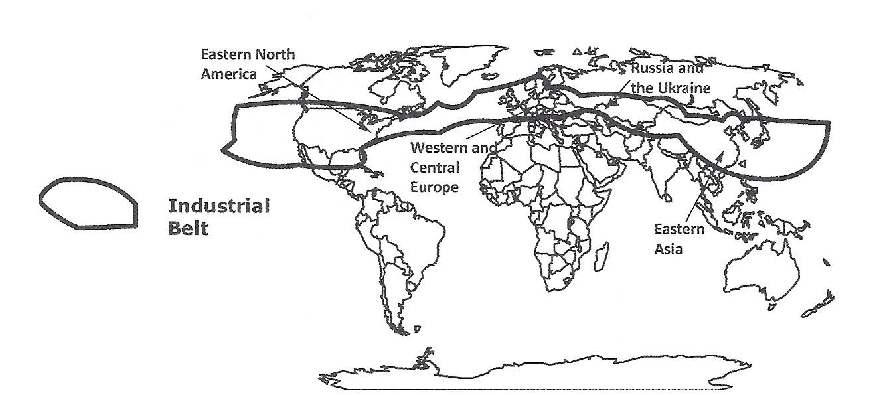
PRIMARY INDUSTRIAL REGIONS
OF THE WORLD
Most of the primary industrial areas of the world exist within a “belt” that stretches from North America, through Europe, southern Russia, China, South Korea and Japan. Even within the belt, other economic activities take place.

Slide 13
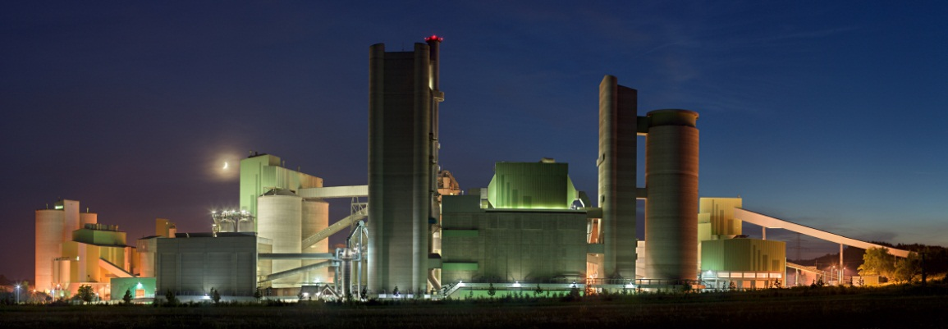
Western and Central Europe
After World War II, American aid to new factories helped to rebuild and incorporate new technologies in industries.
This aid revived Europe’s economies overall.
Primary Industrial Region

Slide 14
Western and Central Europe
Europe’s economic and political influence has allowed it to withstand severe damage from 20th century wars.
However, other parts of the world have come to challenge its industrial preeminence.
Primary Industrial Region

Slide 15
North America
World Wars I and II weakened Europe’s economy, allowing the U.S. to emerge as the world’s strongest industrial power by the mid-20th century.
Production of war materials bolstered a developing industrial economy.
Canada benefitted as well.
Primary Industrial Region

Slide 16
NORTH AMERICAN MANUFACTURING
The core area of North American manufacturing

Slide 17

North America
Other important industrial areas developed in North America during the 20th century.
Primary Industrial Region
North America

Slide 18
North America
Newer industrial areas include:
  Richmond, VA to Birmingham, AL: iron and steel
  Atlanta, GA to Richmond, VA: cotton, tobacco, and furniture
  Oklahoma to Dallas-Ft. Worth, TX, Houston, TX, and New Orleans, LA: growing oil industry
Primary Industrial Region

Slide 19
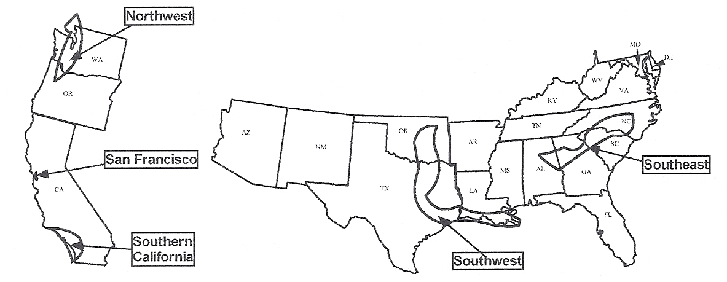
Other North American Manufacturing Regions. During the 20th century, manufacturing spread to other areas of North America from the Manufacturing Belt in the Northeastern United States.

Slide 20

Russia and the Other Former Soviet Republics
By the end of the 19th century, the Ukraine was affected by the diffusion of the Industrial Revolution as it spread eastward across Europe.
Primary Industrial Region

Slide 21
Russia and the Other Former Soviet Republics
When Russia became the Soviet Union in the 20th century, the Ukraine produced much of the country’s coal.
The Ukraine grew into one of the world’s largest manufacturing complexes by the mid-20th century.
Primary Industrial Region

Slide 22
Russia and the Other Former Soviet Republics
Other manufacturing areas grew around Moscow and Leningrad (now St. Petersburg).
After World War II, a series of dams were constructed along the Volga River, making electric power plentiful.
Primary Industrial Region

Slide 23
Russia and the Other Former Soviet Republics
Canals linked the Volga to both Moscow and the Don River, making it easy to transport raw materials, including oil and natural gas from nearby reserves.
Primary Industrial Region

Slide 24
Russia and the Other Former Soviet Republics
Primary Industrial Region
Industry in other regions in Russia follow the Trans-Siberian Railroad that connects western cities across southern Siberia all the way to the Pacific coastline.

Slide 25
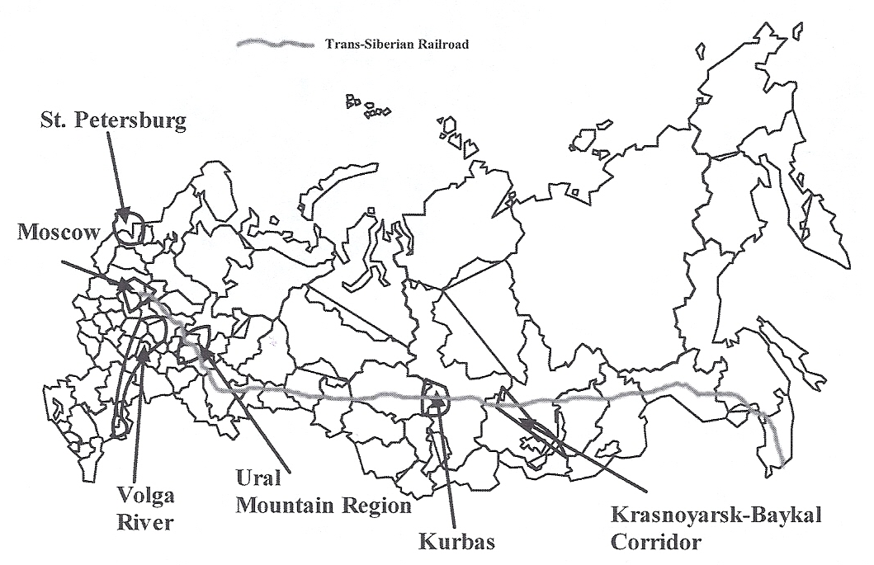
RUSSIAN INDUSTRIAL AREAS
Although many of the industrial regions of the former Soviet Union are outside the boundaries of the modern Russian Federation, several industrial areas remain, including the region around the capital of Moscow, St. Petersburg, and the Volga River. The eastern regions follow the Trans-Siberian Railroad.

Slide 26

Eastern Asia
Japan was the earliest country in
East Asia to industrialize.
Japan’s economic development began during the second half of the 19th century with the Meiji Restoration, a government-sponsored campaign for modernization and colonization.
Primary Industrial Region

Slide 27
Eastern Asia
Japan
Under the leadership of
oligarchs, or industrial and
military leaders who came to
political power, Japan:
    modernized industries
    organized armed forces
    transformed education and transportation systems so that they followed the Western model
Primary Industrial Region

Slide 28

Eastern Asia
Japan
After the massive destruction of World War II, Japan rebuilt its economy so that by the 1980s it was a major post-industrial society.
Japan’s dominant region of industrialization is the Kanto Plain, which includes Tokyo.
Primary Industrial Region

Slide 29
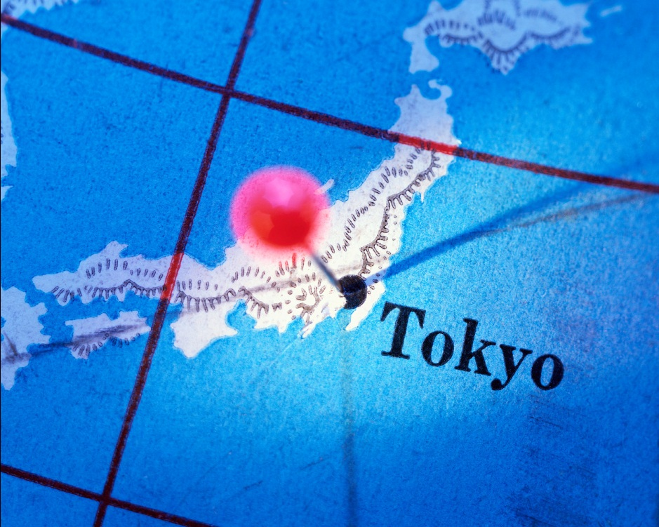
Eastern Asia
Japan
  Many industries and businesses chose Tokyo as their headquarters in order to be near government decision makers.
Primary Industrial Region

Slide 30
Eastern Asia
The “Four Tigers”
  Japan’s economic dominance was challenged in the late 20th century by:
    South Korea
    Taiwan
    Hong Kong
    Singapore
Primary Industrial Region

Slide 31
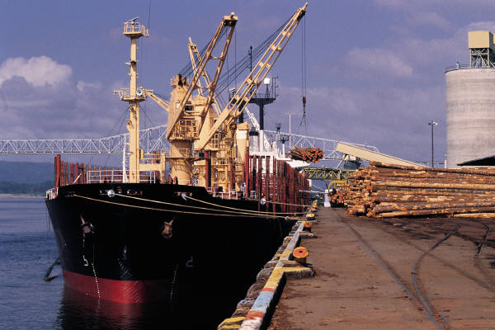
Eastern Asia
The “Four Tigers”
All “Four Tigers” used the strategy of export-oriented industrialization to directly integrate their economies into the global economy.
  They concentrated on economic production to find a place in international markets.
Primary Industrial Region

Slide 32

Eastern Asia
The “Four Tigers”
These countries have focused on the “product life cycle”:
  An innovator country produces something new.
  Next that country moves on to other innovations.
  Meanwhile, other countries think of ways to make the first product better and cheaper and export it back to the innovator country.
Primary Industrial Region

Slide 33
Eastern Asia
The “Four Tigers”
  Asian countries have prospered from the product life cycle with automobiles and electronics in their trade with the United States.
Primary Industrial Region

Slide 34
Eastern Asia
China
China has long been a political power, but its major industrial expansion did not begin until the mid-20th century under communist leaders.
Its earliest industrial heartland was the Northeast District in Manchuria, centered on coal and iron deposits.
Primary Industrial Region

Slide 35

Eastern Asia
China
Other major industrial areas developed around:
  Beijing
  Shanghai
  Hong Kong
Primary Industrial Region

Slide 36

Eastern Asia
China has successfully challenged Japan for economic and political leadership in the early 21st century.
Primary Industrial Region

Slide 37
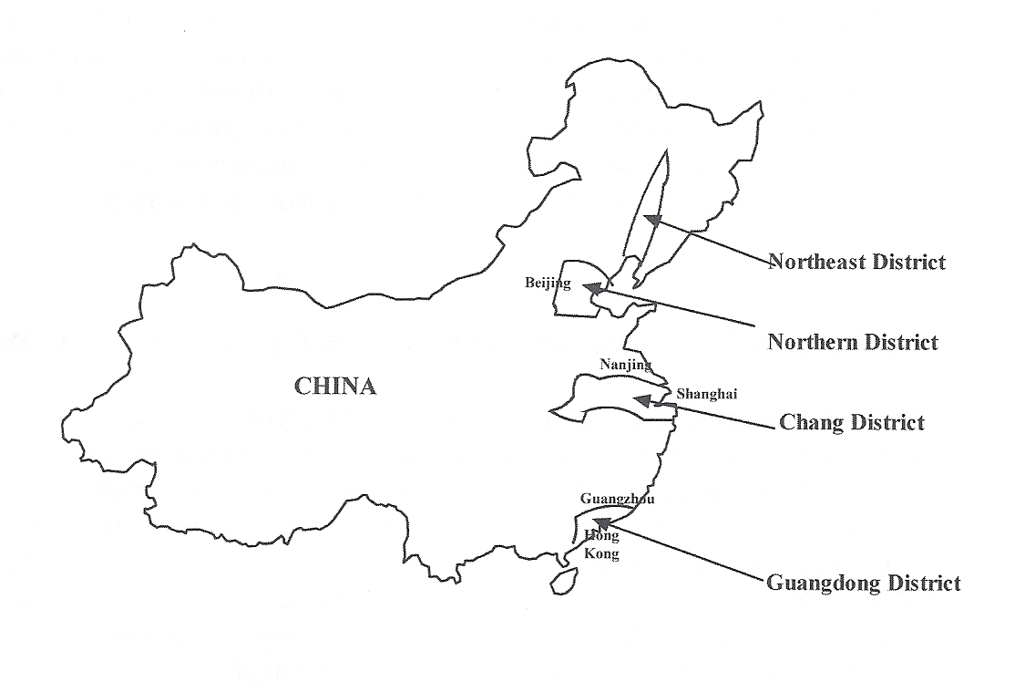
CHINESE INDUSTRIAL AREAS
China’s first large industrial area was the Northeast District, centered on coal and iron deposits located in the basin of the Liao River.

Slide 38
Eastern Asia
The Pacific Rim includes countries that border the Pacific Ocean on their eastern shores.
More cities in China are industrializing, partly through the creation of special economic zones.
Primary Industrial Region

Slide 39
Eastern Asia
Special Economic Zones
(SEZs) are areas where foreign investment is allowed and capitalistic ventures are encouraged.
Primary Industrial Region

Slide 40
SECONDARY INDUSTRIAL REGIONS

Slide 41
Secondary Industrial Regions
Secondary industrial regions lie south of the world’s primary industrial region.
These regions and their industrial centers are not as large as the primary regions, but their economies are growing.

Slide 42
Secondary Industrial Regions
Secondary industrial regions include:
  Thailand
  Indonesia
  South Africa around Johannesburg
  Egypt around Cairo
  Rio de Janeiro, Brazil
  a corridor between Mexico City and Guadalajara

Slide 43
Maquiladoras
A manufacturing zone was created in the 1960s in northern Mexico just south of the border with the United States.
Workers in this maquiladora district have produced goods primarily for consumers in the U.S.

Slide 44
Maquiladoras
A number of U.S. companies have established plants in the zone to transform imported, duty-free components or raw materials into finished industrial products.

Slide 45
Maquiladoras
Over 20% of Mexico’s entire industrial labor force works in the maquiladora district.
Interactions with the U.S. market provide a good example of the new international division of labor in which some components of products are made in one country and other in another.

Slide 46
NAFTA
The North American Free Trade Agreement (NAFTA) was a treaty signed in 1995 by Mexico, the U.S., and Canada.
The treaty eliminated the barriers to free trade, including most tariffs among the three countries.

Slide 47
NAFTA
Boon?
NAFTA was hailed a free trade area that would rival the European Union.
Hindrance?
Integrating the markets of these different countries has been difficult, especially since Mexico has a lower standard of living than the U.S. or Canada.
Environmentalists fear that industries will relocate to Mexico because of their lax environmental laws.

Slide 48
NAFTA
Hindrance?
Mexico faces a new problem: Maquiladora jobs are now being lost to countries where wages are even lower.
Example: Mexican wages are about twice those in China, where wages are only about $1 per hour.

Slide 49
NAFTA
Hindrance?
Since wage rates constitute an important site factor, many firms are moving from Mexico to China.

Slide 50
INDUSTRIALIZATION AND TERTIARY DEVELOPMENT IN INDIA

Slide 51
Changes are occurring in India…
Industrialization in India is expanding as a result of government policies.
Although India has no major oil reserves, it does have:
      hydroelectric potential
      large coal reserves
      iron ore deposits

Slide 52
Changes are occurring in India…
India has a large labor force and a geographical location midway between Europe and the Pacific Rim.

Slide 53
Changes are occurring in India…
India has benefitted from global access to information technology and electronic data submission.
Computer software companies are rapidly growing in places such as Bangalore.

Slide 54
Changes are occurring in India…
Customer interaction services (“call centers”) formerly based in the U.S. have relocated to India.
Examples of services now offered include:
  processing insurance claims
  taking care of banking transactions
  booking airline tickets
  making medical appointments

Slide 55
Changes are occurring in India…
As a result of these changes, the Indian economy has developed a strong tertiary (service) sector, increasingly integrating it into the world market.

Slide 56
Key Terms and Concepts to
Review for this Session
Globalization
Space-time compression
Infrastructure
Primary industrial region
North American Manufacturing Belt
“Four Tigers”
Product life cycle
Special economic zones (SEZs)
Secondary industrial region
Maquiladoras
NAFTA
Tertiary development
“call centers”

