Slide 1
Unit Six:
INDUSTRIALIZATION
Advanced Placement
Human Geography
Session 6

Slide 2
GLOBAL INEQUALITIES

Slide 3

The Industrial Revolution set in motion dramatic global inequalities that exist among people and nations today.

Slide 4
Today…
An increasingly integrated global economy provides challenges for all countries, despite their levels of development.
The problems for more developed countries generally differ from those of less developed countries.

Slide 5
CHALLENGES FOR
MORE DEVELOPED COUNTRIES

Slide 6
Challenges for More
Developed Countries
An important challenge for more developed regions is the protection of their markets from new competitors.
This challenge is increasing since competition now occurs more frequently within regional trading blocs, or conglomerations of trade among countries within a region.

Slide 7
Impact of Trading Blocs
The three most important trading blocs are:
  North America
  The European Union
  East Asia

Slide 8
North America
Since 1994, NAFTA countries have negotiated with other Latin American countries to extend the trading bloc to new areas of the Western Hemisphere.
Important Trading Bloc

Slide 9
The European Union (EU)
Most trade barriers have been eliminated among the members of the EU.
Even European nations that are not EU member-states depend heavily on trade with members.
Important Trading Bloc

Slide 10

East Asia
No formal organization of states exists in East Asia.
However, Japanese companies play leading roles in the economies of the countries of that region.
Important Trading Bloc
East Asia

Slide 11
East Asia
The rapid economic development of many Pacific Rim countries has created a strengthening trade bloc in East Asia in spite of tensions among countries in this region.
Important Trading Bloc

Slide 12
Transnational Corporations
Transnational corporations operate factories in countries other than the ones in which they are headquartered.
Most transnational corporations are also conglomerate corporations comprised of many smaller firms that support the overall industry.
Most transnational corporations are headquartered in the U.S., but other are located in Japan or Europe.

Slide 13

Disparities within Trading Blocs
European Union:
  Industrialization is concentrated in Germany, France, and the United Kingdom.
  Even within those individual countries some areas are more industrialized and richer than others.

Slide 14

Disparities within Trading Blocs
European Union:
    Example of disparity: In France, wealth and industry are concentrated around Paris.
    Example of disparity: The eastern part of Germany, formerly communist, lags behind the rest of Germany.

Slide 15
Disparities within Trading Blocs
Example: Within the NAFTA countries, Mexico’s economy lags behind those of the U.S. and Canada.

Slide 16
Deindustrialization

Slide 17
Deindustrialization
Deindustrialization refers to the decline in employment in the manufacturing sector of the economy.
Deindustrialization is commonly found in more developed countries.

Slide 18
Deindustrialization
Generally, the number of jobs in the service or tertiary sector increases as the percentage of jobs in industry decreases.

Slide 19
Deindustrialization
Deindustrialization is particular evident in:
  The United States
  Europe
  Japan
  The economies of the Four Tigers

Slide 20

Deindustrialization: A Cause for Concern
Some suggest that deindustrialization is the result of the globalization of markets as trade between advanced economies and the developing world has grown.

Slide 21
Deindustrialization: A Cause for Concern
Critics believe that the fast growth of labor-intensive manufacturing industries in LDCs is displacing the jobs of workers in advanced economies.

Slide 22

Deindustrialization: Some Optimism
Some believe that the adjustments between industrial and service sectors will work themselves through without interference.
Advances in the service sector, rather than in the manufacturing sector, are likely to encourage rising standards of living in advanced economies.

Slide 23
CHALLENGES FOR
LESS DEVELOPED COUNTRIES

Slide 24
Industrial development not only lifts the value of exports, it generates money to buy other products.

Slide 25

Problems Encountered by LDCs
Distance from markets
Inadequate infrastructure
Competition with existing manufacturers in other countries

Slide 26
Less developed countries face the challenge of reducing the disparities between their economies and those of more developed countries.

Slide 27
Distance from Markets
Wealthy consumers in MDCs are generally far away, so industrializing countries have had to invest scarce resources in constructing and subsidizing transportation facilities such as:
    airports
    docks
    ships

Slide 28
Inadequate infrastructure
Support services for industrial development are often lacking in LDCs.
These services include:
    transportation
    communications
    equipment production
    fewer schools and universities

Slide 29
Competition with Existing Manufacturers in Other Countries
The control exerted by transnational corporations headquartered in MDCs, but doing business globally, is a problem for LDCs.

Slide 30
Competition with Existing Manufacturers in Other Countries
Transnational corporations have
used low-cost labor in LDCs but have
kept highly skilled jobs in the MDCs,
a phenomenon known as the
international division of labor.

Slide 31

Competition with Existing Manufacturers in Other Countries
The international division of labor is a process that:
  keeps global inequalities in place
  discourages new industries from developing in LDCs
  prevents wealth from flowing from MDCs to LDCs

Slide 32
INDUSTRIALIZATION
AND THE ENVIRONMENT

Slide 33
Industrialization and the Environment
As a result of the Industrial Revolution, coal replaced wood as the leading energy source in North America and Western Europe.

Slide 34
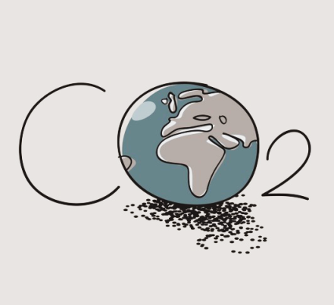
Industrialization and the Environment
The change from wood to coal relieved the environmental pressure of deforestation.
However, it increased the likelihood that coal, and eventually petroleum and natural gas, would be depleted as natural resources.

Slide 35
Industrialization and the Environment
Population growth has added to the problem but energy use in MDCs is far greater than it is in LDCs.

Slide 36
Industrialization and the Environment
Fossil fuels – including coal, petroleum, and natural gas – are residues of plants and animals that were buried millions of years ago.
The world faces an energy problem because fossil fuels, especially petroleum, are rapidly being depleted.

Slide 37

Fossil Fuel Reserves
Energy deposits that have been discovered are called proven reserves.
We do not know how many potential (undiscovered) reserves there are.
Petroleum is being consumed at a more rapid rate than it is being found.

Slide 38
TOP CONSUMERS OF OIL
Country | Usage
United States | 20,700,000 bbl/day
China | 6,534,000 bbl/day
Japan | 5,578,000 bbl/day
Germany | 2,650,000 bbl/day
Russia | 2,500,000 bbl/day
India | 2,450,000 bbl/day
Canada | 2,294,000 bbl/day
South Korea | 2,149,000 bbl/day
Brazil | 2,100,000 bbl/day
France | 1,970,000 bbl/day
Source: NationMaster.com

Slide 39
Consumption of Fossil Fuels
MDCs, with about 25% of the world’s population, consume about 75% of the world’s fossil fuels.

Slide 40
Consumption of Fossil Fuels
As countries with large populations, such as China and India, develop industries, their share of the world’s consumption of energy is increasing.

Slide 41
INDUSTRIAL POLLUTION

Slide 42
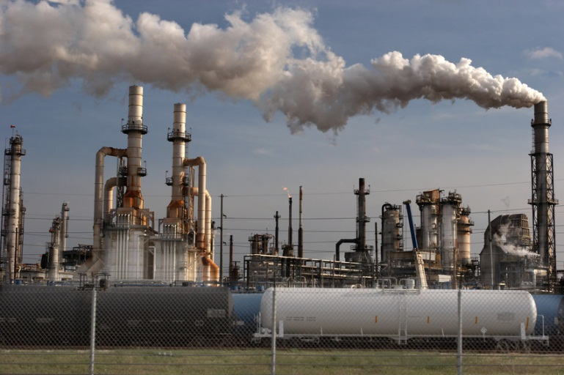
Industrial products have greatly added to the overall pollution of air, water, and land resources on Earth.

Slide 43

Global Warming
Global warming is the increase in earth’s temperature caused primarily by the burning of fossil fuels.
The greenhouse effect is an anticipated warming of earth’s surface that could melt the polar icecaps and raise the level of the oceans enough to destroy coastal cities.

Slide 44
Acid Rain
Another by-product of air pollution is acid rain, which forms when sulfur dioxide and nitrogen oxides are released into the atmosphere by burning fossil fuels.
Pollutants eventually make their way into lakes and streams.

Slide 45
Acid Rain
Results include:
  corrosion of buildings and monuments
  stunted growth of forests
  death of fish
  loss of crops

Slide 46
SUSTAINABLE DEVELOPMENT

Slide 47

Sustainable Development
The basic premise of sustainable development is that people living today should not impair the ability of future generations to meet their needs.

Slide 48
Sustainable Development
Irreparable harm to the environment would compromise the earth’s future.
Many critics believe that the pace of economic development today is no longer sustainable, despite the fact that natural resources still abound.

Slide 49
Possible Solutions to Environmental Problems
Humans may respond to environmental problems in many ways, including the following:
  prevention
  technological change
  mitigation
  compensation

Slide 50
Prevention
Some government policies have encouraged destruction of the environment (e.g. cheap gasoline).
The one-child policy in China is an example of prevention of over-use of natural resources through limiting population growth.

Slide 51
Technological Change
Technological possibilities include:
  installing pollution-capturing filters for industrial runoff
  recycling industrial waste

Slide 52
Mitigation
Damage may be undone or reduced once it has occurred.
Example: Chemical spills may be cleaned up.

Slide 53
Compensation
Political bodies may negotiate compensation for those negatively impacted by industrial wastes.
Example: A company whose chemical wastes have resulted in illness and/or death among workers may be held legally responsible for damages.

Slide 54
Key Terms and Concepts to
Review for this Session
Global inequalities
Global economy
Trading blocs
Trade barriers
Transnational corporations
Conglomerate corporations
Deindustrialization
Infrastructure
International division of labor
Fossil fuels
Global warming
Greenhouse effect
Acid rain
Sustainable development

