Slide 1
Unit Seven: Cities and Urban Land Use
Advanced Placement Human Geography
Session 1

Slide 2

Advanced Placement
Human Geography
Review Sessions: Unit Seven
By Geri Flanary
To accompany AP Human Geography:
A Study Guide
3rd edition
By Ethel Wood

Slide 3
Urban Geography

Slide 4
What is urban geography?
Urban geography focuses on:
  how cities function
  the internal systems and structures of cities
  the external forces that influence cities

Slide 5
Sub-fields of urban geography
THE STUDY OF SYSTEMS OF CITIES
  This sub-field focuses on where cities are located and why they are there.
  The focus is on how cities connect to one another, how they are distributed, and how cities influence the landscape around them.

Slide 6
Sub-fields of urban geography
THE STUDY OF INTERNAL CITIES
  This sub-field focuses on the internal working and structures of cities.
  It involves the analysis of land use patterns, racial and ethnic segregation, and the cycles of construction and development.
  It makes use of quantitative data and qualitative data.

Slide 7
Defining urbanism
What are urban areas? Urban areas are nucleated, with one or more clear core areas. People who live in them work in nonagricultural jobs.

Slide 8
Urbanization Vocabulary
Cities and Towns…how are they similar?
  nucleated settlements
  have residential and non-residential functions
  include a central business district and surrounding residences

Slide 9
Urbanization Vocabulary
Cities and Towns…how are they different?
  Cities are usually surrounded by suburbs, areas that are less nucleated.
  Suburbs use much land space for residences of people who work in or near cities.

Slide 10
Urbanization Vocabulary
Suburbs
  Suburbs are not self-sufficient and would not exist except for their locations near cities.
  Suburbs are economically dependent on cities, but they have their own governments and are separated from the central city by political boundaries.

Slide 11
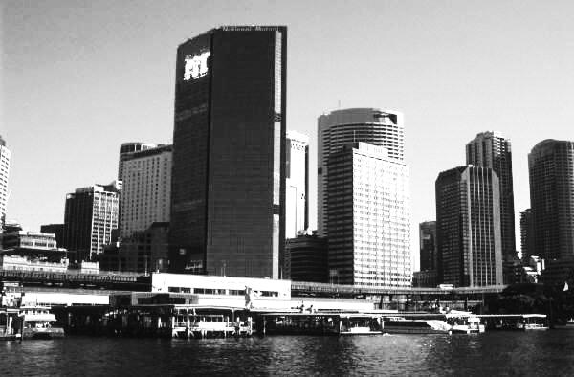
Urbanization Vocabulary
Urbanized area
  An urbanized area consists of a continuously built-up landscape of buildings and populations so that political boundaries are simply imaginary lines that separate them.

Slide 12
Urbanization Vocabulary
A physical city is a continuous development that contains a central city and many nearby cities, towns, and suburbs.
  A physical city may be separated by less developed landscapes, but may still be part of a larger metropolitan area.

Slide 13
Urbanization Vocabulary
Metropolitan Statistical Area
  Metropolitan Statistical Areas are defined by the U.S. Bureau of Statistics.
  An MSA is a central county or counties with at least one urbanized area of at least 50,000 people plus adjacent outlying counties with a large number of residents who commute into the area.

Slide 14
Urbanization Vocabulary
Micropolitan Statistical Area
  A Micropolitan Statistical Area is a similar but smaller version of a metropolis.
  It has at least one urban cluster between 10,000 and 50,000 people plus outlying counties.
  There is considerable social and economic integration.

Slide 15
Urban Hierarchy

Slide 16
Urban Hierarchy
Clustered settlements range in size from hamlets to megalopolises.
They may be arranged in a hierarchy according to the complexity of their centralizing functions.

Slide 17
Urban Hierarchy
From smallest to largest the hierarchy includes:
  hamlet
  village
  town
  city
  megalopolis

Slide 18
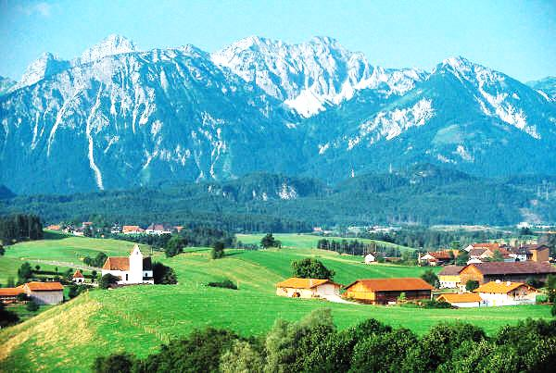
Urban Hierarchy
Hamlet: smallest in size; few dozen people; limited services (e.g. general store); clustered housing

Slide 19
Urban Hierarchy
Villages: larger than hamlets; offer more services
  Instead of a general store, there may be more stores specializing in the sale of food, clothing, furniture, and other small items.

Slide 20
Urban Hierarchy
Towns:
  are considered urban areas with a defined boundary but are smaller than cities in terms of population and area.
  For example, many towns dot the landscape of the Great Plains.
  The surrounding farms shape the hinterland (market area) of the towns. Towns usually have schools and libraries, also.

Slide 21
Urban Hierarchy
Cities:
  large, densely populated areas that may include tens of thousands of people

Slide 22

Urban Hierarchy
Cities:
  have a well-defined central business district (CBD) and suburbs
  may also have commercial centers or shopping malls

Slide 23
Urban Hierarchy
Metropolis: large population, large land area, central city and its suburbs (also referred to, at times, as an urbanized area)

Slide 24
Urban Hierarchy
Megalopolis:
    largest in the urban hierarchy
    a massive urban “blob” of overlapping, integrated metropolitan areas whose distinctive boundaries are increasingly difficult to find
Remember this great example: Bosnywash!

Slide 25
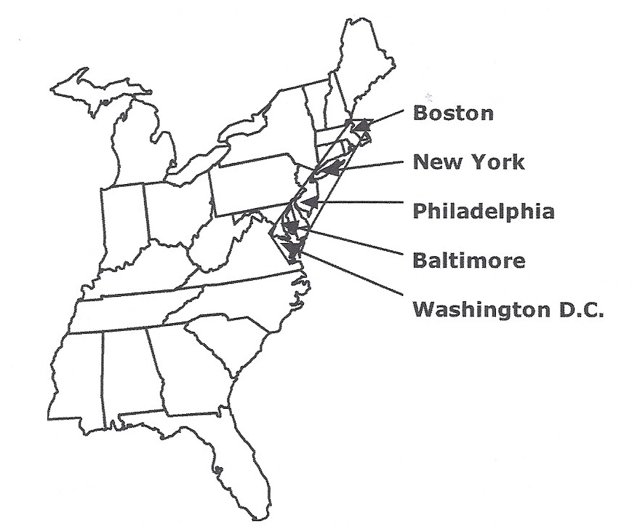
BOSNYWASH
One big megalopolis spreads along the east coast of the U.S.

Slide 26
Social Characteristics of Urban Areas

Slide 27
Characteristics of Cities
In the 1930s social scientist Louis Wirth defined a city as a permanent settlement that has three characteristics that create living experiences for urban residents that are different from residents in rural areas.
  large size
  high density
  social heterogeneity

Slide 28
Characteristics of Cities
Large size
  Residents only know a small percentage of other residents.
  Most come in contact with many people, but do not get to know them very well.

Slide 29
Characteristics of Cities
High density
  People in cities have specialized jobs that collectively require a large number of people to live in one place.
  High density encourages people to compete for space, causing dominance by some social groups.

Slide 30
Characteristics of Cities
High density
  High density leads to higher prices for property and rents, further distinguishing between rich and poor.

Slide 31
Characteristics of Cities
Social heterogeneity
  Large settlements include people with diverse backgrounds.
  Cities allow for more anonymity.
  Wirth noted that despite the freedom associated with a city, people may feel lonely and isolated.

Slide 32
Key Terms to Review
Urban geography
Quantitative data
Qualitative data
Urbanism
Urban areas
Nucleated settlement
Suburbs
Physical city
Metropolitan Statistical Area
Micropolitan Statistical Area
Urban hierarchy
Hamlet
Village
Town
City
Megalopolis
Central business district (CBD)

Slide 33
Key Terms to Review
Metropolis
Bosnywash
Louis Wirth
Social heterogeneity

