Slide 1
Unit Seven: Cities and Urban Land Use
Advanced Placement Human Geography
Session 3

Slide 2
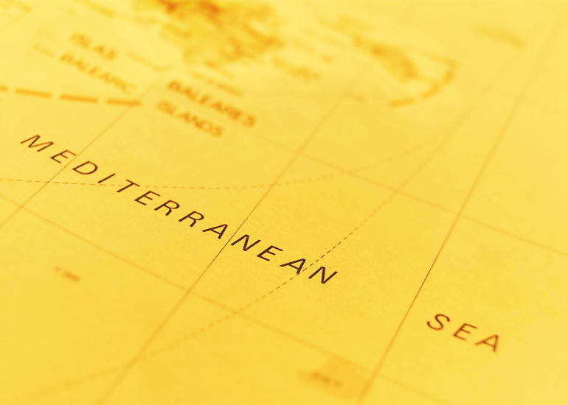
Early Urbanization
Around the Mediterranean

Slide 3
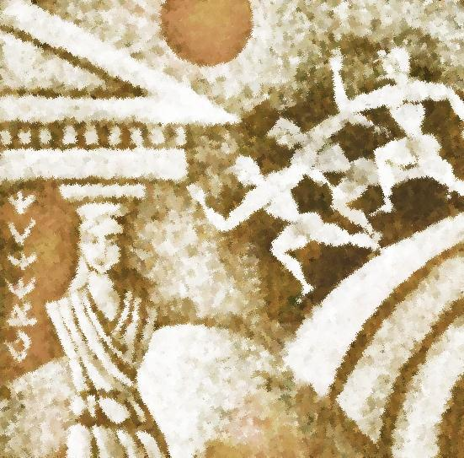
Early Settlements
Settlements were originally established in the area around the eastern Mediterranean Sea about 2500 years ago by forerunners of the ancient Greek s.

Slide 4
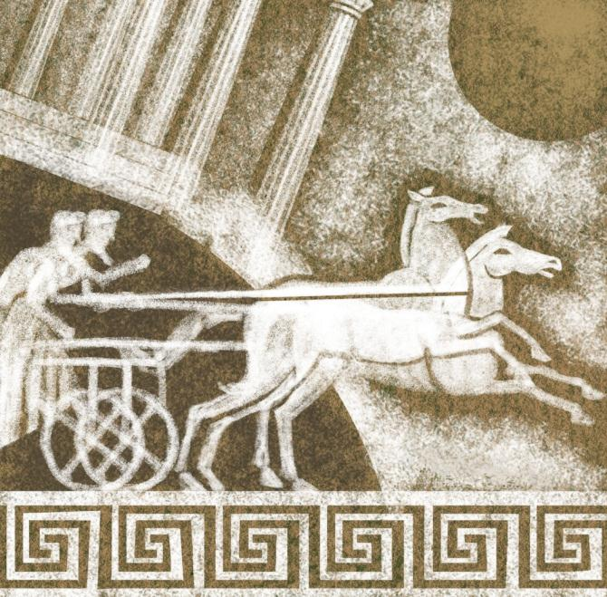
City-states
City-states were organized into self-governing communities that included the nearby countryside.

Slide 5
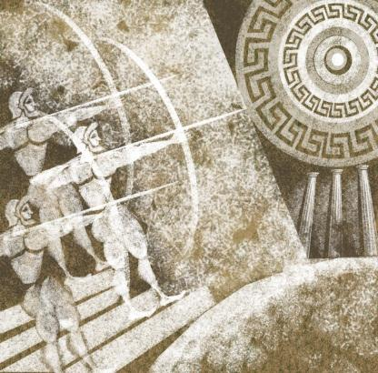
City-states
The city-states provided the following for the surrounding hinterland:
  government
  military protection
  other public services

Slide 6
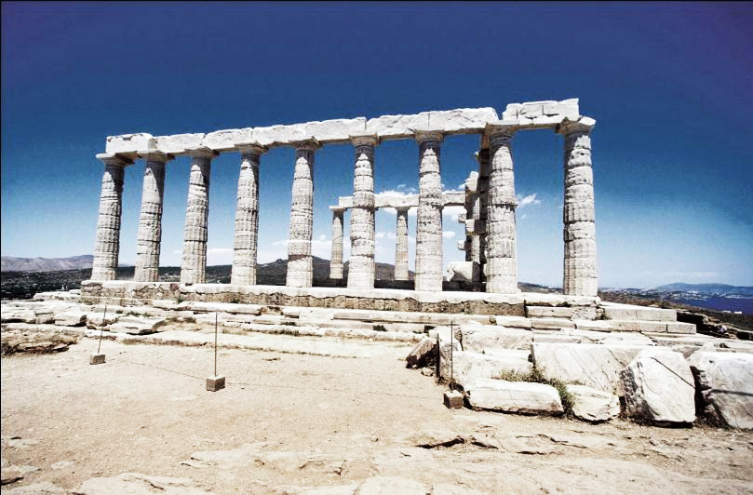
The Greeks
Athens was probably the first city to reach a population of 100,000 during the 5th and 4th centuries B.C.E.

Slide 7
The Romans
When the Romans succeeded the Greeks as rulers of the region, their urban empire incorporated:
  a large part of Europe’s interior
  North Africa
  former Mesopotamian lands

Slide 8
The Romans
Many cities were part of the hinterlands.
Rome reached a population of 250,000 inhabitants in the second century B.C.E.

Slide 9
The Romans
The cities of the Roman Empire were connected by land and sea routes.
Roman roads were so expertly built that many are still intact today.

Slide 10
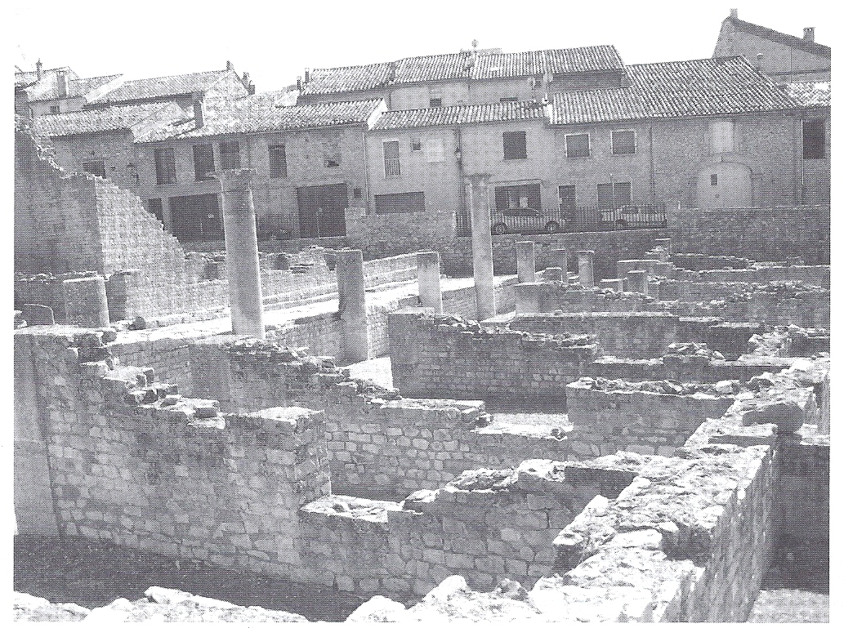
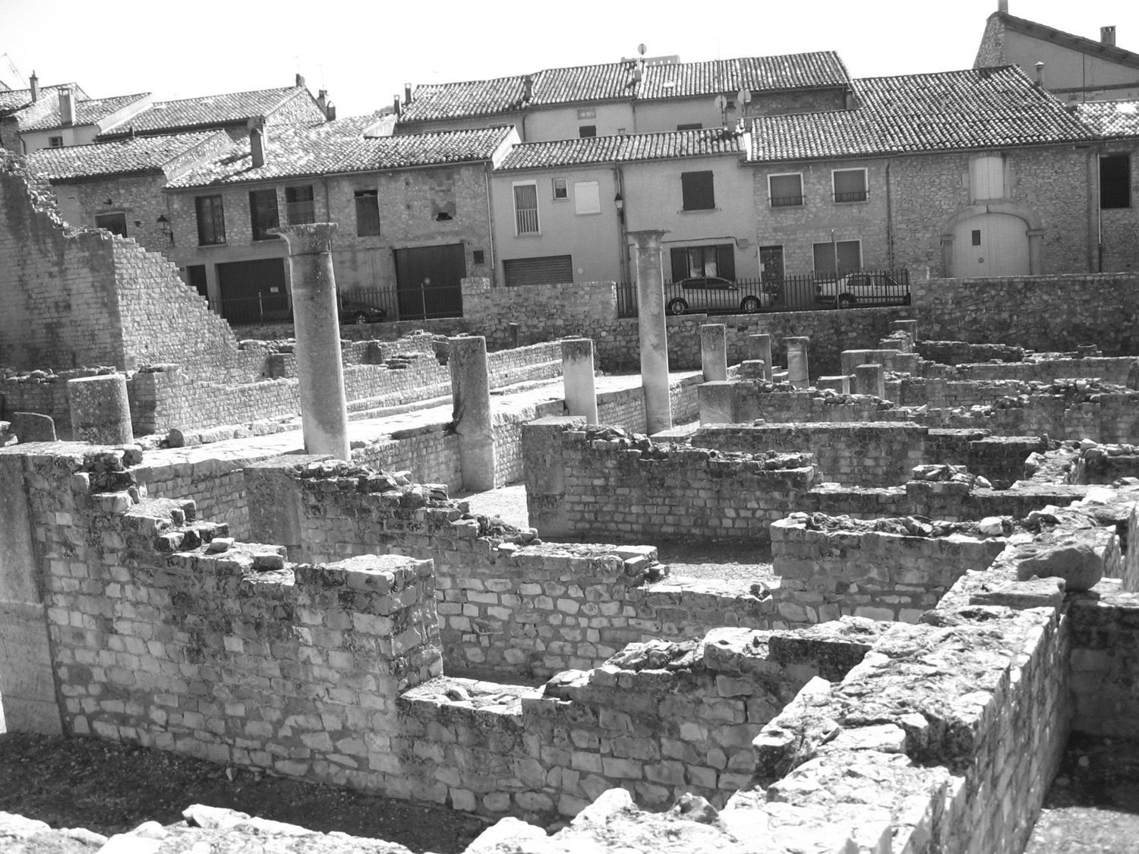
Ruins of a Roman City
These are Roman ruins in southern France. Ruins may be found in many parts of Europe and other areas controlled by Ancient Rome.

Slide 11
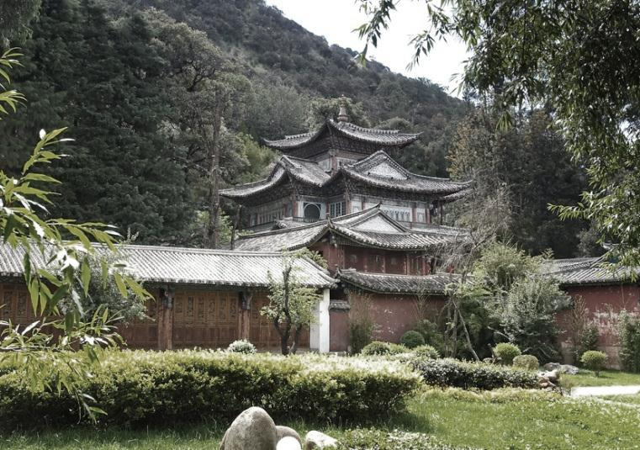
Urban Growth in
China

Slide 12
Earliest Civilizations in China
The earliest civilizations in
East Asia grew around the Huang River and its tributaries.

Slide 13
Earliest Civilizations in China
The great Silk Road stretched from China to the Mediterranean Sea.
This trade route brought much wealth and diversity to Chinese cities.

Slide 14
Earliest Civilizations in China
These cities became centers for:
  government
  culture
  education
  the economy

Slide 15
Urban Growth in China
By the 11th century, the greatest of the trading cities of the south was Hangzhou.
  It was home to merchants, craftsmen, and government officials.
  Its primary exports included silk, copper coins, and ceramics.

Slide 16
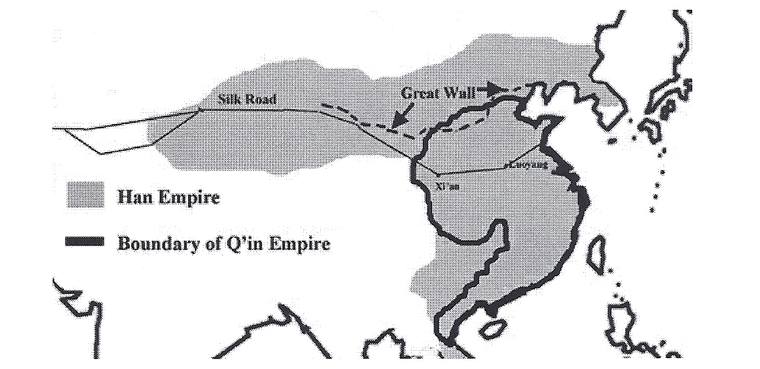
EARLY URBAN CHINA
By the time of the Han Dynasty, an urban empire had developed
in China

Slide 17
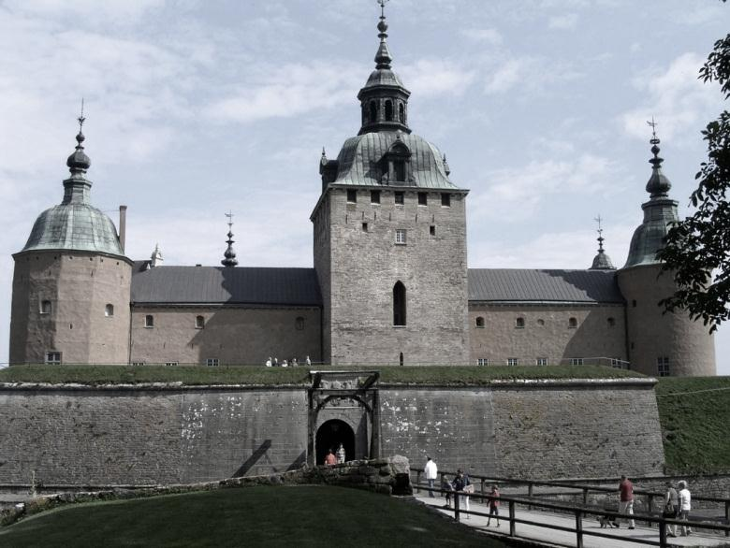
Medieval, Preindustrial, and
Industrial World Cities

Slide 18
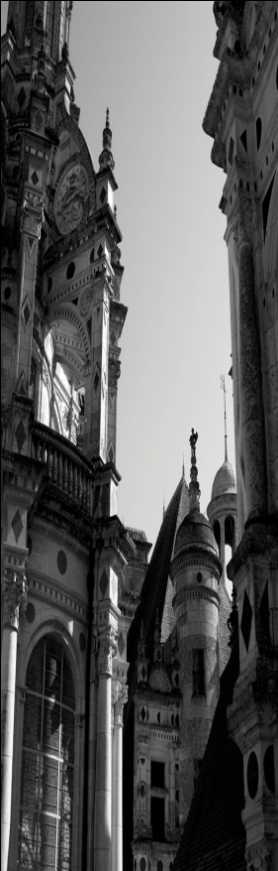
Medieval Cities
After the fall of the Roman Empire, urban life began to revive during the 11th century.
Urban life was stimulated by trade between the Italian cities of Genoa and Venice and the Middle East (a result of the Crusades).

Slide 19
Medieval Cities
Characteristics of medieval cities:
  narrow and winding streets
  occupational groups (e.g. bakers, carpenters) clustered in distinct sections of the city

Slide 20
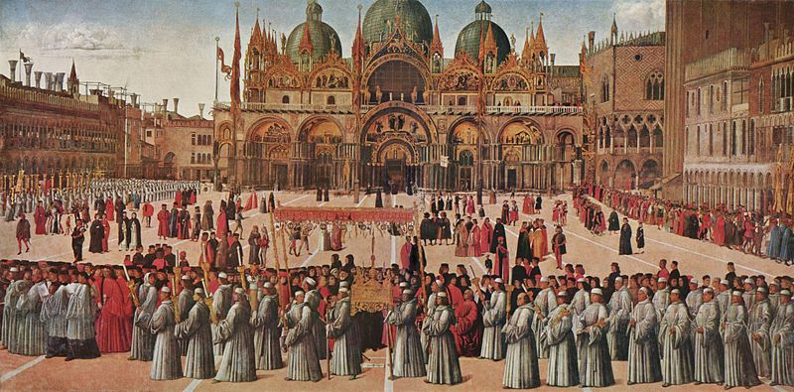
Medieval Cities
Residents often sought to keep out people who were different.
  The term “ghetto” first described the segregation of Jews in Venice.

Slide 21
Preindustrial cities
Primate cities: population is more than twice as large as second largest city in the country/state; serves as a cultural, economic, and political center
Examples:
  Paris
  London

Slide 22
Preindustrial cities
Some scholars believe that world cities varied in this era and that it was a mistake to categorize all of them as “preindustrial.”
Example:
  Religious buildings dominated the landscape in the Middle East, the Americas, and Europe.

Slide 23
Preindustrial cities
Mercantile city (developed in the pre-industrial age—before the Industrial Revolution):
  Trade was central to the design of the city.
  The central square was lined with shops that specialized in products brought in by the trade routes.

Slide 24
The Industrial Revolution
Manufacturing city
  Factories attracted workers from rural areas.
  Small, narrow streets gave way to wide boulevards to accommodate the flow of commercial traffic.
  City planning and zoning was introduced (where to locate businesses, houses, etc.).

Slide 25
The Industrial Revolution
Manufacturing city
  Cities grew along railroad lines that connected the cities to markets.

Slide 26
The Industrial Revolution
Manufacturing city
  Cities suffered from problems such as:
    overcrowding
    sanitation
    pollution
    disarray

Slide 27
The Industrial Revolution
Manufacturing city
  As cities grew, problems multiplied, although conditions improved as a result of:
    government intervention
    legislation
    introduction of city planning and zoning

Slide 28
Rural-Urban Migration
and
Urban Growth

Slide 29
Connection between Industry and Urbanization
Industrial development led to urban growth during the 1800s in Europe and North America.

Slide 30
Urban Growth
Today about ¾ of people in developed countries live in urban areas.

Slide 31
Urban Growth
More recently, migration from rural to urban areas has rapidly increased in the less developed countries of:
  Africa
  Asia
  Latin America

Slide 32
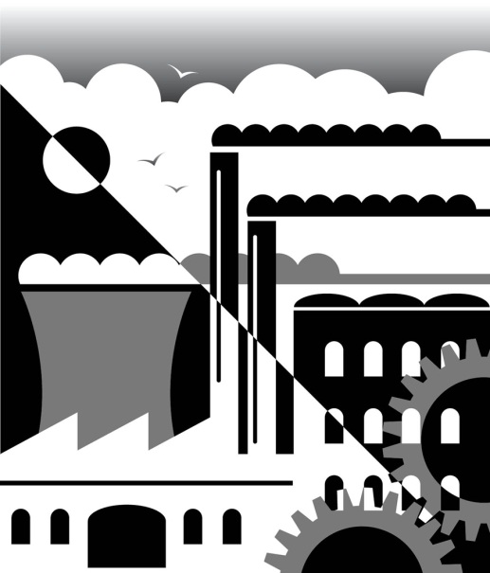
Urban Growth
As countries begin to industrialize, opportunities shift from rural to urban areas.
The pull to the city stimulates migration.

Slide 33
Urban Growth
Nearly all countries have two things in common:
  The proportion of people living in cities is rising.
  The cities themselves are large and growing.

Slide 34
World Cities
and
Megacities

Slide 35
Modern Cities
In the place of great manufacturing cities are modern world cities that have become centers of:
    business
    consumer services
    public services

Slide 36
World Cities
The three world cities that serve as the largest regional centers are:
  London
  New York
  Tokyo

Slide 37
WORLD CITIES

Slide 38
World Cities
World Cities—based on the centrality/accessibility of the following services
  Business (offices, stock exchanges, transportation hubs)
  Consumer (retail, entertainment, cultural)
  Public (government headquarters, seats of political power)

Slide 39
Megacities
Megacities have populations of more than 10 million people in their metropolitan/urbanized areas.
The term was created by the United Nations in the 1970s.
No cities were that large in 1900.

Slide 40
Megacities
Ten largest megacities in the world:
Tokyo
Mexico City*
Seoul, South Korea
New York City
Sao Paulo, Brazil*
Mumbai, India*
Delhi, India*
Shanghai, China*
Los Angeles, CA
Osaka, Japan
*Located in the semi-periphery

Slide 41
Megacities
Many megacities in less developed countries house new arrivals in:
  overpopulated apartment buildings
  tenements
  slums

Slide 42

Megacities
Many megacities are unable to control expansion and haphazard development that seriously affect the quality of life within the urban area.

Slide 43
Key Terms to Review
Early settlements
City-states
Greeks
Roman Empire
Hinterlands
Silk Road
Medieval city
Preindustrial city
Industrial city
Ghetto
Segregation
Primate cities
Mercantile city
Manufacturing city
City planning
Zoning
Rural to urban migration
World cities
Megacities

