Slide 1
Unit Seven: Cities and Urban Land Use
Advanced Placement Human Geography
Session 4

Slide 2
Functions of Cities

Slide 3
Connections
Cities are connected to other cities and to rural areas.
Cities provide services to their own inhabitants as well as those outside of city limits.

Slide 4
Connections
Some cities are transportation centers where major routes converge:
  roads
  railroads
  sea traffic
  air transportation

Slide 5
Connections
Other cities have special functions in:
  mining
  manufacturing
  recreation

Slide 6
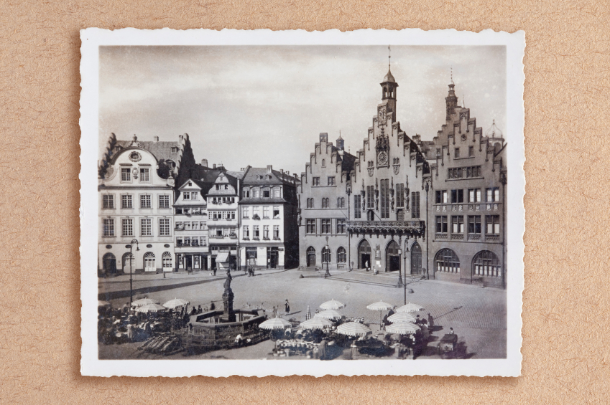
Connections
A common property of all settlements is centrality, so that cities become central places that provide goods and services for the surrounding area.

Slide 7

The Economic Base
of a City

Slide 8
Economic Base of a City
Two levels of activities support the economic base of a city:
  those that connect to the outside
  those that support the internal structure

Slide 9
Economic Base of a City
Some city workers produce goods or services for outside the city.
These “export activities” result in money flowing into the city.
These activities are collectively known as the basic sector of the city’s economy.

Slide 10
Economic Base of a City
Nonbasic, or service sectors, of the economy are crucial to the city’s:
        businesses
        professional office
        city government
        schools
        intracity transit systems

Slide 11
Economic Base of a City
It is difficult to separate the basic and nonbasic sectors of a city’s economy.
Usually workers produce goods and services in both sectors.

Slide 12
Economic Base of a City
The larger the city, the more likely it is to be multifunctional, with workers from both the basic and nonbasic sectors.

Slide 13
Economic Base of a City
A base ratio compares the number of workers employed in the basic sector and those employed in the nonbasic sector.
The larger the city, the larger its ratio of nonbasic workers.
More workers are needed to support the city’s growth.

Slide 14
Economic Base of a City
A multiplier effect takes hold when basic sector employment is accompanied by a larger share of nonbasic workers.

Slide 15
Economic Base of a City
Example of the multiplier effect:
  A new car manufacturing plant locates to an area (basic sector).
  Workers are needed for services such as grocery clerks, doctors, and gasoline station attendants (nonbasic sector).

Slide 16
Economic Base of a City
Chauncy Harris (1943) published an article in which he classified cities in the U.S. into three types according to their functions.

Slide 17
Economic Base of a City
Harris’s types of
U.S. cities:
  manufacturing-dominated cities in the Northeast
  retail centers scattered across the country
  diversified cities with multiple functions

Slide 18
Economic Base of a City
Today’s cities…
  Harris’s categories are blurred because growing size has brought greater diversification.

Slide 19
Economic Base of a City
Examples of diversification:
  Boston has a disproportionate number of universities.
  Las Vegas is a center for gambling.
  Both cities have diversified considerably as they have grown.

Slide 20
Urban Influence Zones

Slide 21
Urban Influence Zones
Urban influence zones are the areas outside the city that are affected by it.
As the distance away from the city increases, its influence on the surrounding countryside decreases.

Slide 22
Urban Influence Zones
The urban hierarchy is almost always at work, as individuals may also be in the
influence zone
of a town or village.

Slide 23

The Changing City

Slide 24

Stages of Change
1967: John Borchert developed four stages in the evolution of the American metropolis.

Slide 25
The Sail-Wagon Epoch
1790-1830
Trade took place across the sea or along coastlines.
Overland trade took place by wagons.

Slide 26
The Iron Horse Epoch
1830-1870
New railroad technology changed the nature of trade and employment.

Slide 27
The Steel-Rail Epoch
1870-1920
The steel industry transformed urban America and job opportunities for workers.

Slide 28
The Auto-Air-Amenity Epoch
1920s-1960s
The internal combustion engine came to dominate life styles, the economic base of cities, and employment opportunities.

Slide 29

Today…
Some might add another epoch initiated by computer technology, which has changed people’s lives and altered employment opportunities.

Slide 30
Models of
Urban Systems

Slide 31
Models of Urban Systems
Two theories of settlement geography, or the patterns of settlement on the earth’s surface, are:
  rank-size rule
  Christaller’s central place theory

Slide 32
Models of Urban Systems
Rank-size rule
  Urban hierarchy identifies settlements of differing sizes and complexities from the hamlet to the megalopolis.
  For many large countries, the city-size hierarchy is summarized by the rank-size rule.

Slide 33
Models of Urban Systems
Rank-size rule
  tells us that the nth largest city will be 1/n the size of the largest city.

Slide 34
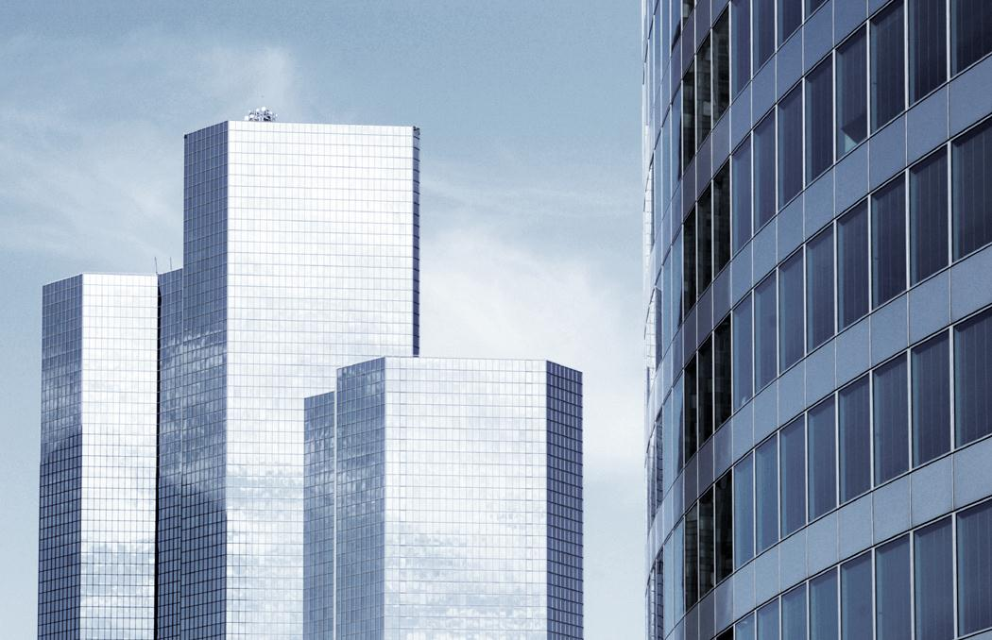
Models of Urban Systems
Rank-size rule
  Example: The second largest city will be ½ the size of the first ranked city. The fifth largest city will be 1/5 as large as the first ranked city.

Slide 35
Models of Urban Systems
Rank-size rule
  often reflects the distribution of wealth in a country.
  often describes the pattern of urban area size in
  well-established countries where economies are more complex.

Slide 36
Models of Urban Systems
Rank-size rule
  In some countries the primate city is so dominant that no other cities fit the rank-size rule (e.g. Seoul, South Korea).

Slide 37

Models of Urban Systems
Rank-size rule
  Countries with primate cities often have a large gap between standards of living in the city and the countryside.

Slide 38
Models of Urban Systems
Central Place Theory
  This theory views urban settlements as centers for the distribution of economic goods and services to surrounding nonurban populations.

Slide 39
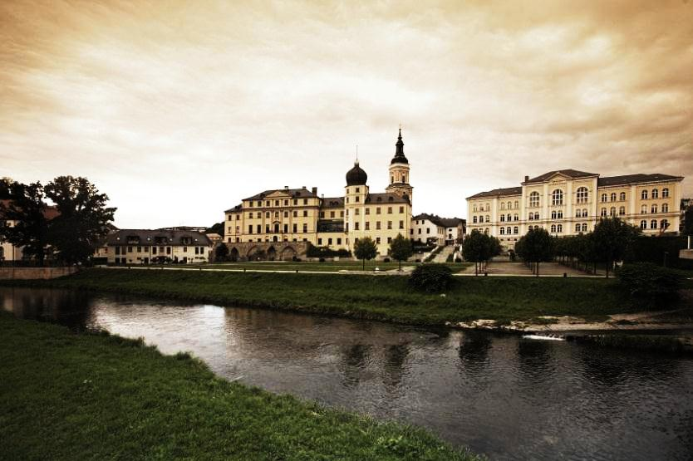
Models of Urban Systems
Central Place Theory
  This theory is based on the work of Walter Christaller in his book entitled The Central Places in Southern Germany (1933).

Slide 40

Models of Urban Systems
Christaller’s assumptions:
  no topographic barriers
  no difference in farm productivity
  an evenly dispersed farm population

Slide 41
Models of Urban Systems
Christaller’s assumptions:
  People have similar life styles and incomes.
  There are differing thresholds.
    Thresholds are the minimum number of consumers necessary to support different products.

Slide 42
Models of Urban Systems
Christaller’s assumptions:
  People will purchase goods and services at the nearest center.

Slide 43

Models of Urban Systems
Christaller made assumptions for the sake of developing a consistent model to explain settlement patterns.
He knew that in reality these factors vary.

Slide 44

Models of Urban Systems
Christaller’s results have formed the basis of central place theory.

Slide 45
Models of Urban Systems
Christaller’s results included the following:
  The landscape is divided into noncompeting market areas known as complementary regions.
  Each individual urban center and its merchants have a sale monopoly.

Slide 46
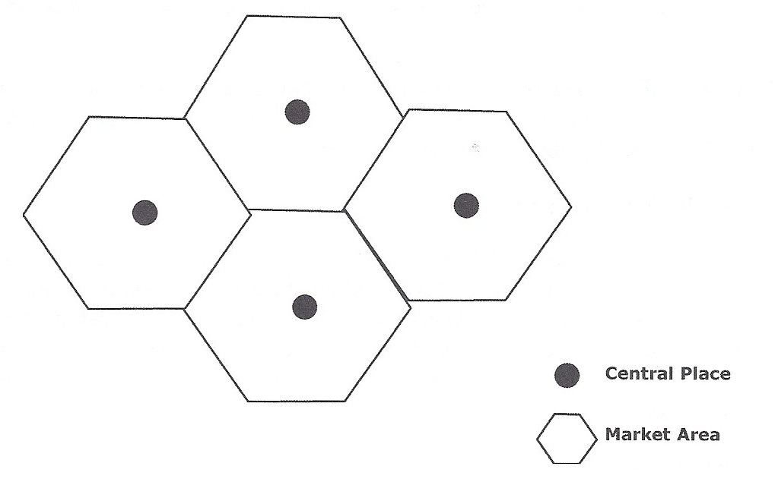
COMPLEMENTARY REGIONS
Central Place Theory
According to Christaller, market areas form hexagons in order to cover all markets without overlap.

Slide 47

Models of Urban Systems
Christaller’s results included the following:
  Market areas form a series of hexagons that cover the area.
  All areas are served.
  There is no area with equal service from two centers.

Slide 48
Models of Urban Systems
Christaller’s results included the following:
  The central place is at the center of each hexagon.
  The central place will supply all the goods and services to consumers in that area.

Slide 49
Models of Urban Systems
Christaller’s results included the following:
  The size of the market area of a central place is based on the number of goods and services offered.
  The larger the number of goods and services, the larger the market area.

Slide 50
Models of Urban Systems
Christaller’s results included the following:
  Within each hexagon, or around its edges, lie smaller hexagons with central places that serve smaller areas.

Slide 51

Models of Urban Systems
Christaller’s results included the following:
  The nesting of small hexagons within larger ones creates a hierarchy of central places.

Slide 52
Models of Urban Systems
Christaller’s results included the following:
  Small centers may provide goods with low thresholds (e.g. foodstuffs).
  Larger centers provide more expensive items, like cars or farm machinery.

Slide 53
Models of Urban Systems
Christaller came to two important conclusions regarding settlement patterns.

Slide 54
Models of Urban Systems
Christaller’s first conclusion:
  Towns of the same size are evenly spaced because they are in the centers of like-sized market areas.
  Larger towns are farther apart than smaller towns because their market areas are larger.

Slide 55
Models of Urban Systems
Christaller’s second conclusion:
  Towns are part of an interdependent system.
  If a central place is eliminated, the entire system readjusts, altering the spatial pattern to meet the needs and demands of the inhabitants.

Slide 56
Models of Urban Systems
Christaller’s conclusions describe agricultural areas particularly well.
In areas where cities are multi-functional, the model is less applicable.

Slide 57
Key Terms to Review
Connectivity
Centrality
Economic base
Internal structure
Basic sector
Nonbasic sector
Multifunctional cities
Multiplier effect
Chauncy Harris
Urban influence zones
Urban hierarchy
Rank-size rule
Central place theory
Primate cities
Complementary regions
Market areas

Slide 58
Key Terms to Review
Hexagons
Mass transportation

