Slide 1
Unit Seven: Cities and Urban Land Use
Advanced Placement Human Geography
Session 5

Slide 2
Internal Cities

Slide 3
Sub-field of Urban Geography
A second sub-field of urban geography is the study of internal cities.

Slide 4
Sub-field of Urban Geography
Models of urban land use focus on several factors:
  accessibility
  high cost of accessible space
  transportation
  societal and cultural needs

Slide 5
Sub-field of Urban Geography
Accessibility
  In order to operate effectively, the city requires that its functions be fulfilled in spaces accessible to its inhabitants.

Slide 6
Sub-field of Urban Geography
High cost of accessible space:
  Space is at a premium.
  Mass transportation has helped to increase the amount of usable space.

Slide 7
Sub-field of Urban Geography
Transportation:
  Lines of transportation determine the growth of the city.
  Example: Houses and stores follow roads.

Slide 8
Sub-field of Urban Geography
Transportation:
  Land with the highest accessibility is the most desirable, and as a result, generally more expensive.

Slide 9
Sub-field of Urban Geography
Societal and cultural needs:
  Economic competition is an important determinant of land use.
  Some highly desirable land is usually set aside to meet societal and cultural needs (e.g. schools, public parks).

Slide 10
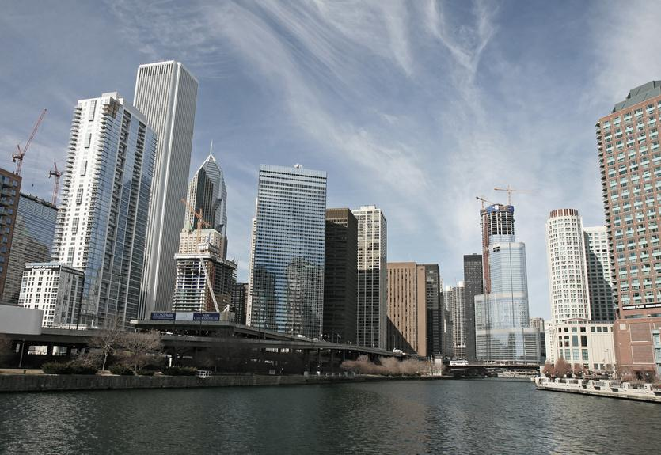
Models of
Urban Land Use

Slide 11
Urban Land Use Models
Three models help explain different land uses within cities:
  Concentric zone model
  Sector model
  Multiple nuclei model

Slide 12
Urban Land Use Models
All three models:
  Based on Chicago, a city on flat land with only Lake Michigan to the east
  Include a central business district (CBD)
  Have residential areas with various levels of income

Slide 13
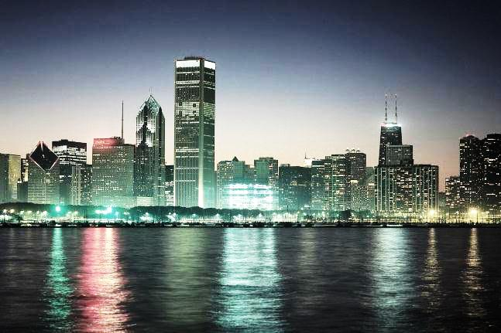
Urban Land Use Models
The concentric zone model:
  created by E.W. Burgess (1923)
  views cities as growing outward from a central area in a series of concentric rings
Chicago Skyline

Slide 14
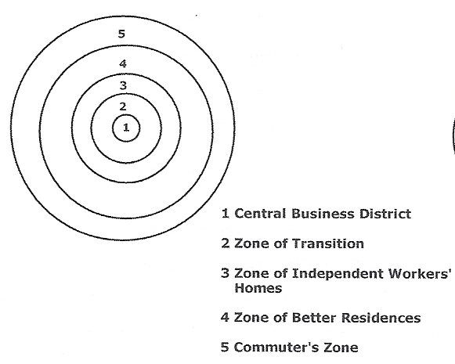
Illustration of Concentric Zone Model
This model illustrates that a city grows in a series of rings that surround the central business district.

Slide 15

Urban Land Use Models
Zones of the concentric zone, or Burgess, model:
  Characteristics of Zone One
    the central business district (CBD)
    concentration of nonresidential activities
    high property costs
Zone 1

Slide 16
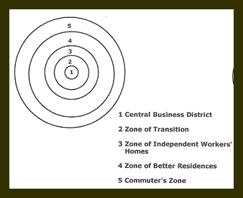
Urban Land Use Models
Zones of the concentric zone, or Burgess, model:
  Characteristics of Zone Two
    A zone of transition
    Transition between the CBD and purely residential areas
    Light industry and housing for the poor
Zone 2

Slide 17
Urban Land Use Models
Zones of the concentric zone, or Burgess, model:
  Characteristics of Zone Three
    working class homes
    housing less expensive here than in the outer rings
Zone 3

Slide 18
Urban Land Use Models
Zones of the concentric zone, or Burgess, model:
  Characteristics of Zone Four
    larger and more expensive homes
    middle-class residences
    residents able to afford transportation to CBD
Zone 4

Slide 19
Urban Land Use Models
Zones of the concentric zone, or Burgess, model:
  Characteristics of Zone Five
    commuter’s zone
    farthest away from CBD
    residences for sleeping and leisure time activities
Zone 5

Slide 20
Urban Land Use Models
About the Burgess model:
  It is dynamic as inner rings grow larger.
  Neighborhoods change through a process of invasion and succession.
  Poorer inhabitants drive wealthier residents further away from the central city.

Slide 21
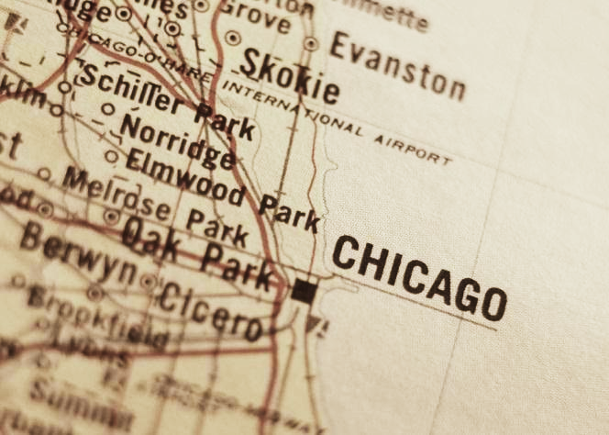
Urban Land Use Models
The sector model:
  Created by Homer Hoyt (1939) as a variant of the concentric zone theory
  Describes a city that develops in a series of sectors, not rings

Slide 22
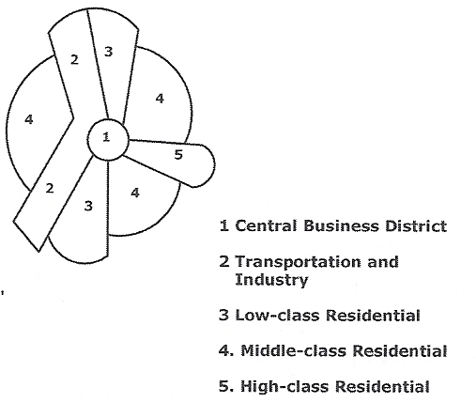
Chicago
Hoyt’s sector model demonstrates that a city grows in a series of sectors, or wedges, out from the central business district.

Slide 23
Urban Land Use Models
According to Hoyt, the sectors may be determined by environmental factors (e.g. bodies of water), or they simply may develop by chance.

Slide 24

Urban Land Use Models
Once a district is established for industry, other industries will develop around it, creating the wedge.
Likewise, a district where wealthy people live will attract other wealthy people.

Slide 25
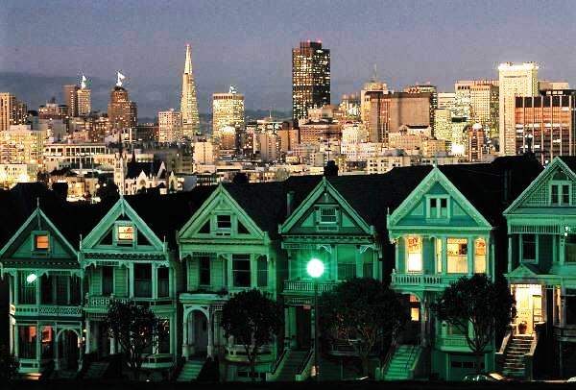
Urban Land Use Models
Middle class residences are next to the high-income areas, and low-income residents occupy the left over areas.

Slide 26
Urban Land Use Models
Hoyt, like Burgess, noted that as the city grows, residential areas once occupied by the wealthy “filter down” to the middle class.
Residential areas eventually filter down to the lower class as property is sold from one owner to another.

Slide 27

Urban Land Use Models
The multiple nuclei model:
  Developed by C.D. Harris and E.L. Ullman (1945)
  Stated that large cities develop by spreading from several nodes of growth, not just one

Slide 28
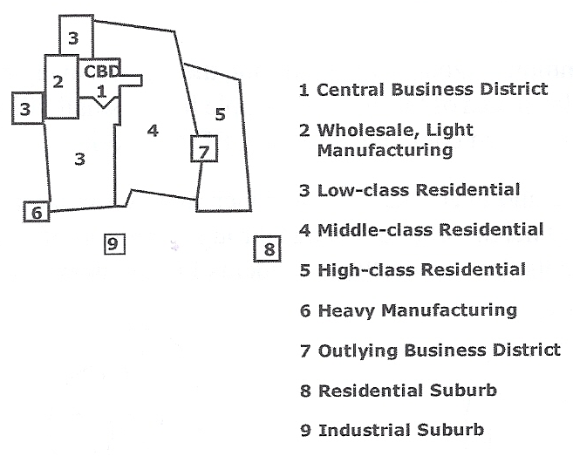
The Multiple-Nuclei Model
According to this model, different types of people
and activities cluster around each node.

Slide 29
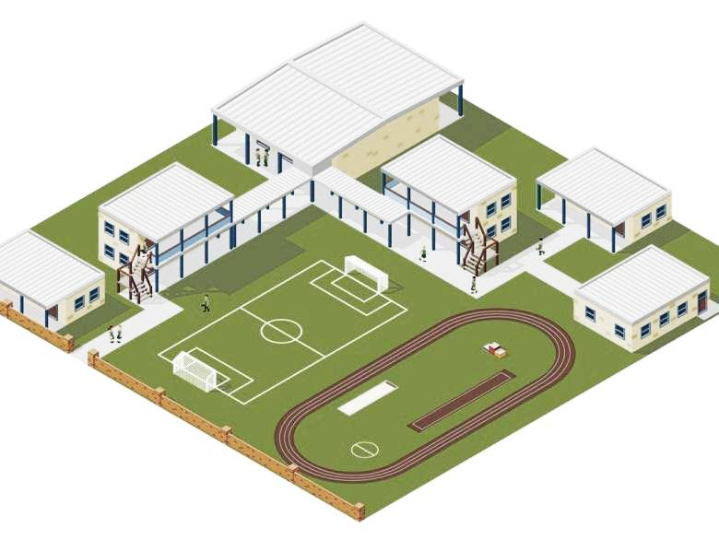
Urban Land Use Models
Individual nodes have special functions like:
  ports
  neighborhood
  businesses
  universities
  airports
  different levels
  of residences

Slide 30
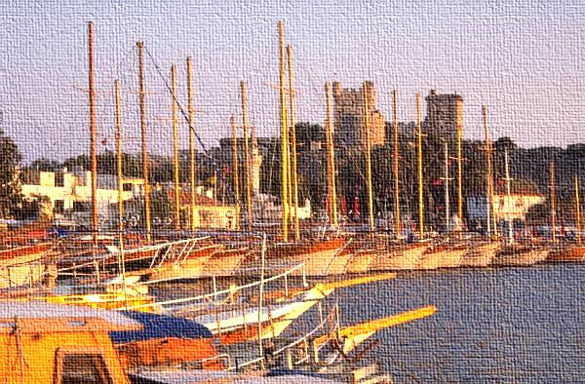
Urban Land Use Models
The multiple nuclei model explains that incompatible land use activities do NOT cluster in the same locations.
The nodes, then, influence the type of development that occurs around them.

Slide 31
Urban Land Use Models
The three models help to explain land use in cities AND the different social characteristics of people who live in particular areas of a city.

Slide 32
Urban Land Use Models
Urban areas in the U.S. are divided into census tracts, areas of approximately 5,000 people that correspond whenever possible to neighborhood boundaries.

Slide 33

Urban Land Use Models
Every 10 years the U.S. Census Bureau publishes reports on the demographic characteristics of each tract including:
  ethnicity
  race
  median income
  education levels of residents

Slide 34
Patterns of
Class, Age, Gender,
Race, and Ethnicity

Slide 35
Distribution of social groups
Social area analysis puts together information from the census tracts to create an overall picture of how various types of people are distributed within a broader area, like a city.

Slide 36
Distribution of social groups
Urban models support the idea that people prefer to live near others with
similar characteristics.

Slide 37
Distribution of social groups
The larger and more economically and socially complex cities are, the stronger the tendency for resident to segregate themselves into groups based on:
  social class
  race
  ethnicity

Slide 38

Distribution of social groups
Once social divisions are in place, they tend to carry over from one generation to the next.
“Mixed” neighborhoods are often just in temporary transition to domination by another group.

Slide 39
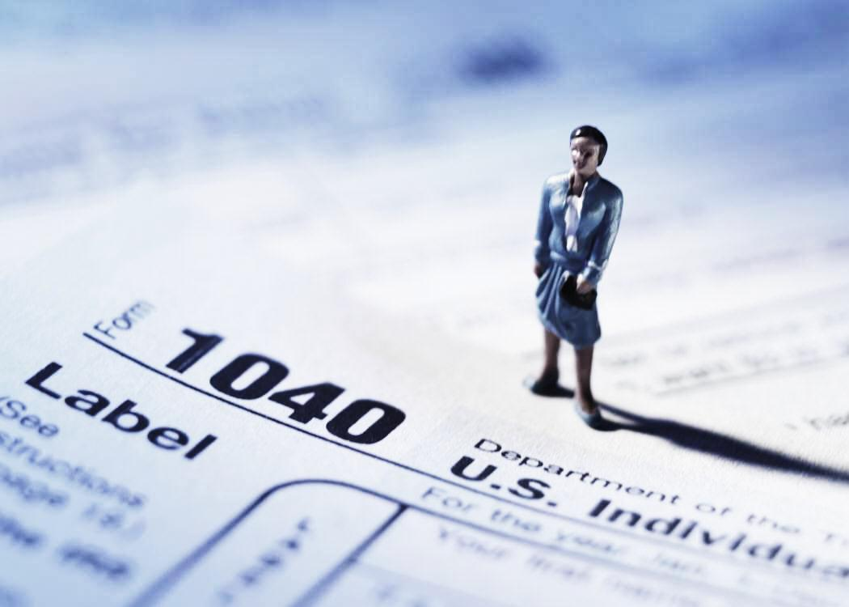
Distribution of social groups
SOCIAL CLASS
is often measured by:
        income
        education
        occupation

Slide 40
Distribution of social groups
SOCIAL CLASS
  One indicator of social class is the number of people who live per room in a house.
  A low number of people per room tends to indicate high status.

Slide 41
Distribution of social groups
SOCIAL CLASS
  Of the three models of urban land use, Hoyt’s sector model is most reflective of clustering patterns by social status.
  If people from a lower status move into an area, the higher status residents tend to move away.

Slide 42

Distribution of social groups
AGE AND MARITAL
STATUS
Younger families tend to live farther away from the city center because they are seeking space for child rearing.
  They tend to cluster according to social status as well.

Slide 43
Distribution of social groups
AGE AND MARITAL STATUS
  Houses are larger with green space around for children’s play in neighborhoods with younger families.

Slide 44
Distribution of social groups
AGE AND MARITAL STATUS
  Groups that need less living space often live closer to the city center.
  Young professionals, unmarried or without children, are more likely to live close to the city center as well.

Slide 45

Distribution of social groups
GENDER
  A growing phenomenon in American society is the increase in the number of one-parent families.

Slide 46
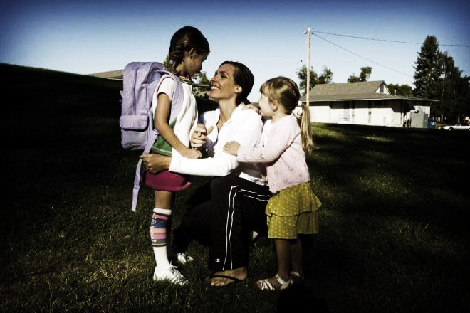
Distribution of social groups
GENDER
  According to the 2000 census, 28% of U.S. families with children under 18 have only one parent in the household.
  78% of all one-parent families are headed by women.

Slide 47
Distribution of social groups
GENDER
  A disproportionate number of one-parent families live in low-income neighborhoods.
  This trend is called the feminization of poverty, or the increasing proportion of the poor who are women.

Slide 48
Distribution of social groups
GENDER
  Because their incomes are lower, women rely more heavily on public transportation than do men.
  As a result, they tend to be concentrated in or near central cities.

Slide 49
Distribution of social groups
RACE AND ETHNICITY
  Once a group moves into an area, that “node” tends to attract others.
  This process is explained
  by the multiple nuclei
  model.
  Examples:
    “Little Italy”
    “Chinatown”

Slide 50

Distribution of social groups
RACE AND ETHNICITY
  In many American cities, blacks
  and Latinos are segregated into
  nuclear communities that are
  frequently undesirable
  neighborhoods called ghettos.

Slide 51
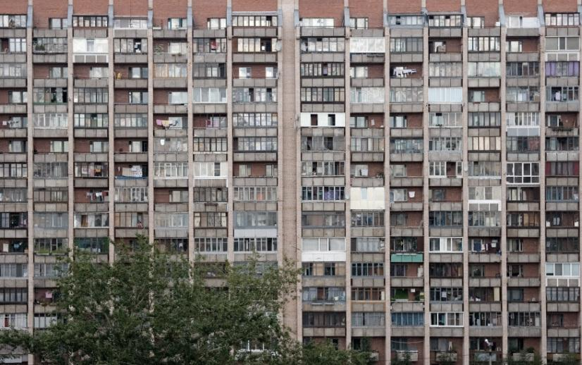
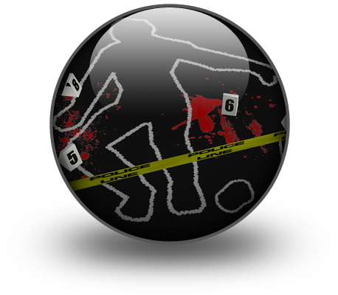
Distribution of social groups
RACE AND ETHNICITY
  These ghettos are characterized by:
    dilapidated housing
    high crime rates
    inadequate schools

Slide 52

Distribution of social groups
RACE AND ETHNICITY
  Racial and ethnic segregation tends to create a vicious cycle of poverty that is hard to break.
  Today, the average black city dweller lives in a census tract that is more than 75% minority.

Slide 53
Distribution of social groups
RACE AND ETHNICITY
  Contrary to popular stereotypes, black-white separation
  is highest in metropolitan areas in the Northeast and Midwest, and lowest in the
  metropolitan areas of the
  South and West.

Slide 54
Key Terms to Review
Internal cities
Accessibility
Concentric zone model
Central business district (CBD)
E.W. Burgess
Zone of transition
Commuter
Sector model
Homer Hoyt
Multiple nuclei model
Harris and Ullman
Nodes
Social characteristics
Census tracts
Social area analysis

Slide 55
Key Terms to Review
Social class
“Mixed neighborhoods
Feminization of poverty
Ghettos
Ethnic neighborhoods

