Slide 1
Unit Seven: Cities and Urban Land Use
Advanced Placement Human Geography
Session 6

Slide 2
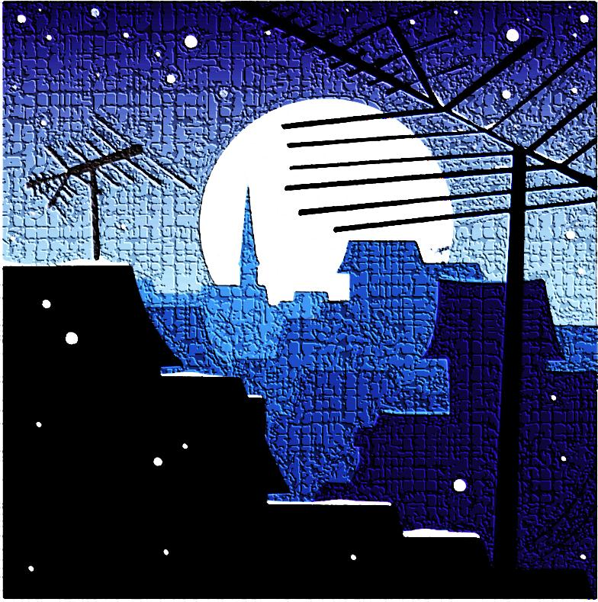
Ghettoization

Slide 3
Ghettoization
The changing pattern of ethnic clustering within metropolitan areas is determined partly by residential choice and partly by discrimination.

Slide 4
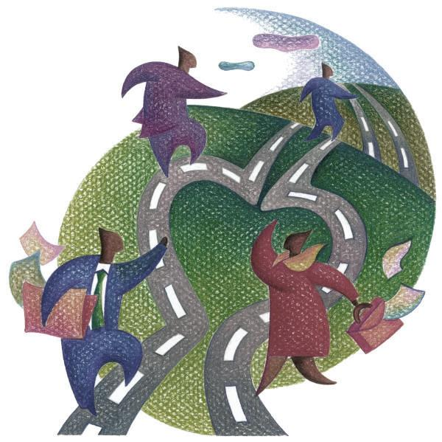
Ghettoization
Where forced segregation limits residential choices, ethnic or racial minorities may be confined to the older low-cost housing areas typically close to the city’s center.
This forced segregation is called ghettoization.

Slide 5
Ghettoization
Patterns of ghettoization of African Americans historically have differed by region:
  Early southern ghetto
  Classic southern ghetto
  Early northern ghetto
  Classic northern ghetto

Slide 6
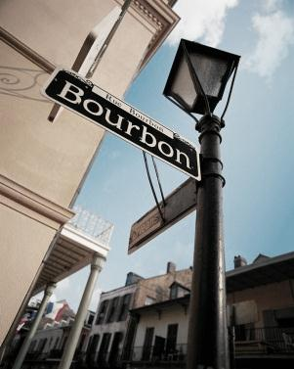
Ghettoization
Early southern ghetto:
  In pre-Civil War cities such as Charleston and New Orleans, African Americans were confined to small houses in alleys and back streets.
  They were near white communities where they worked as house and garden slaves.

Slide 7
Ghettoization
Classic southern ghetto:
  After slavery was banished, newly-free blacks lived in small houses of poor quality on undesirable land (e.g. next to railroad tracks).
  There was full spatial and social segregations from whites.

Slide 8
Ghettoization
Early northern ghetto:
  As African Americans migrated to northern cities in the early 20th century, they competed with other groups for living space.
  They often lived in high-density deteriorating housing on the margins of the CBD.

Slide 9
Ghettoization
Classic northern ghetto:
  Black ghettos often grew in areas that surrounded the CBD.
  Ghetto inhabitants lived in crowded low rent housing.
  Growth was shaped by white neighborhoods that strongly resisted blacks moving into their areas.

Slide 10
Ghettoization
Until the 1960s, few legal regulations existed to curb the racial discrimination that reinforced racial ghettos.

Slide 11
Ghettoization
Banks clearly identified “risky” neighborhoods by redlining them and refusing to give out loans for houses there.
Redlining kept property values low in those areas and restricted the flow of money for upkeep and repairs.

Slide 12
Ghettoization
Another practice that insured racial segregation was blockbusting, which occurred when a real estate agent would sell a house in a white neighborhood to an African American for a very low price.

Slide 13
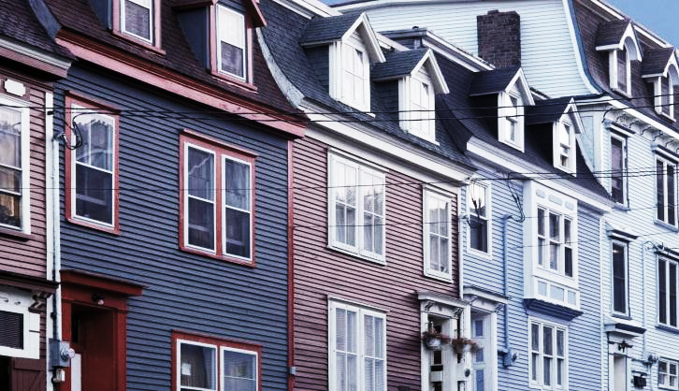
Ghettoization
More about blockbusting…
  The real estate agents would use scare tactics to get white neighbors to sell.
  Real estate agents earned commissions based on this practice, and neighborhoods rapidly changed to ghettos.

Slide 14
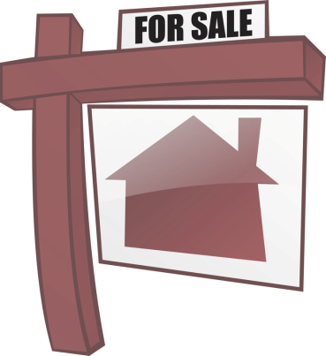
Ghettoization
  More about blockbusting…
  Blockbusting became illegal in the 1960s but was replaced by racial steering, an attempt to change ghetto boundaries by showing houses to blacks in white neighborhoods and to whites in black neighborhoods.

Slide 15
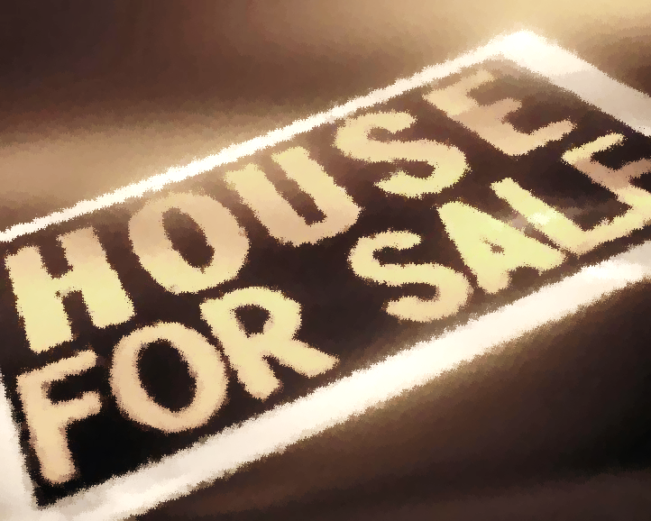
Ghettoization
In spite of the fact that these practices eased with political oversight, city neighborhoods have remained highly segregated.

Slide 16
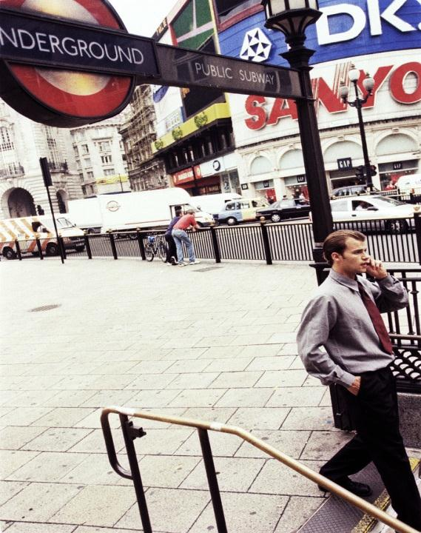
Transportation
and
Infrastructure

Slide 17

Infrastructure
Infrastructure refers to the facilities that support basic economic activities to such a degree that a city cannot function without them.

Slide 18
Infrastructure
Structures that support economic activities include:
  banks
  post offices
  hotels
  cable networks
  television and radio stations
  communication companies

Slide 19
Infrastructure
A city’s infrastructure includes transportation systems such as:
  airports
  roads
  docks
  railways
  taxis
  intracity transit systems

Slide 20
Infrastructure
More than half of the trips that people make are
work related.

Slide 21
Infrastructure
The shapes of cities changed dramatically once modes of transportation made it possible for people to live further away from their places of work.

Slide 22
Transportation
Modern forms of transportation have impacted the demographic layout and functions of cities.

Slide 23
Transportation
Motor vehicles
  People in the suburbs usually rely more on motor vehicles than railroads, particularly in the U.S.

Slide 24
Transportation
Motor vehicles
  For people living outside of cities in the U.S., cars are a near necessity because public transportation facilities are often limited.

Slide 25
Transportation
Motor vehicles
  The U.S. government has encouraged car ownership by funding road building, so that driving a car is usually the most efficient way to get from one place to another.

Slide 26
Transportation
Motor vehicles
  Multi-lane freeways cut huge swaths through the heart of cities.
  Elaborate interchanges consume even more space.

Slide 27
Transportation
Public transportation
  In the U.S., public transportation systems other than roads for automobiles are much more common in cities than in suburban or rural areas.

Slide 28

Transportation
Public transportation
  A large percentage of population movement in and out of and within cities takes place during rush hours.

Slide 29
Transportation
Public transportation
  A rush hour is the two-hour period in the morning when people are going to work and the two-hour period in the afternoon when people are going home.

Slide 30
Transportation
Public transportation includes:
  buses
  trains
  subways

Slide 31
Transportation
Public transportation
  Despite the fact that most Americans prefer to commute by car, public transportation is:
    cheaper
    less polluting
    more energy-efficient

Slide 32
Transportation
Public transportation
  Some U.S. cities have established public transportation systems.
  Those cities include:
    New York
    Boston
    Chicago

Slide 33
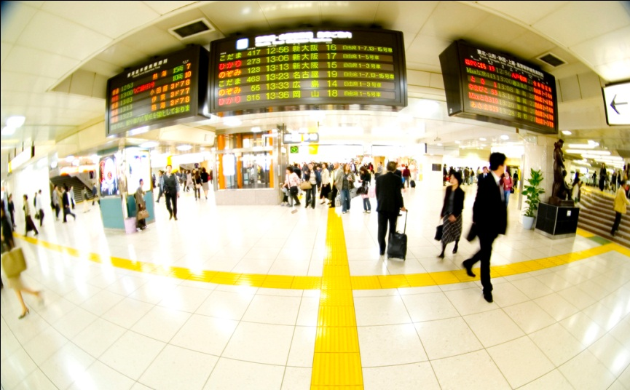
Transportation
Public transportation
  In contrast to the U.S., public transit is much more developed and more likely to be funded by government in most European countries and Japan.

Slide 34
Key Terms to Review
Ghettoization
Forced segregation
Early southern ghetto
Classic southern ghetto
Early northern ghetto
Classic northern ghetto
Redlining
Blockbusting
Racial steering
Infrastructure
Intracity transit system
Multi-lane freeway
Interchanges
Public transit
Rush hour

