Slide 1
Unit Seven: Cities and Urban Land Use
Advanced Placement Human Geography
Session 7

Slide 2
Political Organization
And
Urban Planning

Slide 3
Urban Planning
Since World War II, governments have become more active in controlling land-use arrangements and growth patterns of most
U.S. cities.

Slide 4
Urban Planning
Governments have passed laws to restrict ways that property and city areas can be developed and used.

Slide 5

Urban Planning
In U.S. cities, emphasis has been on:
  land-use planning
  zoning ordinances
  building codes
  health codes
  safety codes

Slide 6
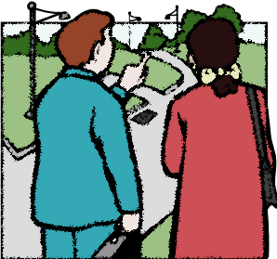
Zoning
Zoning ordinances encourage spatial separation by preventing mixed land use within the same district.

Slide 7
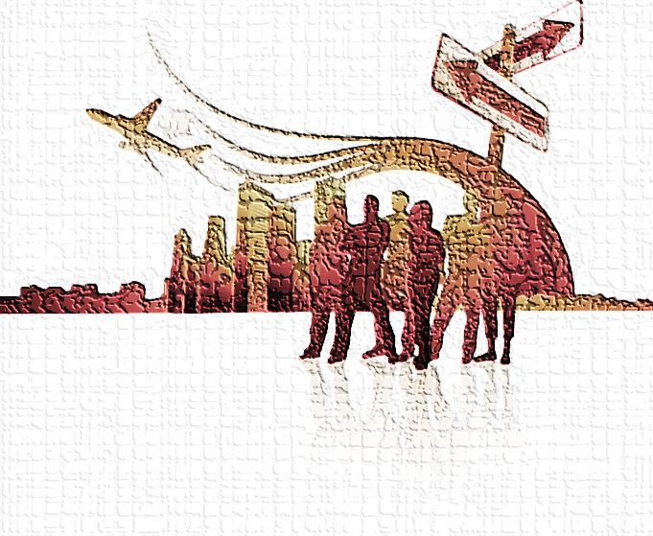
Zoning
Zoning ordinances usually separate the following in different areas:
  single-family houses
  apartments
  industry
  commerce

Slide 8
Zoning
Zoning ordinances separate types of activities because not doing so can be unhealthy and inefficient.

Slide 9

Zoning
Critics of zoning believe that it has reinforced class, racial, and ethnic lines.

Slide 10
Zoning
In most of Asia there is no zoning.
It is quite common to have mixed neighborhoods.
Often homes serve as businesses as well, with no interference by the government.

Slide 11
Zoning
In Europe and Japan, neighborhoods often contain a wide variety of building types in close proximity.
This variety of building types is not as common in the U.S. and Canada.

Slide 12
Local Government Fragmentation

Slide 13
Fragmentation
A city’s local government often operates separately from those of its suburbs, causing local fragmentation.

Slide 14

Fragmentation
Local fragmentation makes it difficult to solve regional problems, such as:
  Traffic flow
  Solid waste disposal
  Provisions of social
  services

Slide 15
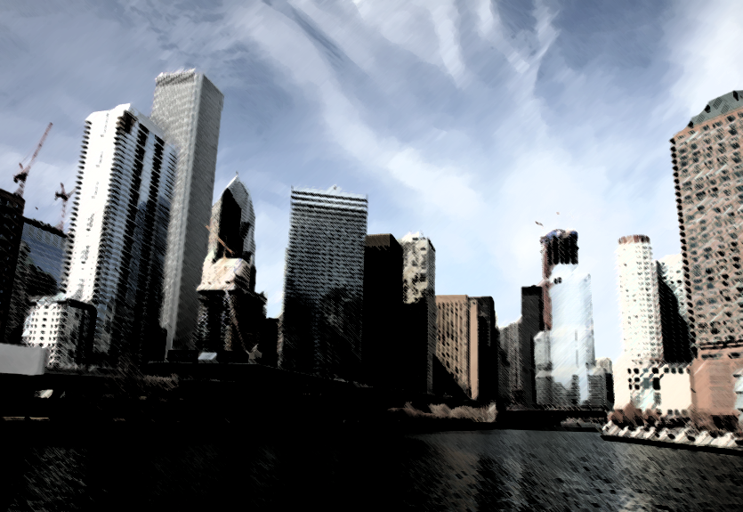
Fragmentation
Example of fragmentation:
  Chicago has 1,200 different local government within its urban area.

Slide 16
Fragmentation
More metropolitan areas are calling for cooperation among local governments, with many forming
councils of government.
These councils are cooperative agencies consisting of representatives from local governments in the region.

Slide 17
Fragmentation
Example of consolidated government:
  Indianapolis has consolidated governments so that no differences exist between city and county governments.

Slide 18
Planning for Growth

Slide 19
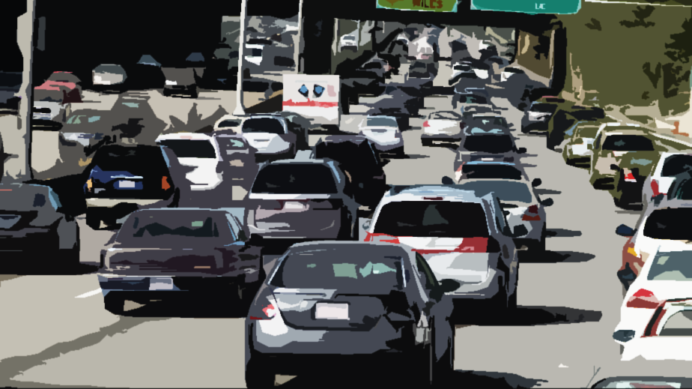
Growth of Cities
Smart growth involves steps to:
    curb sprawl
    limit traffic congestion
    reverse inner city decline

Slide 20
Growth of Cities
The goal of smart growth is to produce a pattern of controlled development, while protecting rural lands for:
  agriculture
  wildlife
  recreation

Slide 21
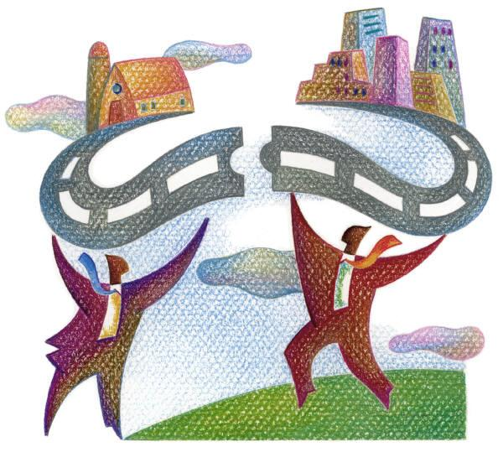
Growth of Cities
Smart growth has been enacted in some U.S. states such as:
  Maryland
  Oregon
  Tennessee

Slide 22
Growth of Cities
Some smart growth provisions have limited highway funding.
Others have defined growth boundaries for new development.

Slide 23
Urban Renewal
and
Gentrification

Slide 24
Urban Renewal
Many cities are attempting to improve inner-city neighborhoods through
urban renewal.

Slide 25
Urban Renewal
Urban renewal programs allow governments to:
  buy properties from owners
  relocate residents and businesses
  clear the sites
  build new roads and utilities

Slide 26
Urban Renewal
Once the land is bought by the government, the land is turned over to private developers or to public agencies to construct new building and services.

Slide 27
Urban Renewal
The national government has helped cities pay for urban renewal through
federal grants.

Slide 28
Urban Renewal
Public housing, reserved for
low-income households, has been built and funded by the federal government.

Slide 29
Urban Renewal
Public housing in Europe:
  In Great Britain, more than one-third of all housing is publicly owned.
  In other parts of Western Europe, governments do not own the housing. Instead, governments subsidize construction costs and rent for many privately built housing units.

Slide 30
Urban Renewal
Many public housing projects in the U.S. have been demolished because of deterioration.

Slide 31
Urban Renewal
An alternative to demolishing inner-city houses is to renovate them.
Renovation projects often attract middle-class residents, a process called gentrification.

Slide 32
Urban Renewal
Middle class people are often drawn to gentrified areas because they are close to downtown where there are:
  job opportunities
  restaurants
  cultural opportunities

Slide 33

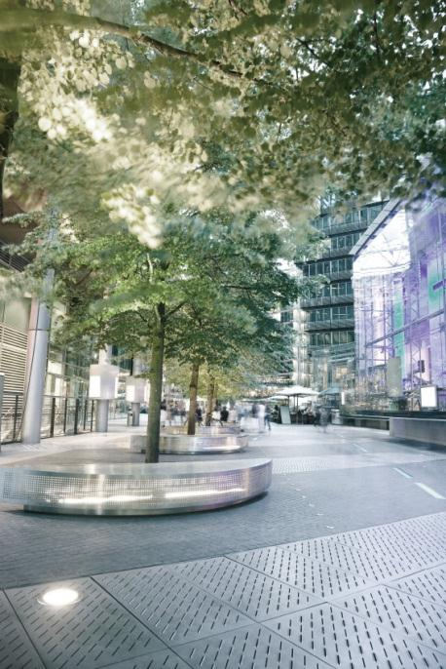
Urban Renewal
How do cities encourage gentrification?
  They provide low-cost loans and tax breaks.

Slide 34
Urban Renewal
Critics of gentrification claim that government actions act as subsidies for the middle class at the expense of the poor.
The poor are often forced out because of rent increases.

Slide 35
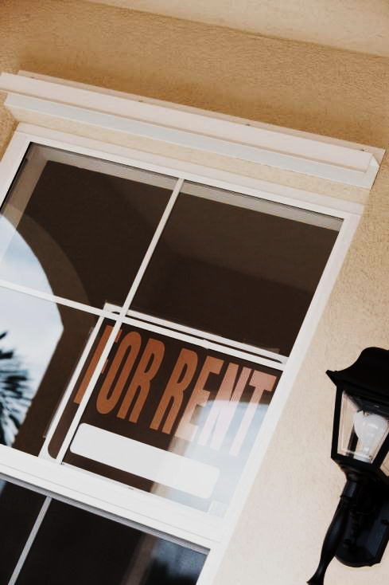
Urban Renewal
By law, cities must reimburse families forced to move, both for moving expenses and for rent increases over a four-year period.

Slide 36
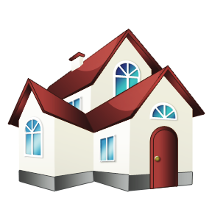
Suburbanization
and
Edge Cities

Slide 37
Suburbanization
Suburbs in the U.S. began to expand after World War II, partly because automobiles were made more affordable through assembly-line production.

Slide 38

Suburbanization
As demand for new homes grew, the interstate highway system improved.
The GI Bill of Rights provided government-sponsored loans for veterans to buy houses.

Slide 39
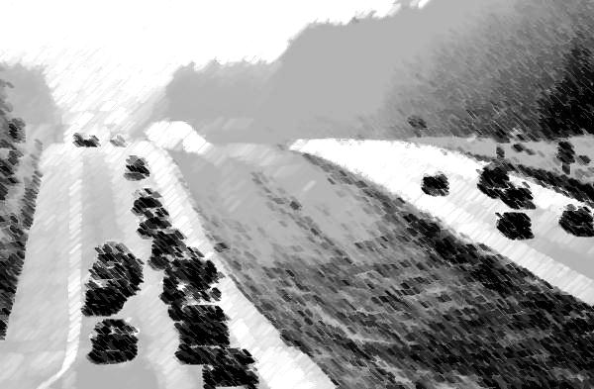
Suburbanization
The suburbs were linked to center cities by
highway transportation.

Slide 40
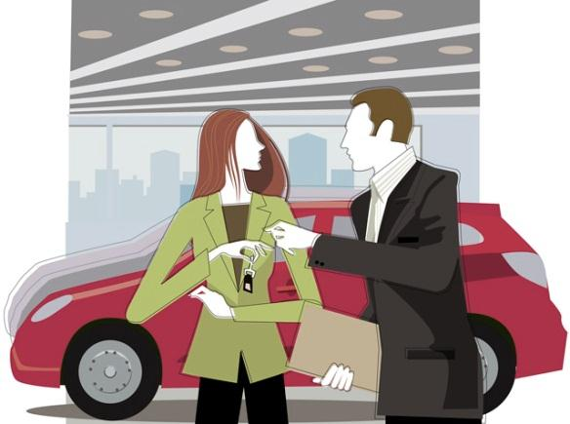
Suburbanization
As more people moved to suburbs, businesses followed, with retailing increasingly concentrated in shopping malls.
There was plenty of space in the planned shopping malls for parking.

Slide 41
Suburbanization
Chain stores began in the 1920s.
Store architecture became similar no matter where the malls were located.

Slide 42

Suburbanization
The availability and low cost of land in the suburbs has led to the construction of megastores – huge stores with a wide variety of products designed for one-stop shopping.

Slide 43
Suburbanization
Today U.S. cities have stopped their spatial growth because residents in outlying areas organize their own services rather than pay city taxes for them.

Slide 44
Suburbanization
These legally independent suburban areas may grow to become edge cities.

Slide 45
Suburbanization
Chauncy Harris describes the formation of edge cities through his peripheral model of an urban area consisting of an inner city surrounded by suburban residential and business areas.

Slide 46
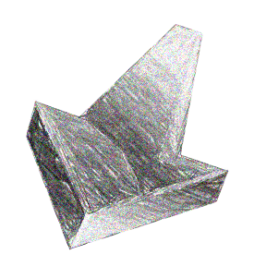
Suburbanization
As the distance increases from the center of the city, the density of residents and houses decreases.
This change is called the density gradient.

Slide 47
Suburbanization
What is sprawl?
  Sprawl is the progressive development of landscape in the suburban areas, which allows people to have larger houses and more land.

Slide 48

Suburbanization
Why is sprawl criticized?
  Sprawl wastes agricultural land as well as energy.
  The costs of new roads and utilities often lead to higher taxes and home prices.

Slide 49

Suburbanization
The supply of land for new construction is limited in Europe.
Many cities are surrounded by
greenbelts.

Slide 50

Suburbanization
What are greenbelts?
  Greenbelts are rings of open space where houses may not be built.
  They preserve land, but they tend to increase house prices in the cities that they protect.

Slide 51
Key Terms to Review
Urban planning
Zoning ordinance
Mixed neighborhoods
Local fragmentation
Councils of government
Consolidated government
Smart growth
Urban renewal
Gentrification
Public housing
Suburbanization
Edge cities
Interstate system
GI Bill of Rights
Shopping malls
Megastores

Slide 52
Key Terms to Review
Peripheral model
Density gradient
Sprawl
Greenbelts

