Slide 1
Unit Seven: Cities and Urban Land Use
Advanced Placement Human Geography
Session 8

Slide 2
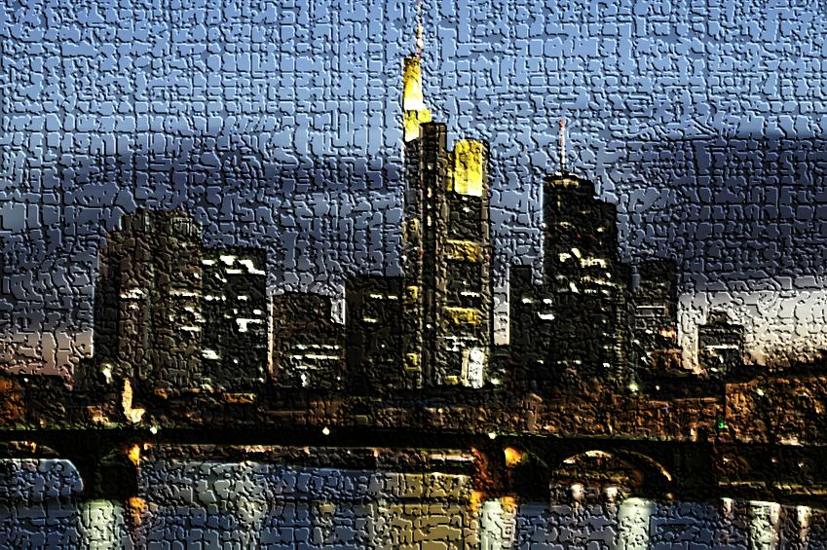
Comparative Urbanization

Slide 3
Comparative Urbanization
The North American and European models for urban patterns are often difficult to apply to cities in:
    Africa
    Asia
    Latin America

Slide 4
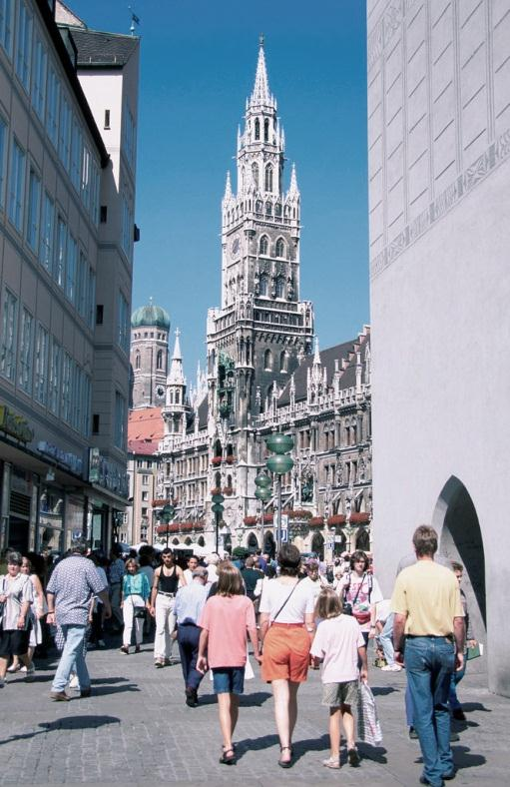
Comparative Urbanization
In many areas that were once colonized, Western styles and layouts are still apparent.

Slide 5
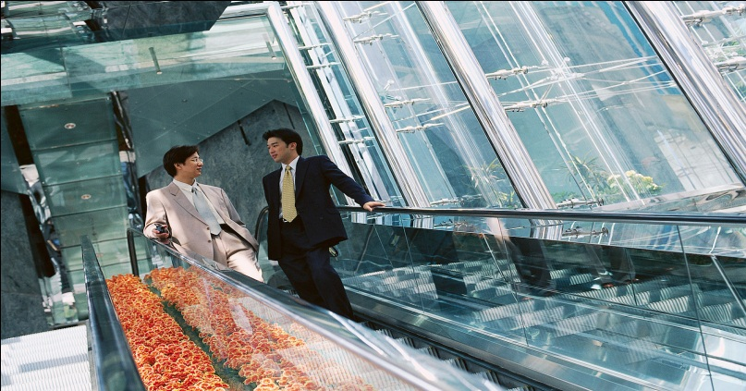
Comparative Urbanization
In today’s postcolonial megacities, the patterns have been altered by modernization and immigration.
In many cases, they have been transformed.

Slide 6
Comparative Urbanization
Geographers have developed regional models that more accurately reflect the spatial arrangement of urban areas.

Slide 7
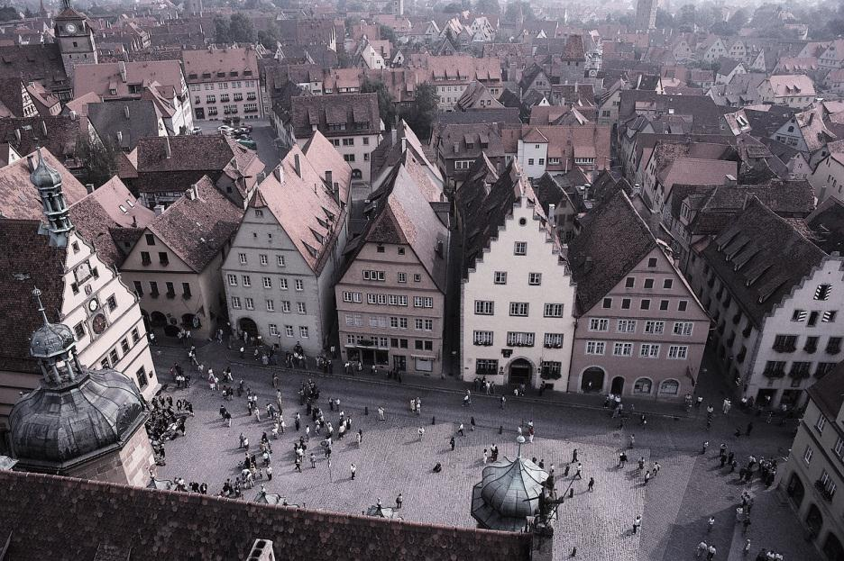
European Cities

Slide 8
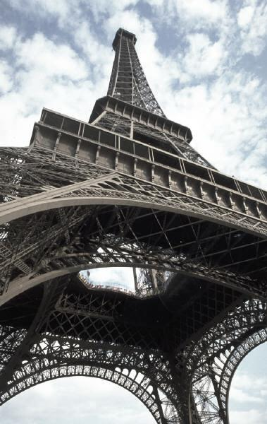
European Cities
The upper-class residential areas cluster around a sector that extends out from the CBD.
Example: Paris

Slide 9
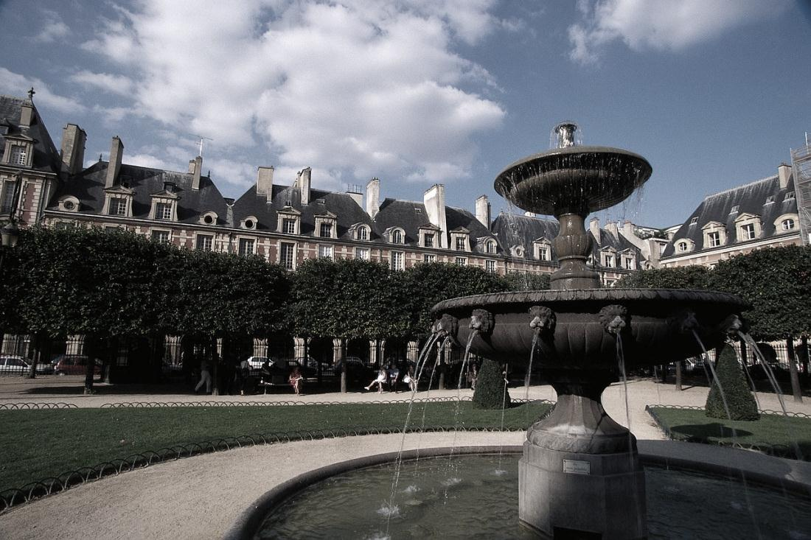
European Cities
Many years ago, the rich moved to the southwestern hills of Paris to be near the king’s palace.

Slide 10
European Cities
Since most people do not have large private yards, Europeans frequent public parks that have deep historical roots.

Slide 11
European Cities
In the past, poor people also lived in the central European city.
  As cities expanded with the Industrial Revolution, housing for workers was constructed near factories and away from the rich.

Slide 12
European Cities
Currently most poor people live on the outskirts of cities.

Slide 13
European Cities
Many European suburbs are centers for:
  crime
  violence
  drug dealing
Recent immigrants from Africa or Asia who have settled in suburbs often face discrimination in the larger society.

Slide 14
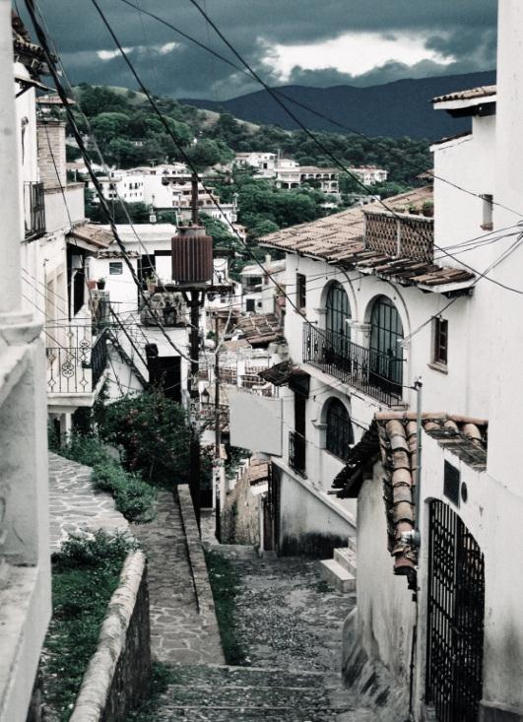
Latin American
Cities

Slide 15
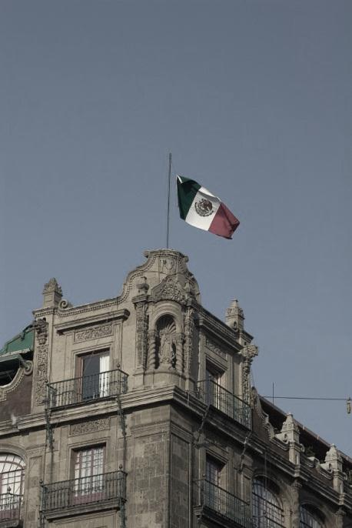
Latin American Cities
Latin American cities are growing faster than those in most other areas of the world.

Slide 16
Latin American Cities
The central business district is the main focus of:
  business
  employment
  entertainment

Slide 17
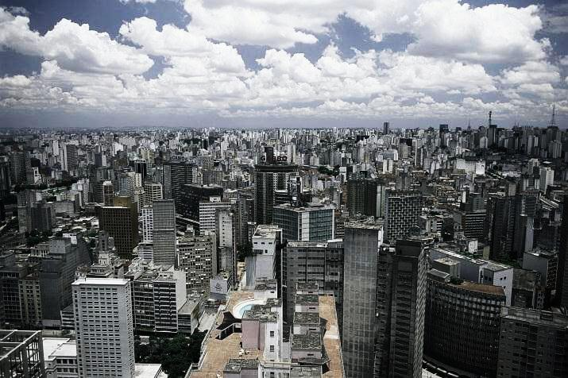
Latin American Cities
The CBD is divided into a market sector, where old-fashioned markets are set up, and a high rise sector, where more modern businesses are headquartered.

Slide 18
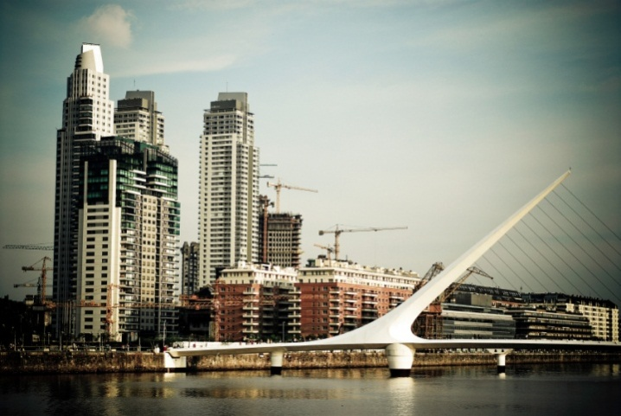
Latin American Cities
From the high rise sector a commercial spine radiates away from the city.
The commercial spine is surrounded by an elite residential sector.
Buenos Aires, Argentina

Slide 19
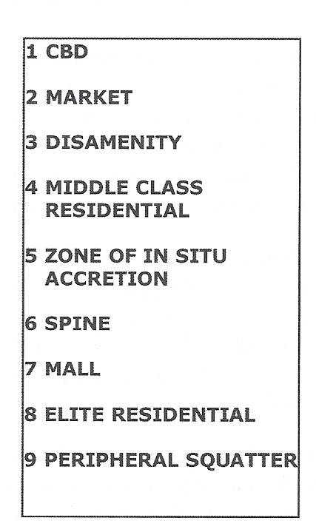

THE GRIFFIN-FORD MODEL
OF
LATIN AMERICAN CITY STRUCTURE

Slide 20
Latin American Cities
Remaining concentric zones are residential areas for the poor and middle class.
Socioeconomic levels and housing quality decrease as distance from the center city increases.

Slide 21
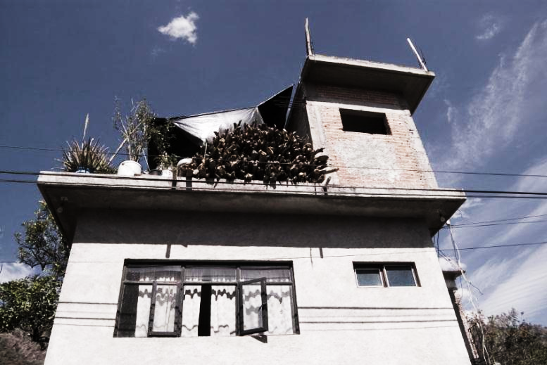
Latin American Cities
Closer in to the city are the middle classes, who form a
“zone of maturity” of generally well-maintained homes.

Slide 22
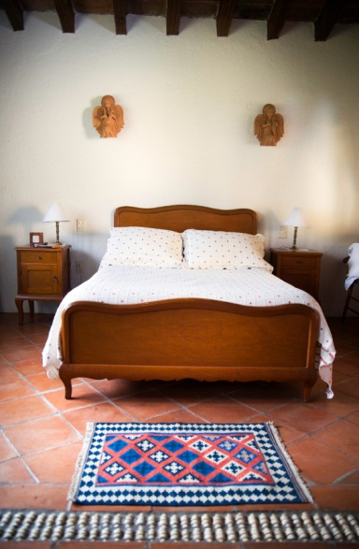
Latin American Cities
The “zone of maturity” is ringed by the “in situ accretion” zone that contains much more modest housing and transitions to the outer-ring of poverty.

Slide 23
Latin American Cities
The disamenity sector is a relatively stable slum area that radiates from the central market to the outermost zone of squatter settlements on the periphery.
This outermost zone consists of high-density shantytowns.

Slide 24
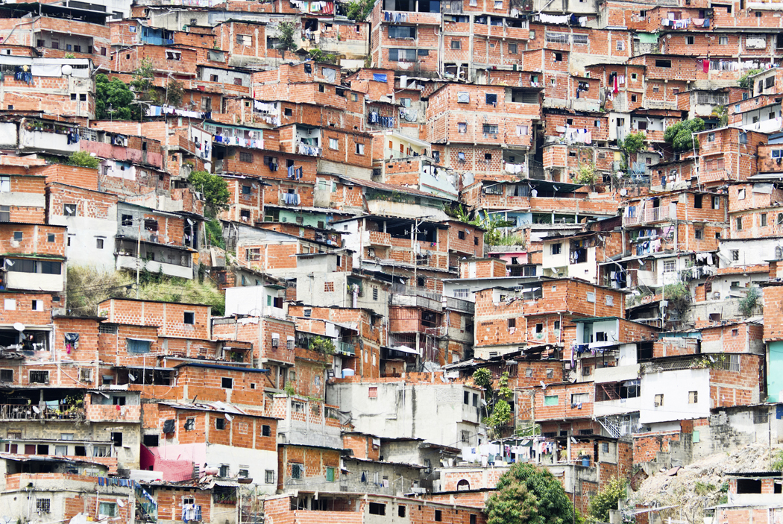
A shantytown in Caracas, Venezuela

