Slide 1
African
Cities

Slide 2

African Cities
Cities in Africa are shaped by the fact that many are located in the global periphery.
Many of the cities are large and are characterized by squatter settlements on their outskirts.

Slide 3
African Cities
Africa is a diverse continent with many different geographical and historical influences.
Therefore, it is difficult to formulate a model for African cities.

Slide 4
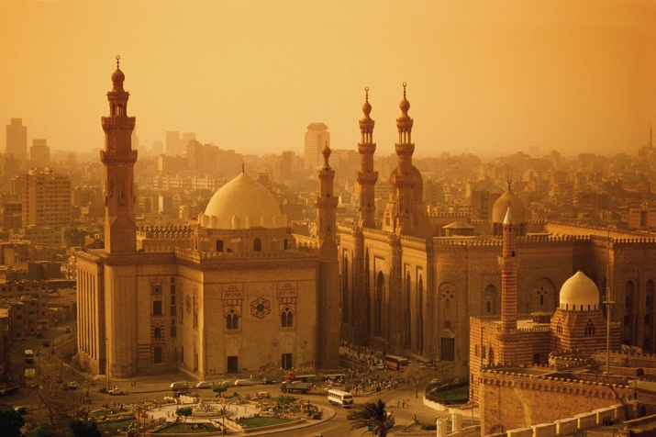
African Cities
Cities in the northern part of Africa are strongly influenced by Islamic tradition.
Mosques are at the city’s center.
A marketplace, or bazaar, is located nearby and serves as the commercial center.
Cairo, Egypt →

Slide 5
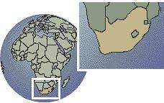
African Cities
Cities in South Africa are essentially Western since they were colonized and built by Europeans.
South Africa

Slide 6
African Cities
The largest city in Africa is Lagos, Nigeria.
Lagos is rapidly growing into a megacity.

Slide 7

African Cities
Lagos is a confused landscape of shanty developments with no running water or sewers that coexist with areas of :
  high-rise buildings
  paved streets
  modern facilities

Slide 8
African Cities
One model of Sub-Saharan cities indicates that the central city consists of three CBDs:
  the remains of the colonial CBD
  an open-air market zone
  a transitional business center where business is less transitory

Slide 9
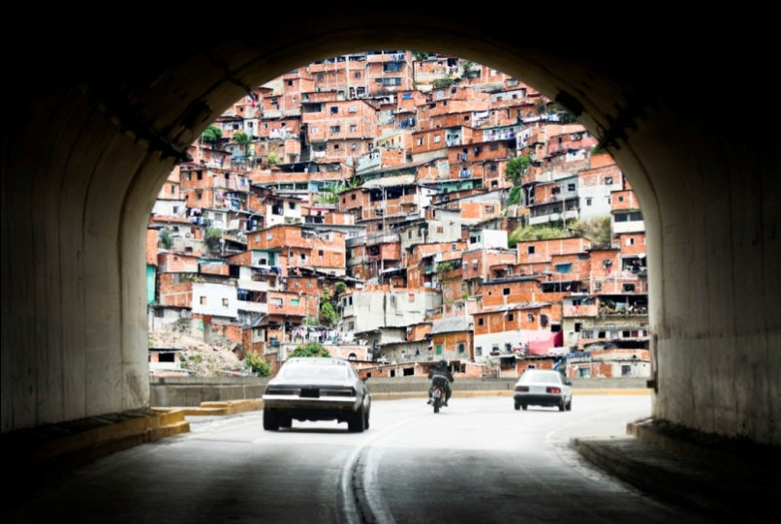
African Cities
Like Latin American cities, the outermost ring of African cities tends to be squatter settlements.
A view of a shantytown through a tunnel

Slide 10
Asian Cities

Slide 11
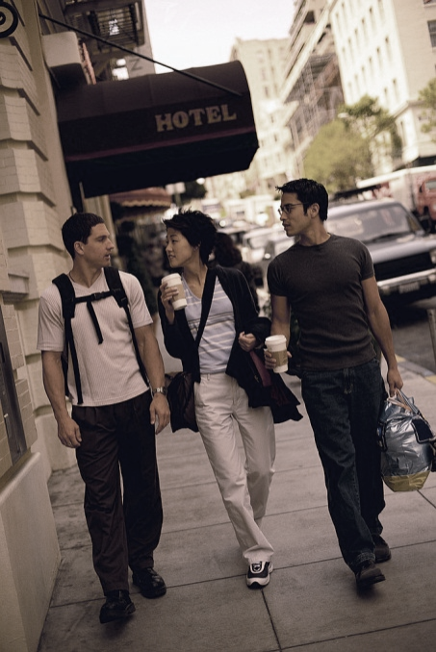
Asian Cities
Many large cities of Asia were founded and developed by Europeans, so they often follow the European model.

Slide 12
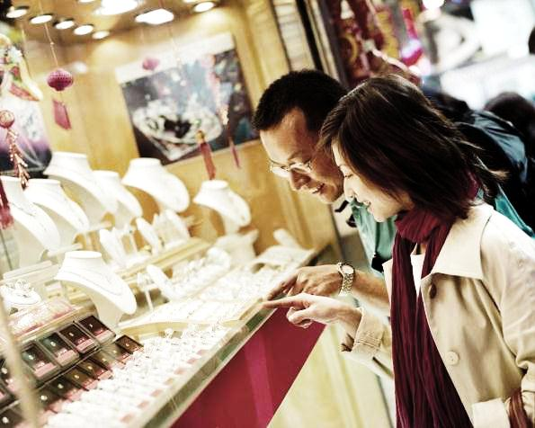
Asian Cities
Southeast Asian Cities
  They tend to be centered on a port.
  Around the port is a Western-style CBD with European:
    shops
    hotels
    restaurants

Slide 13
Asian Cities
Southeast Asian Cities
  Around the ports are one or more “alien commercial zones” where merchants from other areas (such as India or China) have established themselves.
  Peripheral squatter zones house the majority of the city’s population.

Slide 14
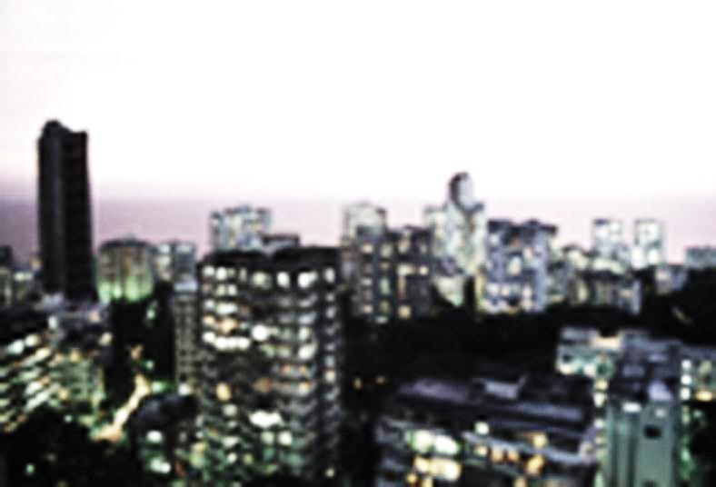
Asian Cities
The South Asian City may take two forms:
    colonial based
    traditional
Mumbai, India

Slide 15

Asian Cities
The South Asian City
  Colonial based:
    Clearly segregated neighborhoods and businesses for natives and for Europeans

Slide 16
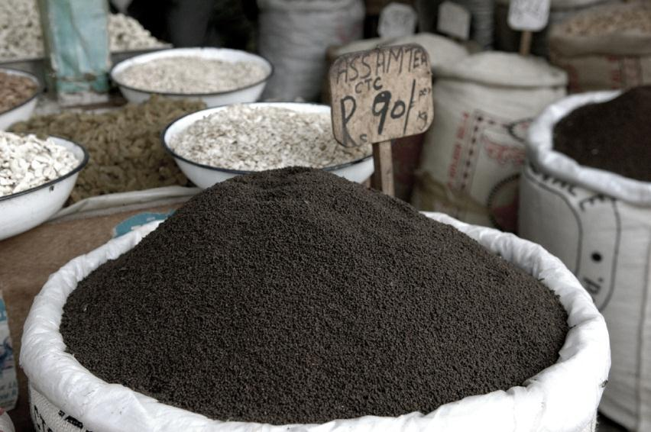
Asian Cities
The South Asian City
  Traditional city:
    Centered on a bazaar or marketplace from pre-colonial times

Slide 17
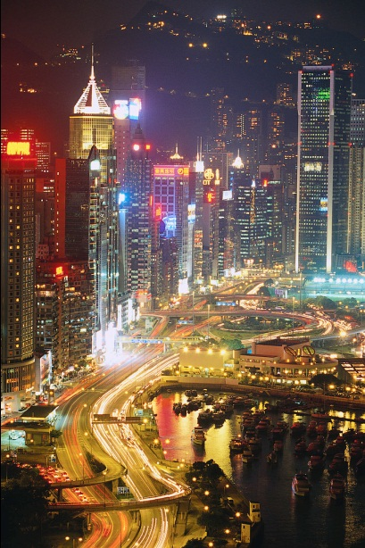
Asian Cities
Many parts of Asia are still on the periphery of the world system.
Others are central to world trade including:
  Hong Kong
  Singapore
  Shanghai

Slide 18
Asian Cities
Asia’s urban growth is explosive, with millions of people migrating from rural areas to the cities every year.

Slide 19
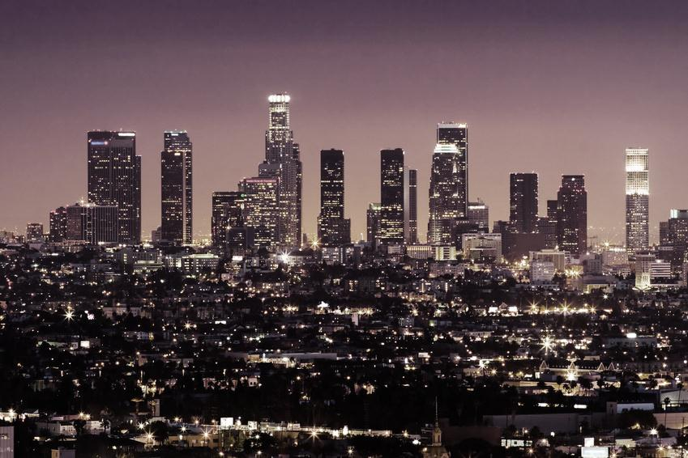
Conclusion

Slide 20
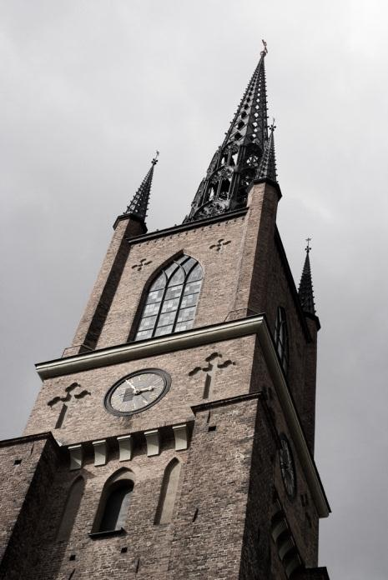
Urbanization
Urbanization is a global phenomenon that presents challenges to modern citizens and governments.

Slide 21
Urbanization
Although cities have been part of human geography for thousands of years, they have become home for the majority of people in the industrialized world over the past century.

Slide 22
Urbanization
Today the developing world is rapidly urbanizing, with cities generally struggling to keep up with demands for:
jobs
housing
safe water
other services

Slide 23
Key Terms to Review
Comparative urbanization
Postcolonial megacities
Regional models
Public parks
Outskirts
Market sector
Elite residential sector
Griffin-Ford Model
Zone of maturity
“In situ accretion”
Disamenity sector
Squatter settlements
Shantytown
Periphery
Bazaar

Slide 24
Key Terms to Know
Open-air market
“Alien commercial zones”
Peripheral squatter zones

